Slide 1

Les Contes de Fée
Title Slide
Name of presenter and contact details

Slide 2
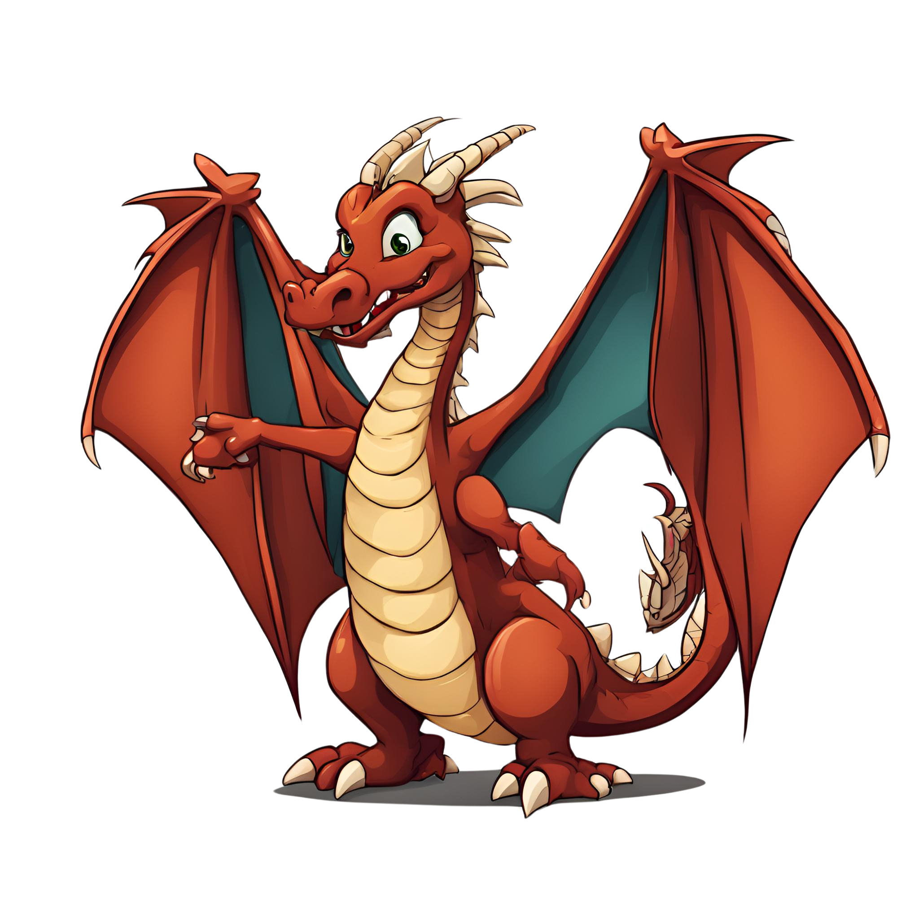
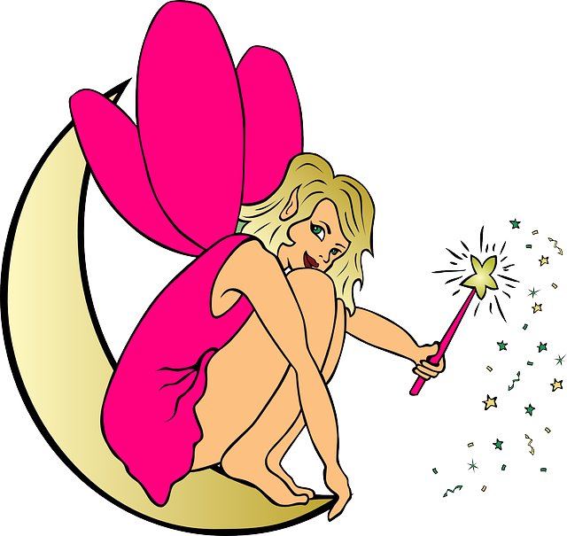
Bienvenue
Welcome Slide
Bonjour,
je suis un dragon.
Bonjour,
je suis une fée.

Slide 3
Objectives
Objective Slide
Learn about various Fairy Tale characters in French
Be able to recognise and name the characters in French
Review basic presentation and introductions (je suis, je m’appelle)
Identify characters based on images
Mime or draw characters in a class activity
Add descriptors to further French vocabulary (adjectives)

Slide 4
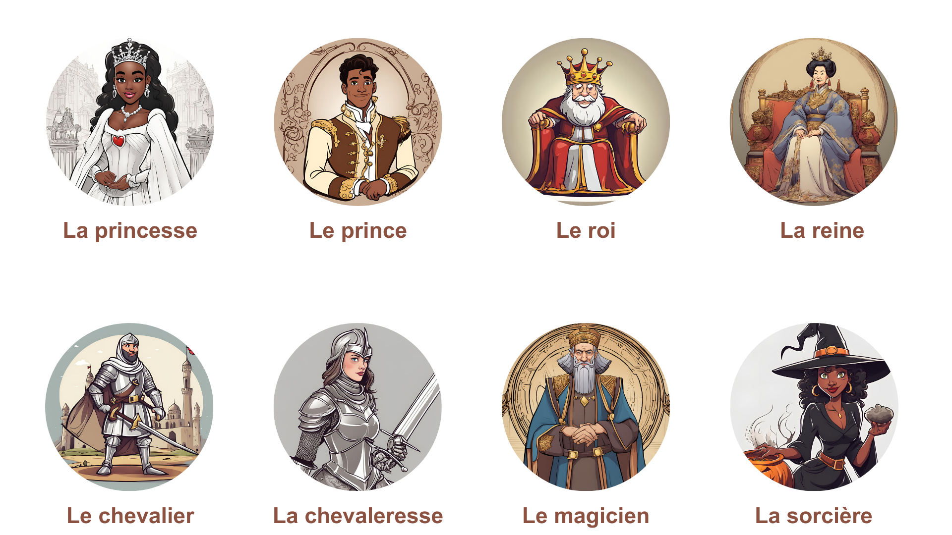
Les personnages
Lesson Slide

Slide 5
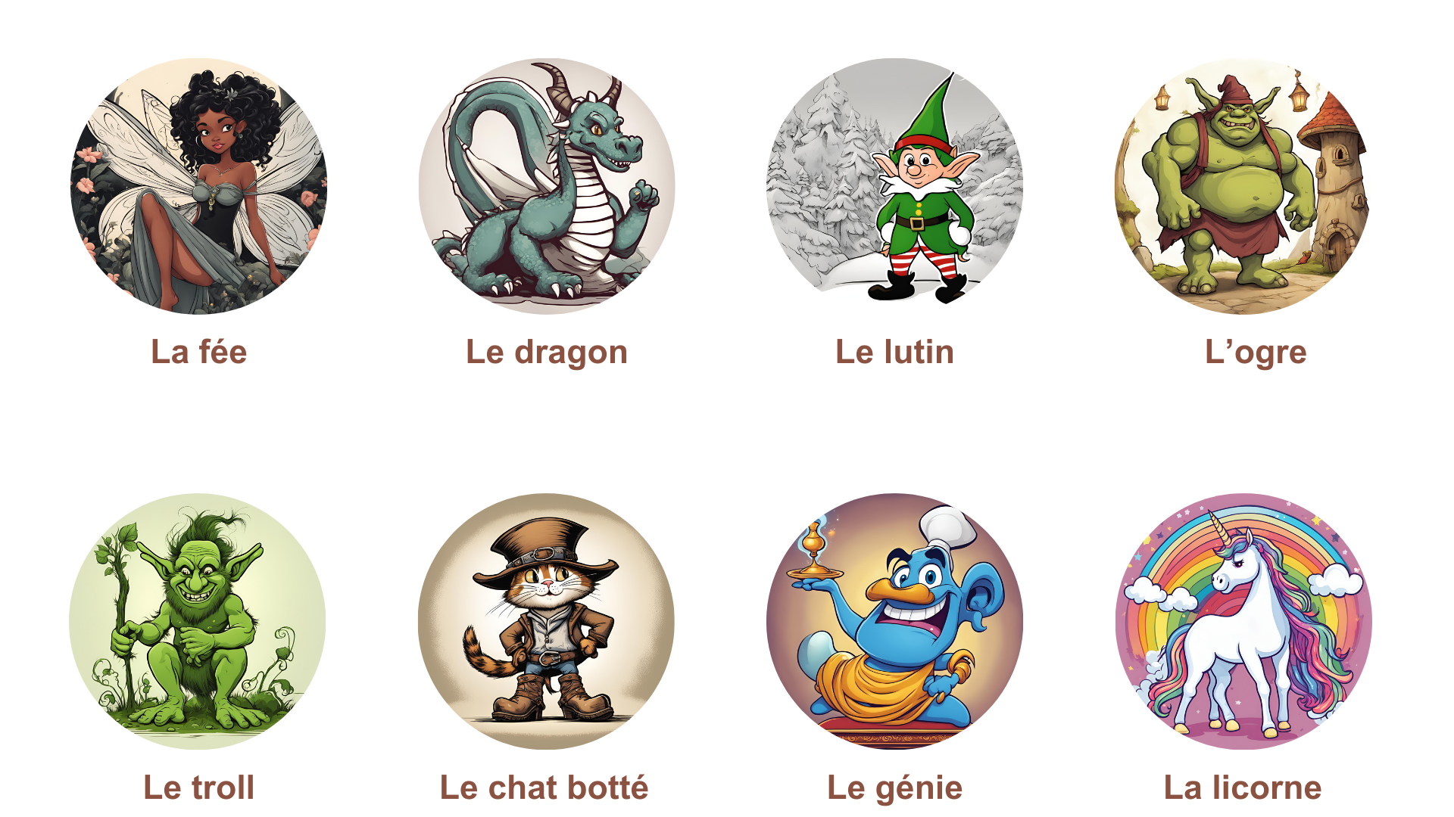
Les créatures fantastiques
Lesson Slide

Slide 6
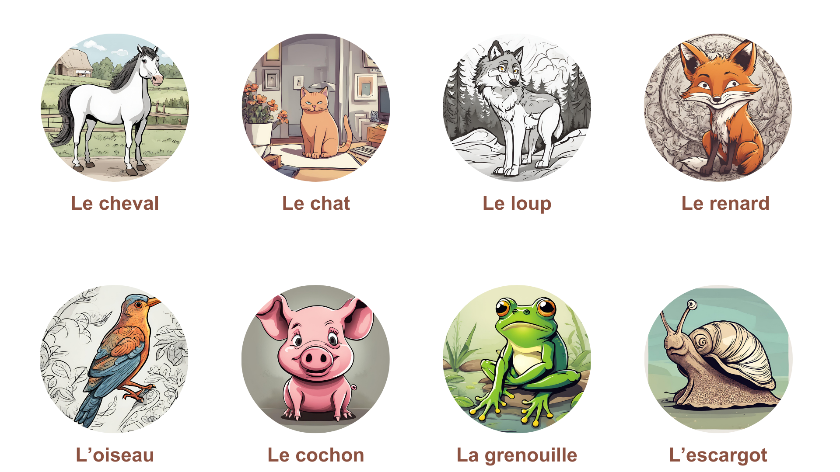
Les animaux
Objective Slide

Slide 7
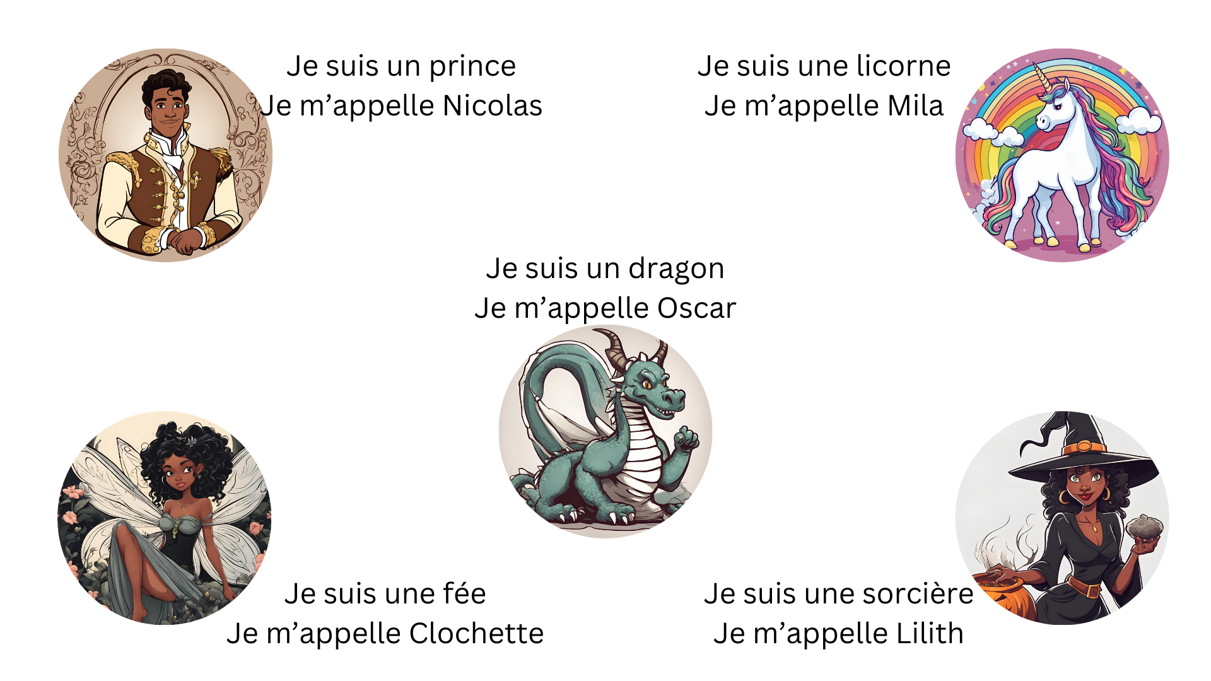
Je suis et Je m’appelle

Slide 8
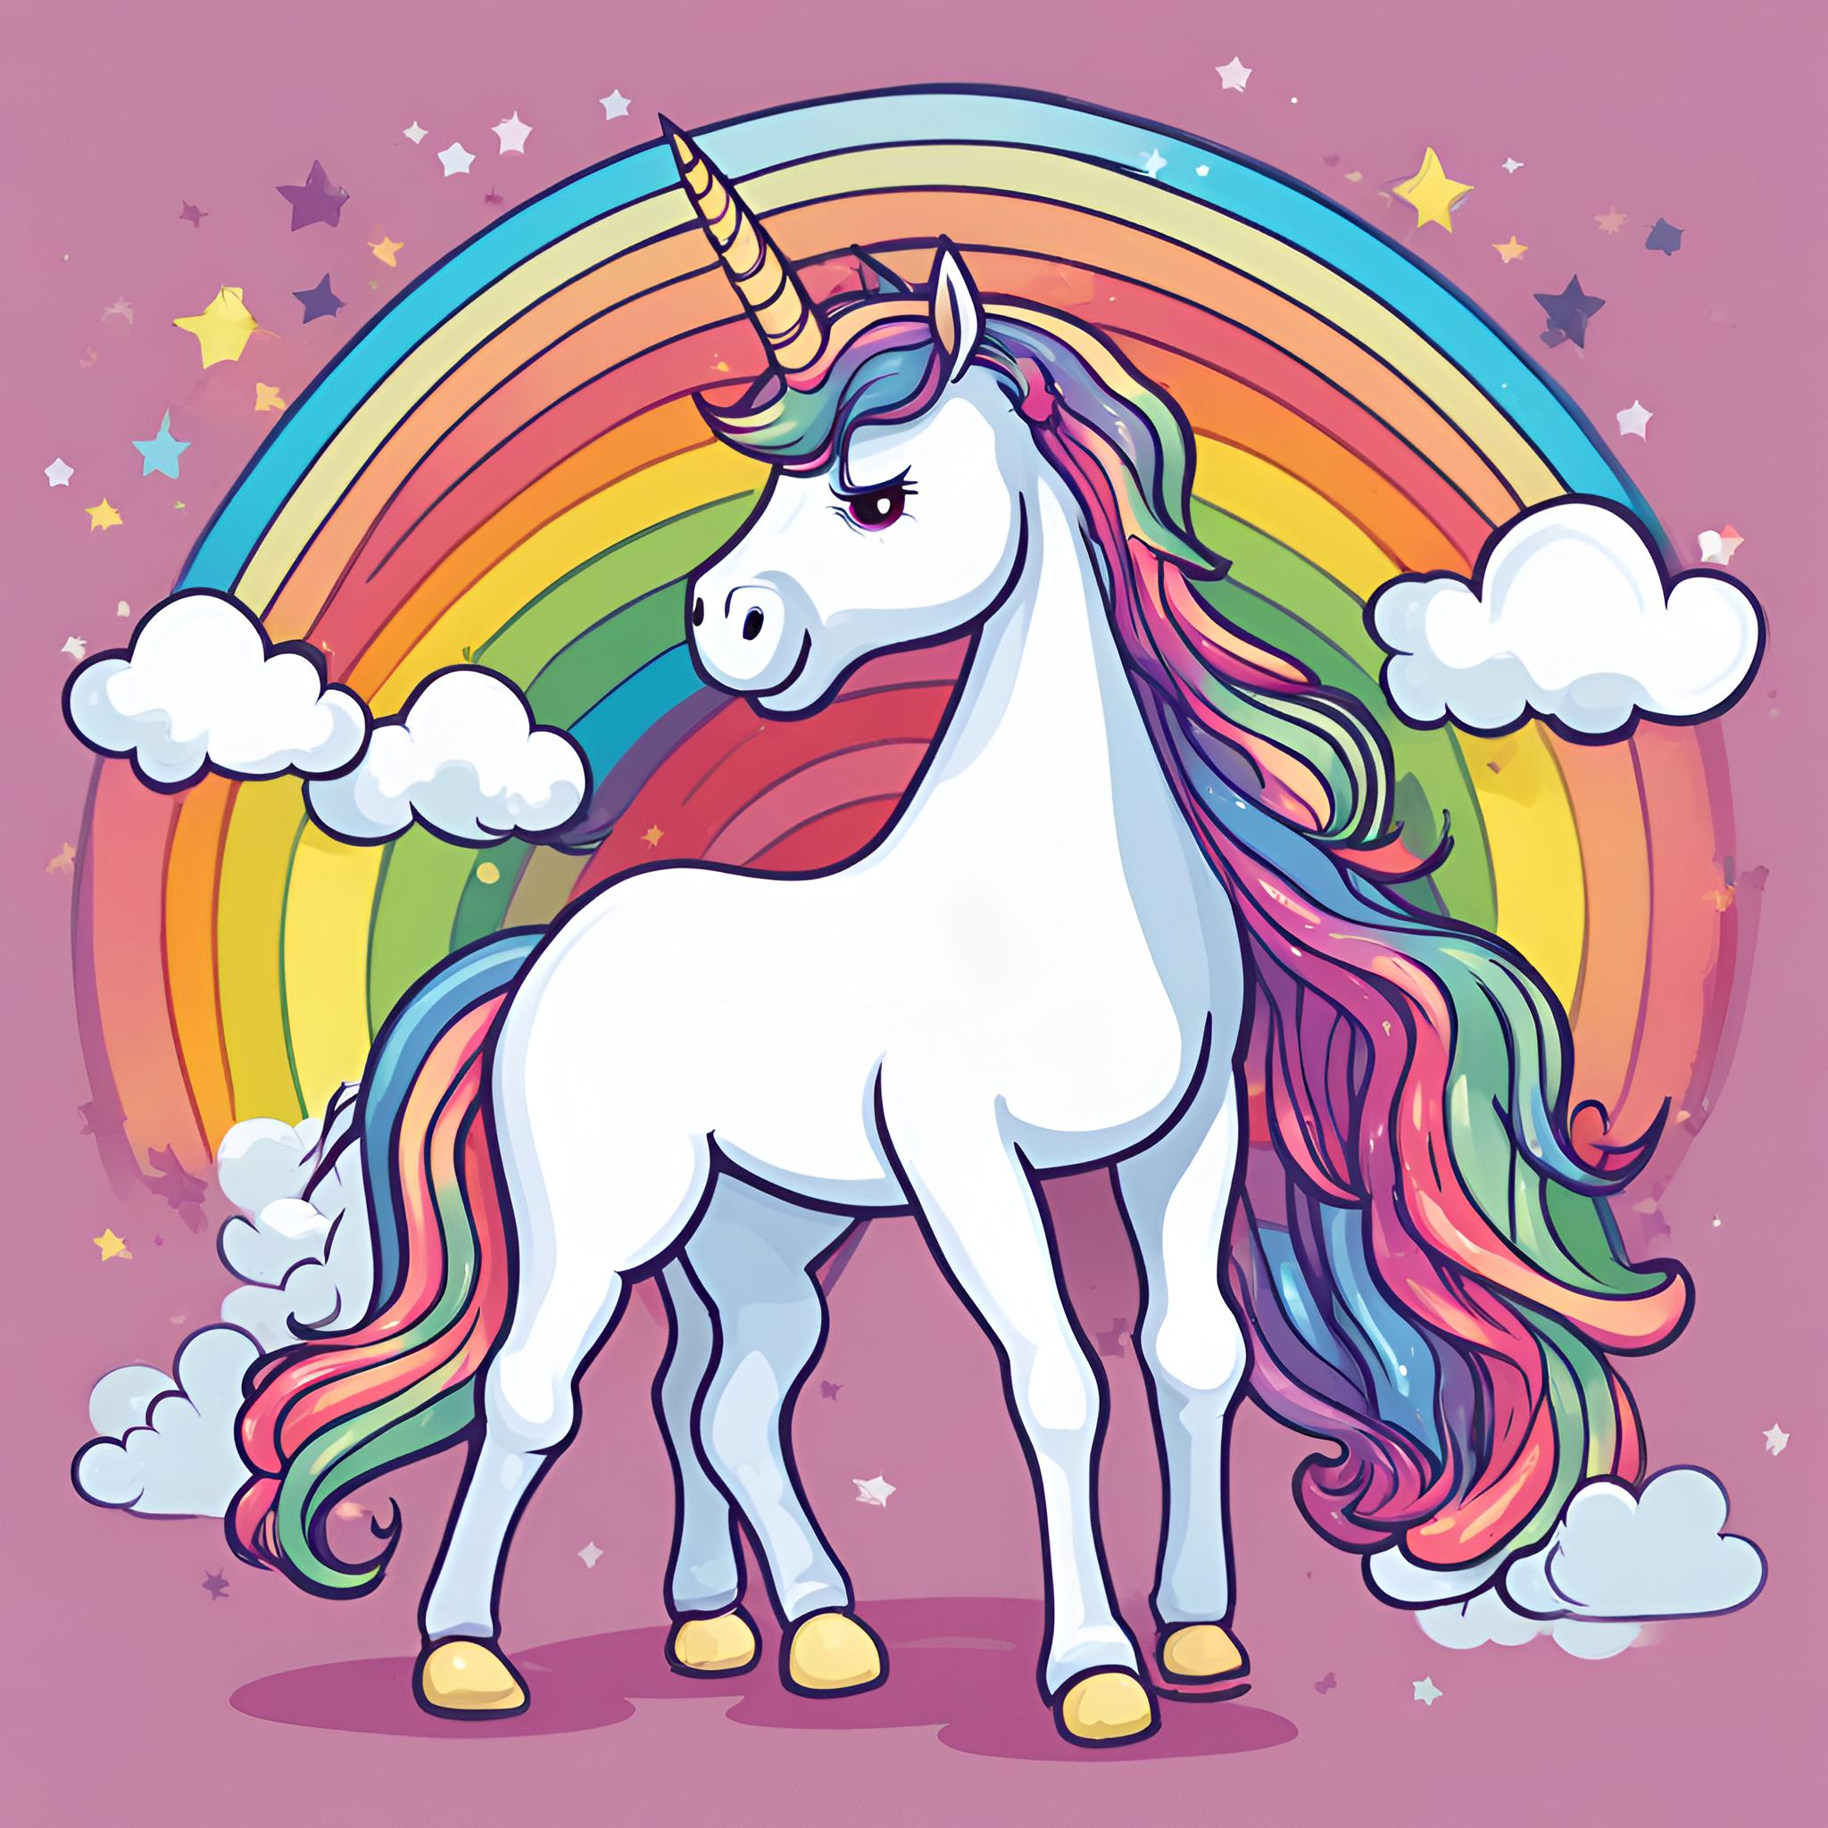
Activity: Introduce yourself in French
If you could be a fairy tale character what would your name be? and which one would be? Use the French words that we have just learned to introduce yourself as a fairy tale character.

Slide 9
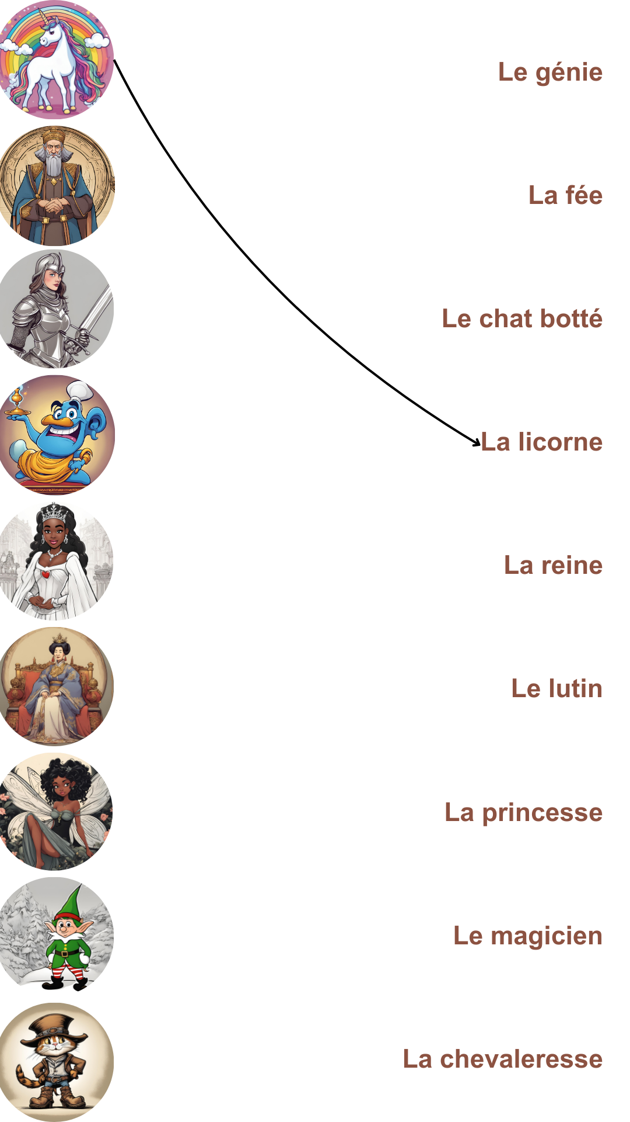
Activity: Associate the pictures with the words

Slide 10
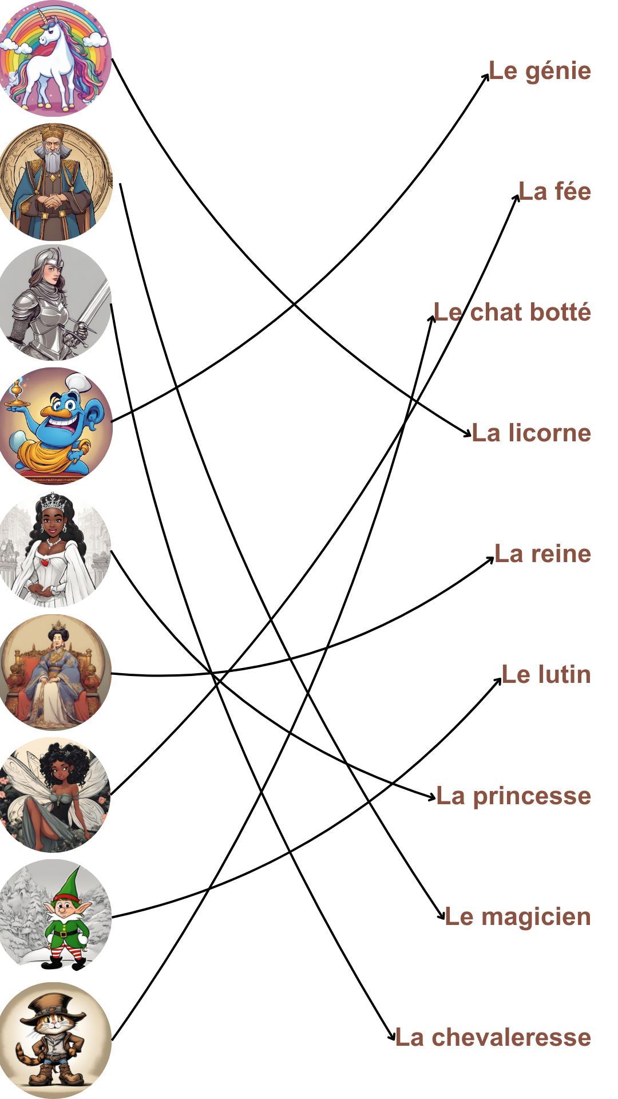
Activity: Associate the pictures with the words

Slide 11
Activity: Mime or Draw
Pick a card and either mime what is on the card or draw it on the board to make your classmates guess.

Slide 12
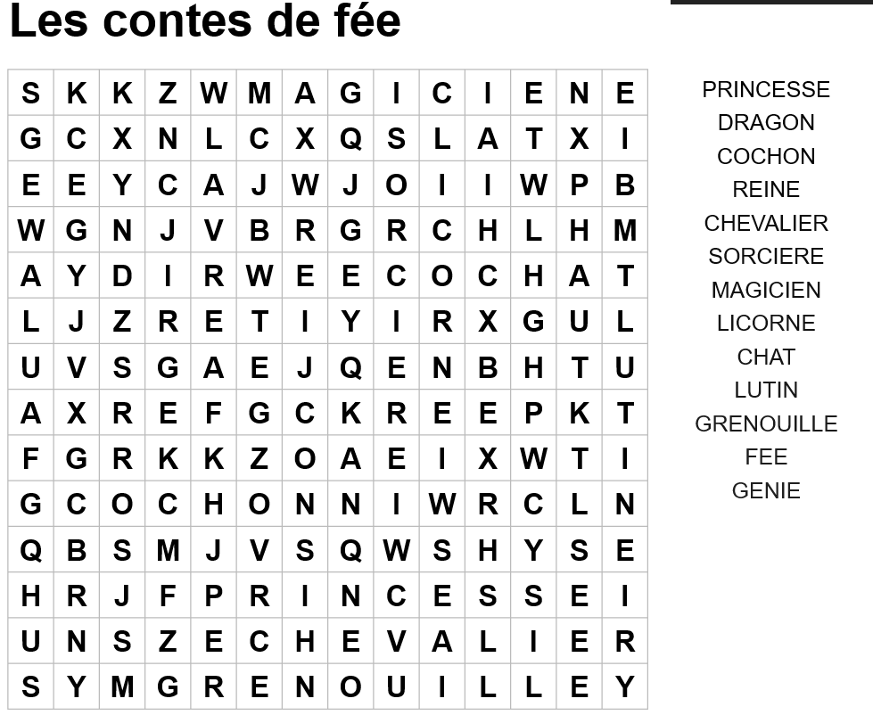
Activity: Find the words

Slide 13
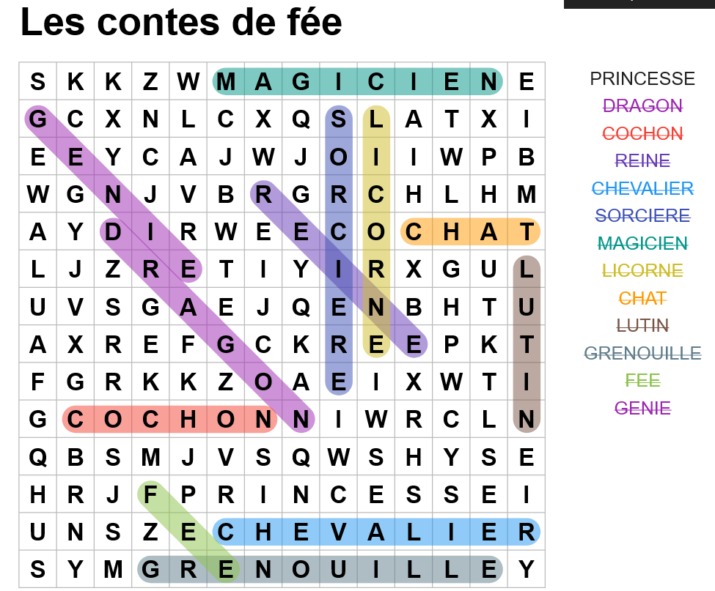

Solution: Find the words

Slide 14
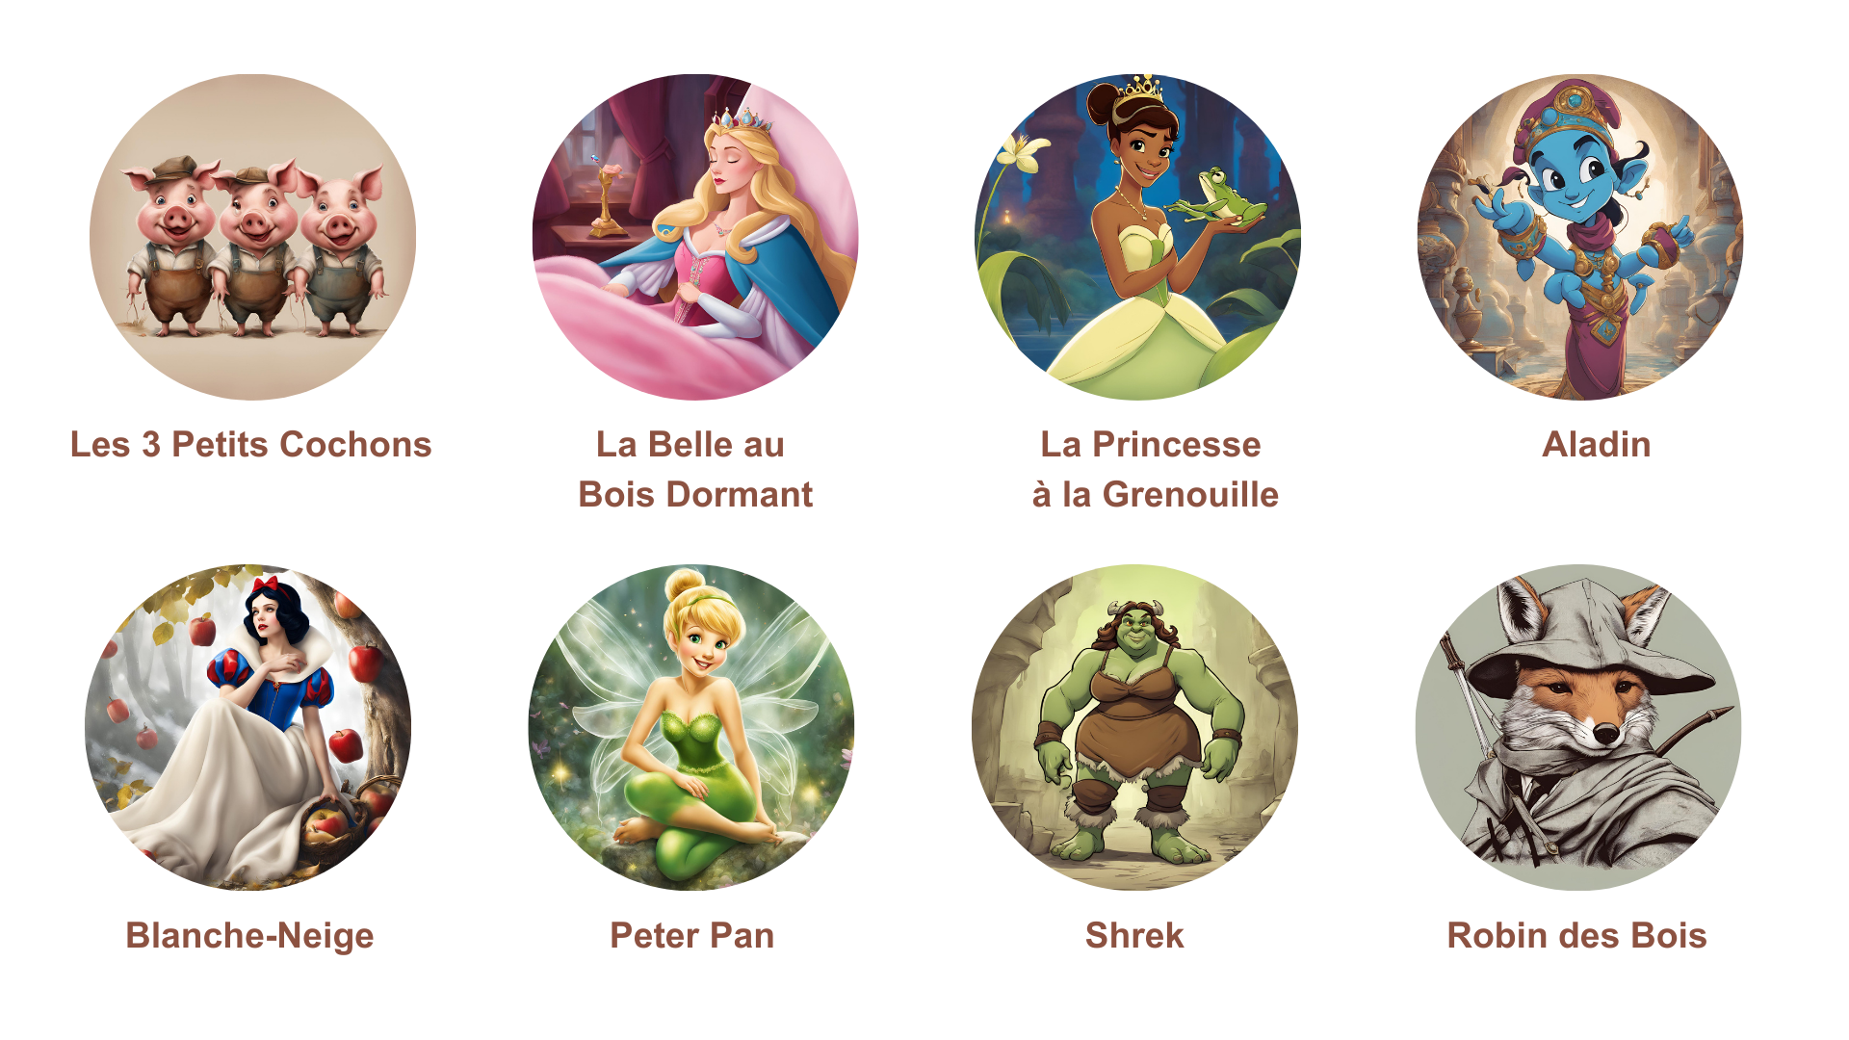
Activity: Which characters are in the following tales?

Slide 15
JOIN OUR MAILING LIST

Slide 16

ευχαριστώ
Gracias
谢谢
Danke
Bedankt
Dziękuję
Diolch
Fa’afetai
Merci
Kiitos
Ласкаво просимо
Спасибо
Tak skal du have
Köszönjük
אדאנק
شكرًا لك
Teşekkürler
Thank you

