Slide 1

Les Contes de Fée 2
Title Slide
Name of presenter and contact details

Slide 2
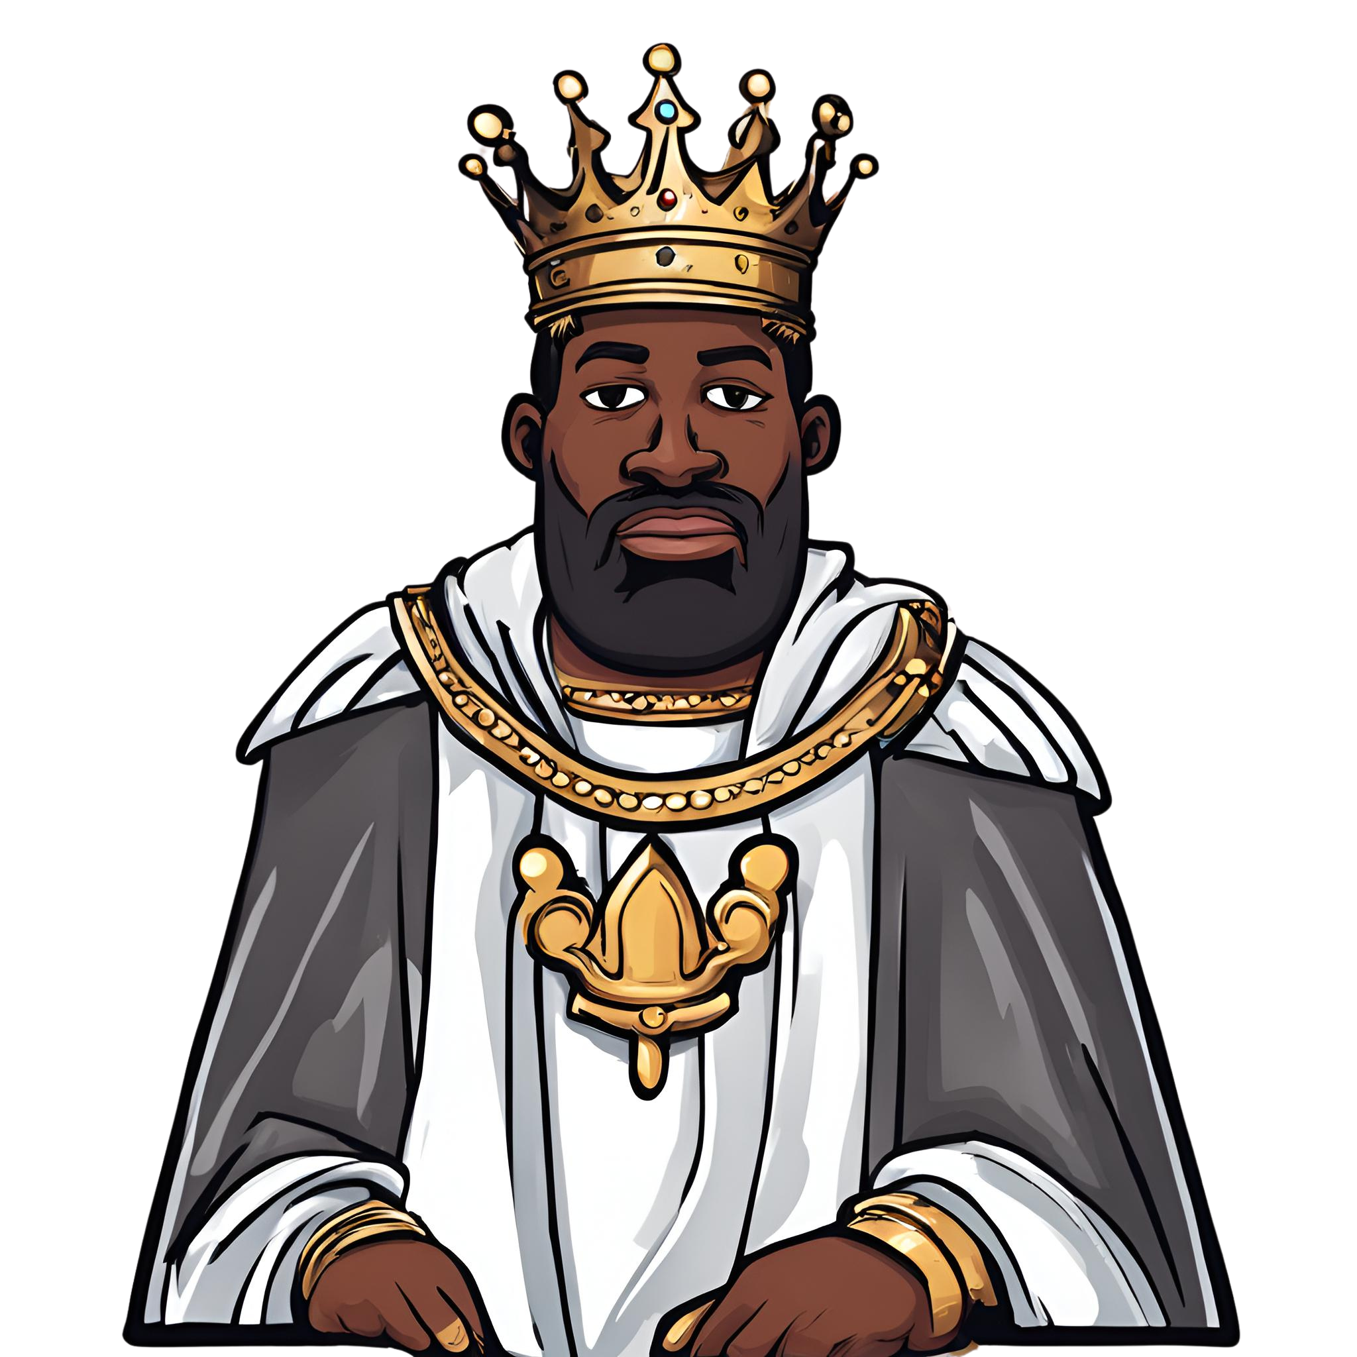
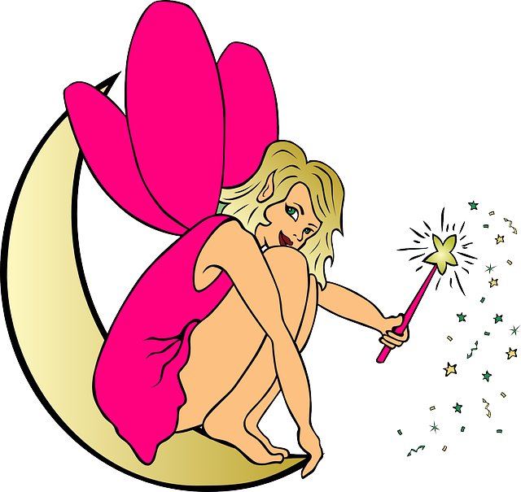
Bienvenue
Welcome Slide
J’habite dans le chateau, j’ai une couronne
J’habite dans la forêt, j’ai une baguette magique

Slide 3
Objectives
Objective Slide
Learn about various Fairy Tale places and objects in French
Be able to recognise the places and objects in French
Link the characters with places and objects
Review the verbs avoir and habiter
Draw a fairy tale scene combining places, objects, and characters

Slide 4
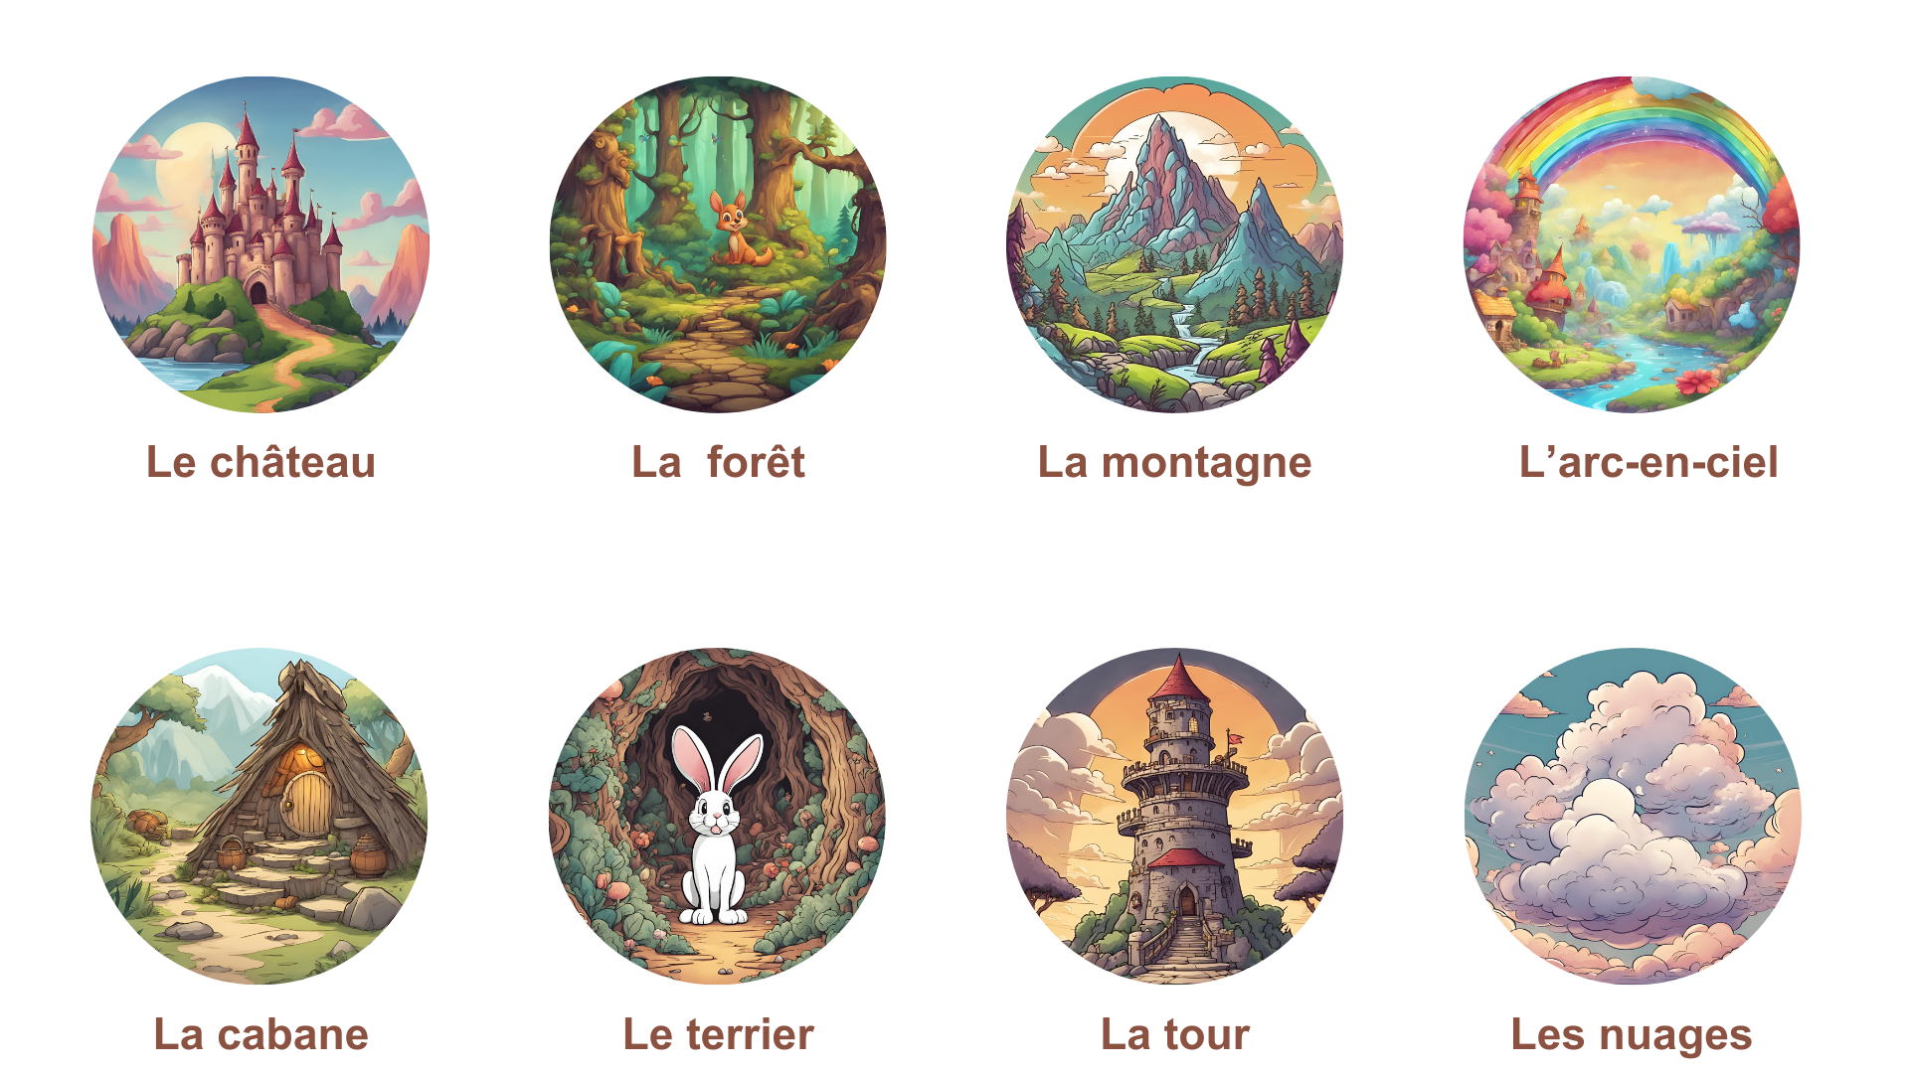
Les lieux
Lesson Slide

Slide 5
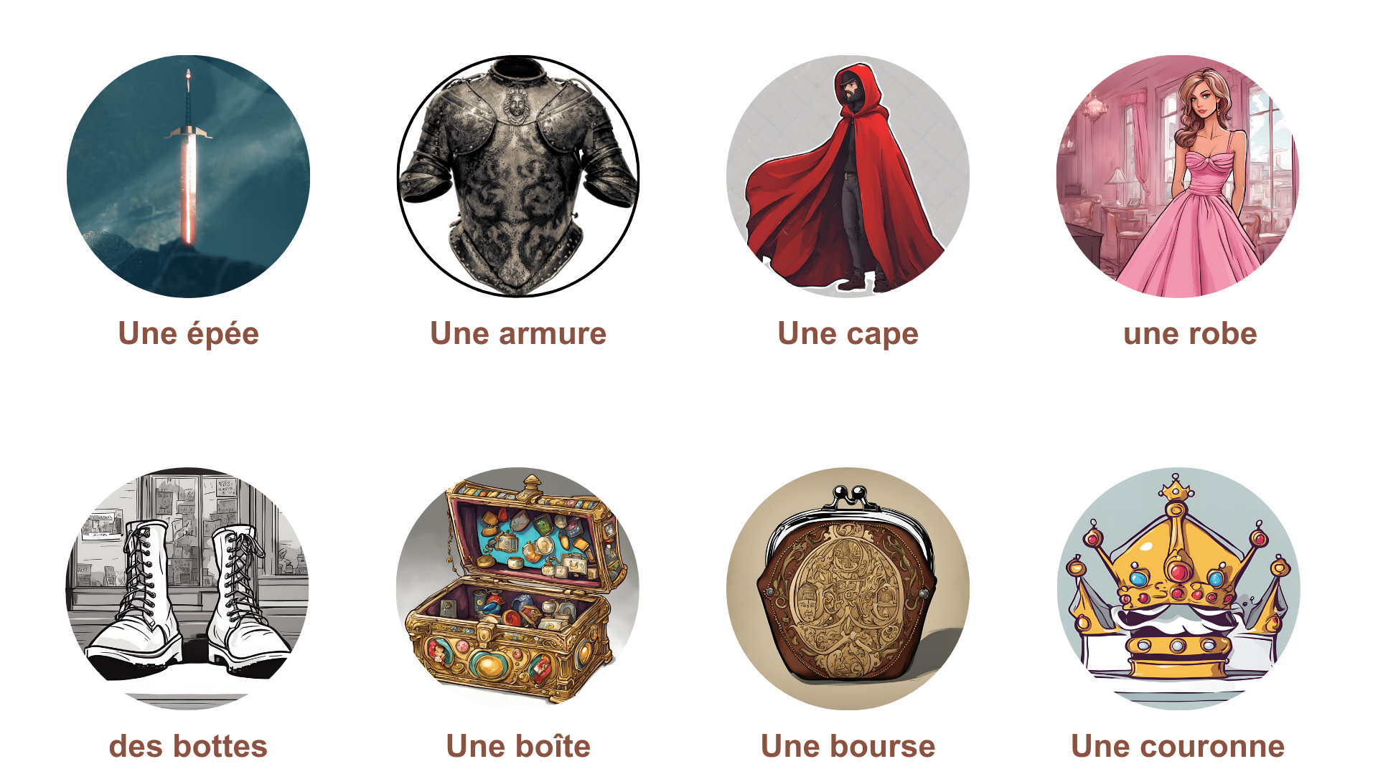
Les objets
Lesson Slide

Slide 6
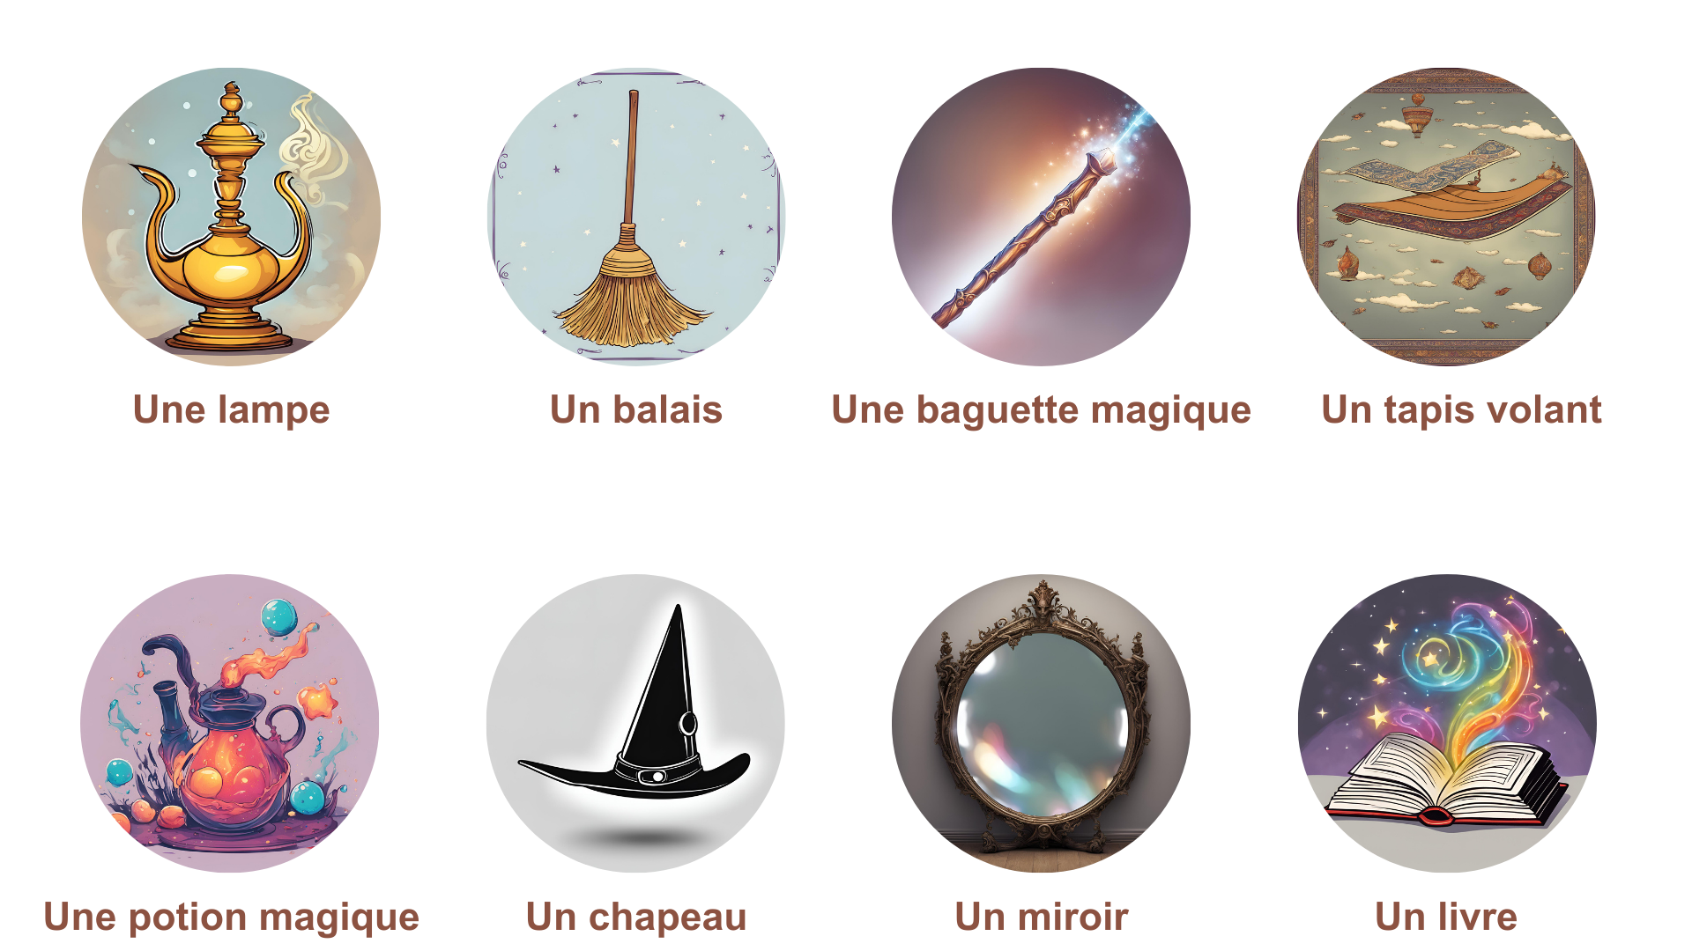
Les objets magiques
Objective Slide

Slide 7
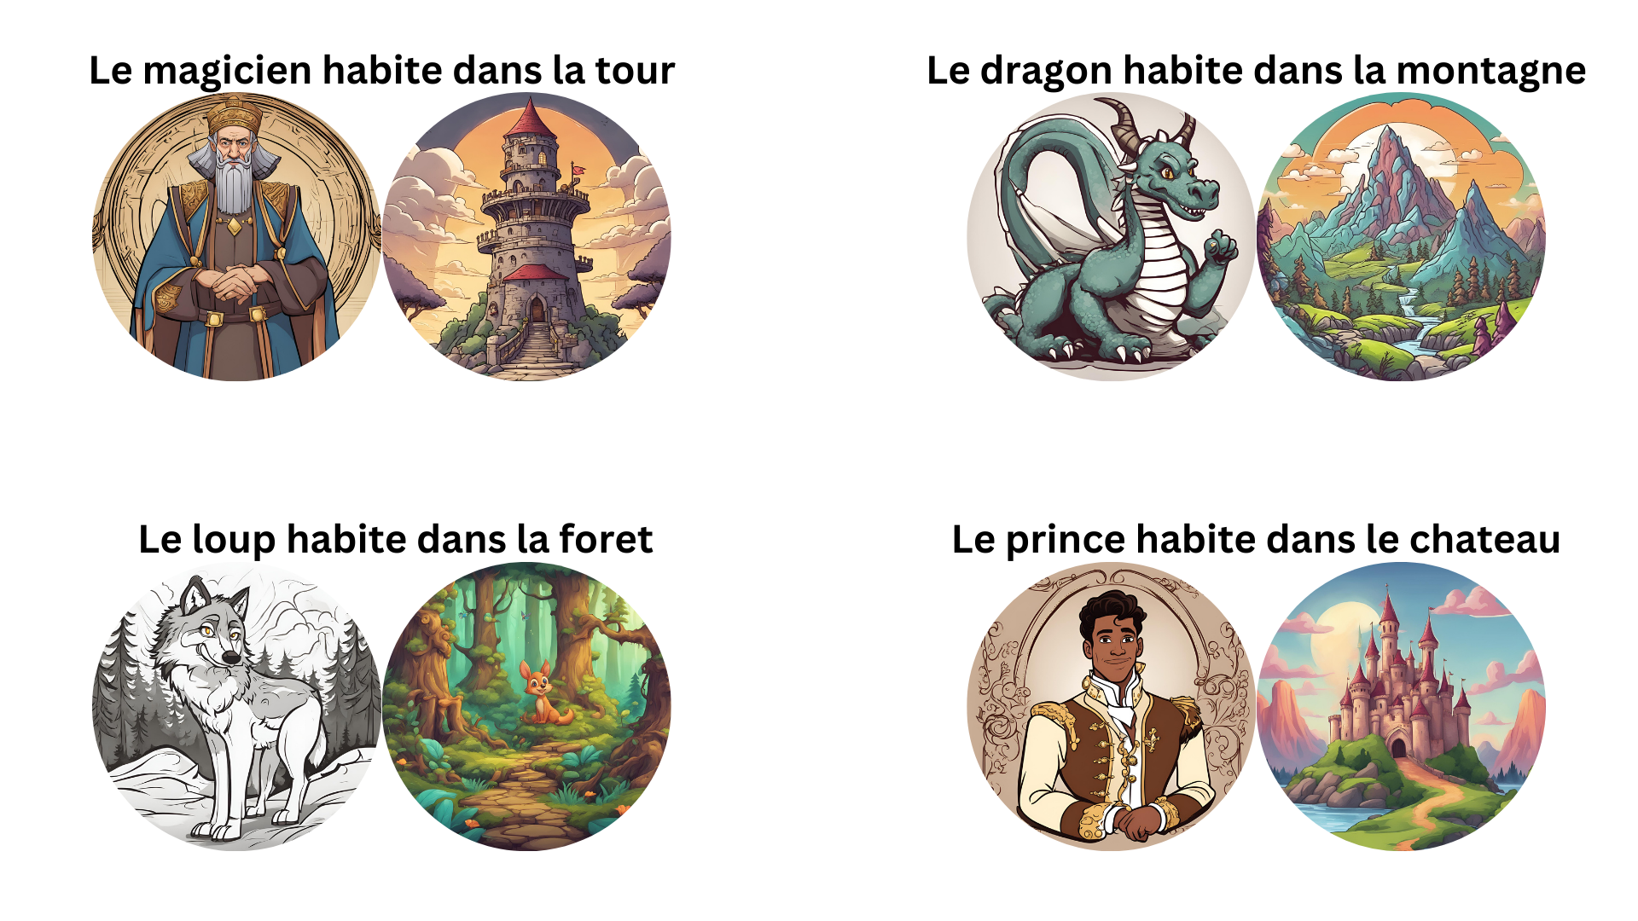
Habiter

Slide 8
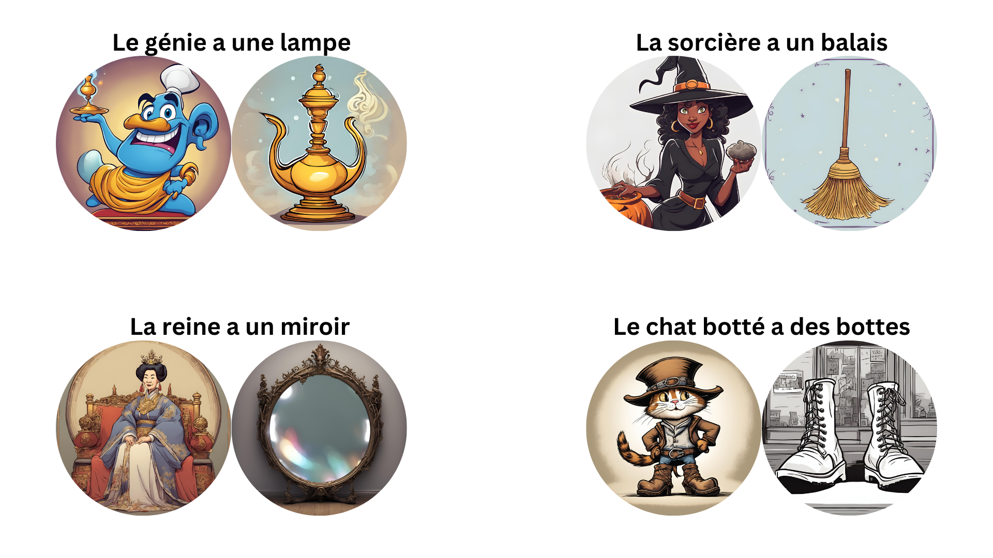
Avoir

Slide 9
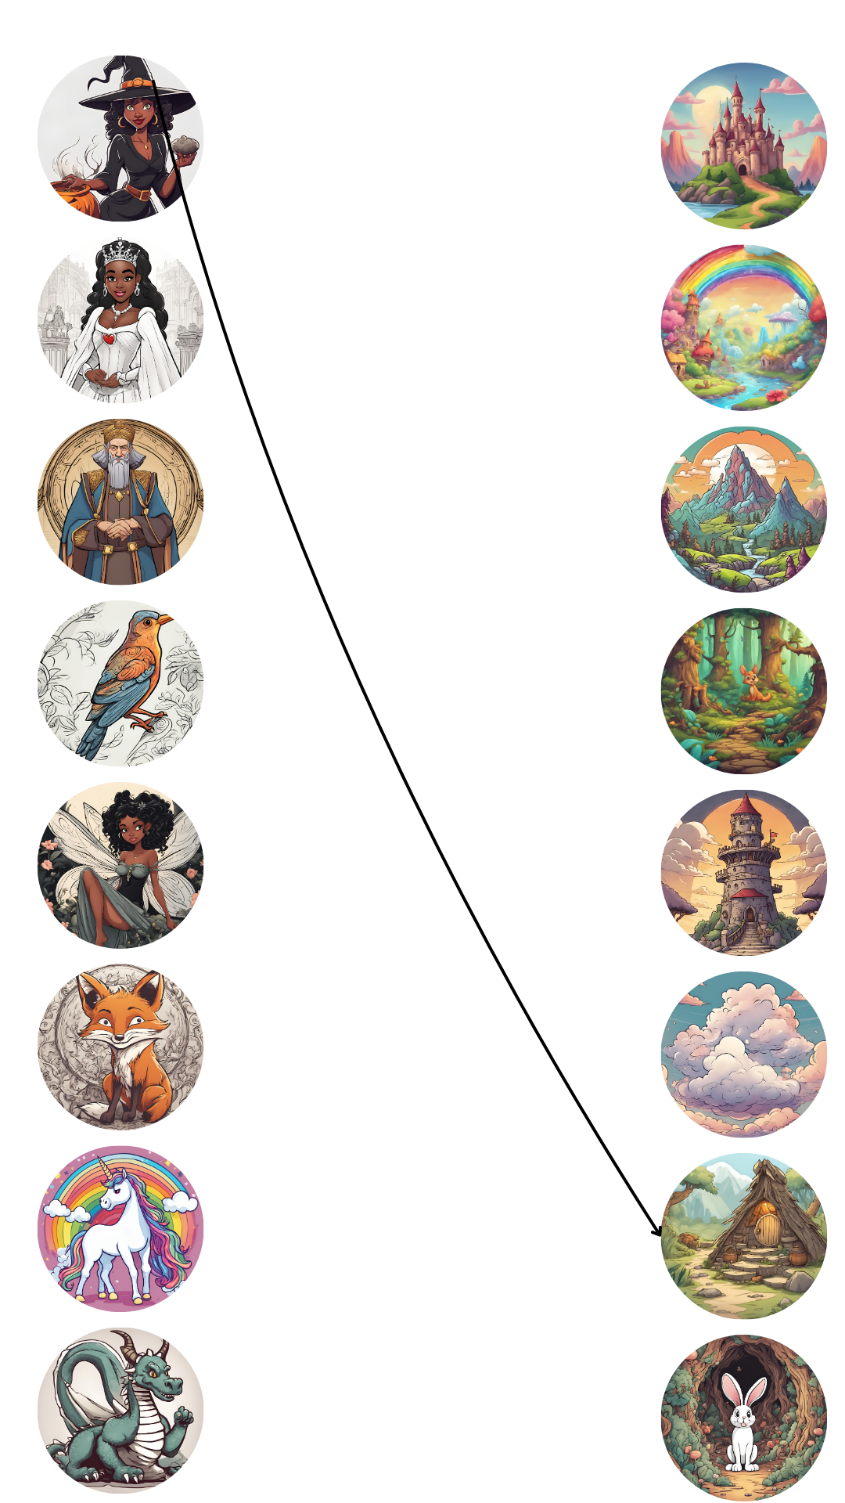
Activity: Associate the characters with the places and make a sentence
La sorcière habite dans la cabane.

Slide 10
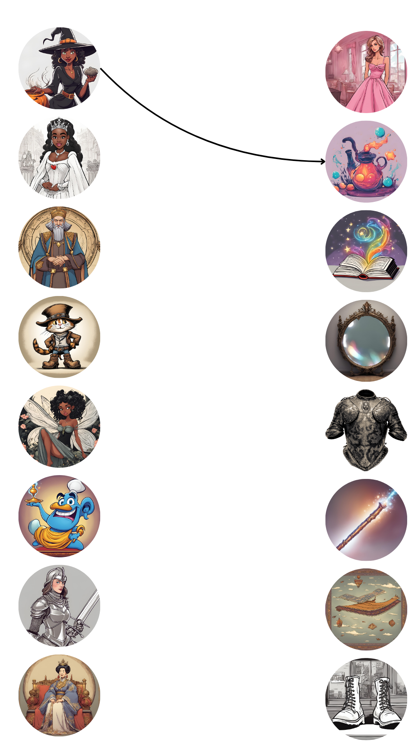
Activity: Associate the characters with the objects and make a sentence
La sorcière a une potion magique.

Slide 11
Activity: In groups draw a fairy tale scene and present it to the class

Slide 12
JOIN OUR MAILING LIST

Slide 13

ευχαριστώ
Gracias
谢谢
Danke
Bedankt
Dziękuję
Diolch
Fa’afetai
Merci
Kiitos
Ласкаво просимо
Спасибо
Tak skal du have
Köszönjük
אדאנק
شكرًا لك
Teşekkürler
Thank you

