Slide 1
Deutsch mit Felix und Franzi
Exploring Germany:
Time for Breakfast!
Sprachniveau: A1

Slide 2
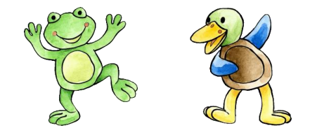

Sing mit Felix & Franzi
Hallo Song (Melodie: Nice one, Cyril)
Hallo Felix. Hallo Franzi.
Hallo. Guten Morgen.
Hallo. Guten Tag.
Hello Felix. Hello Franzi.
Hello. Good morning.
Hello. Good day.
Notes:
The teacher plays the song several times and the pupils try to sing.
Then, the teacher plays with the puppets and ask Franzi ‘Wie geht’s? She replies with ‘Es geht. Ich habe Hunger und ich habe Durst’ (I have hunger and I have thirst, literally)
goethe.de/resources/files/mp31/halo_felix_mastered.mp3

Slide 3
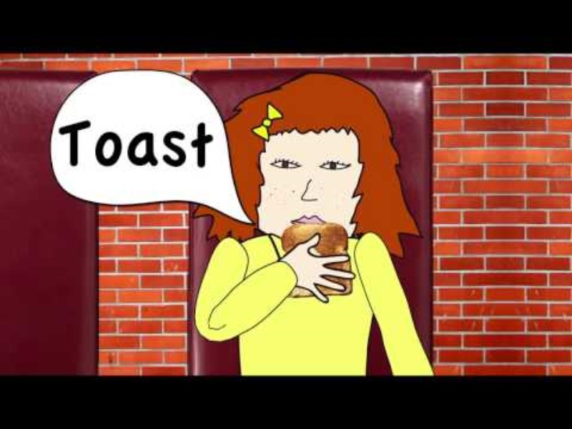
Das Video
Notes:
The teacher shows the video once or twice : https://youtu.be/S4OQfWZZreM?list=PL5jjjxhBmRrmtlRKYGJZgHGn_PQmbePPQ

Slide 4
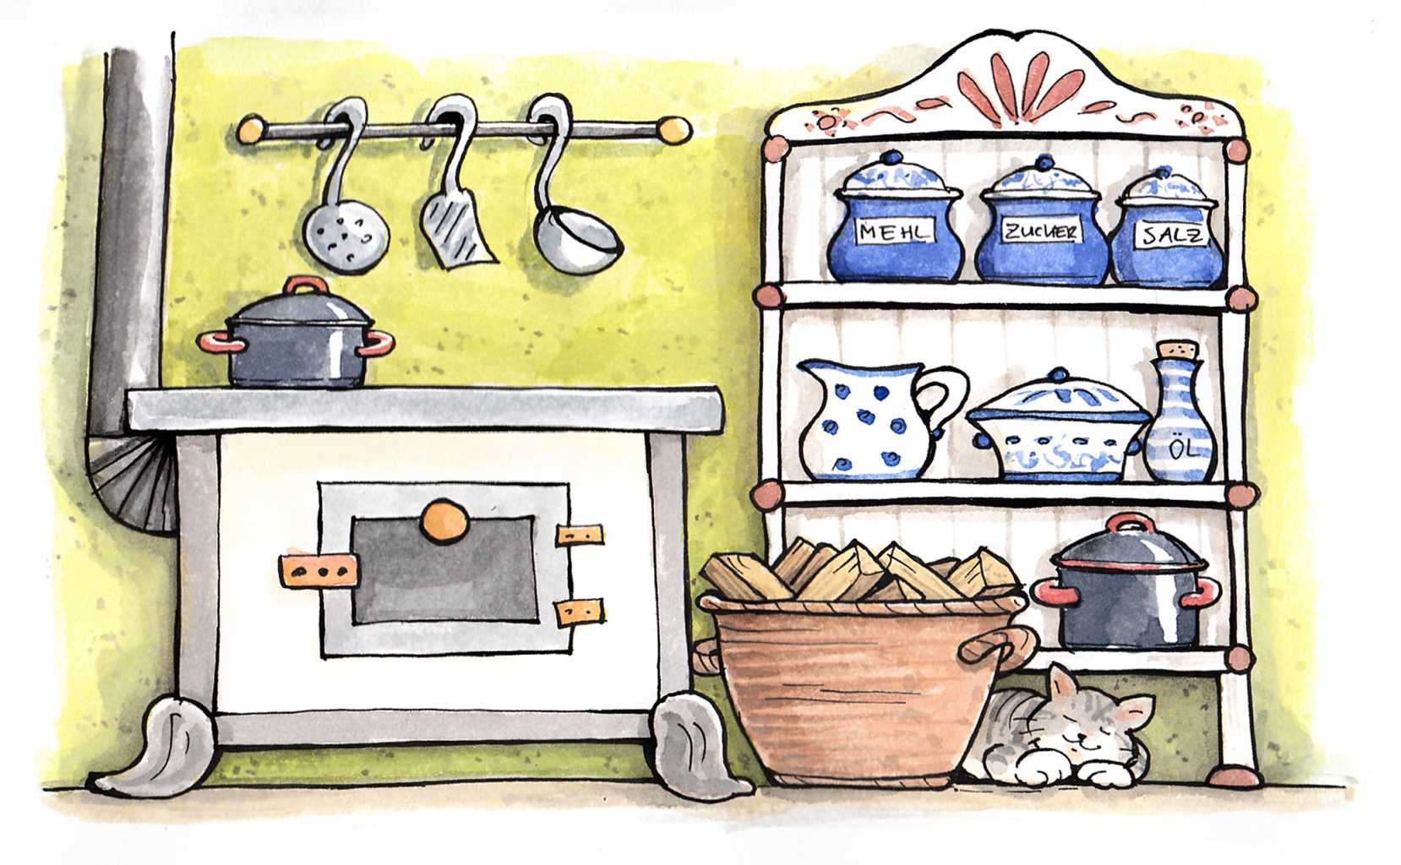
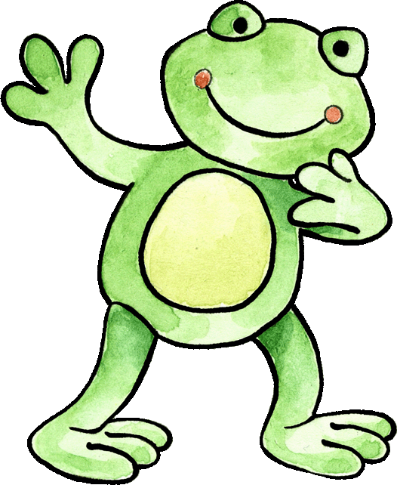
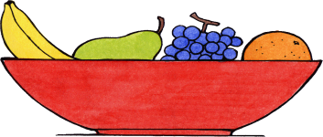
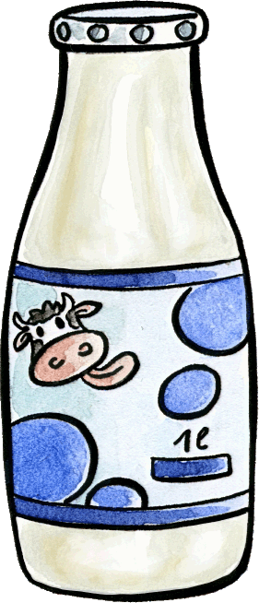

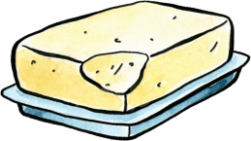
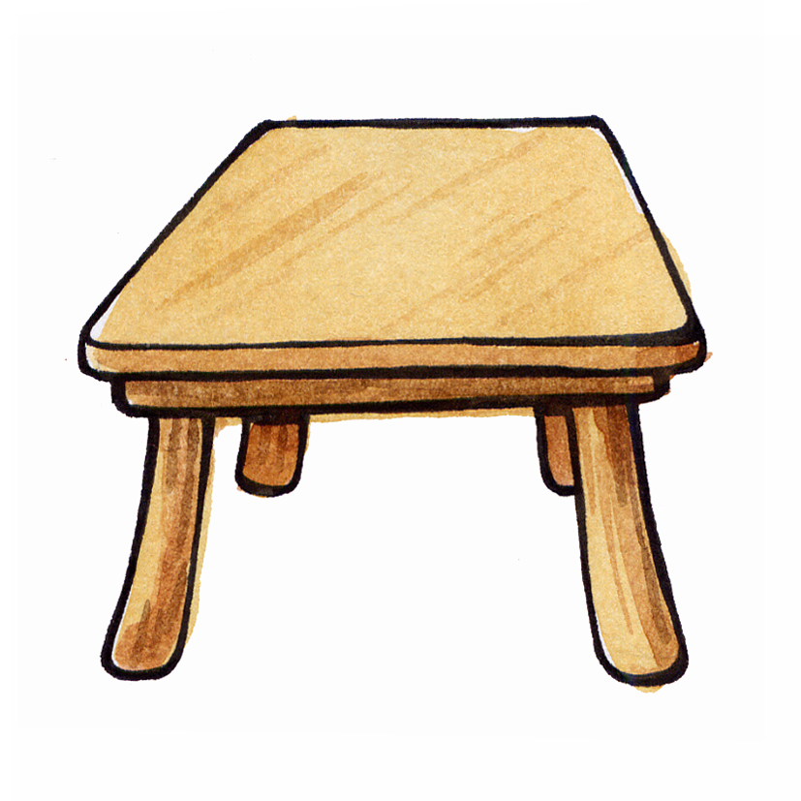
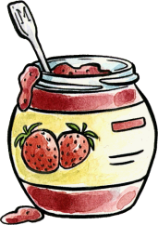
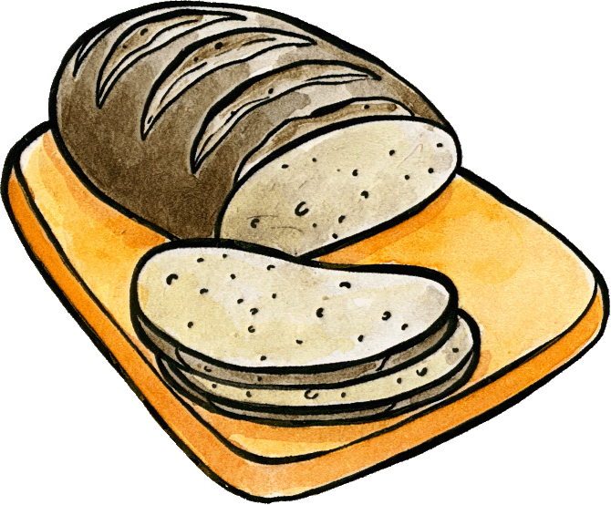
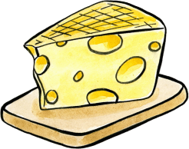
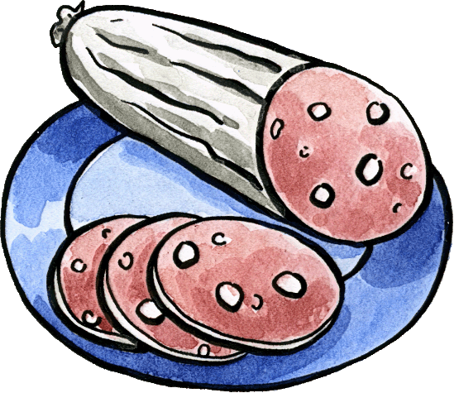
Felix will frühstücken.
Ich habe Hunger!
Notes:
The pupils try to name the ingredients as they appear on the table.

Slide 5
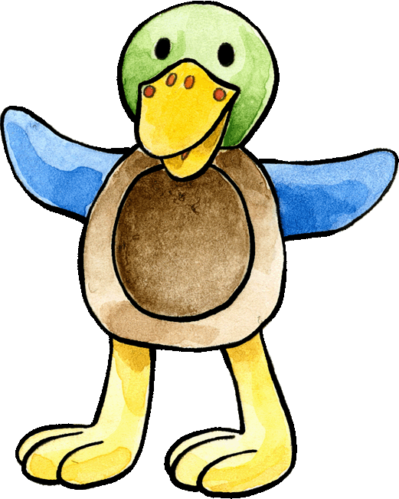
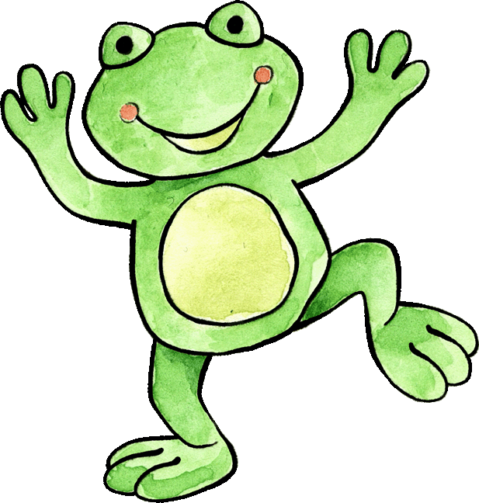
Was essen Felix und Franzi?
Ich esse gern...!
Ich esse nicht gern...!
Ei
Butter
Orangen
Wurst
Brot
Marmelade
Notes:
The pupils try to name the ingredients as they appear and then try to formulate sentences to express, following the example of Felix and Franzi, what they like or dislike to eat.

Slide 6
Was trinken Felix und Franzi?
Ich trinke gern...!
Ich trinke nicht gern...!
Milch
Saft
Notes:
The pupils work in pairs and try to name the ingredients as they appear and then try to formulate sentences to express, following the example of Felix and Franzi, what they like or dislike to drink.

Slide 7
Das Picknick
Machst du mit?
Notes:
Pupils say the words in German and helps him prepare the table while miming the gesture and using the flashards.

Slide 8

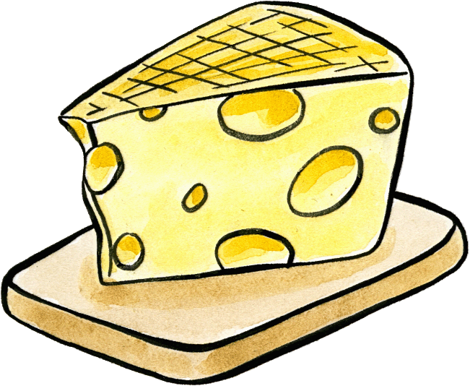
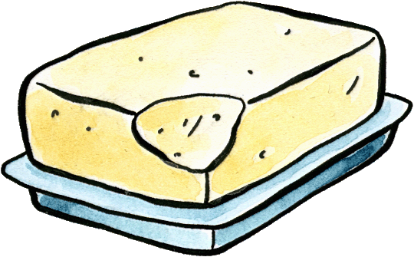
Kennst du schon die Wörter?
Was ist das?
Das ist ….
Notes:
Do you know the words?
Which item is disappearing? The pupils write the words on a paper or on the board. Alternatively, in pairs, one pupil can take a flashcard and ask his/her classmate ‘Was ist das’ and the other pupil answers with a sentence ‘Das ist...’.

Slide 9


Erkennst du die Wörter?
1
7
das Brot
die Orange
Was ist hinter den Sternen?
4
die Wurst
2
der Saft
6
die Milch
3
5
der Käse
die Butter
Notes:
How well do you know the words?
The pupils try to recognise the words behind the stars

Slide 10
Sing mit Felix and Franzi
Auf Wiedersehen Song
(Melodie: Nice one, Cyril)
Tschüss Felix. Tschüss Franzi.
Tschüss Freunde.
Auf Wiedersehen. Bis bald.
Bye Felix. Bye Franzi.
Bye friends.
Goodbye. See you soon.
Notes:
Sing Felix and Franzi back into the box.
goethe.de/resources/files/mp31/goodbye_felix_mastered.mp3

Slide 11
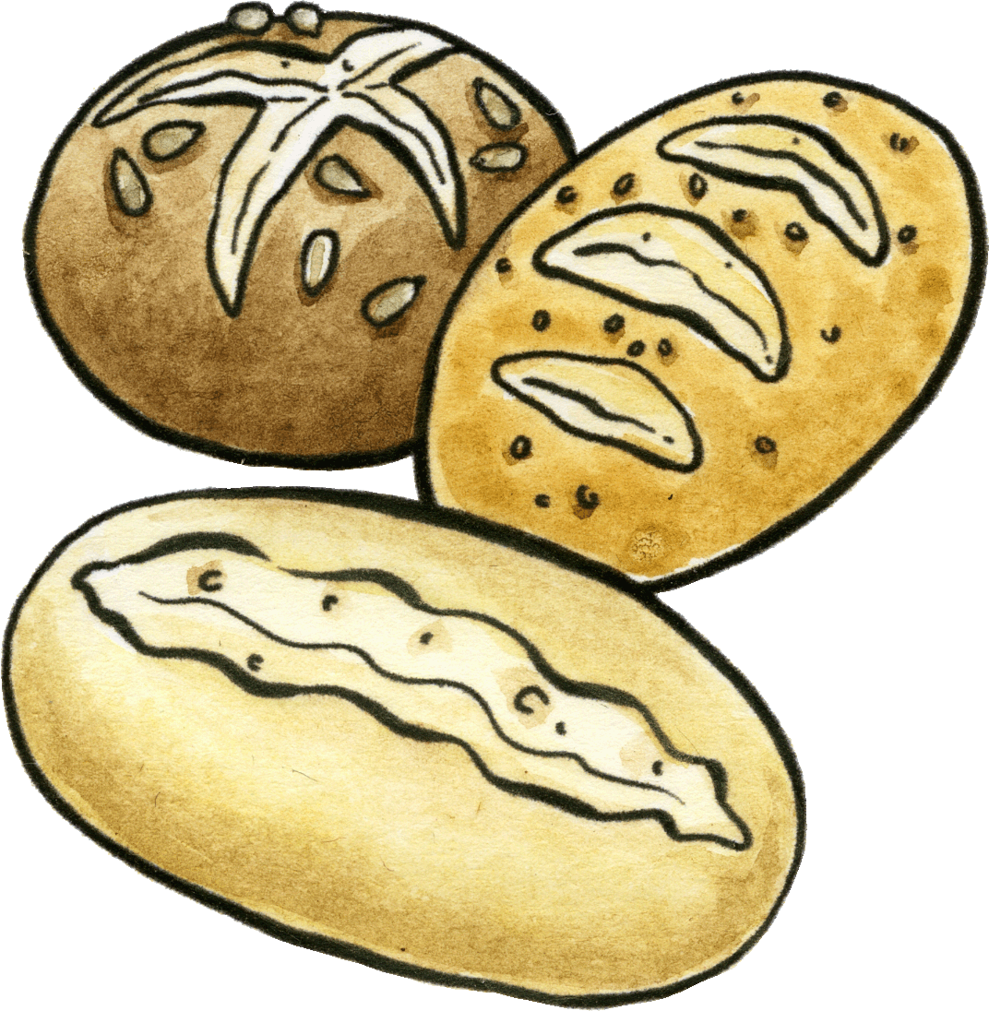
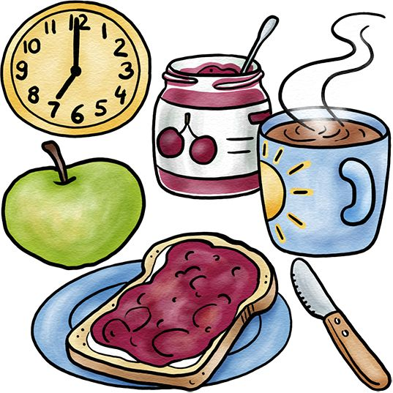
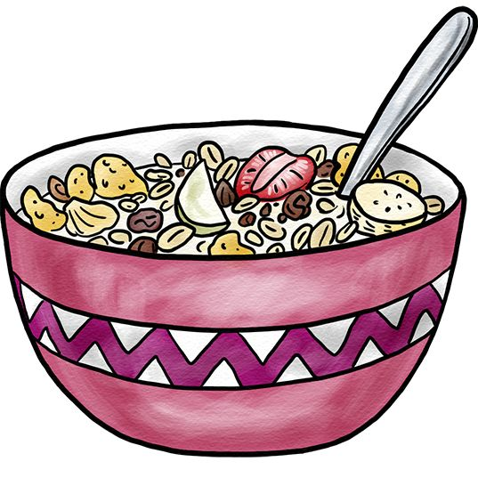
Ideas for a German project/performance
Wir haben Hunger
We are hungry, hungry, hungry, are hungry, hungry, hungry, are hungry, hungry, hungry, are thirsty.
Where is the dinner, dinner, dinner, is the dinner, dinner, dinner, is the dinner, dinner, dinner, is the sausage?
Optional: Unless we don´t get get get anything, we will eat flies, flies, flies we will eat flies, flies, flies, from the wall
Heritage breakfast
Class learn and rehearses a choregraphy and the song "Wir haben Hunger" and performs it (perhaps with props such as toast) at the end of the school-wide Culture Day
Notes:
The pupils learn the song in class and learn a choreography
They organise a heritage breakfast based on reflection on German breakfast, everyone brings their favourite breakfast by way of an intercultural exchange.
goethe.de/resources/files/mp31/u-7.1.-wirhabenhunger.mp3

Slide 12
Slide Title
Q&A

Slide 13
JOIN OUR MAILING LIST

Slide 14

ευχαριστώ
Gracias
谢谢
Danke
Bedankt
Dziękuję
Diolch
Fa’afetai
Merci
Kiitos
Ласкаво просимо
Спасибо
Tak skal du have
Köszönjük
אדאנק
شكرًا لك
Teşekkürler
Thank you

