Slide 1
Spanish Cultural Performance 1
Spanish cultural performance
Primary

Slide 2
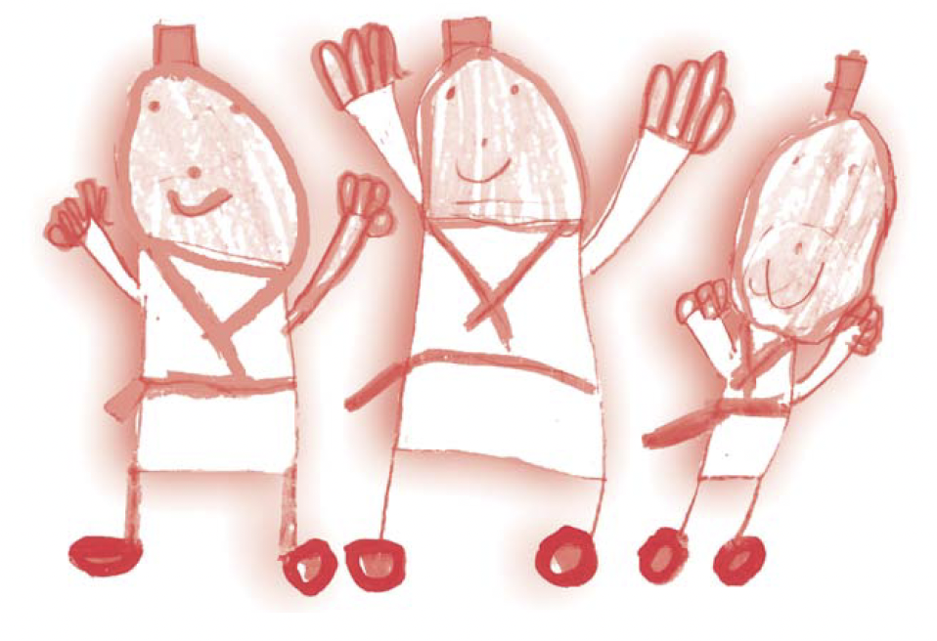
Spanish cultural performance
¡Música, maestro!
Let’s perform!
‹#›

Slide 3
Spanish cultural performance
Contenidos – Contents
1 Song “Mi barba tiene tres pelos”
Suggested activities
2 Other songs
Suggestions for the creation of a Spanish children’s song music festival

Slide 4
Spanish cultural performance
Objetivos de aprendizaje – Learning objectives
To learn a song in Spanish…
… and perform it in front of an audience!

Slide 5
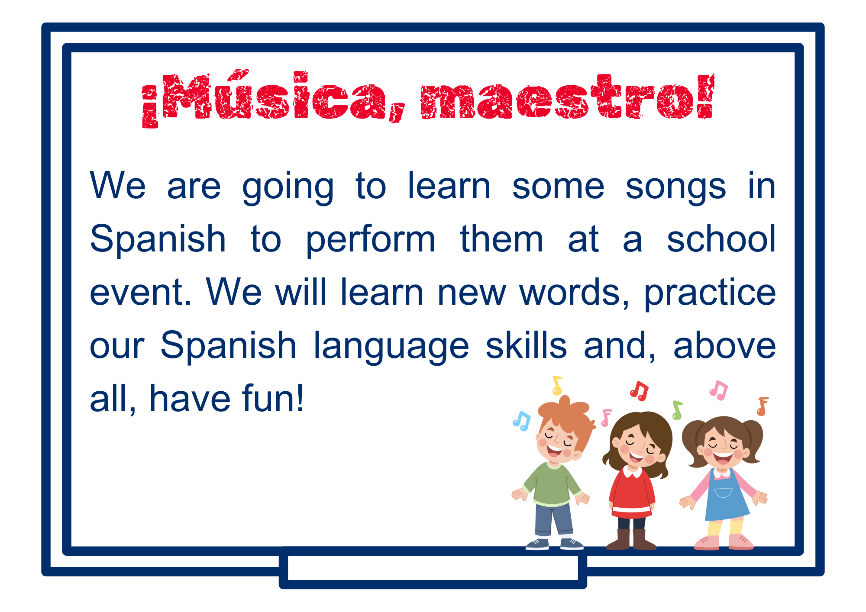
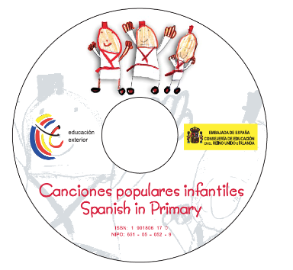

Spanish cultural performance
¡Música, maestro! – Let’s perform!
Click on the image or link below to download the song tracks and further learning materials:
https://shorturl.at/jovIK
‹#›

Slide 6
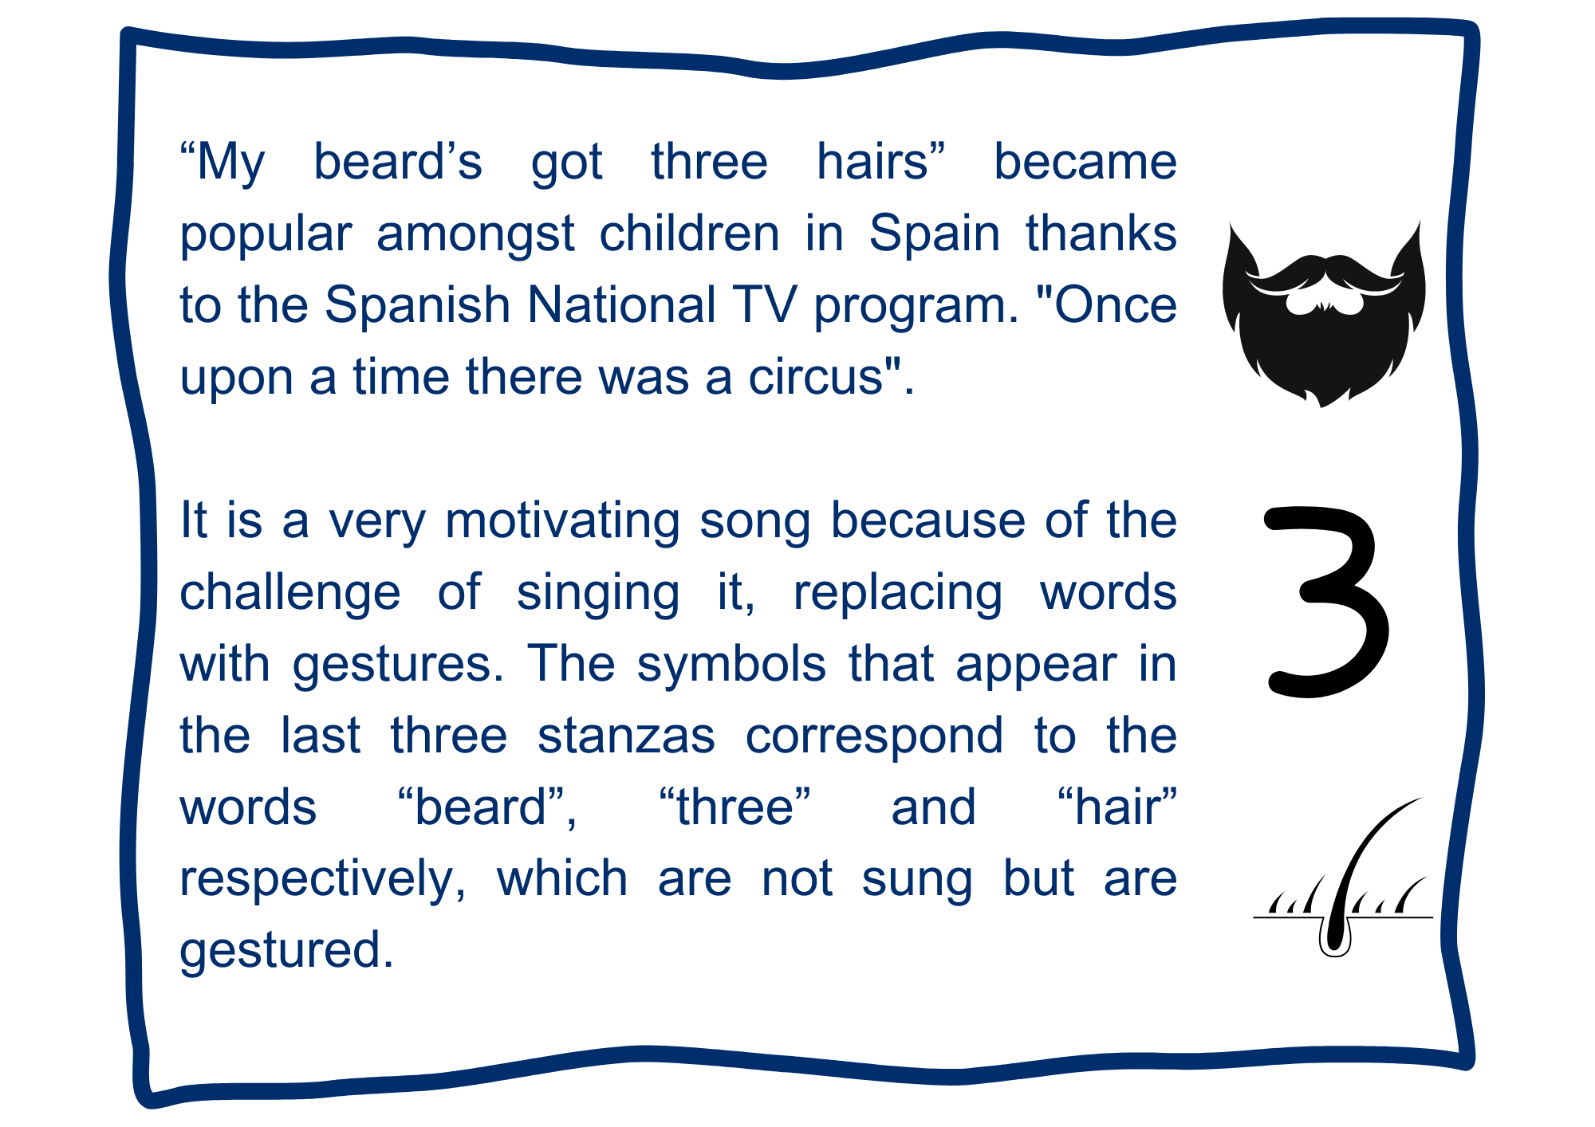
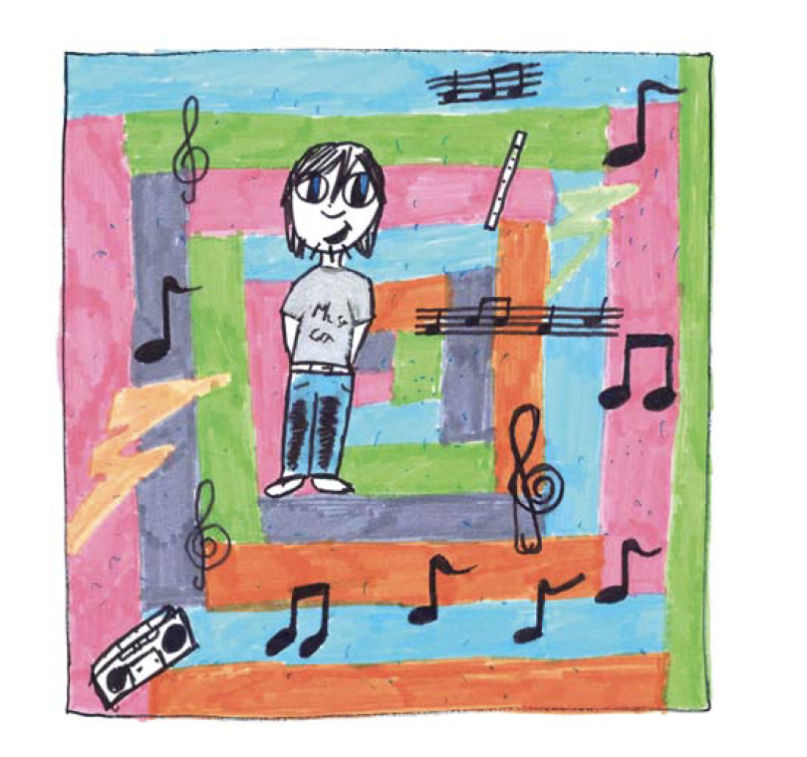

Spanish cultural performance
Mi barba tiene tres pelos – My beard’s got three hairs
‹#›

Slide 7
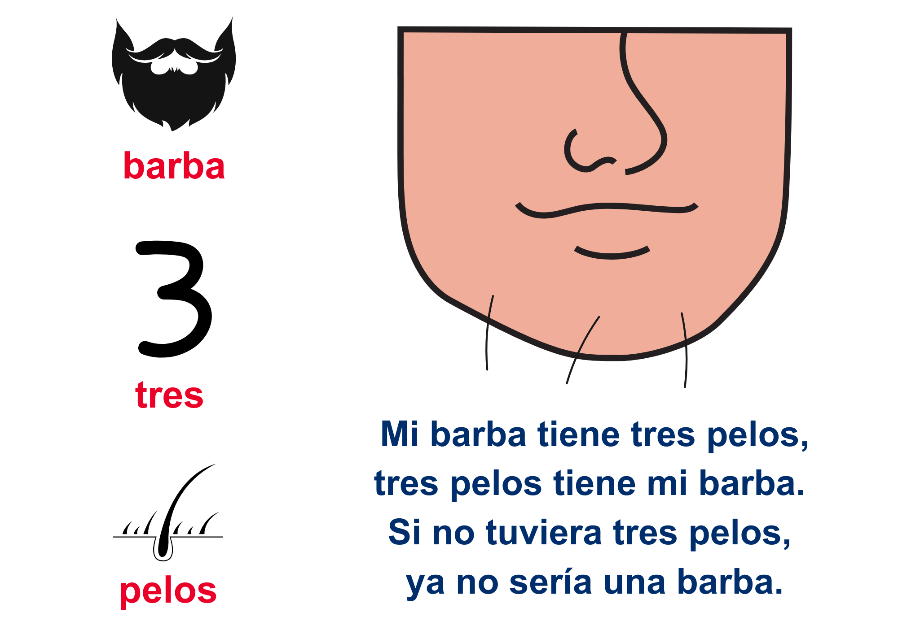
Spanish cultural performance
Mi barba tiene tres pelos – My beard’s got three hairs
‹#›

Slide 8
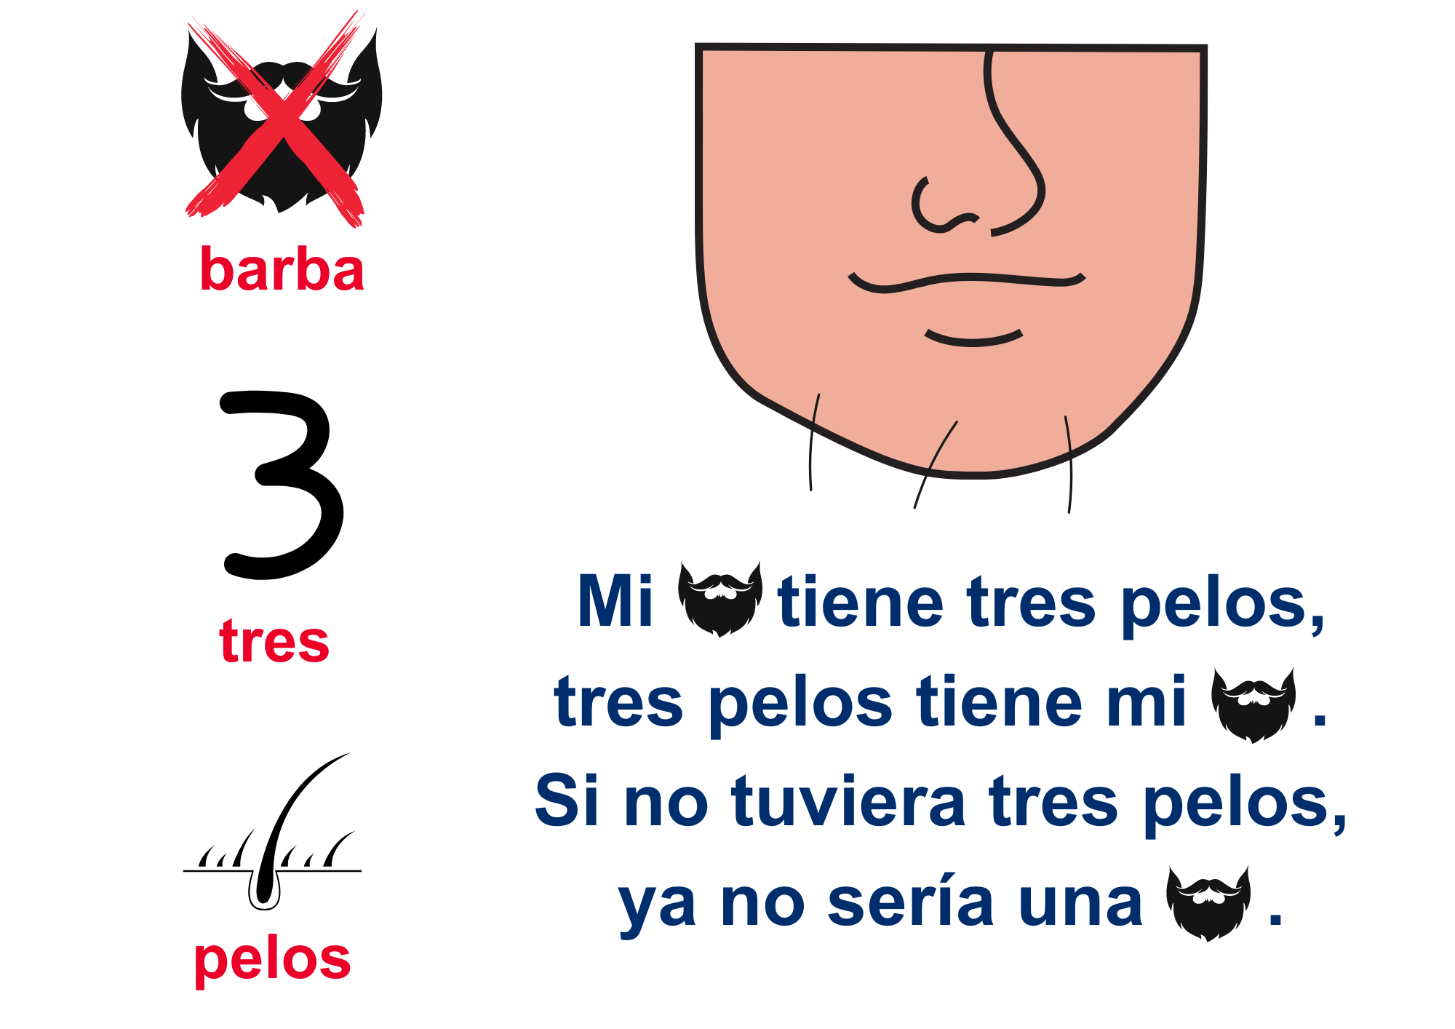
Spanish cultural performance
Mi barba tiene tres pelos – My beard’s got three hairs
‹#›

Slide 9
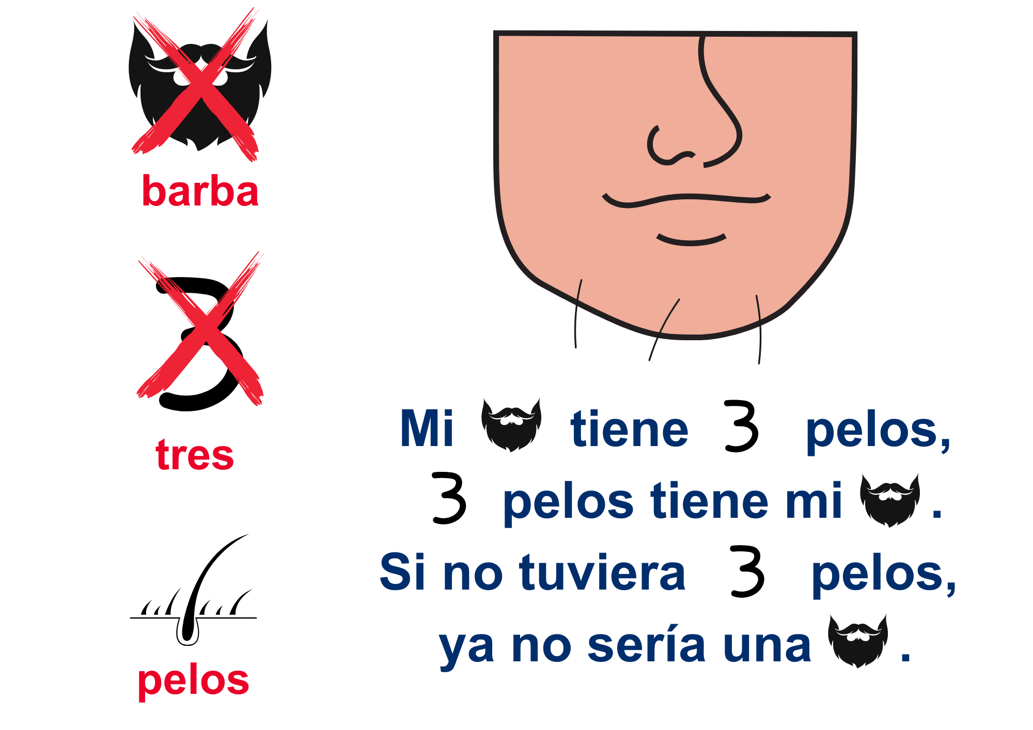
Spanish cultural performance
Mi barba tiene tres pelos – My beard’s got three hairs
‹#›

Slide 10
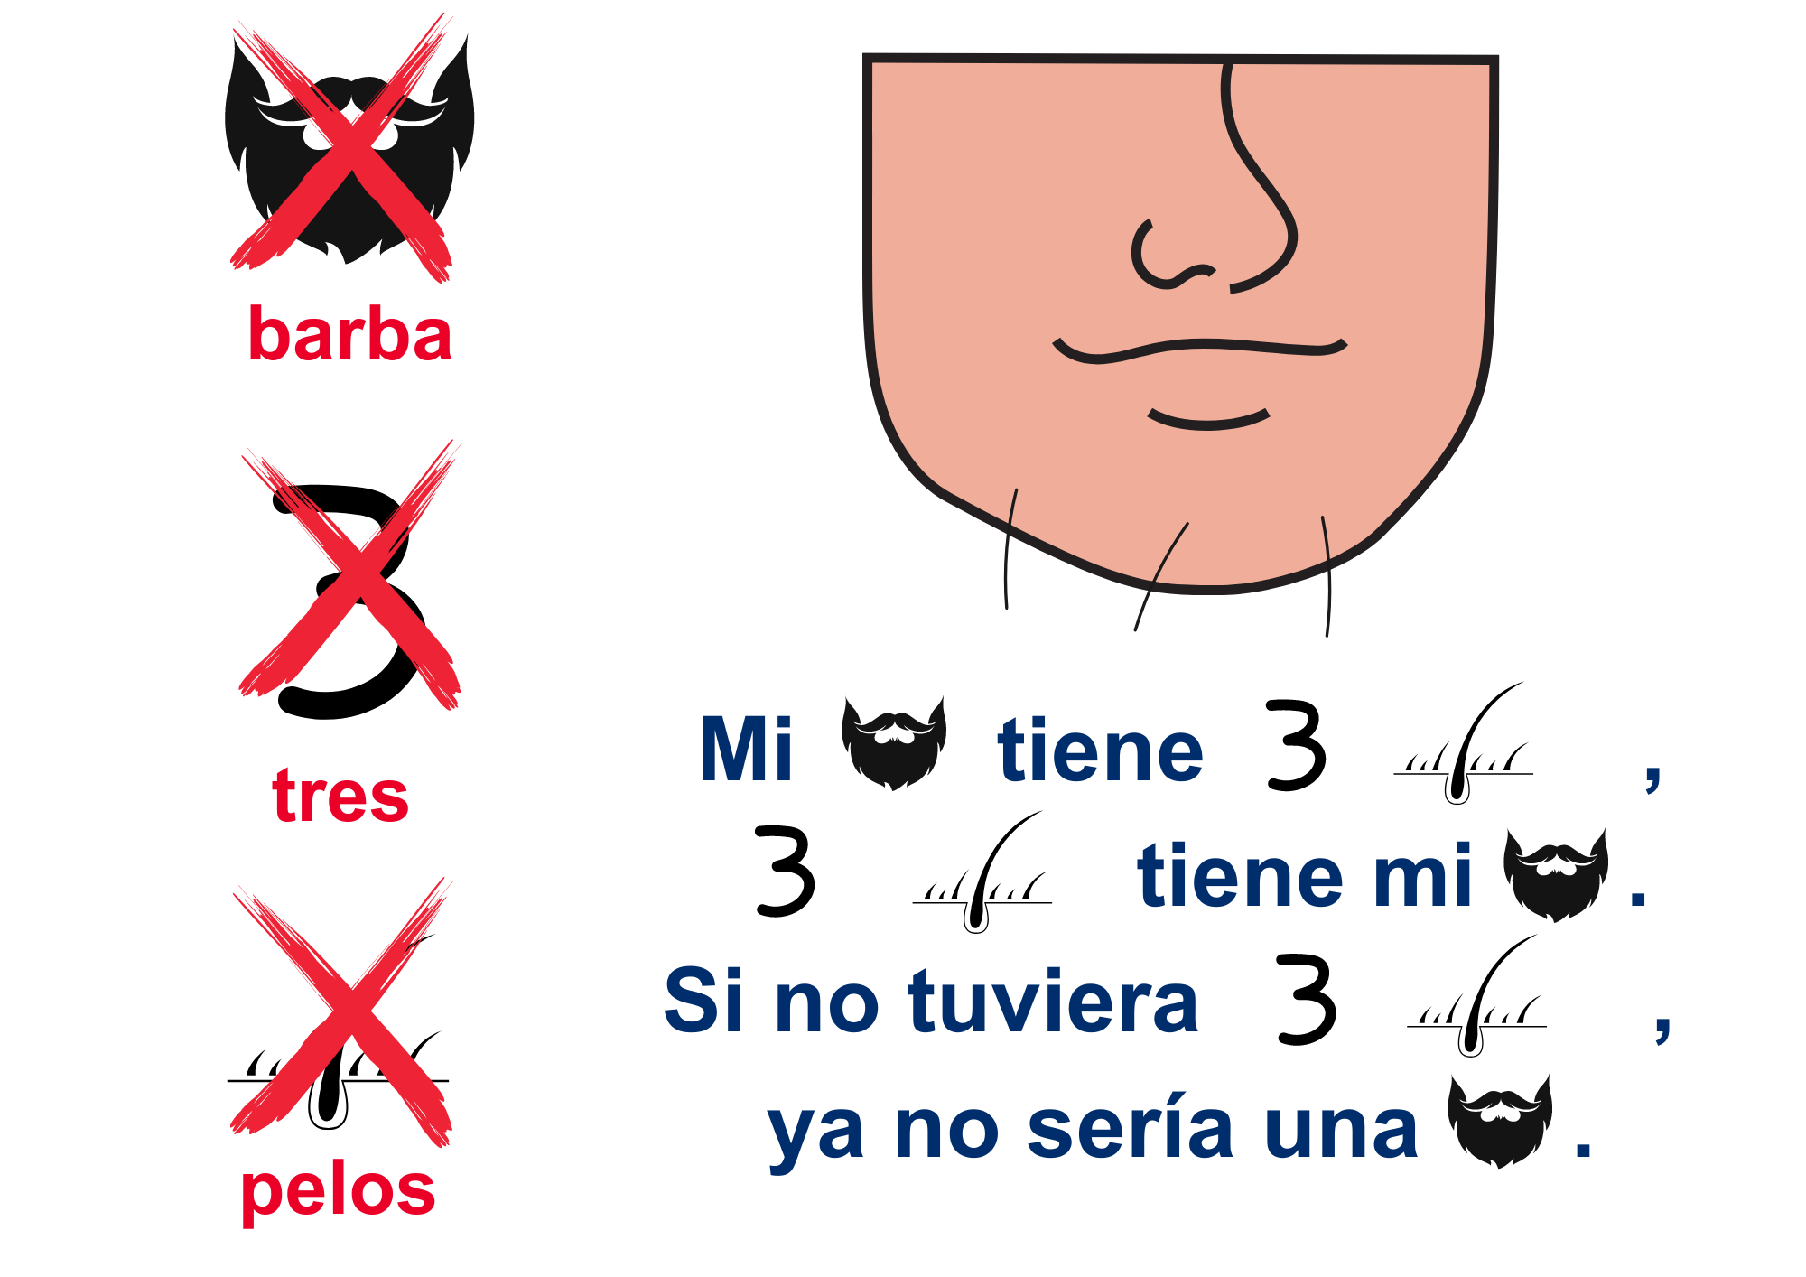
Spanish cultural performance
Mi barba tiene tres pelos – My beard’s got three hairs
‹#›

Slide 11
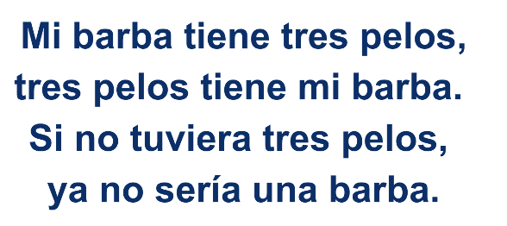
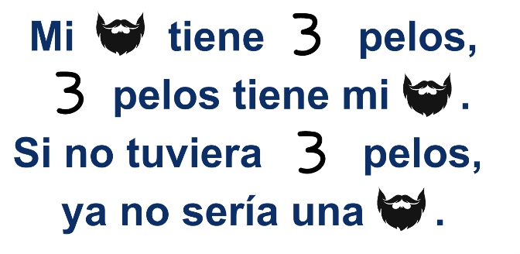
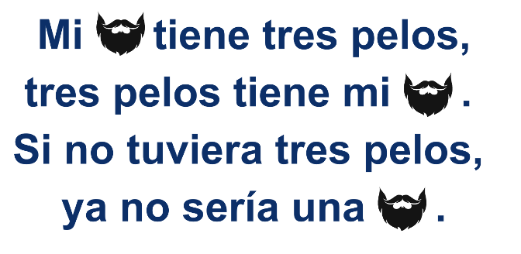
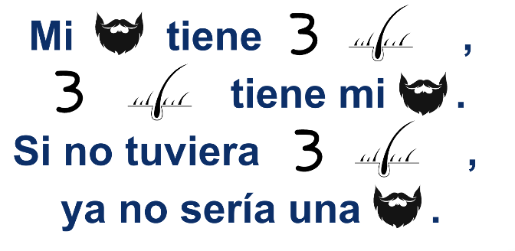
Let’s sing!
Mi barba tiene tres pelos
1
3
2
4
‹#›

Slide 12
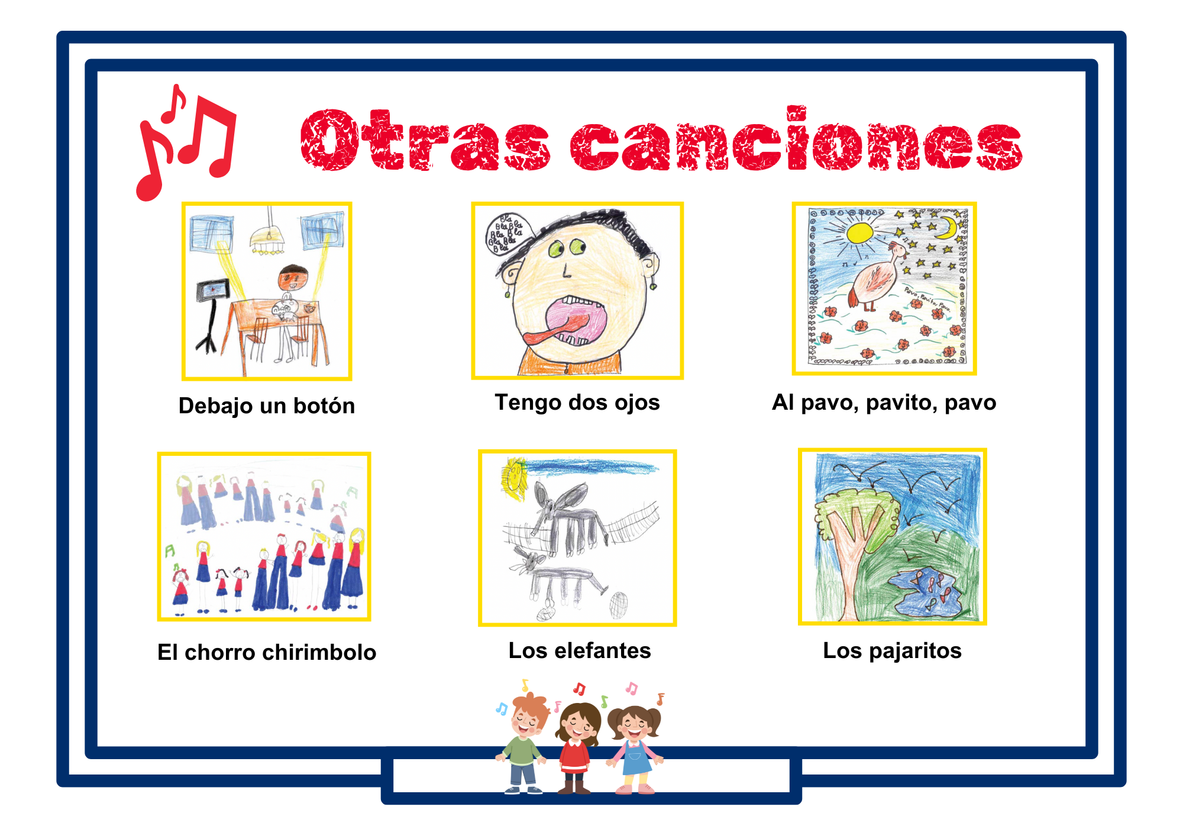
Spanish cultural performance
Otras canciones – Some other songs
All the songs are available here:
https://shorturl.at/jovIK
‹#›

Slide 13
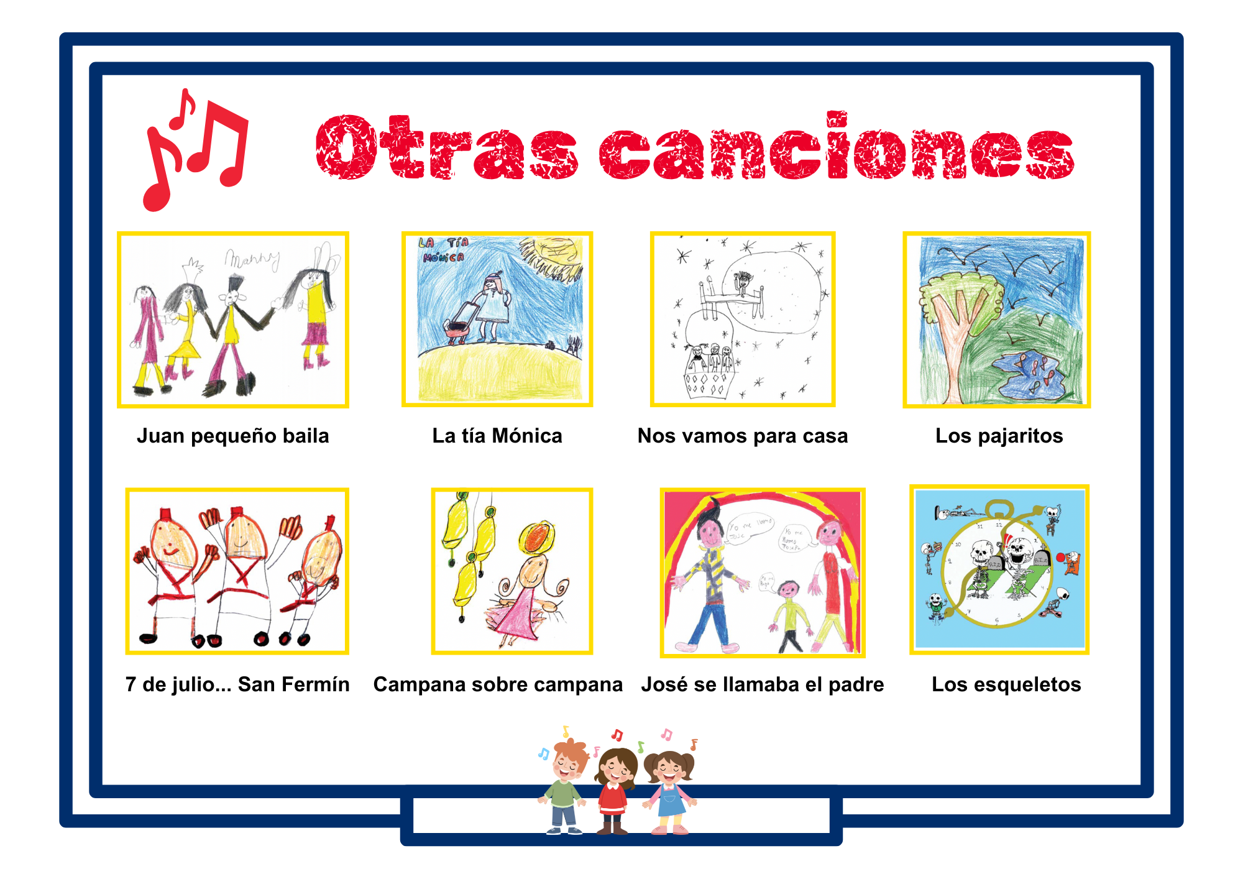
Spanish cultural performance
Otras canciones – Some other songs
All the songs are available here:
https://shorturl.at/jovIK
‹#›

Slide 14
Spanish cultural performance
Usos y recomendaciones – Uses and recommendations
Song name | Play | Dance | Acting out | Festival | Language component | Sociocultural component
Debajo un botón | X |  |  |  | Vowel phonemes
El corro chirimbolo | X | Spatial coordination |  |  | Body parts and vowel phonemes
Tengo dos ojos | X |  | X |  | Body parts | Onomatopoeias
Mi barba tiene 3 pelos | X |  | X |  | Body parts
Los elefantes | X | X |  |  | Enumerations and animals
Al pavo, pavito, pavo | X |  |  |  | Animals, vowel phonemes and numbers
Los pajaritos | X |  | X |  | AnimaIs and verbs of movement
‹#›

Slide 15
Spanish cultural performance
Usos y recomendaciones – Uses and recommendations
Song name | Play | Dance | Acting out | Festival | Language component | Sociocultural component
José se llamaba el padre | X | X |  | Father's Day |  | Names in Spain
Juan pequeño baila | X | X | Spatial coordination |  | Body parts
La tía Mónica | X | X | X |  | Clothes
Los esqueletos | X |  | Spatial coordination |  | Numbers and times | Mexican traditions
Nos vamos para casa |  |  |  | End of school day | Farewell, physical states | Spanish TV programmes
Siete de Julio … San Fermín | X | X |  | X | Enumerations, dates, months, numbers | San Fermin festival in PampIona
Campana sobre campana | X |  |  | Christmas song | Christmas vocabulary | Christmas songs in Spain
‹#›

Slide 16
¡Ahora estás preparado para un festival de canciones infantiles en español!
You are now ready for a Spanish music festival for children!
‹#›

Slide 17
Slide Title
Q&A

Slide 18

JOIN OUR MAILING LIST

Slide 19

ευχαριστώ
Gracias
谢谢
Danke
Bedankt
Dziękuję
Diolch
Fa’afetai
Merci
Kiitos
Ласкаво просимо
Спасибо
Tak skal du have
Köszönjük
אדאנק
شكرًا لك
Teşekkürler
Thank you

