Slide 1
Spanish Cultural Performance
Spanish cultural performance
Secondary

Slide 2
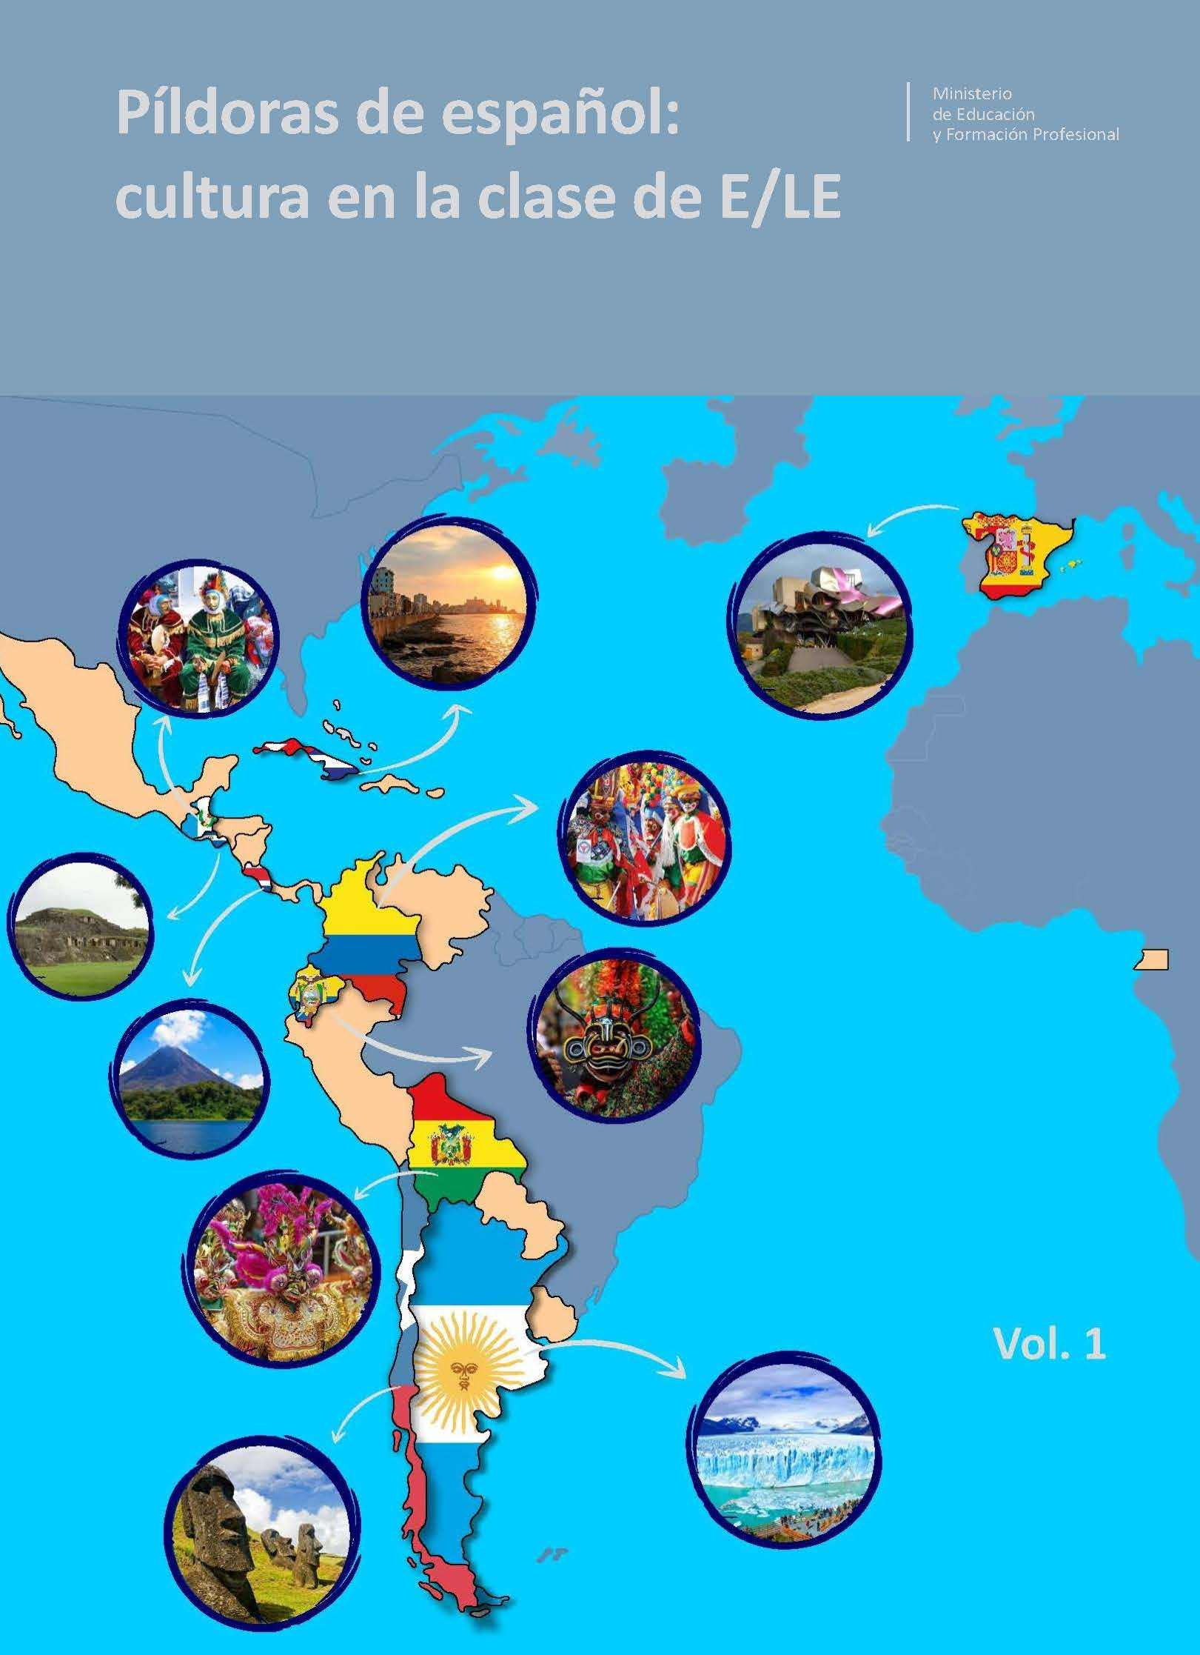
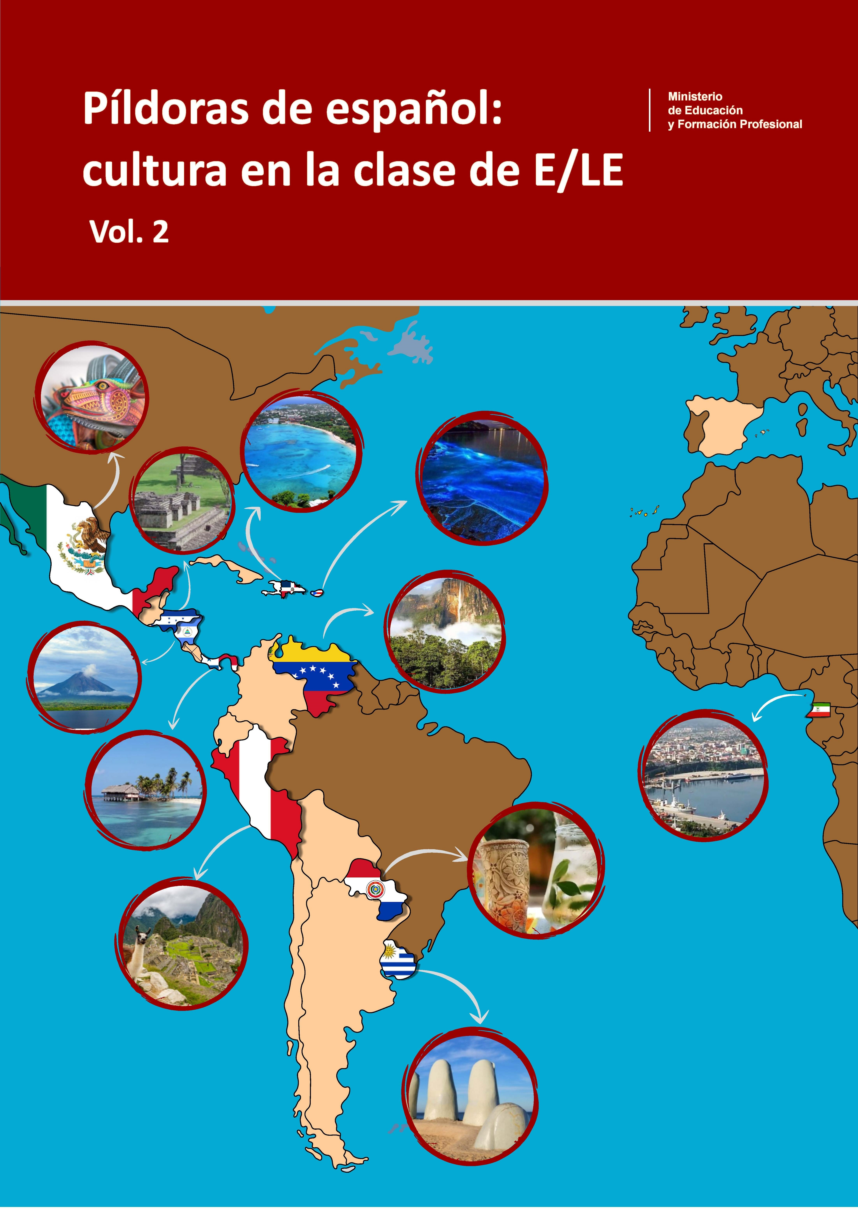
Spanish cultural performance
Sesión 1: rincones culturales
Session 1: cultural stations
2

Slide 3
Spanish cultural performance
Contenidos – Contents
1 Self-reflection questionnaire
2 Cultural stations
3 Whole group findings
4 Display boards for the community

Slide 4
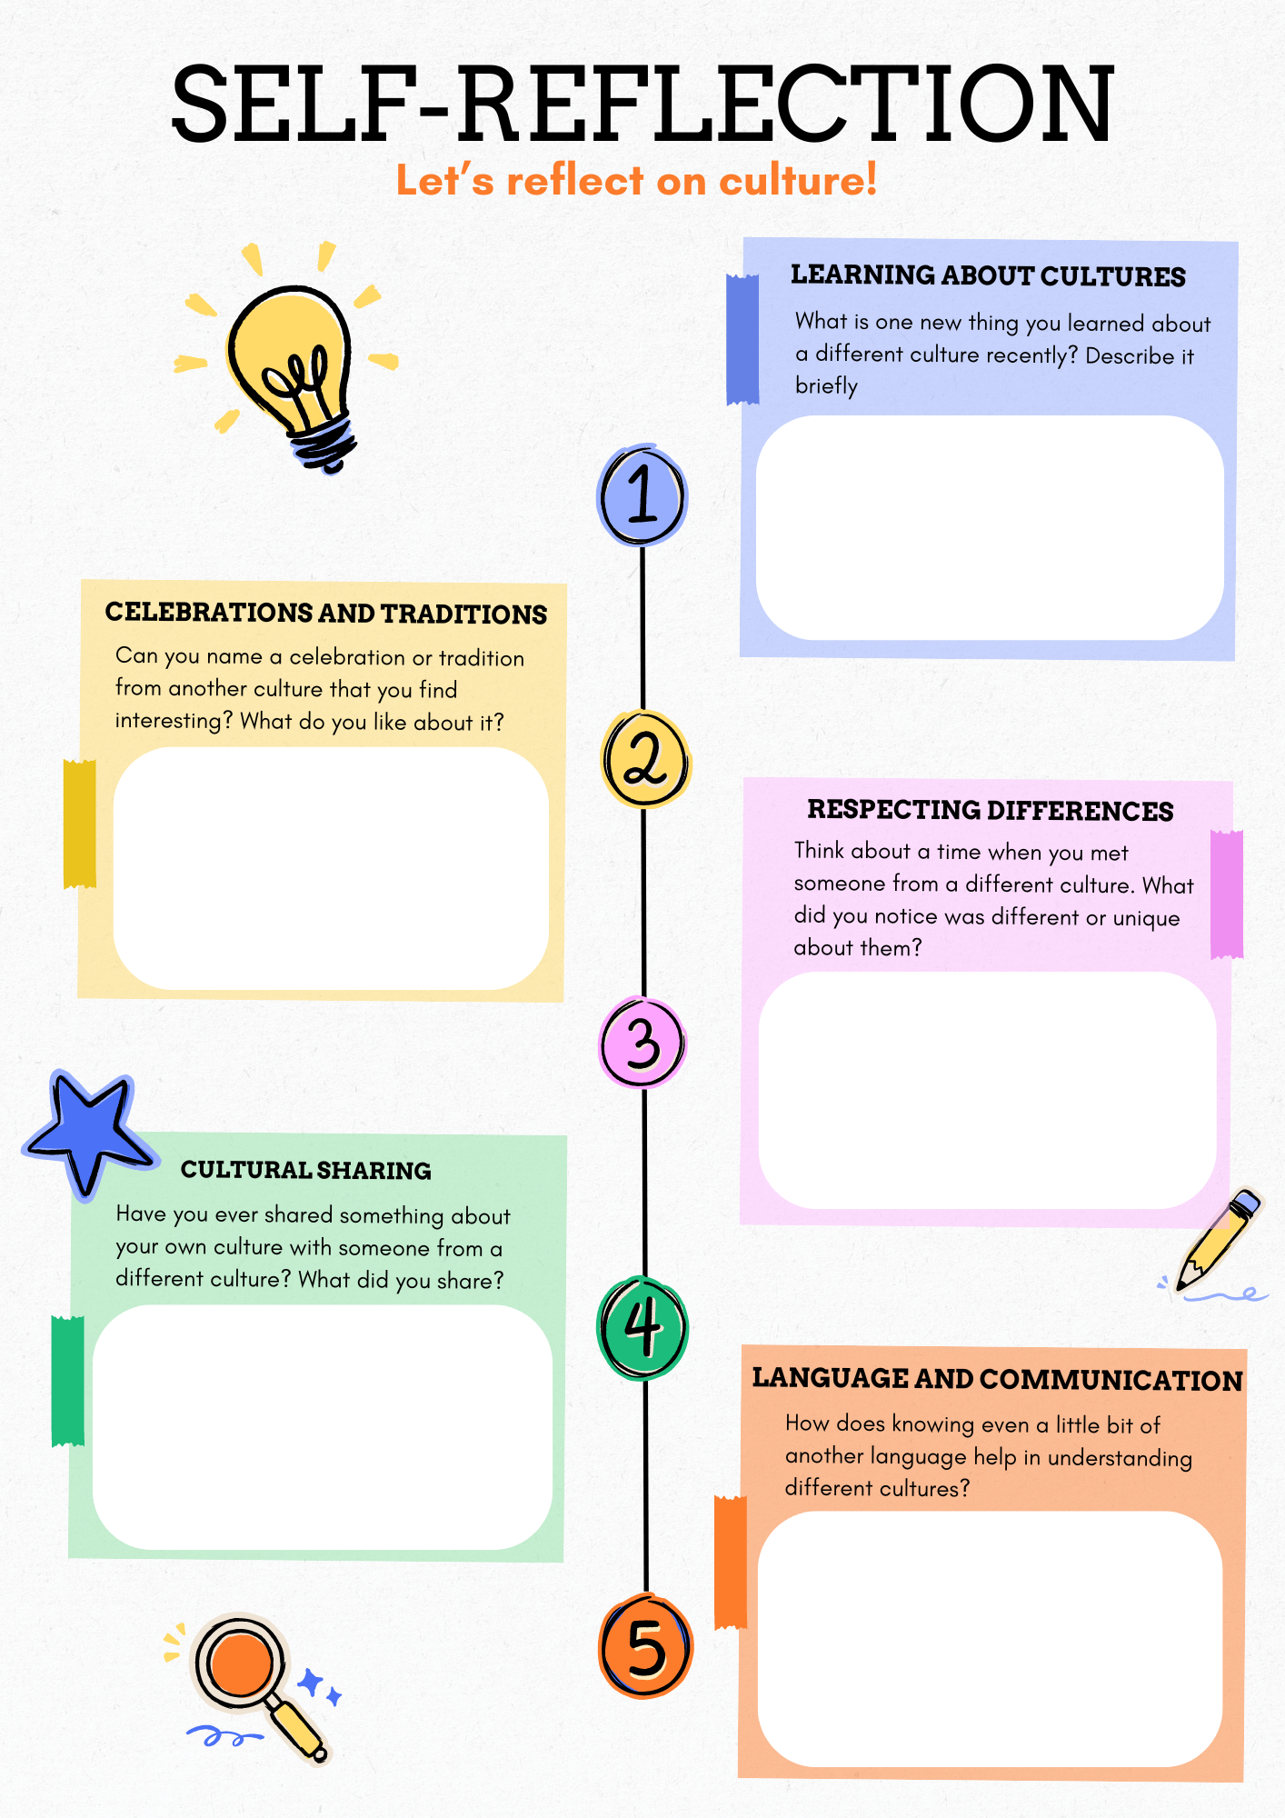
Spanish cultural performance
Autoreflexión – Self-reflection

Slide 5
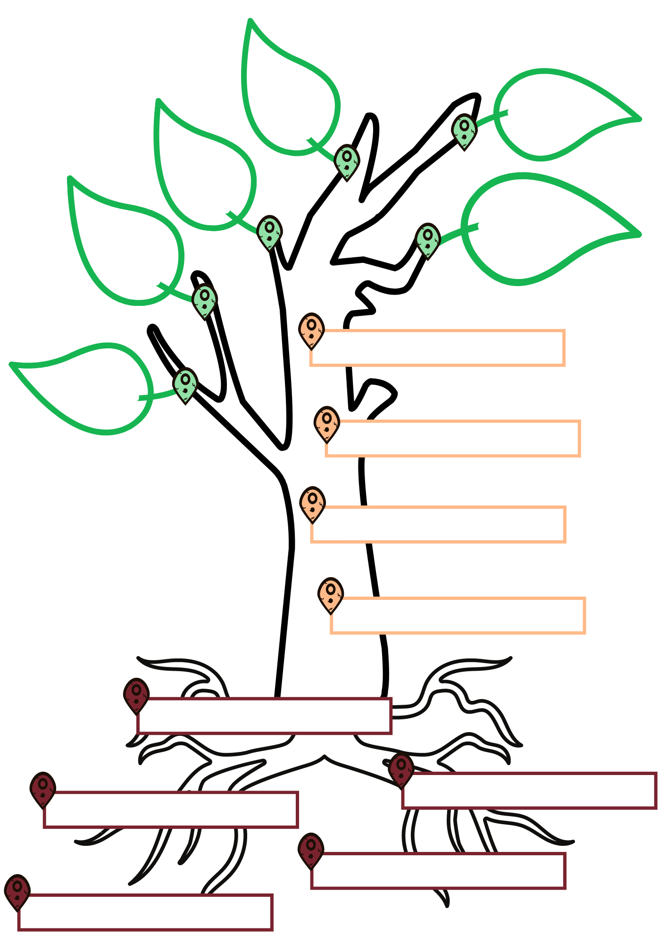
Spanish cultural performance
Mi trasfondo cultural – My cultural background

Slide 6
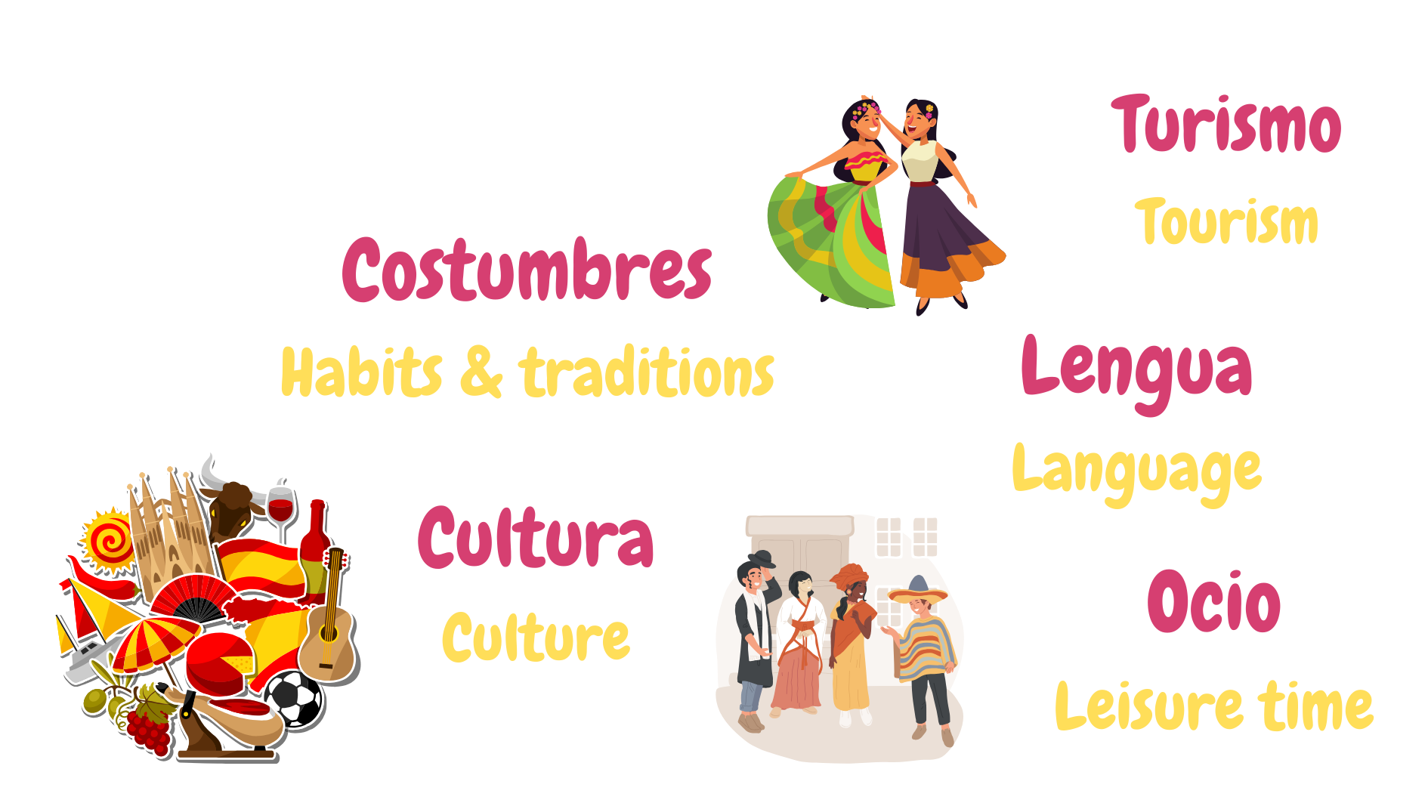
Spanish cultural performance
Rincones culturales – Cultural stations

Slide 7
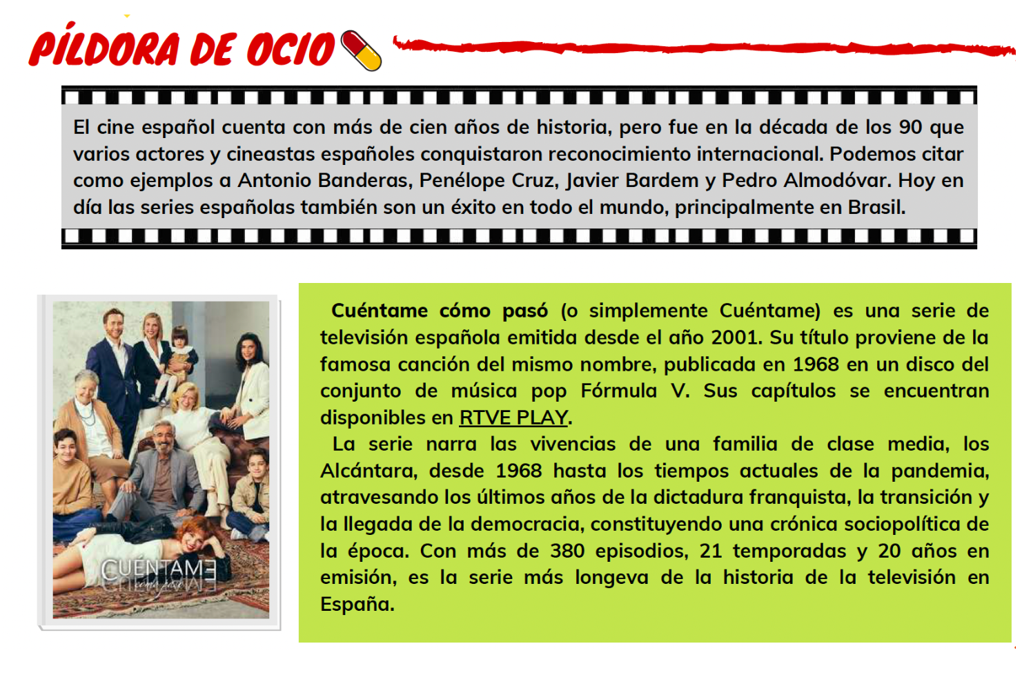
Spanish cultural performance
Rincones culturales – Cultural stations

Slide 8
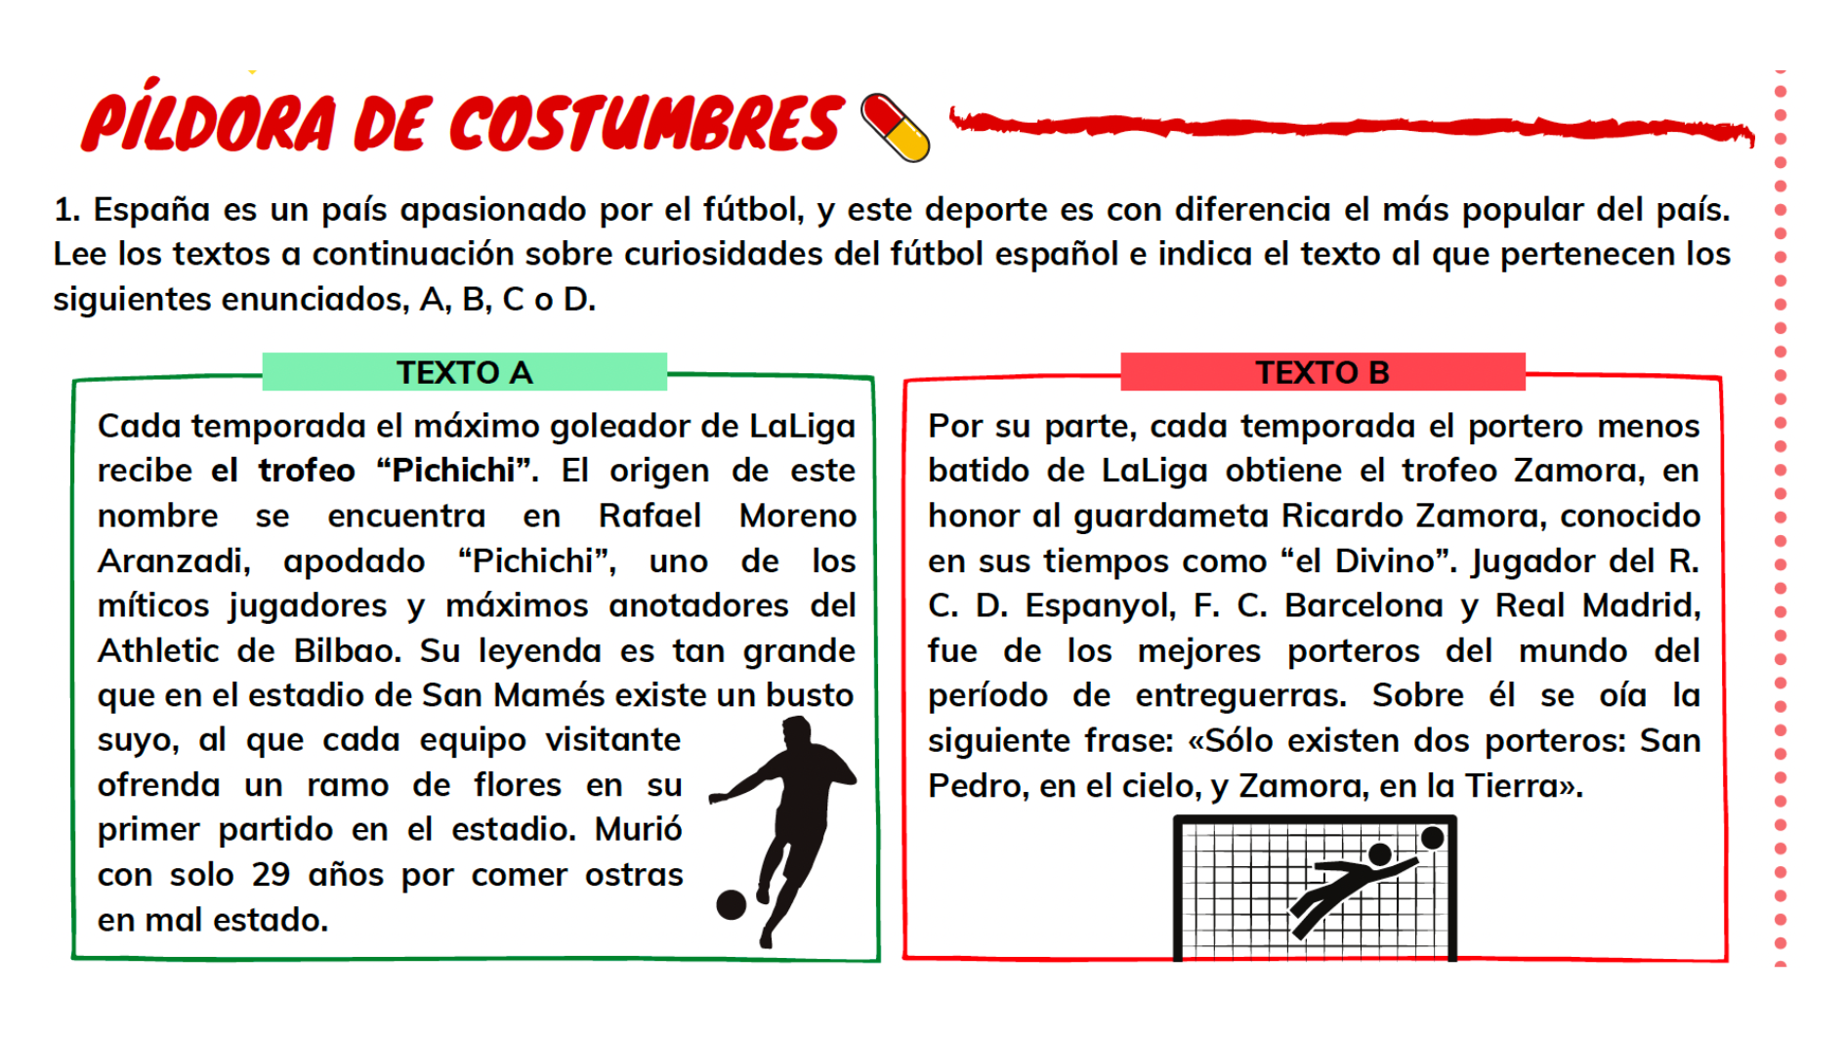
Spanish cultural performance
Rincones culturales – Cultural stations

Slide 9
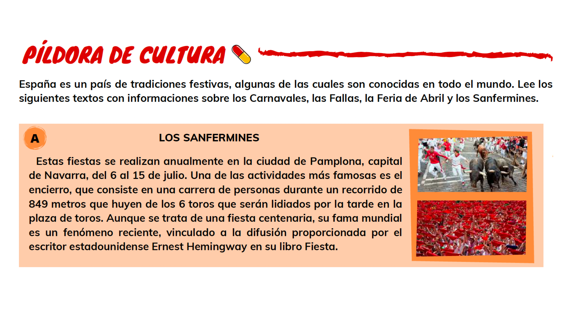
Spanish cultural performance
Rincones culturales – Cultural stations

Slide 10
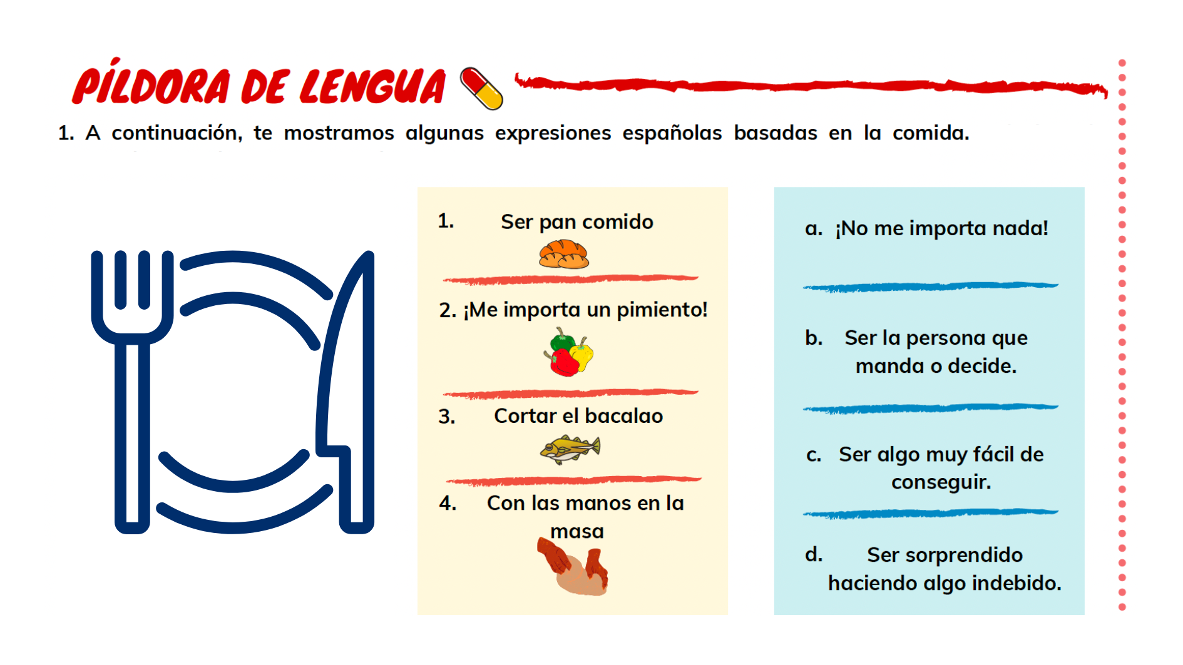
Spanish cultural performance
Rincones culturales – Cultural stations

Slide 11
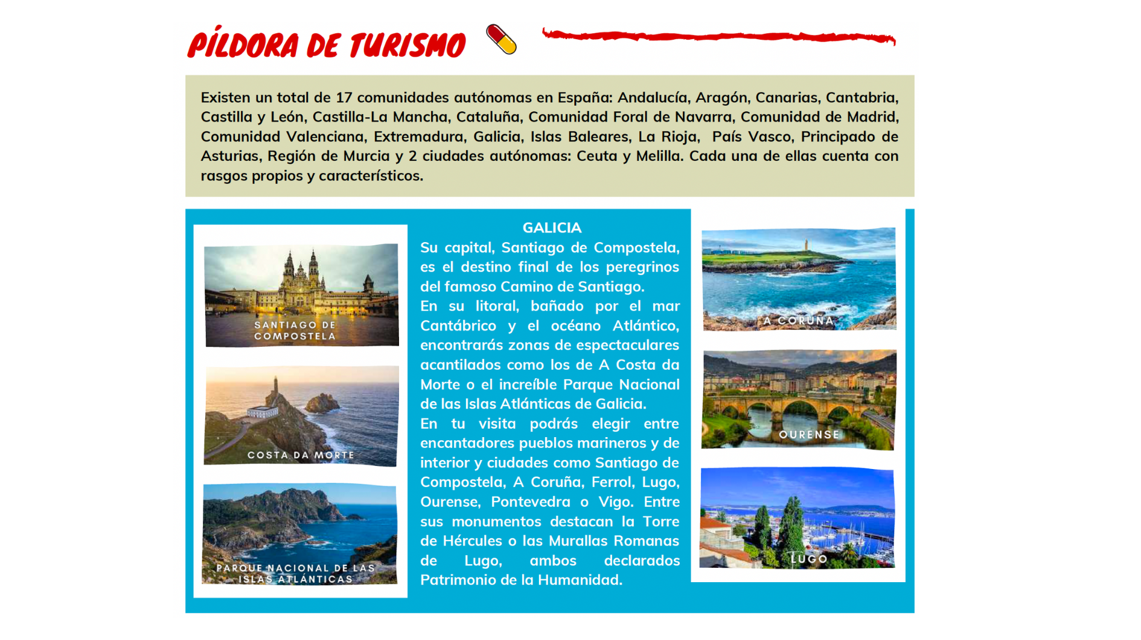
Spanish cultural performance
Rincones culturales – Cultural stations

Slide 12
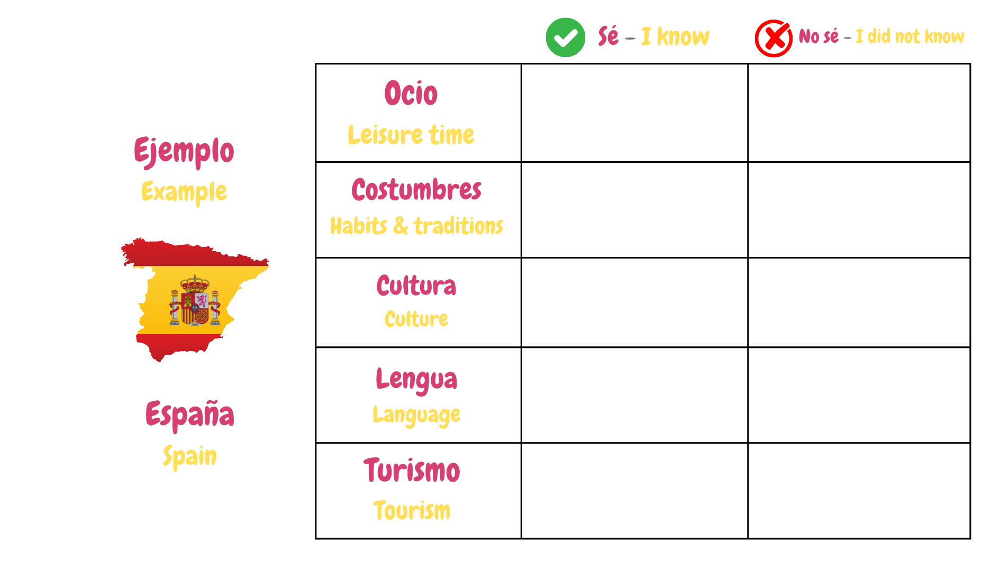
Spanish cultural performance
Rincones culturales – Cultural stations

Slide 13
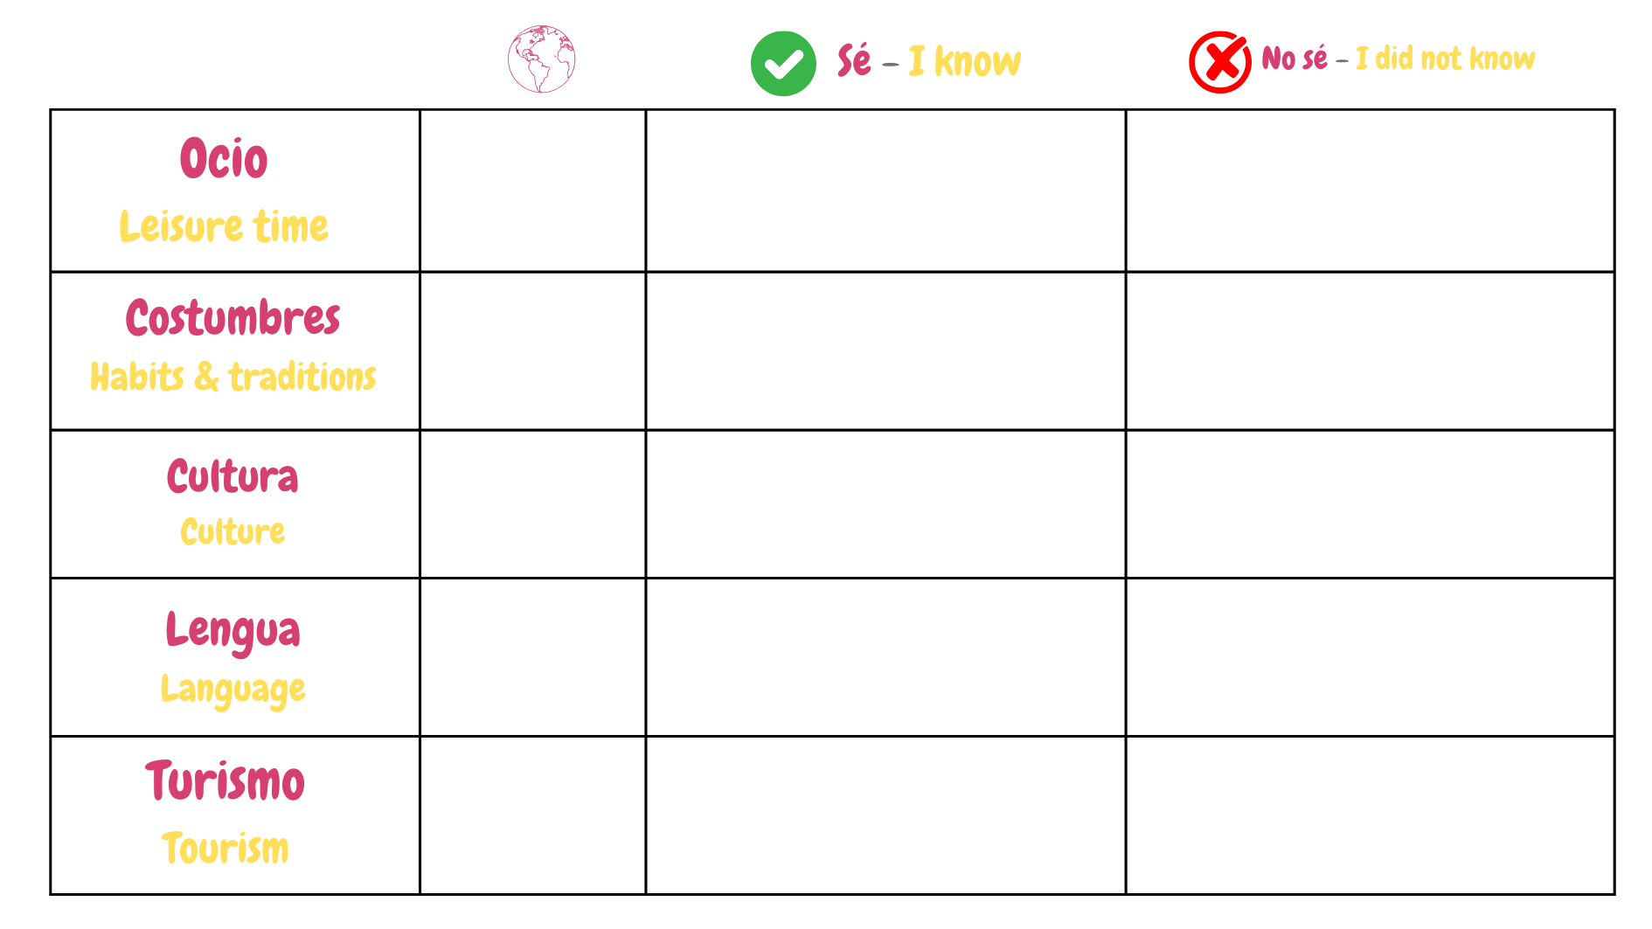
Spanish cultural performance
Discusión en grupo – Whole group findings

Slide 14
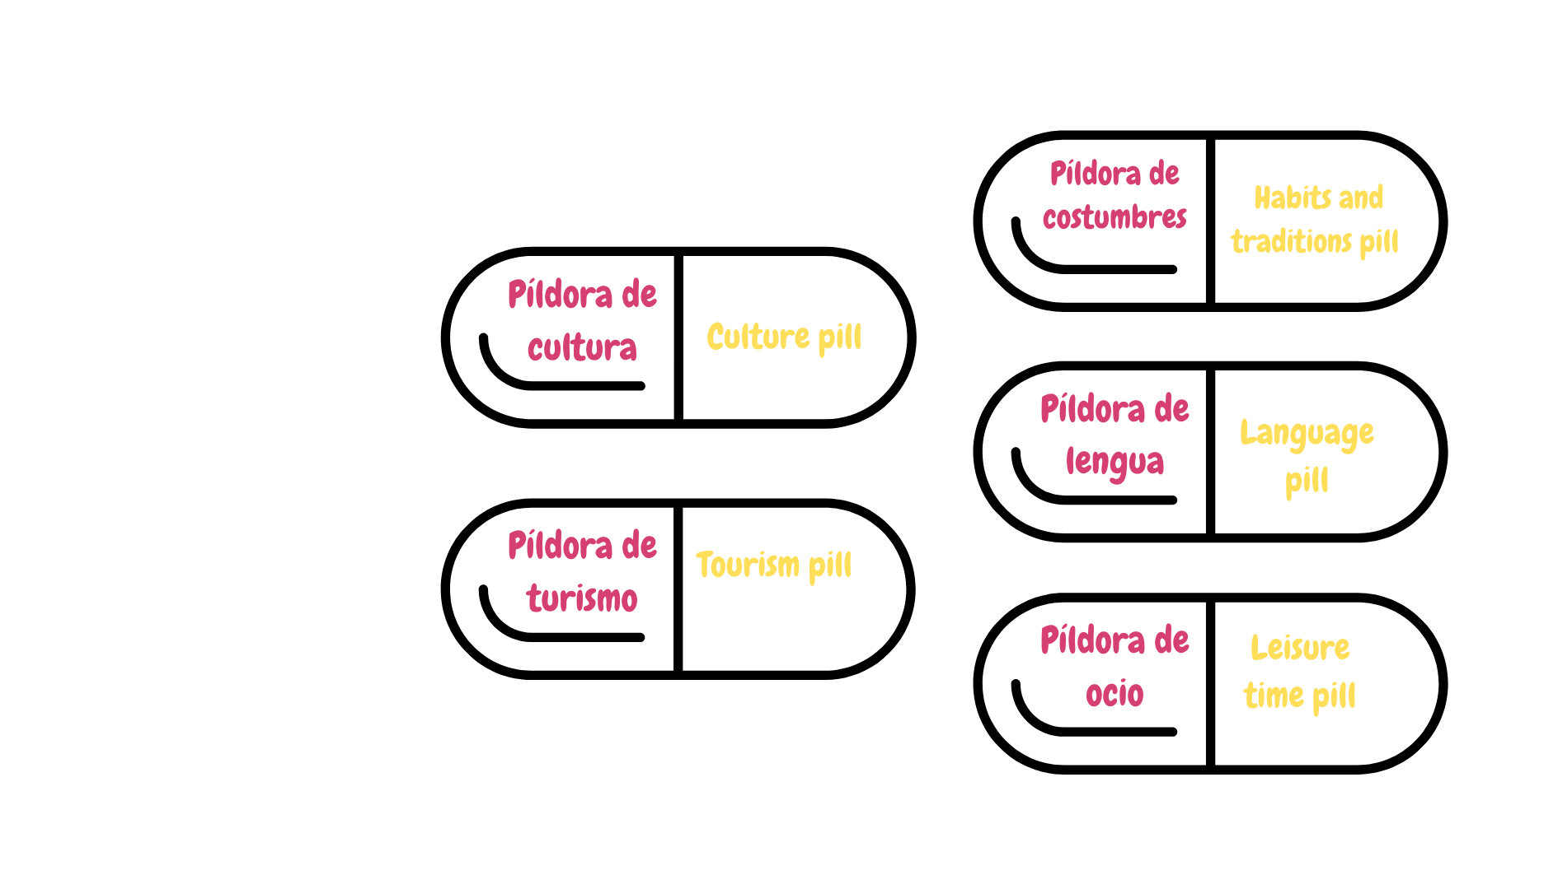
Spanish cultural performance
Paneles informativos – Poster exhibition for the community

Slide 15
¡Ahora ya sabes algo más respecto a la cultura en los países de habla hispana! ¡Compártelo!
You are now more aware of cultural aspects in Spanish speaking countries, let’s share it!
15

Slide 16
Slide Title
Q&A

Slide 17
JOIN OUR MAILING LIST

Slide 18

ευχαριστώ
Gracias
谢谢
Danke
Bedankt
Dziękuję
Diolch
Fa’afetai
Merci
Kiitos
Ласкаво просимо
Спасибо
Tak skal du have
Köszönjük
אדאנק
شكرًا لك
Teşekkürler
Thank you

