Slide 1
French Taster
French Taster
Primary

Slide 2

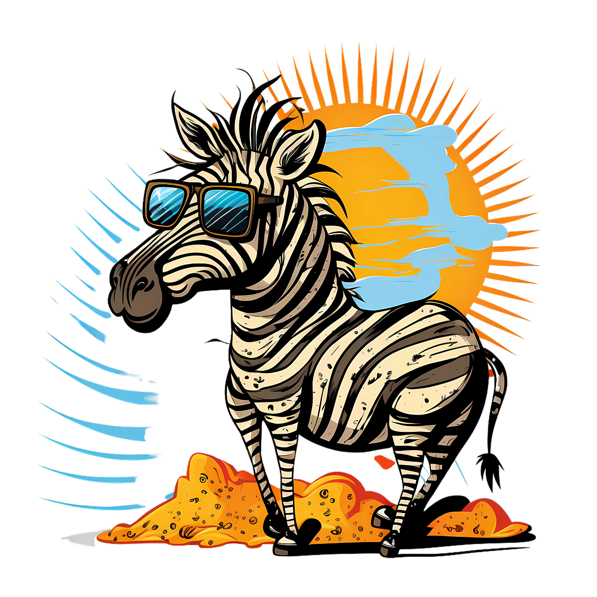
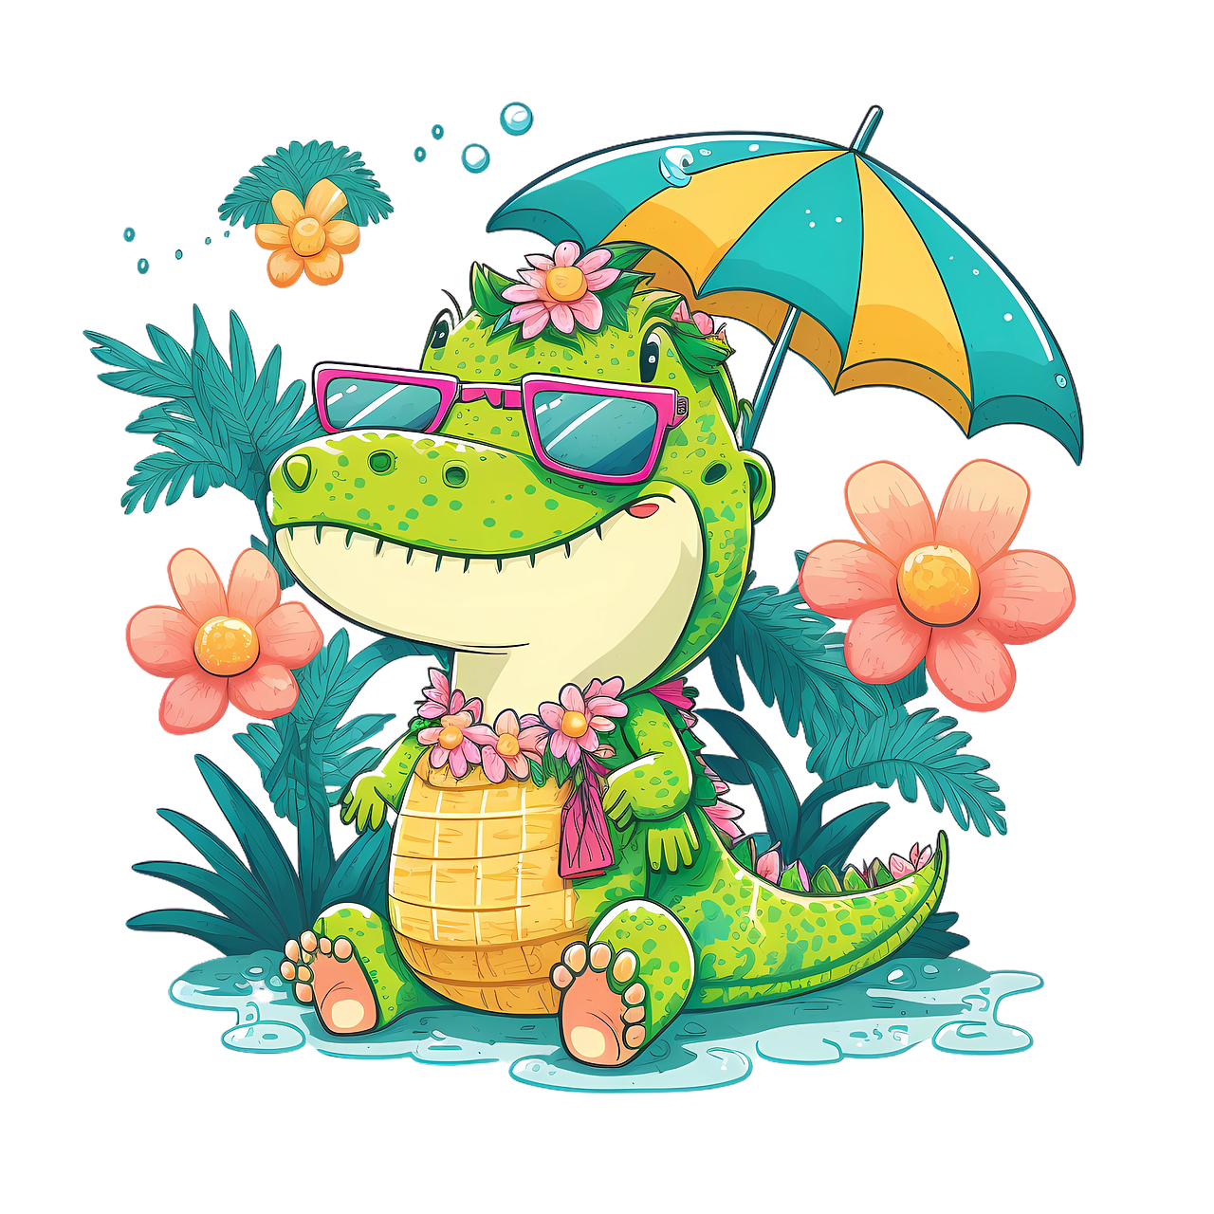
Coucou, je m’appelle Agathe l’Alligator
Et moi, je m’appelle Zachary le Zèbre
Together we’ll learn… l’alphabet en français !
Notes:
Illustration by Icons 8 from Ouch!

Slide 3
Learning objectives – Today you will…
Learn the alphabet in French
Learn how to introduce yourself in French

Slide 4

Show-off…
Ok, everyone, try to spot all of the words that look or sound similar to English. They’re called COGNATES.
Let’s start by watching a little video! (I’m even featured in it)

Slide 5
What cognates did you find?
Les mots de la classe :

Slide 6
Now, let’s listen to the song again. Try to repeat each letter and the word that goes with it!
Attention ! The pronunciation of some letters in French is very different from English.
Content
Minimum 16pt

Slide 7
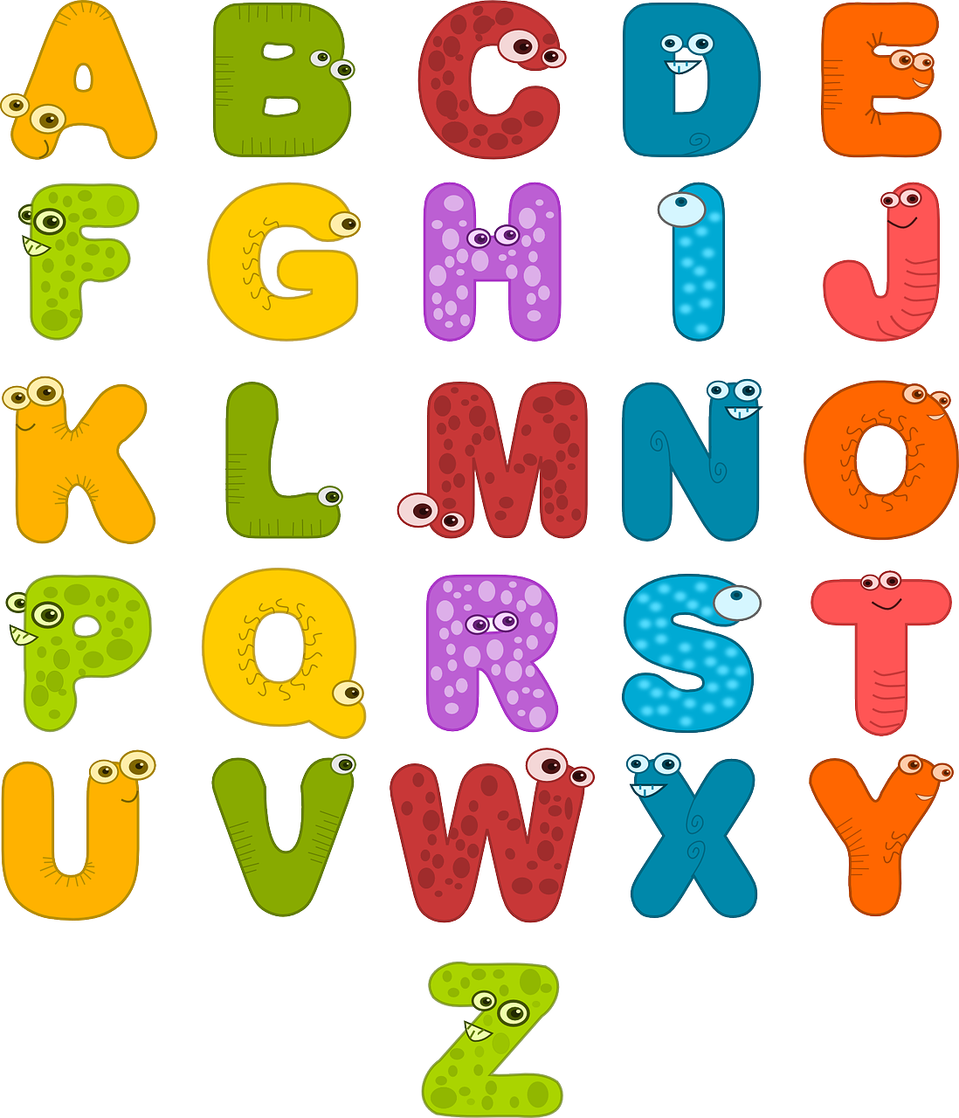
Répétons tous ensemble !

Slide 8
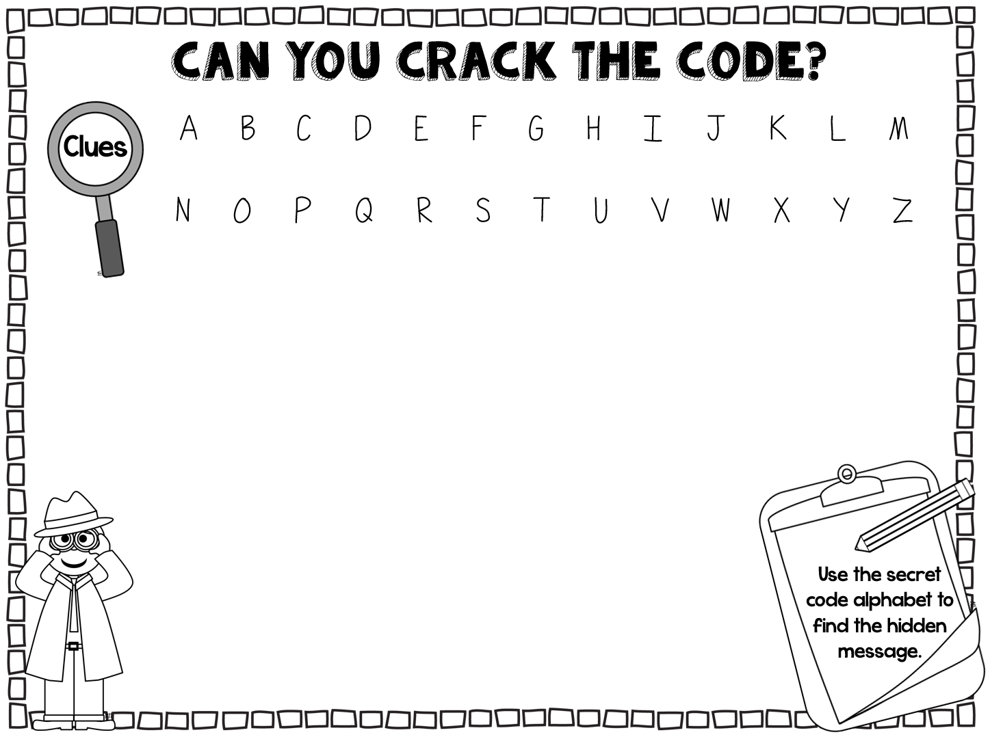









Un code secret ! Probably a secret admirer. Can you help me crack it?
____ ____ ____ ____ ____ ____ ____
____ ____
____ ‘____ ____ ____ ____ ____ ____ ____ ____ ?

Slide 9
‘Comment tu t’appelles ?’ Does anyone know what that means?
So? Were you able to decipher the message!?
Comment tu t’appelles ? What’s your name?

Slide 10
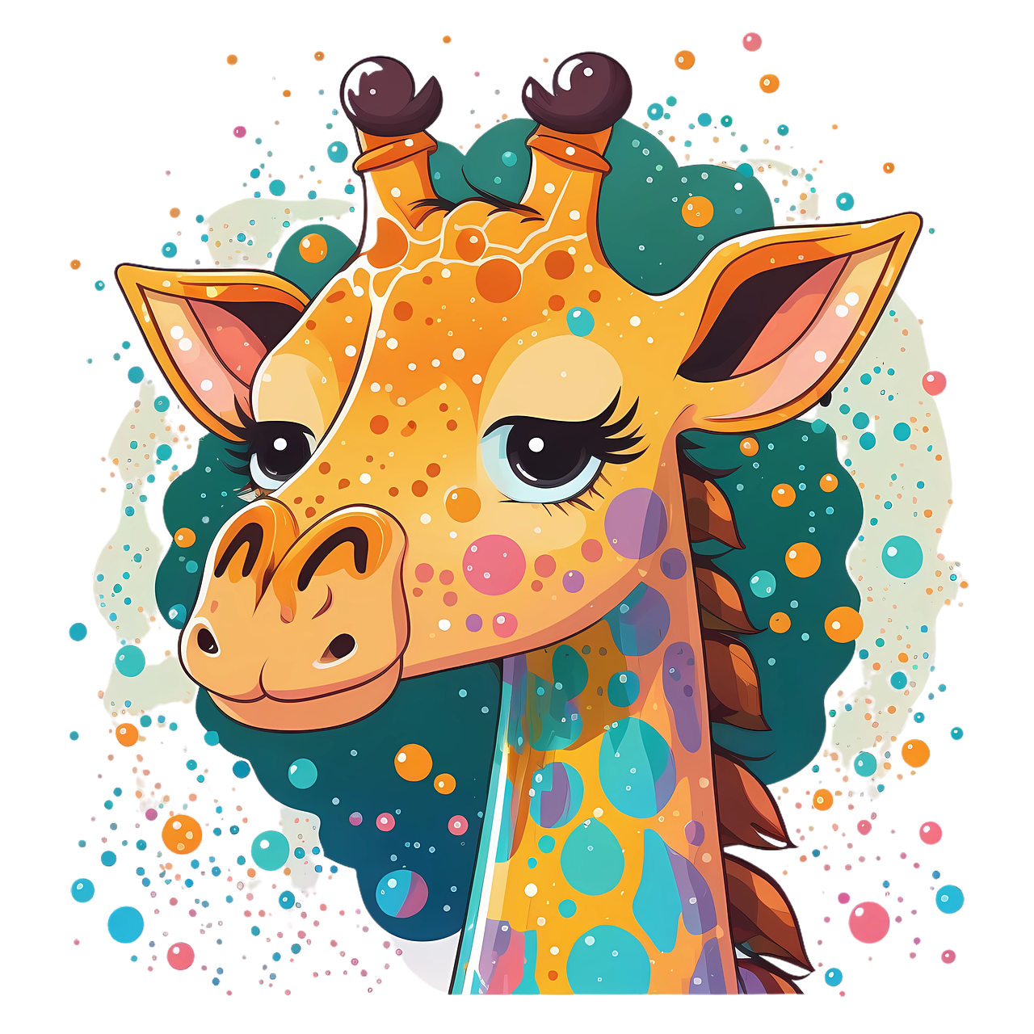
Comment tu t’appelles ? Je m’appelle…
Don’t be offended… Moi, je m’appelle Agathe l’Alligator.
Eh bien… Je m’appelle Zachary le Zèbre.
What’s my name!? A fan should know this!
Enchantée ! Je m’appelle Gaby la Girafe.

Slide 11
Comment tu t’appelles ? Je m’appelle…
Here we go again… Enchantée et bienvenue Gaby !
Wouah, she’s so pretty… Enchanté.
Merci ! I can see you you have many other friends. Comment vous appellez-vous ?

Slide 12
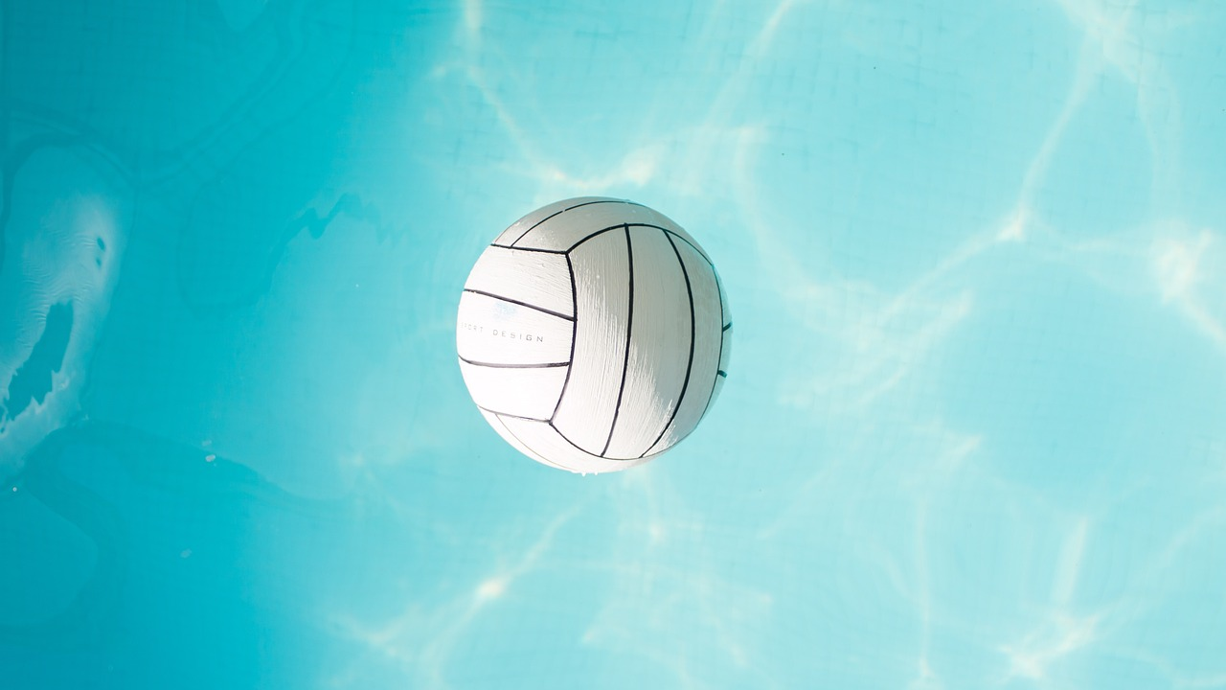
Comment tu t’appelles ? Je m’appelle…
Pass the ball to someone else to ask what their name is. Attention, tout en français !

Slide 13
Make sure you repeat your letter in French once you’re in the correct order !
You all have one or more letters and need to come to front and get in the correct order to spell the word out.
Alors, let’s all spell out some words.

Slide 14
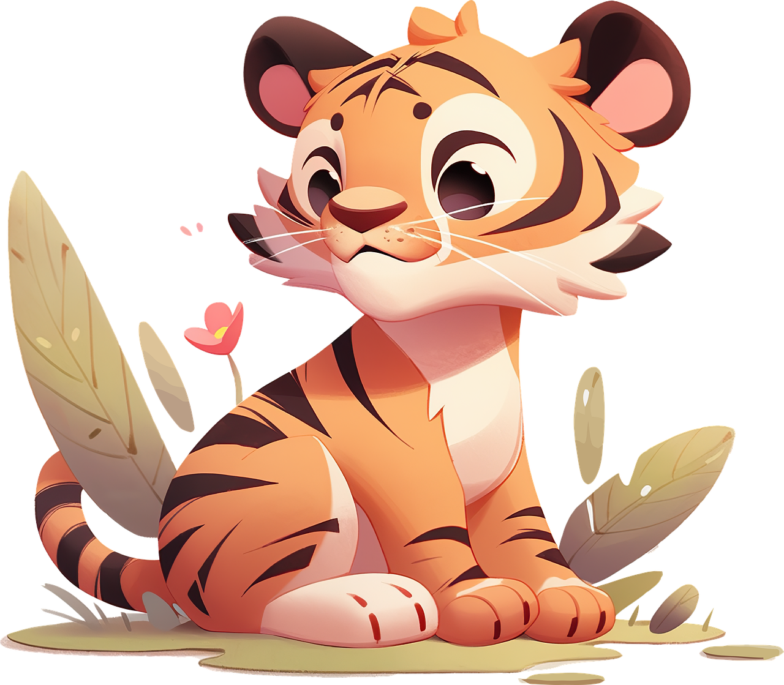
TIGRE
Let’s do a practice run. C’est parti !

Slide 15
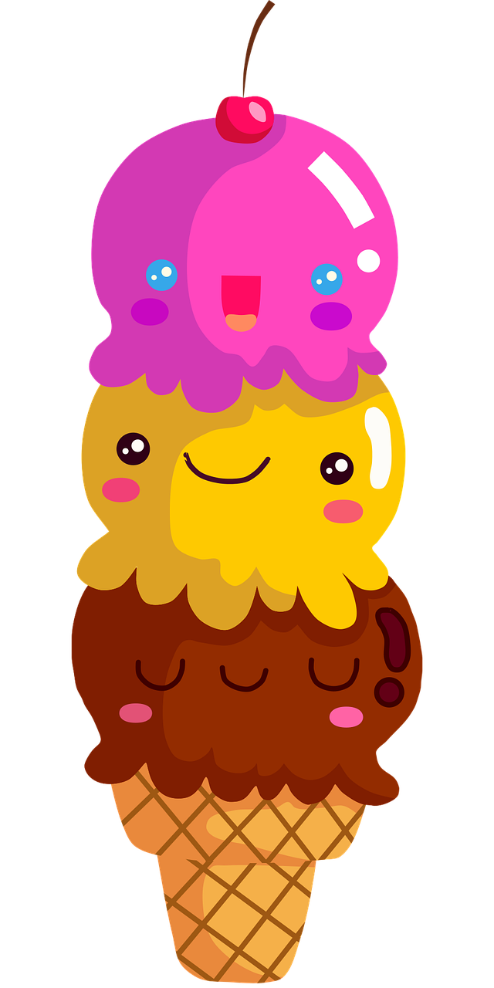
GLACE
Vous êtes prêts ? On y va !

Slide 16

YAOURT

Slide 17
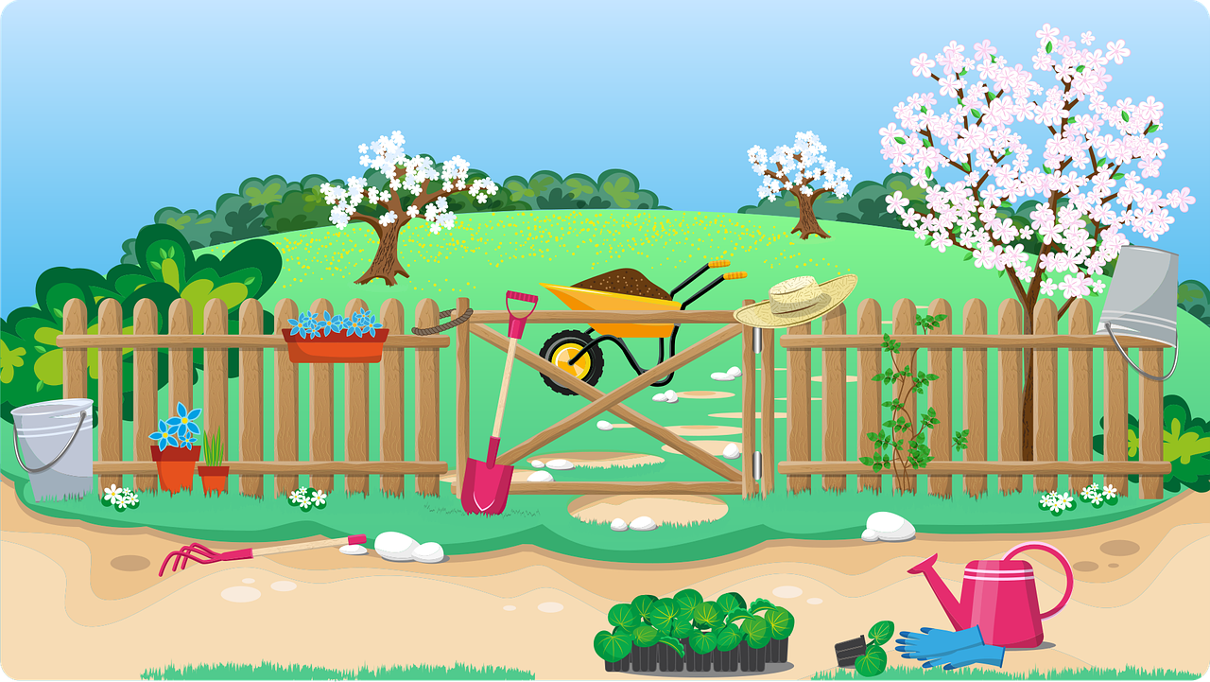
JARDIN

Slide 18
ZÈBRE

Slide 19
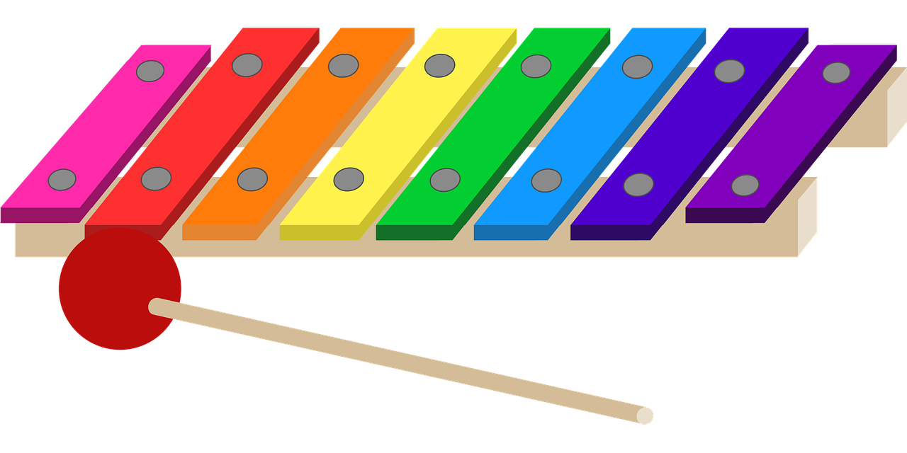
XYLOPHONE

Slide 20
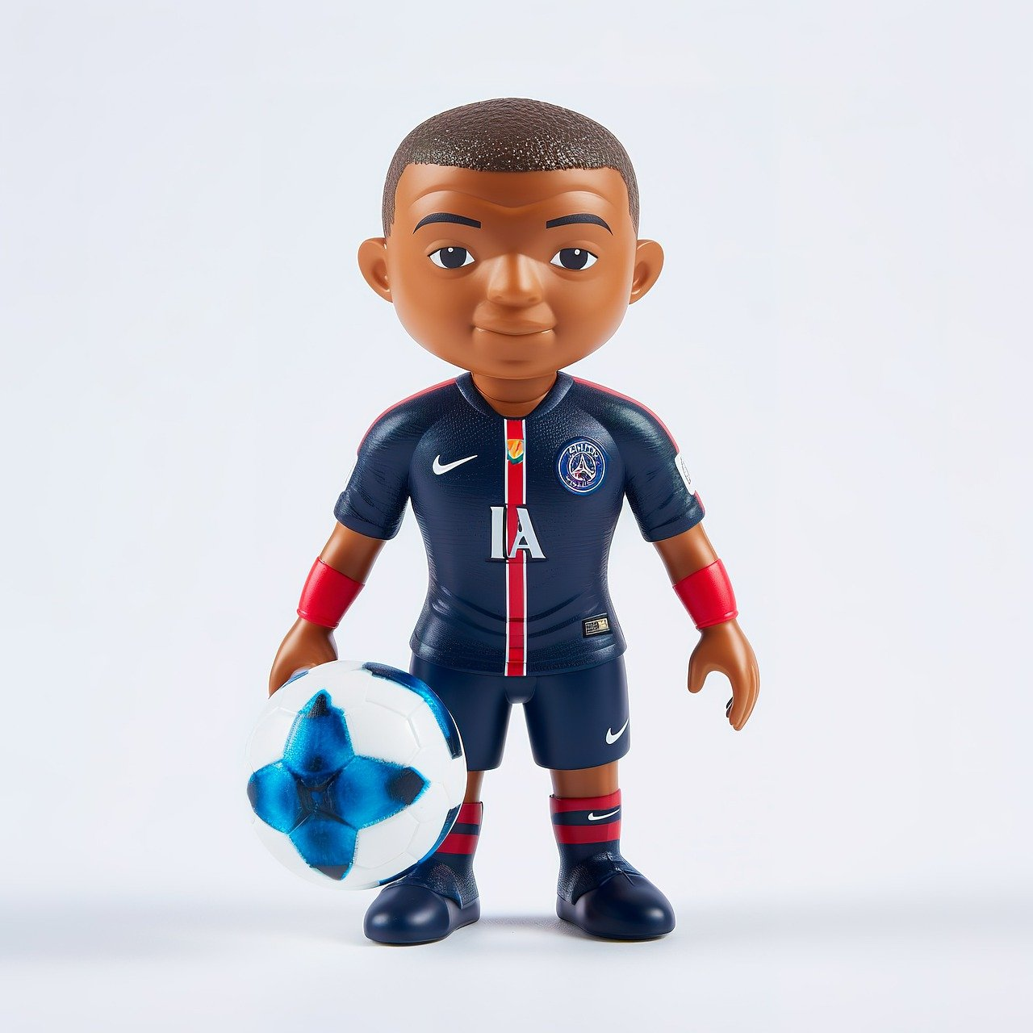
KYLIAN MBAPPE

Slide 21
Oh, already? We hope you enjoyed your first French lesson!
Voilà, c’est fini !
Au revoir !
One last thing! What did you learn today?

Slide 22
Q&A

Slide 23
JOIN OUR MAILING LIST

Slide 24

ευχαριστώ
Gracias
谢谢
Danke
Bedankt
Dziękuję
Diolch
Fa’afetai
Merci
Kiitos
Ласкаво просимо
Спасибо
Tak skal du have
Köszönjük
אדאנק
شكرًا لك
Teşekkürler
Thank you

