Slide 1
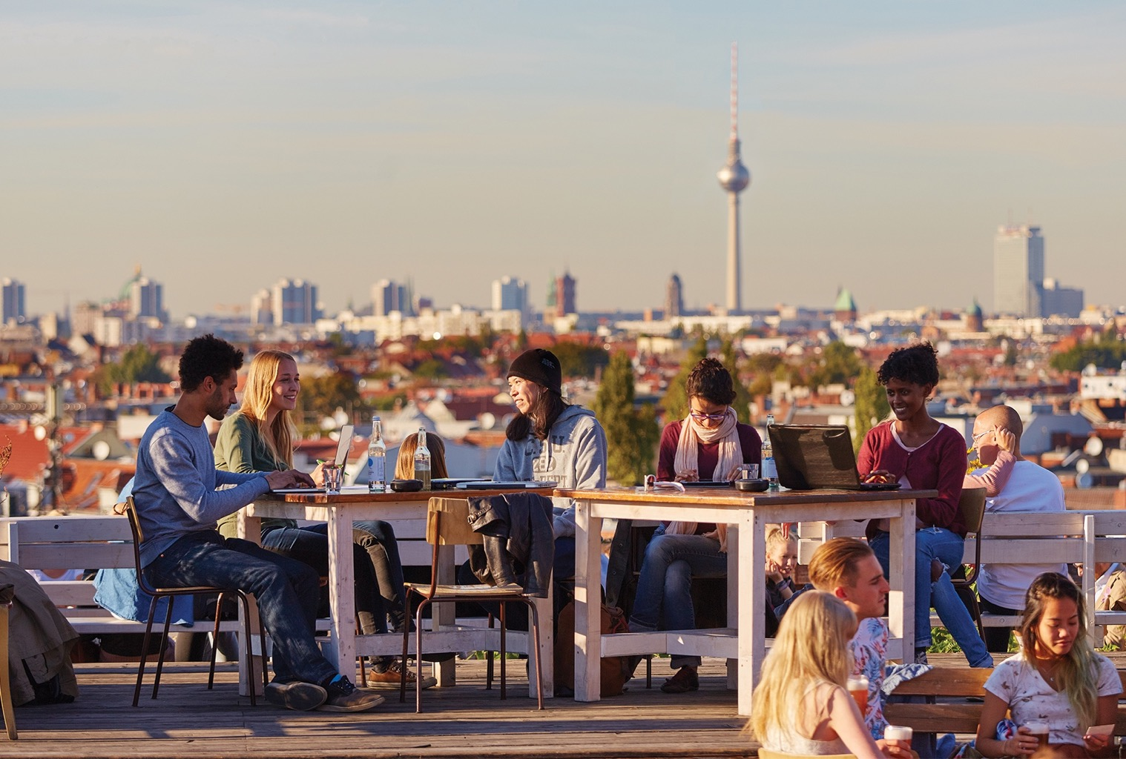

Slide 2

German American
Partnership Program (GAPP)
Jana Kosancic
Community Outreach Program Coordinator
GAPP, New York

Slide 3
Agenda
1
About GAPP
2
GAPP exchanges
3
Outcomes for your students & school
4
Eligibility requirements
5
How GAPP supports your exchange
6
Your next steps

Slide 4
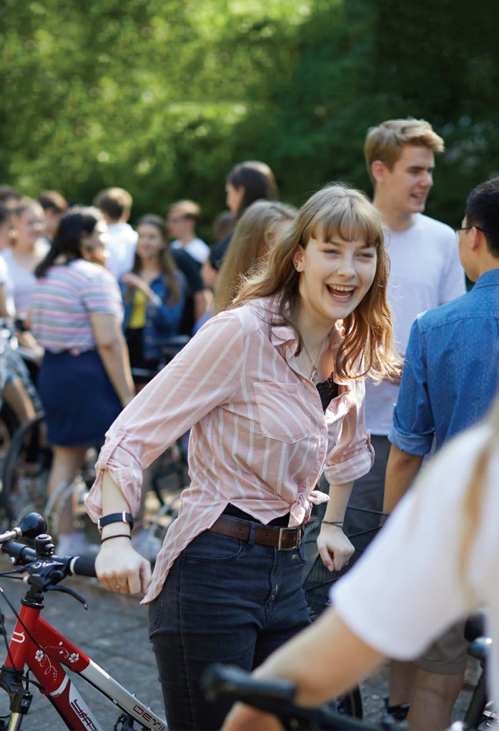
Our mission
We facilitate enriching cultural exchanges between schools in
the U.S. and Germany, inspiring intercultural understanding, promoting German language instruction, and fostering new and lasting friendships.

Slide 5
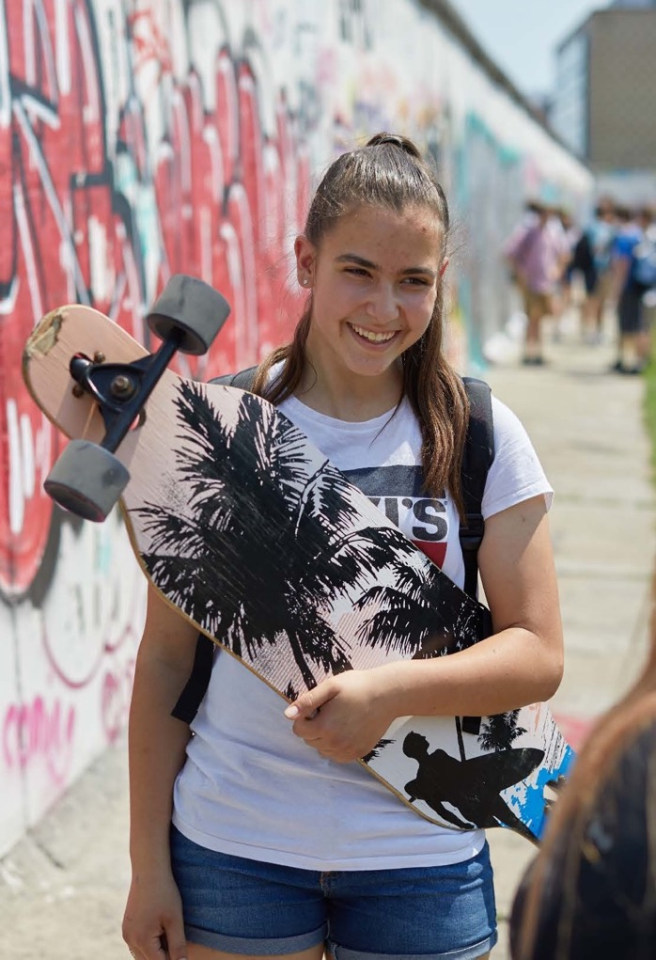
Our goals
We strengthen international friendship
We support German as a
foreign language
We build global awareness
and intercultural competencies

Slide 6
A SNAPSHOT

Slide 7
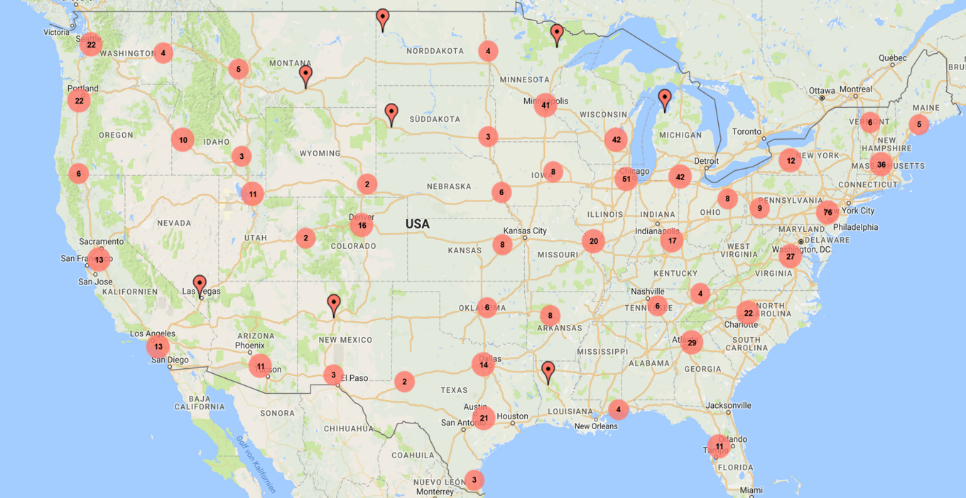
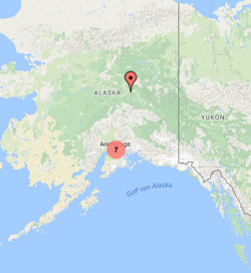
WHERE WE ARE in the U.S.

Slide 8
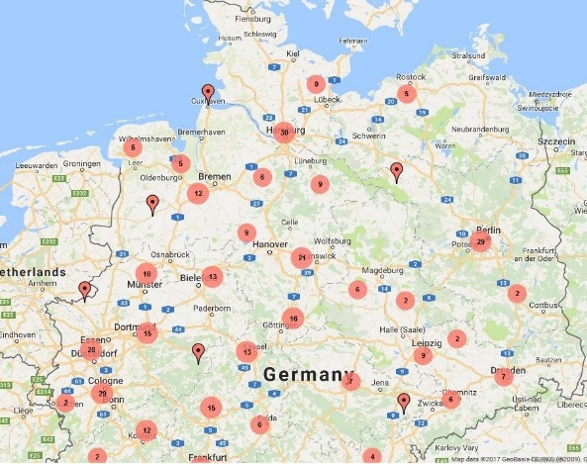
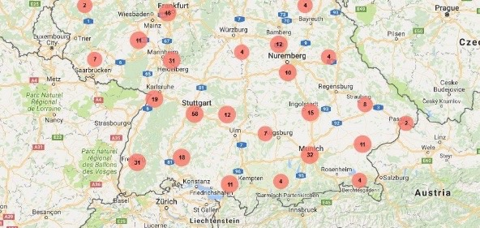
WHERE WE ARE in Germany

Slide 9




WE’RE SUPPORTED BY…

Slide 10
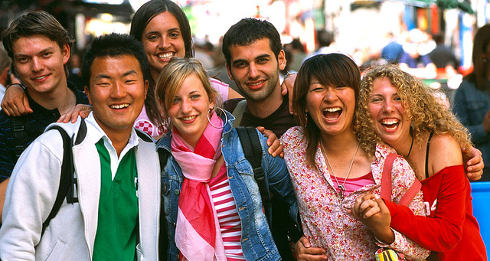
Gapp exchanges are:
1.
Immersive, and educational
2.
3.
4.
  Led by teachers
Embedded in long-term
school partnerships
Valuable for schools with
and without German programs

Slide 11
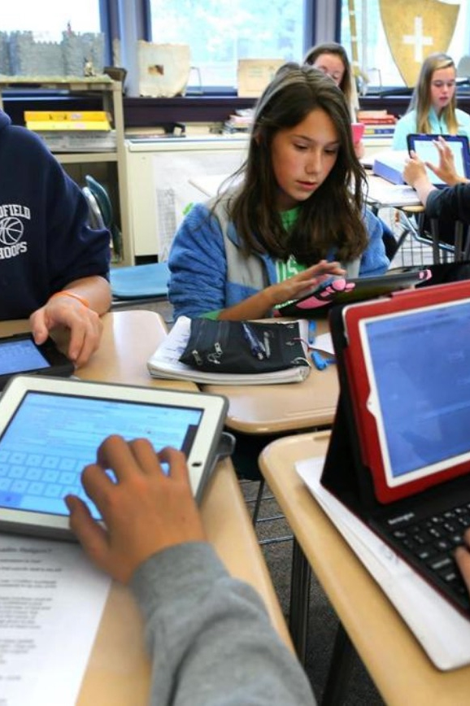
OUTCOMES FOR STUDENTS
Gain global perspective and intercultural understanding
Experience the real Germany
Boost German language skills
Develop leadership, confidence,
and independence
Form lifelong friendships
Have fun!

Slide 12

OUTCOMES FOR TECAHERS &
SCHOOLS
Strengthen German programs
Build community
Gain recognition,
and appreciation
as well as an international partner
Career opportunities

Slide 13
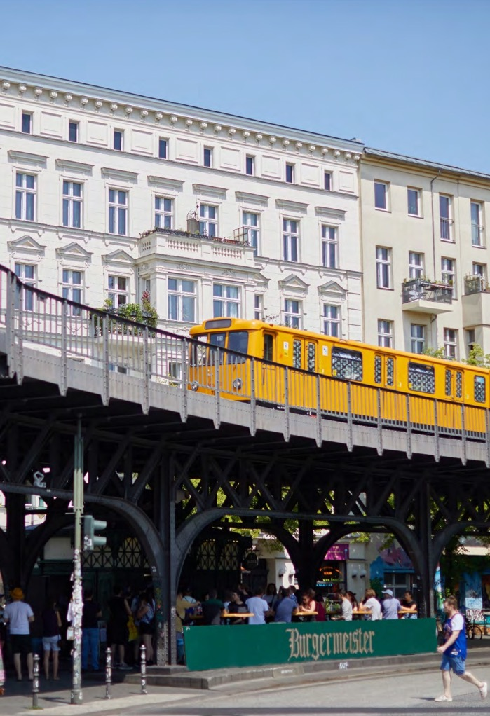
GAPP eligibility
To receive a grant:
At minimum, an exchange must include:
A 14 day trip to Germany
10 days spent with host families
5 days in school
An exchange-related theme/topic
for students

Slide 14
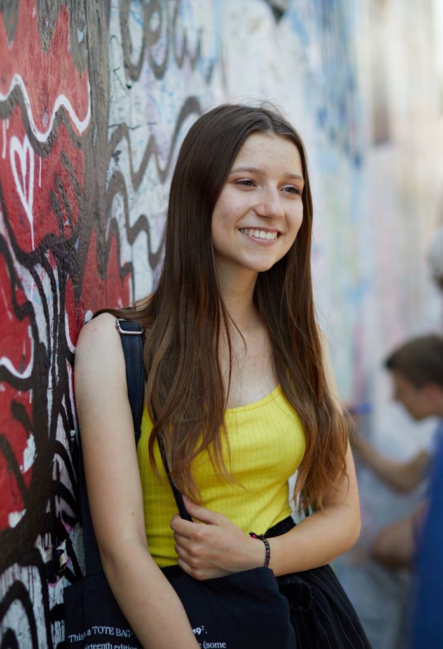
GAPP costs
About $1,200–$3,000 per student
Includes:
Travel to your partner school
Insurance
Local activities
Pocket money

Slide 15
GAPP’s financial support
We support 250+ exchanges annually, with...
Group grants
Travel grants for teachers
Individual scholarships
for students
Airfare subsidies (Lufthansa
and Icelandair)

Slide 16
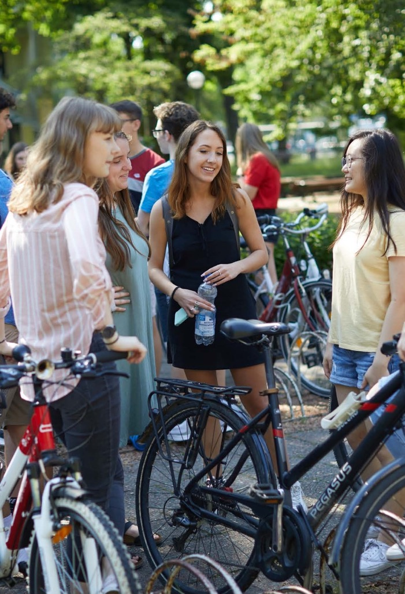
GAPP coordinator support
In-person and digital workshops
Insurance guidance
Promotional materials and templates
Support network of experienced coordinators
https://www.facebook.com/groups/GAPPteacherforum/
Online German language courses
for coordinators

Slide 17

YOUR next steps
Get your school
Excited
About Gapp
Get your parents
Excited about
GAPP
We will give
You
materials
to make
the case

Slide 18

Find your partnerschool
CREATE A PROFILE ON
www.partnerschulnetz.de
CONNECT WITH A GERMAN SCHOOL
600 + schools in
Germany
Are looking for
partners

Slide 19

Grant applications 2024
Available online: since October 31, 2023
February 21: Applications due for an early spring exchange, when traveling before April 3, 2024
April 3: For spring /summer exchange, when traveling before August 1st, 2024
June 1st: For fall/winter exchanges until December 21st, 2024

Slide 20
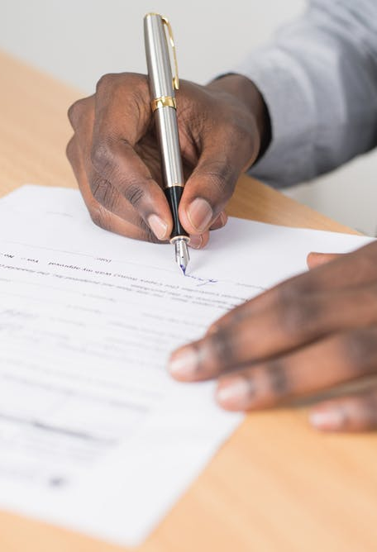
steps - Grant application 2024
1. Click on the link on our website
Short-term exchange program - Goethe-Institut USA
2. Complete the online forms and have the quote or invoice for your group’s airfare ready for digital upload
Your GAPP Grant Application is only completed once all the information and documents have been received.
Your application will be reviewed, and you will be informed about your grant status shortly after deadline

Slide 21
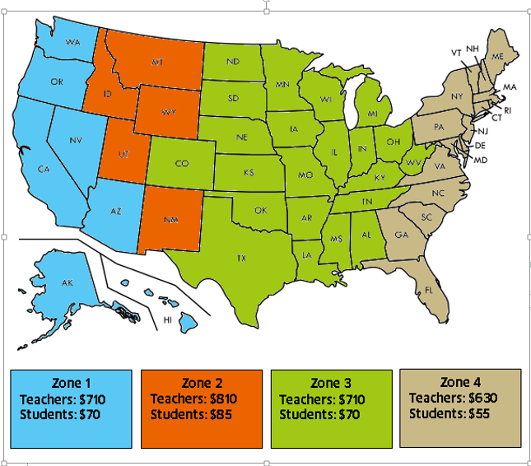
Distribution of group grants

Slide 22

What is available from gapp?
1. Teacher Grants
Up to 2 accompanying teachers receive air fare subsidies
calculated as a flat rate depending on the average regional fare.
Groups of more than 10 students are eligible for 2 teacher grants.
2. Group Grants
American and German students receive airfare subsidies depending on their region of departure.
3. Optional free Insurance
Teachers that qualify for the above teacher grants may be enrolled via the online GAPP Grant Application.
Note: GAPP New York only serves American schools.

Slide 23

What is available?
Optional Free Liability Insurance:
Enrollment can be completed via your online Grant Application. Details for coverage are available online.
In matters of liability or in case of an accident, please contact our German insurance broker and state that you are a GAPP coordinator:
Klemmer International Versicherungsmakler
Tel.:+49 (0) 8041-7606-300 –
Fax:+49 (0) 8041-7606-350
E-mail: info@klemmer-international.com

Slide 24

Individual scholarships
1. GAPP Diversity, Equity and Inclusion Scholarship
2. GAPP Future Career German(Y) Scholarship
GAPP provides approx. 500-1,000 USD per student
Teachers apply on behalf of their students
You can submit as many as you like
Please keep deadlines in mind

Slide 25

When can i expect the grant checks?
Submit your Grant Application as early as you have your full information.
GAPP cannot process or follow up on incomplete applications.
We make every effort to get your grant checks to you 10-14 days before your departure to Germany.
It is not first come first serve!

Slide 26

Social media
GAPP 101
Where you can find us on Social Media
How to get information, help and advice for your planned GAPP exchange on Social Media:
Safety
Annette Baran
Social Media Manager

Slide 27

SOCIAL MEDIA
Your exchange trip is not just a journey; it's an achievement for your students and your school. Documenting these achievements on social media allows us to celebrate your successes and acknowledge the hard work you put into organizing such an impactful program.
The easiest and fastest way to share your succesfull exchange with schools, parents and GAPP , is by using Social Media ☺
You can find us here:
Instagram, X (Twitter) and Facebook:
@gappexchanges
LinkedIn:
German American Partnership Program

Slide 28
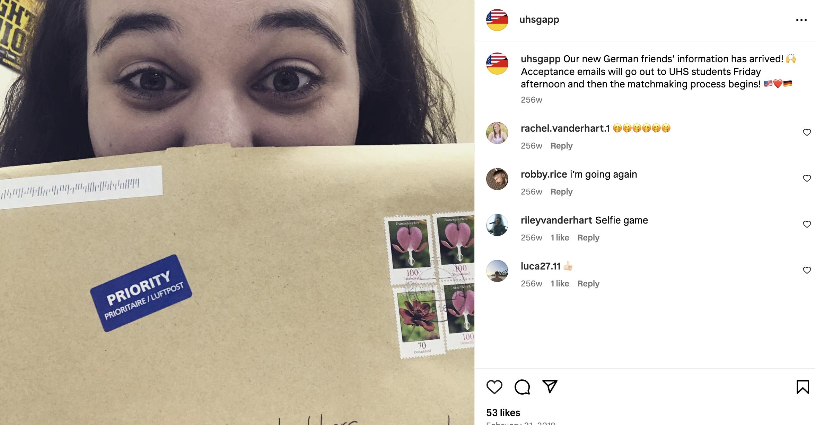
Ideas to promote educational value:
Motivation to start a channel:
Your memories will be accessible for current and past students.
For years to come, those who you allow to follow your channel can cherish those memories and
go back to the pictures whenever
they feel like it.
Ideas to post:
Countdown on your IG channel
until you‘ll see each other again
optional SM assignmet for students (diary)
personal highlights like baking with their host families,
German word of the day

Slide 29
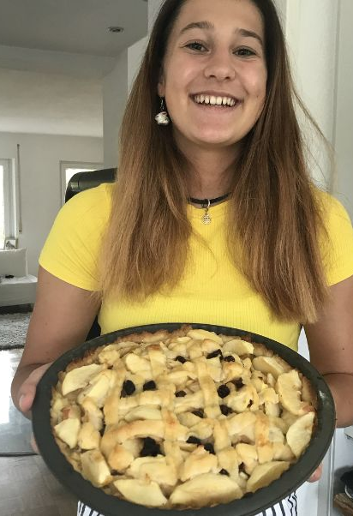
Implementing SM into you GAPP exchange
Nominating students to post daily highlights of the trip
Students can share stories, short videos & pictures of
Excursions and Cultural differences
Special moments like Arrival and Departure
Host families and lifestyle
Fundraiser & events
Tag us @gappexchanges
This way you can make sure we can see your posts
Only # wont guarantee us seeing the post
Disclaimer: Please make sure consent forms are
filled out and you have
the OK from school and parents
"Dieses Foto" von Unbekannter Autor ist lizenziert gemäß CC BY-NC

Slide 30
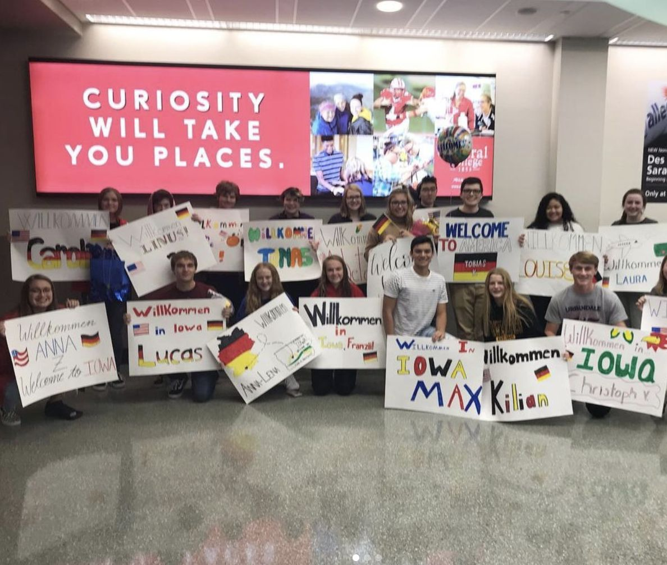
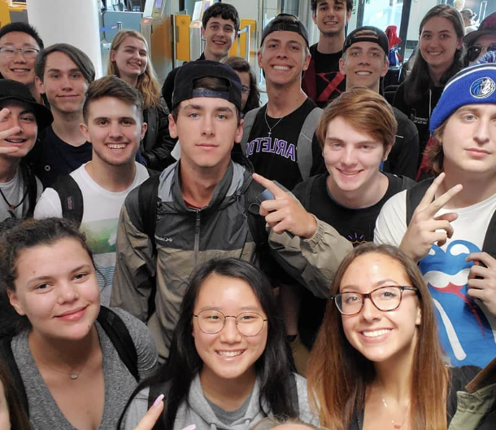
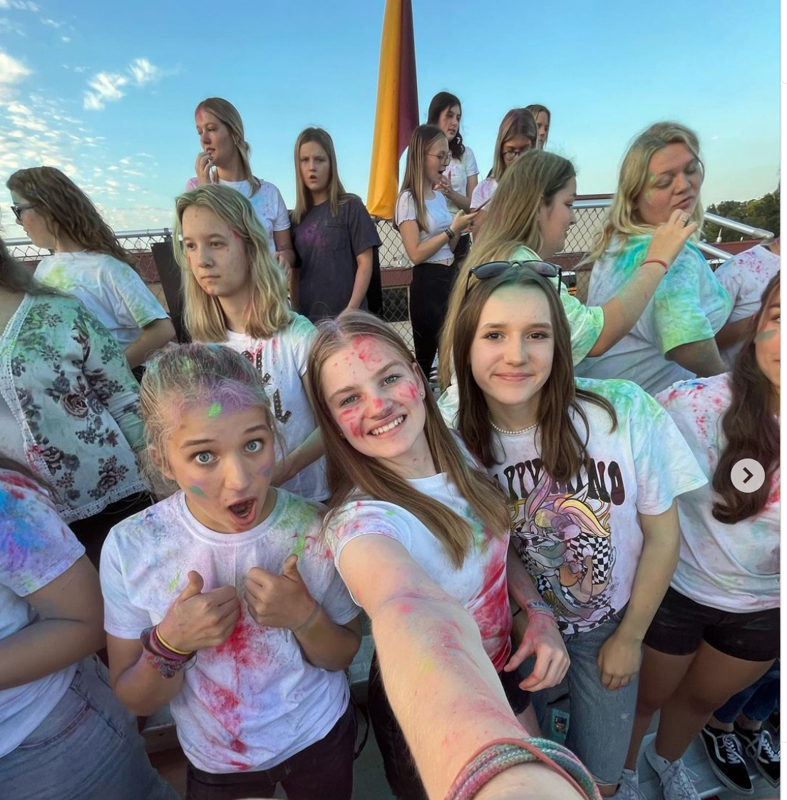
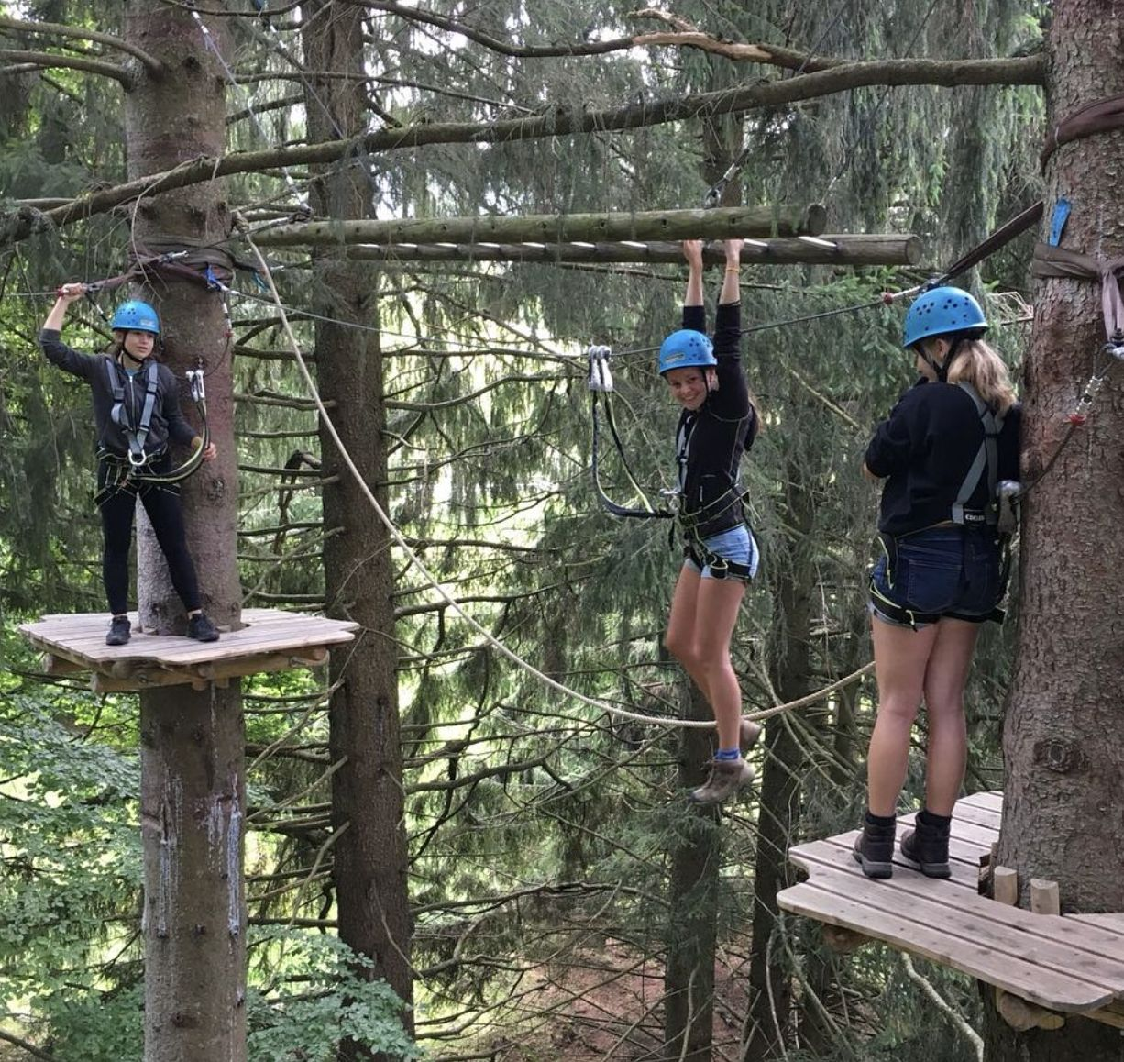
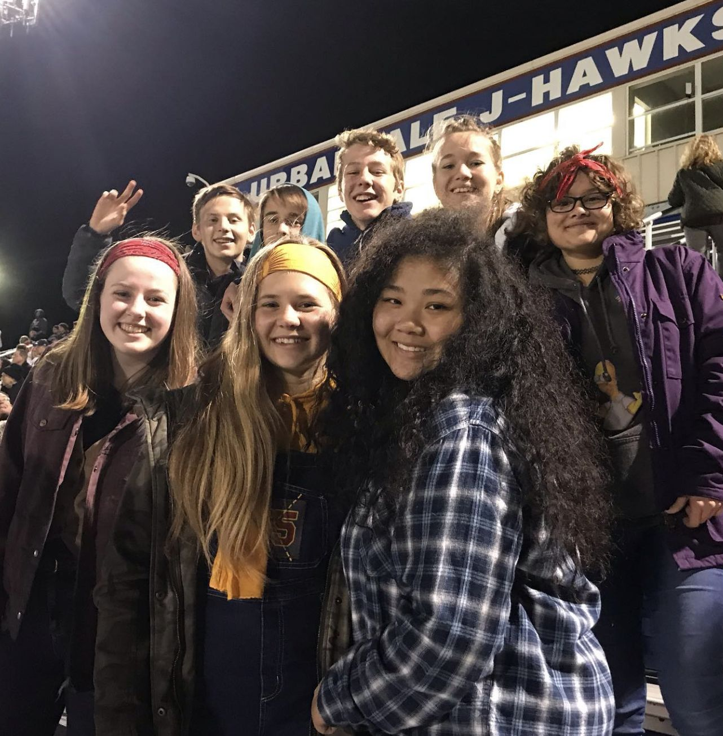
Examples

Slide 31

Combining gapp and GAVE
GAVE: Over 2,000 participants at over 200 schools in 2021-2023.
GAVE can be used as preparation for an in-person exchange
Register here:
German-American Virtual Exchange (GAVE) - Goethe-Institut USA

Slide 32
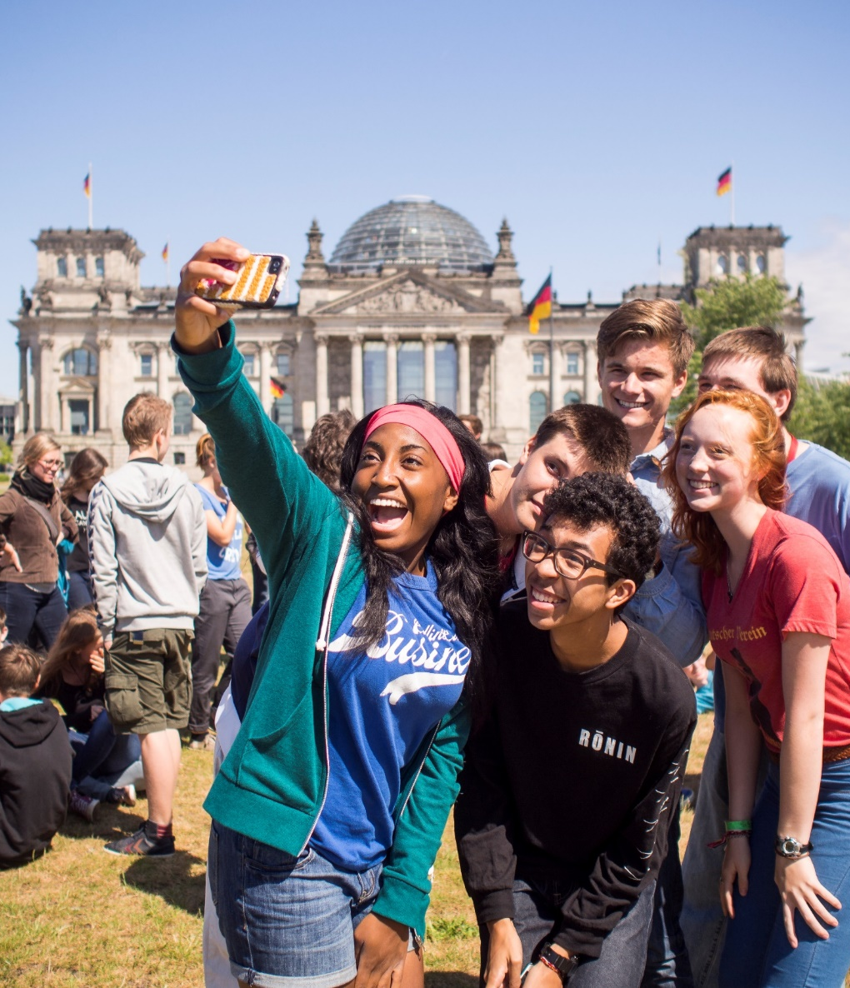

Search for alumni
Alumni will be interviewed and stories will be posted on goethe.de/GAPP. Interested alumni should contact gapp@goethe.de

Slide 33
QUESTIONS?

Slide 34

CONTACT US
Jana Kosancic
GAPP Community Outreach Program Coordinator
Jana.Kosancic@goethe.de
German American Partnership Program
c/o Goethe-Institut New York
30 Irving Place
New York, NY 10003, USA
goethe.de/GAPP

Slide 35
THANK YOU!
DANKESCHÖN!

