Slide 1
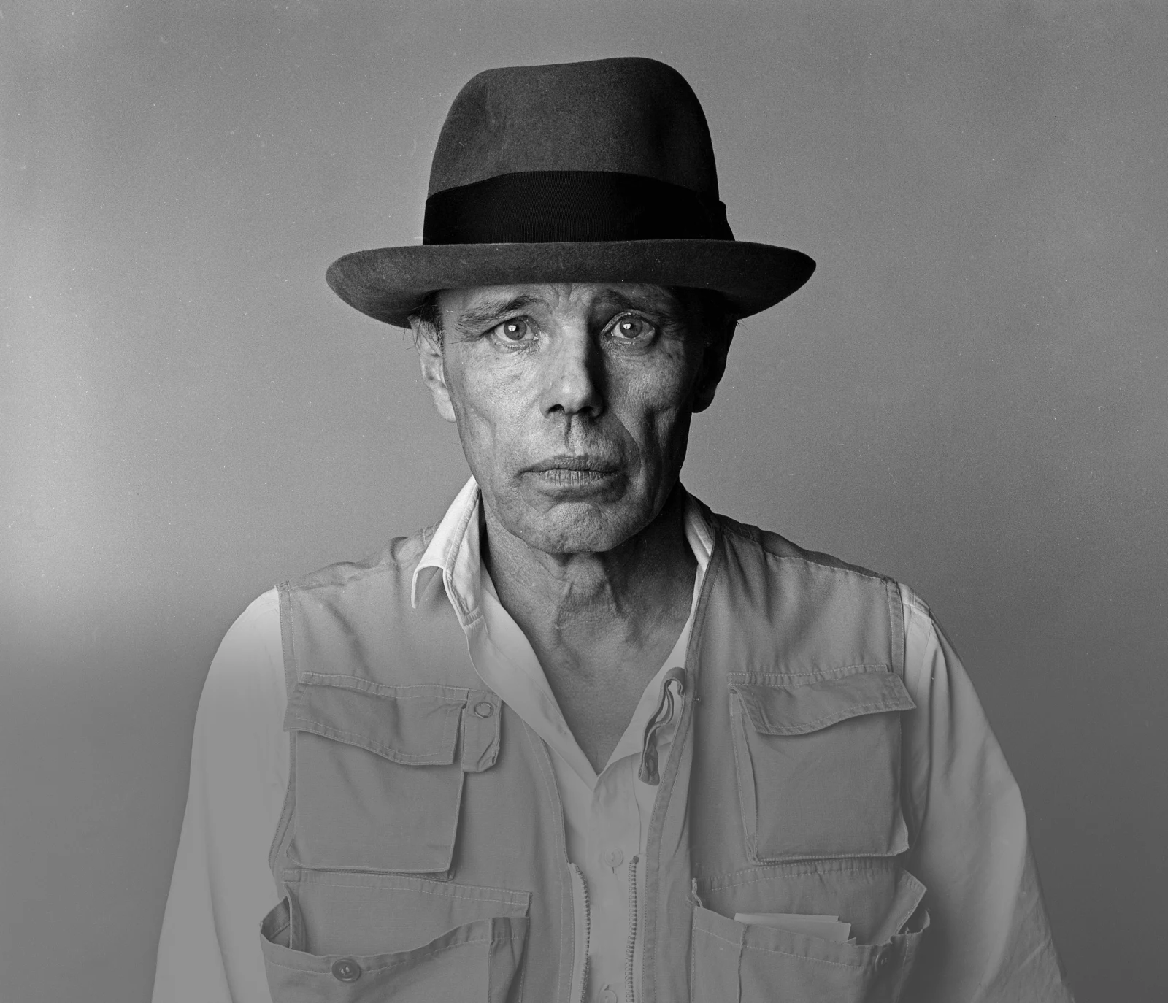
AFTERSCHOOL
PROGRAM:
BE BEUYS
Session 10 - Datum

Slide 2
WELCOME TO SESSION 10
PLEASE ACTIVATE
MICROPHONE
WEBCAM

Slide 3
WELCOME TO SESSION 10
MICROPHONE TEST
Today is our last lesson: How are you feeling?
WE CAN HEAR YOU.
WE CANNOT HEAR YOU.

Slide 4

Willkommen zu Sitzung 10
Mikrofon TEST
Heute ist unsere letzte Stunde: Wie fühlst du dich?
WIR KÖNNEN DICH HÖREN.
WIR KÖNNEN DICH NICHT HÖREN.

Slide 5

GOALS FOR TODAY
You understand the role of PR in Beuys life and work.
You create a social media post about your project.
You reflect on our afterschool program.

Slide 6






PROGRAM OVERVIEW
1 MIN
FIND OUT WHERE WE ARE IN OUR PROGRAM.
Find a Cause you’re Passionate About!
Choose Materials and Places that Matter to you!
Create your Brand and Art Persona!
Finalize and Present your Project Plan!
Share your Project in a Social Media Post!

Slide 7
AGENDA
STEPS | TIME | CONTENT
Step 1 | 5 Minutes | Arrival
Step 2 | 10 Minutes | Warm-Up: Social Media
Step 3 | 15 Minutes | Input: The role of PR in Beuys Life
Step 4 | 20 Minutes | Miro Task: Social Media Post
Step 5 | 7 Minutes | Voting
Step 6 | 20 Minutes | Final Reflection & Goodbye

Slide 8


WARM-UP: SOCIAL MEDIA
8 MIN
DISCUSS THE QUESTIONS IN YOUR GROUP.
Screenshot
Which social media do you use? For what?
How much time do you spend daily on social media?

Slide 9
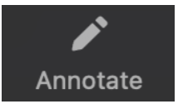






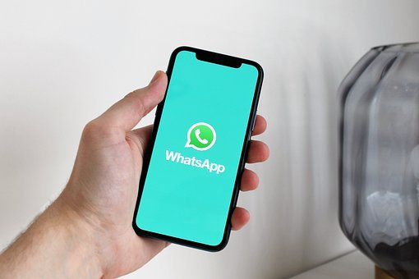

WARM-UP: SOCIAL MEDIA
2 MIN
WHAT SOCIAL MEDIA DO YOU USE?
Other channels

Slide 10
WARM-UP: SOZIALE MEDIEN
8 MIN
DISKUTIERT DIE FRAGE IN EURER GRUPPE.
Screenshot
Welche Sozialen Medien benutzt du?
Wofür benutzt du sie?
Wie viel Zeit verbringst du täglich auf sozialen Medien?

Slide 11
WARM-UP: SOZIALE MEDIEN
2 MIN
WELCHE SOZIALEN MEDIEN BENUTZT DU?
Andere Soziale Medien

Slide 12


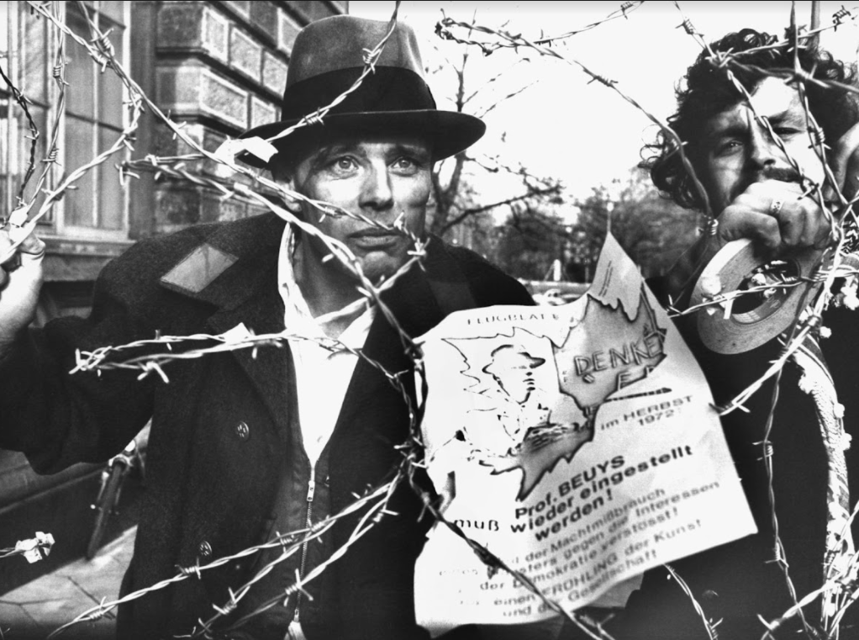
THE ROLE OF PR IN BEUYS LIFE
6 MIN
WATCH THE TRAILER AND TAKE NOTE.
Social Media did not exist during Beuys’ lifetime. Which media channels did Beuys use for his PR?
Watch the trailer of the movie “Beuys” and take notes of all media channels you see in the movie.

Slide 13




THE ROLE OF PR IN BEUYS LIFE
8 MIN
READ THE FIRST PART OF THE TEXT AND DISCUSS THE QUESTIONS.
Joseph Beuys had a very strong media presence. He was often mentioned in newspaper articles and frequently appeared on TV or on the radio. His media presence increased over the years: In 1974 Beuys appeared 30 times in the media, e.g., in discussions, interviews, and speeches. By 1979 this number had increased to 50. At this time, this was a huge media presence and Beuys could have been described as an influencer. The media provided insights into his workshop and work, interpretations of his work, and autobiographical information. For the most part, however, the media covered Beuys opinion and comments on social, ecological, economic, educational, and political questions and his understanding of art.
What do you think:
Why was the press so interested in Joseph Beuys?
And why was Beuys so interested in the press?

Slide 14
THE ROLE OF PR IN BEUYS LIFE
8 MIN
READ THE SECOND PART OF THE TEXT AND COMPARE THE EXPLANATIONS TO YOUR OWN.
The media was interested in Beuys life and work because his art and thinking were groundbreaking for this time. Beuys questioned existing structures and concepts and challenged the understanding of art. He created something new and thought provoking. Beuys polarized and provoked. Beuys also had a high recognition value: He always wore a felt hat and his fishing vest.
Beuys used the media for branding himself as an artist. For him, debates, lectures and discussions about his work and concepts were as important as his work. He described this concept as 'parallel process'. Beuys wanted to reach and engage a larger audience. He wanted to provoke the society to think about his art, and art in general and he used the media to convey his social, political, ecological, economic and educational messages. Beuys wanted to leave a legacy and change the world through his art.

Slide 15





OUR SOCIAL MEDIA POST
10 MIN
YOUR PROJECT HAS BEEN SUCCESSFULLY EXECUTED. NOW, IMAGINE WHAT YOU WANT TO SEE WRITTEN ABOUT YOUR ACTION. DISCUSS THE QUESTIONS AND PREPARE A SOCIAL MEDIA POST ABOUT YOUR PROJECT. QUESTIONS.
Which (social) media channel do you want to choose for your art project?/ Why?
How do you want others to perceive your project (your topic, materials, objects, places and characters?)
How can you communicate this via social media?
What impact did your project leave?/ How could the world be different after hearing about your project?

Slide 16








MIRO TASK: OUR SOCIAL MEDIA POST
10 MIN
CREATE YOUR SOCIAL MEDIA POST.
After discussing the questions, start drafting your post using any media forms you like (images, video, text, drawing…) and post it on Miro.

Slide 17




VOTING
7 MIN
CHECK OUT WHAT THE OTHER TEAMS CAME UP WITH. AWARD THREE GROUPS. TALK TO YOUR GROUP ABOUT YOUR CHOICES.
You can award one badge of each category to a team of your choice.
Do not award your own project.
Place the badge in the area marked with the dotted line.

Slide 18


PROJECT REFLECTION
Hinweis an die LK:
Ergänzen Sie ein QR für die Word Cloud hier
10 MIN
REFLECT ON THE QUESTION.
his groundbreaking art
During the last 10 weeks you got to know the artist, Joseph Beuys. What fascinates you about Joseph Beuys? Add your thoughts to the word cloud.
his choice of materials

Slide 19
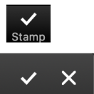
GOALS FOR TODAY
You understand the role of PR in Beuys life and art.
You created a social media post about your art project.
You reflected on our afterschool program.

Slide 20
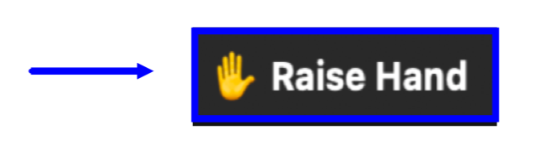









PROJECT REFLECTION
7 MIN
WHAT DID YOU LIKE THE MOST ABOUT OUR AFTERSCHOOL PROGRAM?
I liked the most that…

Slide 21

THANK YOU FOR YOUR PARTICIPATION!

Slide 22
SCHEIDEMANN, R. (1973, OCTOBER 20). JOSEPH BEUYS IN A LOG-BOAT.[PHOTOGRAPH]. ČTK/DPA, DÜSSELDORF.
MÜLLER, B. (1972, NOVEMBER 23). JOSEPH BEUYS. MASCHENDRAHTZAUHN. [PHOTOGRAPH]. DPA, DÜSSELDORF.
WEIß, P. (2021, Juli 1). BEUYS IN DEN MEDIEN. SPRINGERLINK - RETRIEVED NOVEMBER 14, 2021, from mhttps://link.springer.com/chapter/10.1007/978-3-476-05792-1_24.
CITATIONS

