Slide 1
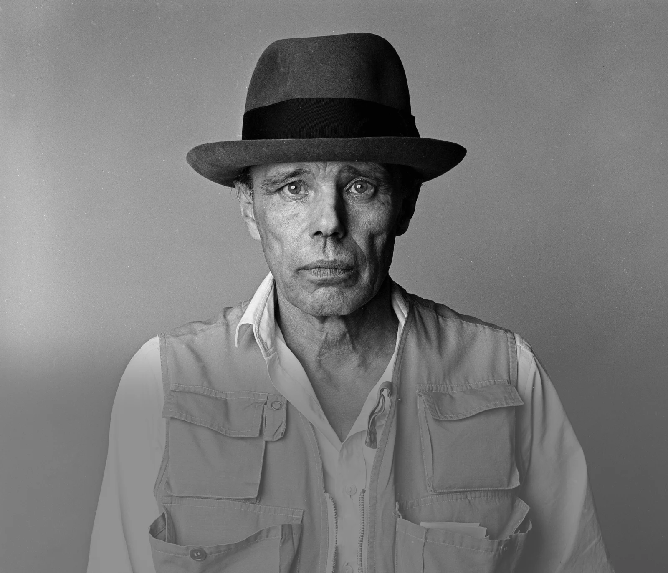
AFTERSCHOOL
PROGRAM:
BE BEUYS
Session 1 - Datum

Slide 2
WELCOME TO SESSION 1
PLEASE ACTIVATE
MICROPHONE
WEBCAM

Slide 3
WELCOME TO SESSION 1
MICROPHONE TEST
How are you?
WE CAN HEAR YOU.
WE CANNOT HEAR YOU.

Slide 4

Willkommen zu Sitzung 1
Mikrofon TEST
Wie geht es dir?
WIR KÖNNEN DICH HÖREN.
WIR KÖNNEN DICH NICHT HÖREN.

Slide 5
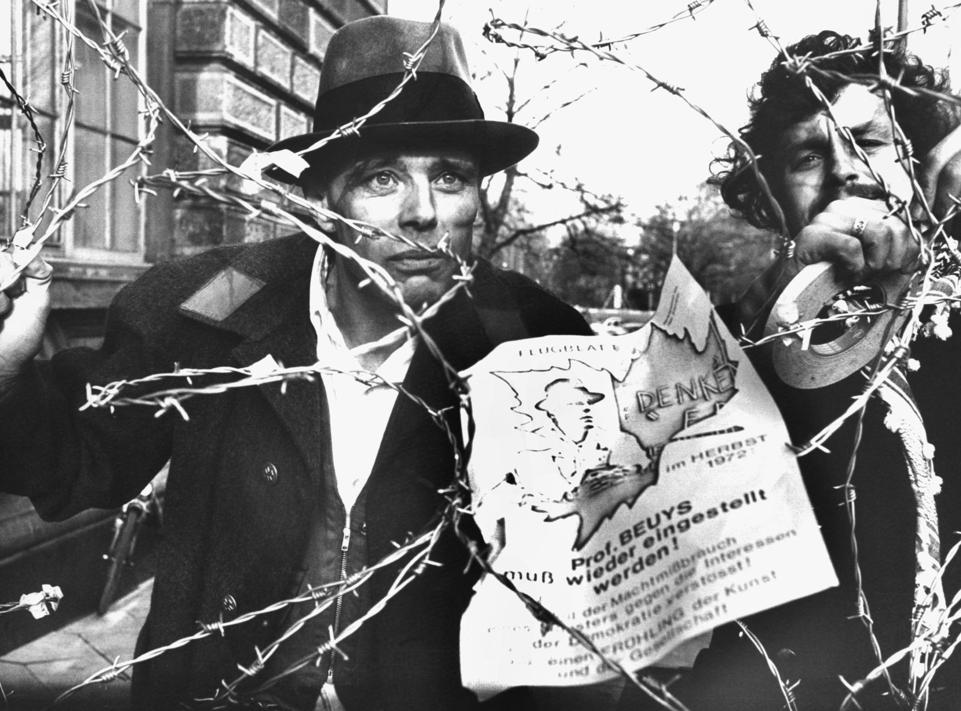
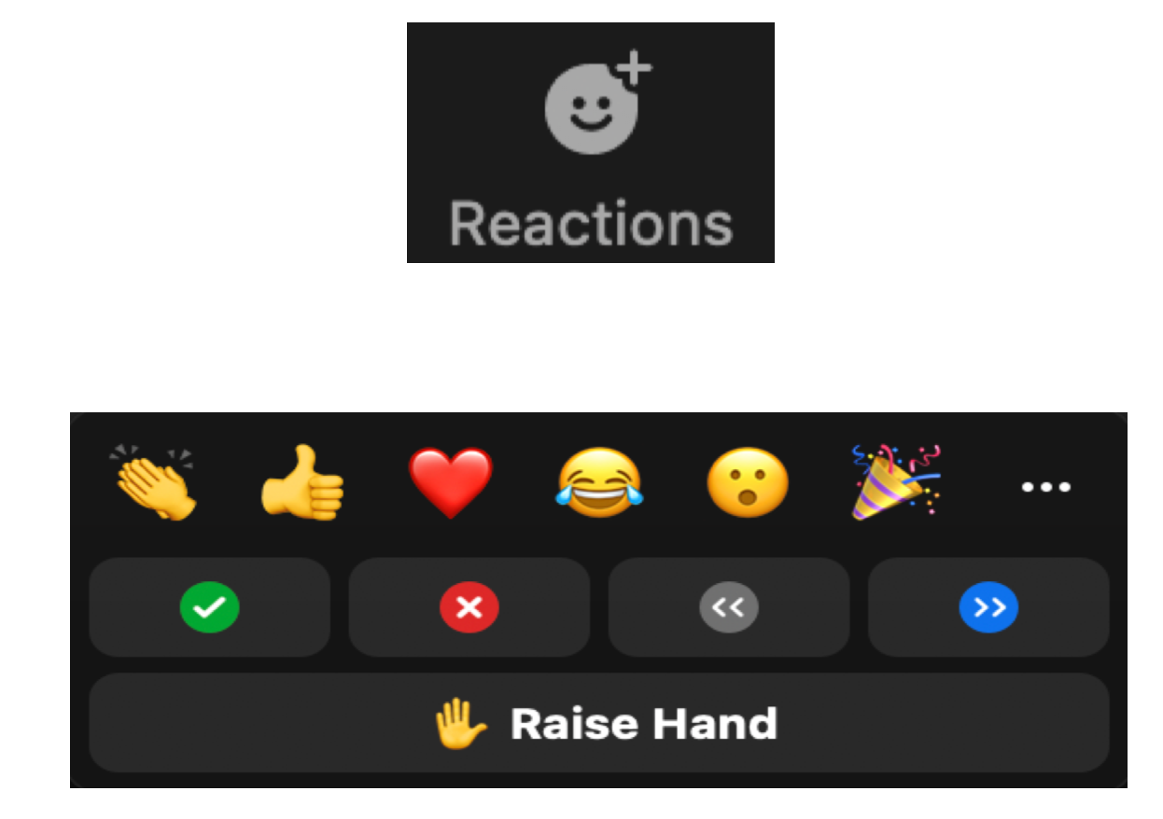
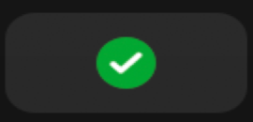
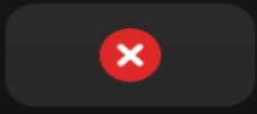
WELCOME TO SESSION 1
HOW TO COMMUNICATE ON ZOOM - I
Have you heard about Joseph Beuys before?

Slide 6
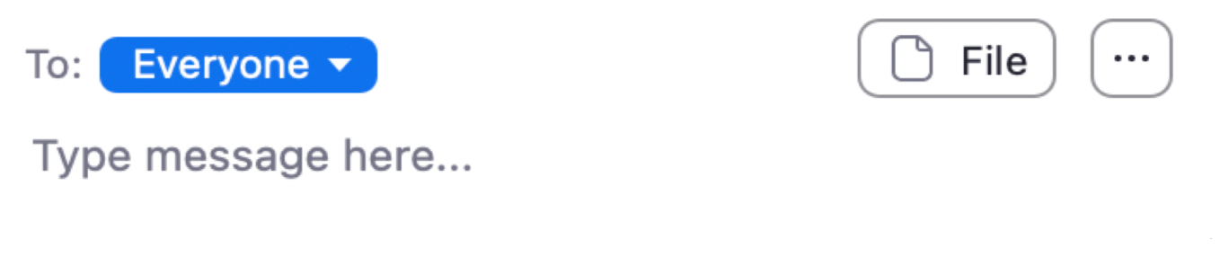

WELCOME TO SESSION 1
HOW TO COMMUNICATE ON ZOOM - II
You can always write questions into the chat:
OR SIMPLY RAISE YOUR HAND:

Slide 7
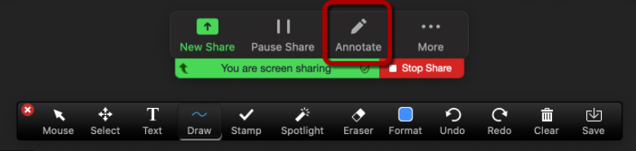
WELCOME TO SESSION 1#
HOW TO COMMUNICATE ON ZOOM - III
You can also use annotate to write, draw or stamp on the slides:
Write your name in the box.

Slide 8
WELCOME TO SESSION 1#
HOW TO COMMUNICATE ON ZOOM - III
You can also use annotate to write, draw or stamp on the slides:
Draw a smiley in the box.

Slide 9
WELCOME TO SESSION 1#
HOW TO COMMUNICATE ON ZOOM - III
You can also use annotate to write, draw or stamp on the slides:
Stamp in the box.

Slide 10
GOALS FOR TODAY
YOU GET TO KNOW EACH OTHER.
YOU REFLECT ON YOUR ART PREFERENCES.
→
→

Slide 11
AGENDA
STEPS | TIME | GAME
Step 1 | 10 Minutes | Arrival & Zoom Tutorial
Step 2 | 12 Minutes | Getting to Know Each Other
Step 3 | 8 Minutes | Introduction to the Project Goals and to Miro
Step 4 | 38 Minutes | Group Discussion: Art Preferences
Step 5 | 7 Minutes | Reflection, Preview & Goodbye

Slide 12


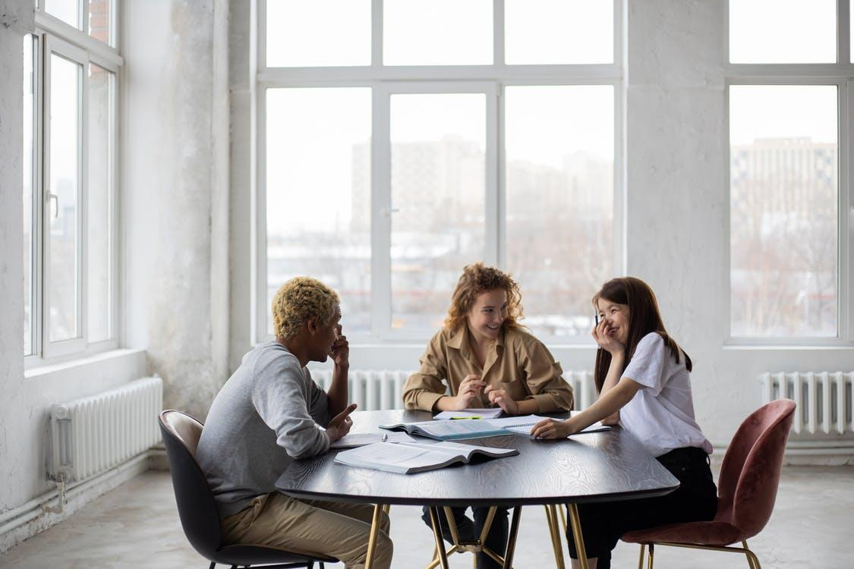

GETTING TO KNOW EACH OTHER
8 MIN
INTRODUCE YOURSELF IN TWO DIFFERENT GROUPS.
Round I – 3 Min
Round II – 3 Min
Where do you live?
What are your hobbies?
Why did you join this afterschool program?
Screenshot

Slide 13
KENNENLERNEN
8 MIN
STELL DICH IN ZWEI GRUPPEN VOR.
Runde I – 3 Min
Runde II – 3 Min
Wo wohnst du?
Was sind deine Hobbys?
Warum bist du hier?
Screenshot

Slide 14
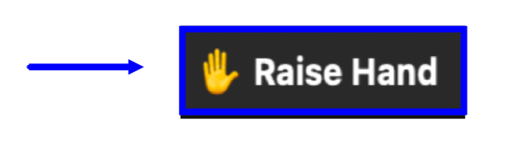
GETTING TO KNOW EACH OTHER
4 MIN
PRESENT ONE INTERESTING FACT ABOUT ONE PARTICIPANT.
I talked to __________ . S/he …

Slide 15
KENNENLERNEN
4 MIN
PRÄSENTIERT EINE INTERESSANTE INFORMATION ÜBER
EINE PERSON.
Ich war in der Gruppe mit _________ .
Er/ Sie…
Ich habe mit ____________ gesprochen.
Er/Sie …

Slide 16




OVERVIEW: PROGRAM OBJECTIVES
3 Min
Listen to our program‘s objectives.
Get to know the German artist Joseph Beuys and his art.
Follow in Beuys’ steps and plan a socially relevant art project.
Present your project plan at the end of our program.

Slide 17


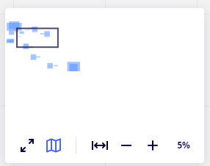
INTRODUCTION TO MIRO
7 MIN
GET TO KNOW THE MAIN FUNCTIONS OF MIRO.
Arrow: Select.
Klick on the arrow to activate the hand function:
Hand: Move the board
Textbox: Write on the board.
Zoom: Zoom in and out.

Slide 18

INTRODUCTION TO MIRO
7 MIN
GET TO KNOW THE MAIN FUNCTIONS OF MIRO.
Insert a picture on the Miro Board:
Search a picture or link on google.
Copy the picture or link (CtrC).
Paste it on the Miro Board (CtrV).

Slide 19

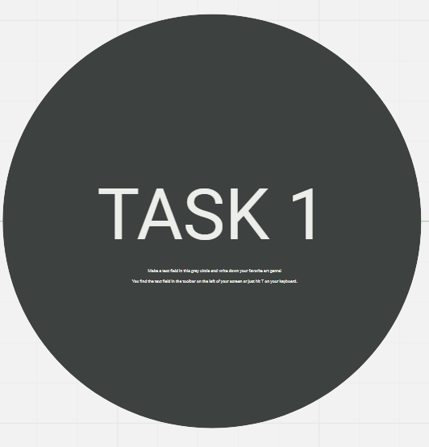

GROUP ACTIVITY 1: ART GENRES
12 MIN
DISCUSS THE QUESTION IN YOUR GROUP.
What is your favorite art genre?

Slide 20
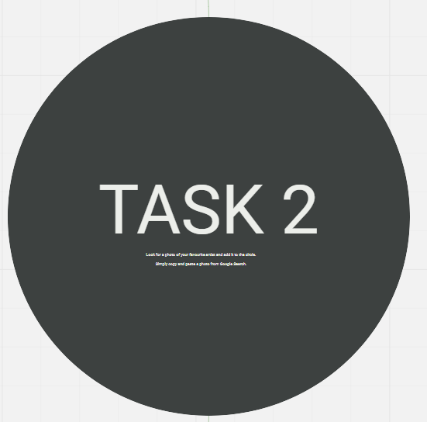

GROUP ACTIVITY 2: ARTISTS
12 MIN
DISCUSS THE QUESTION IN YOUR GROUP.
Who is your favorite artist?

Slide 21
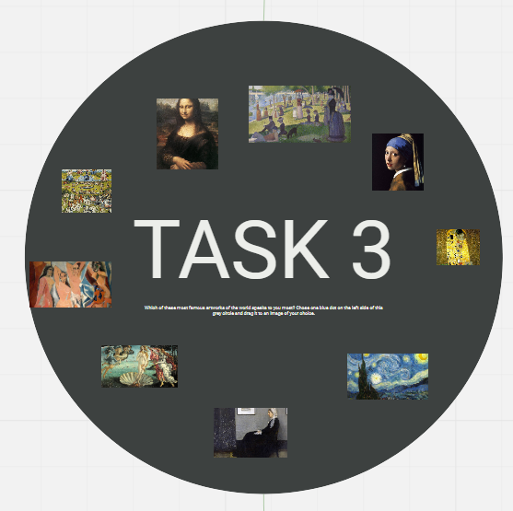

GROUP ACTIVITY 3: ART WORKS
12 MIN
DISCUSS THE QUESTION IN YOUR GROUP.
Which of these famous art works speaks to you most?

Slide 22

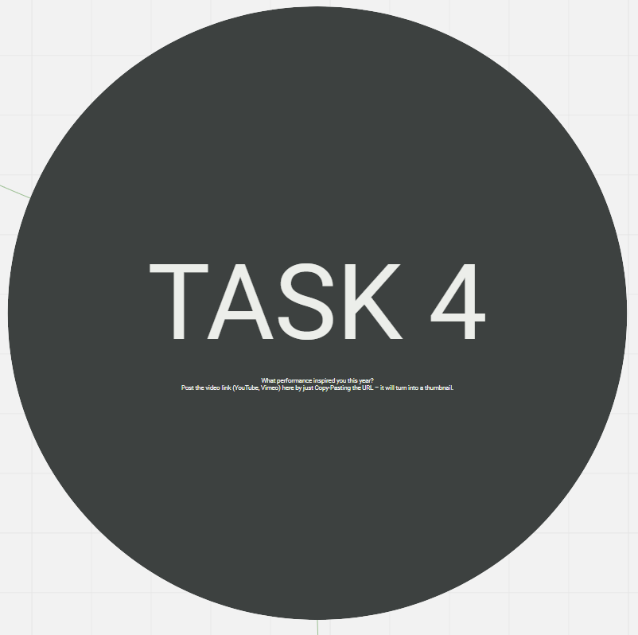

OPTIONAL: TASK 4
10 MIN
OPTIONAL: COMPLETE TASK 4 AT HOME.
What performance inspired you this year?

Slide 23
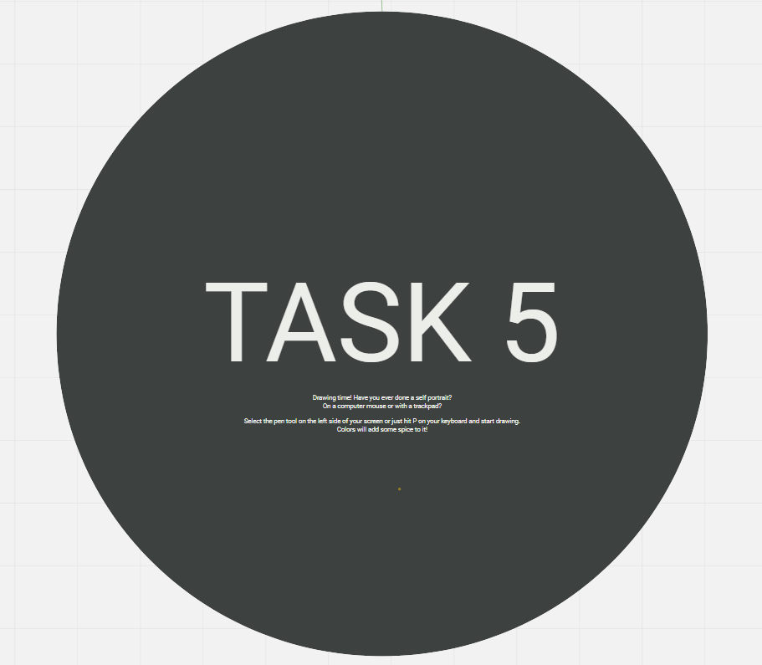

OPTIONAL: TASK 5
10 MIN
OPTIONAL: COMPLETE TASK 5 AT HOME.
Have you ever done your own self portrait? On a computer mouse or on a trackpad? Draw your own self portrait and post it in the gray circle.

Slide 24
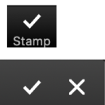
GOALS FOR TODAY
WE GOT TO KNOW EACH OTHER.
WE REFLECTED ON OUR ART
PREFERENCES.

Slide 25
REFLECTION
3 MIN
ANSWER THE QUESTION.
Which activity did you like most today? Why?

Slide 26
PREVIEW: SESSION 2
Who was Joseph Beuys?
You will learn about the artist and his art.

Slide 27
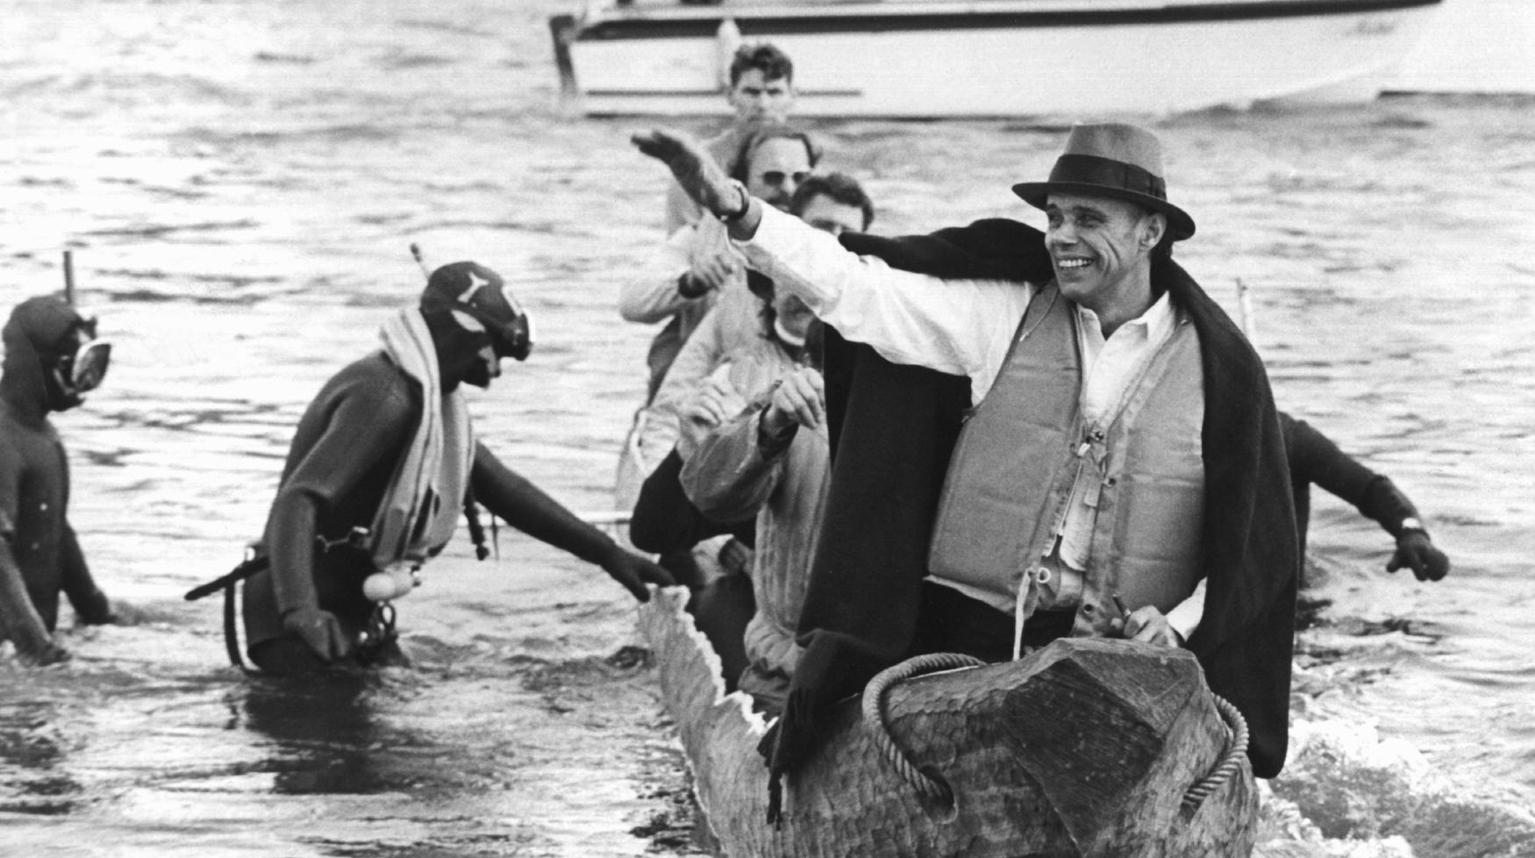
SEE YOU NEXT WEEK!

Slide 28
Schneidermann, R. (1973, OCTOBER 20). JOSEPH BEUYS ARTIST 01[PHOTOGRAPH]. DPA.
Müller, B. (1972, November 23). Joseph Beuys Maschendrahtzaun[Photograph]. DPA, Düsseldorf.
CITATIONS

