Slide 1
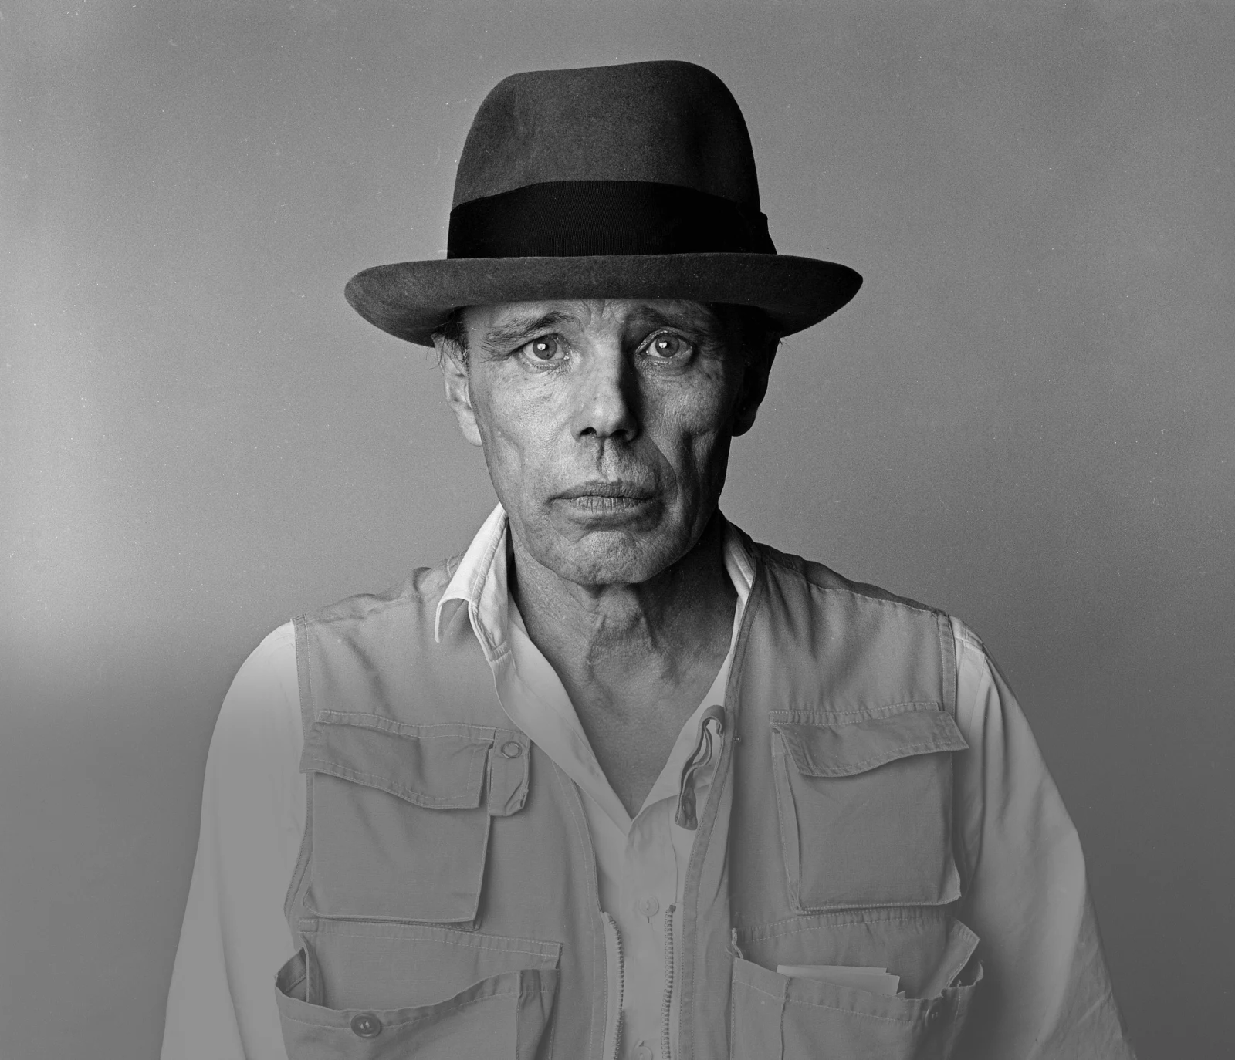
Afterschool Program: Be Beuys
Session 2 - Datum

Slide 2
Welcome to Session 2 Please activate
Microphone
Webcam

Slide 3
Welcome to Session 2 Microphone test
Which art genre do you not like at all?
We can hear you.
We canNOT hear you.

Slide 4

Willkommen zu sitzung 2 Microphone test
Welches Kunstgenre gefällt dir gar nicht?
We can hear you.
We canNOT hear you.

Slide 5
Goals for today → You learn important facts about the artist Josep beuys. → You get to know some of beuys’ most significant works of art → You present one of Beuys’ Artworks

Slide 6
Agenda
Steps | Time | Goal
Step 1 | 7 Minutes | Arrival
Step 2 | 8 Minutes | Warm-Up: Getting to Know Each Other
Step 3 | 25 Minutes | The Life of Joseph Beuys
Step 5 | 30 Minutes | Expert groups: Beuys‘ works of art
Step 6 | 5 Minutes | Reflection, Preview und Goodbye

Slide 7

Warm-up: Getting to know each other 5 Min CHOOSE one of the questions AND DISCUSS IT in your group.
What role does art play in your everyday life? Is it important to you or are you new to the field?
Which art performance inspired you this year (concert, art show, museum …)?
Did you draw a self—portrait after last class? What was the process/result like?
Tip: For questions 2 & 3 you can share your findings/results via screensharing.

Slide 8
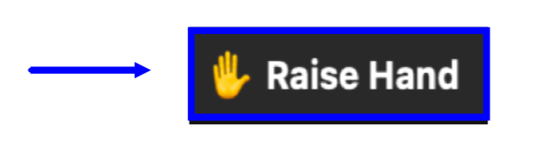
Warm-up: Kennenlernen 3 Min What did your group discuss? Present.
Our Group discussed question ___ …
(JOSEPH BEUYS)

Slide 9


The Life of Joseph Beuys 1 Min HAVE YOU HEARD OF JOSEPH BEUYS BEFORE? ANSWER THE POLL.
(JOSEPH BEUYS)

Slide 10

The Life of Joseph Beuys 5 Min What do you know about joseph beuys? Write down your ideas.
artist

Slide 11
Das Leben von Joseph Beuys 5 Min Was wisst ihr über joseph beuys? Notiert eure Ideen.
der Künstler

Slide 12


The Life of Joseph Beuys 8 Min watch the video and take notes on the worksheet.
Download the worksheet.
Watch out for bonus questions.
You may not find all relevant information in the video.

Slide 13

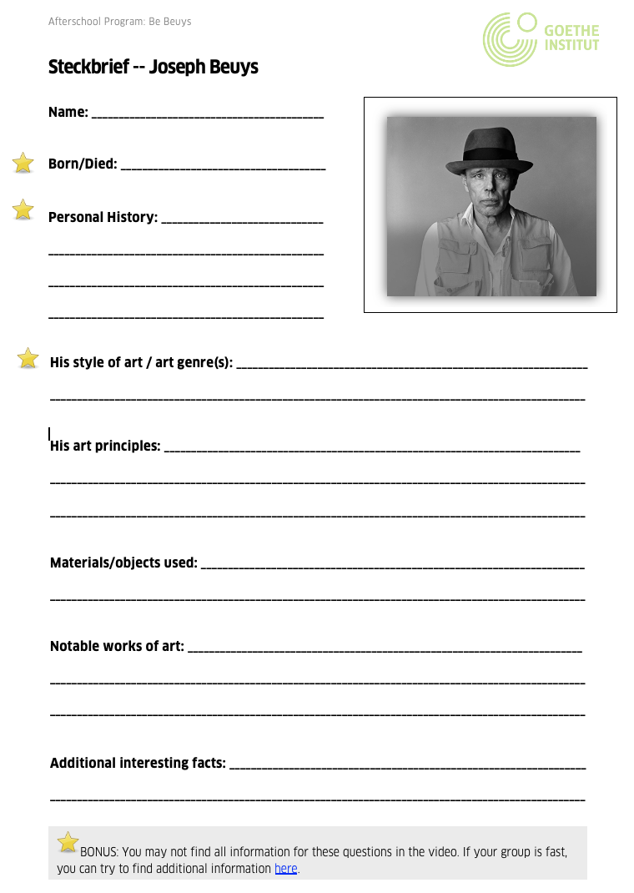
The Life of Joseph Beuys 8 Min discuss your notes with a partner & complete the worksheet.
You can research the bonus questions if your team is fast!

Slide 14

The Life of Joseph Beuys 3 Min Briefly respond to the questions.
Which bonus information did you find out about Beuys?
Did your team
still have any
questions?

Slide 15

Expert groups: Beuys’ works of art 15 Min explore one of Beuys‘ artworks in your group.
Write your name next to the artwork you want to research.
Download the worksheet for your group.
Group 1 (Dead Hare): ________________________________
Group 2 (The Fat Corner): ____________________________
Group 3 (7000 Oaks): ________________________________
Group 4 (I like America): _____________________________
(JOSEPH BEUYS)

Slide 16

Expert groups: Beuys’ works of art 12 Min Present the artwork you researched in your new group.
Each person has 3 Minutes to present.
(JOSEPH BEUYS)

Slide 17
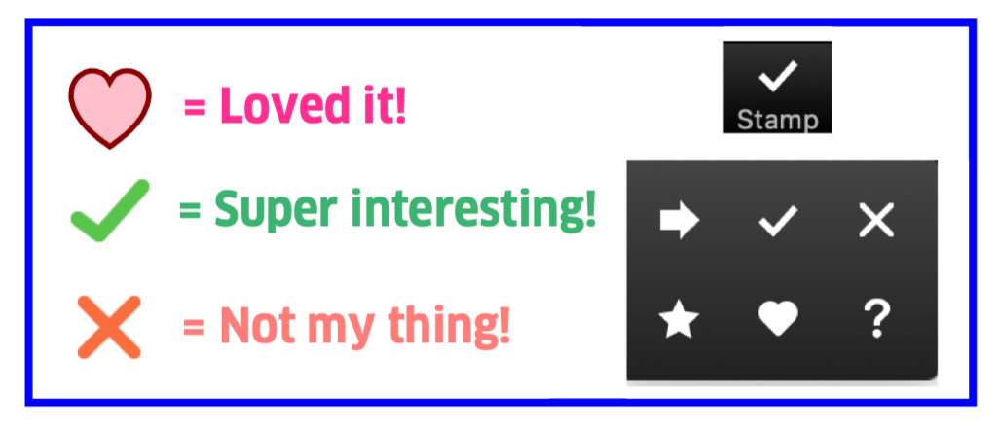

Expert groups: Beuys’ works of art 3 Min Vote for your favorite artwork.
7000 Oaks.
How to Explain Pictures to a Dead Hare.
I Like America and America Likes me.
The Fat Corner.
(JOSEPH BEUYS)

Slide 18
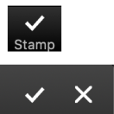
Goals for today You know important facts about the artist Joseph beuys. You know some of beuys’ most significant works of art You can present one of Beuys’ Artworks

Slide 19


I pack my suitcase and take with me… 3 Min What did you learn today? Write everything in the suitcase.

Slide 20
Preview: Session 3
What were Beuys’ art principles?
You are going to learn about the social and political causes, which informed Beuys’ work.
You will also take the first step in your group projects ☺.
(JOSEPH BEUYS)

Slide 21
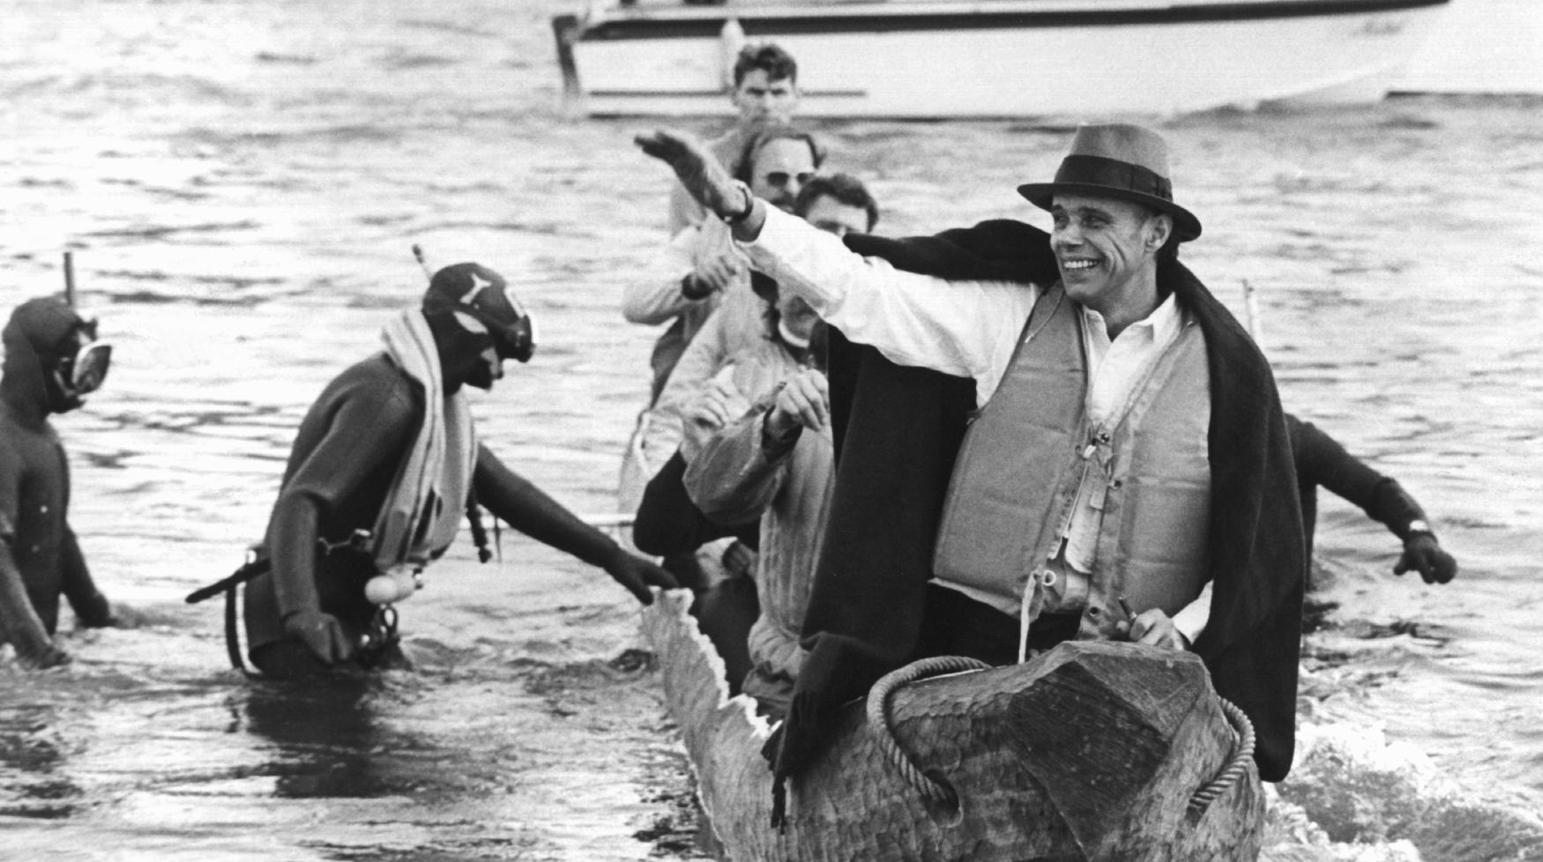
See you next week!
ČTK/DPA/Roland Scheidemann

Slide 22
Evans, M. (1985, May 01). Joseph Beuys Artist 01[Photograph]. AF Archive. National Galleries (Producer). (2016, August 12). Who is Joseph Beuys? [Video file]. Retrieved September 29, 2021, from https://www.youtube.com/watch?v=e7pIGGcIoLk Scheidemann, R. (1973, October 20). Joseph Beuys in a log-boat.[Photograph]. ČTK/DPA, Düsseldorf.
Citations

