Slide 1
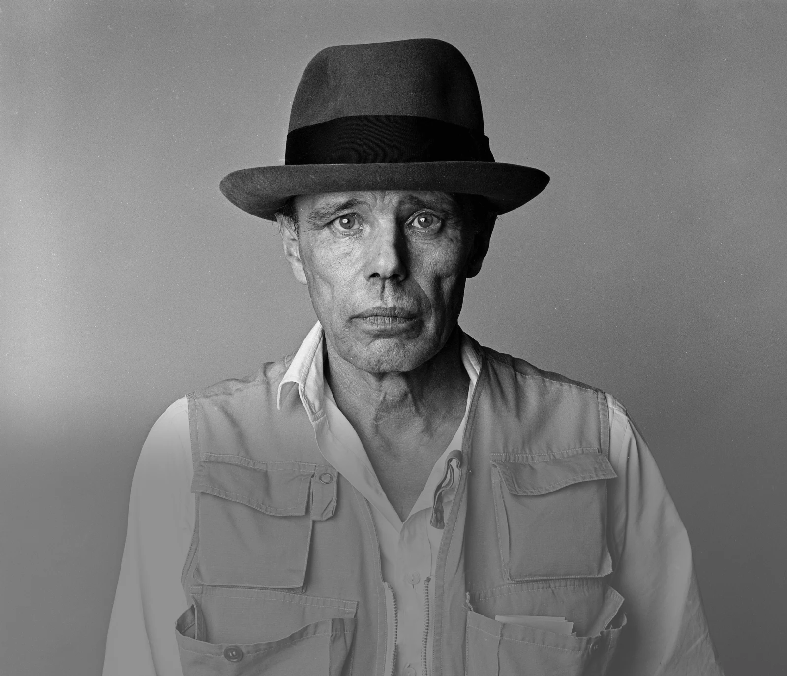
Afterschool
Program:
Be Beuys
Session 3 - Datum

Slide 2
Welcome to Session 3
How was your day?

Slide 3

Willkommen zu Sitzung 3
Wie war dein Tag?

Slide 4
Goals for today
→ you learn about the objective of our after-school program
→ You get to know which social /
Political Causes informed Beuys’ work
→ You decide on a cause that shapes your group project

Slide 5
Agenda
Steps | Time | Goal
Step 1 | 5 Minutes | Arrival
Step 2 | 10 Minutes | Discussion: What makes an Artist?
Step 3 | 5 Minutes | Overview: Program Objective
Step 4 | 26 Minutes | Causes That Matter
Step 5 | 24 Minutes | Our Personal Art Projects
Step 7 | 5 Minutes | Reflection, Preview & Goodbye

Slide 6

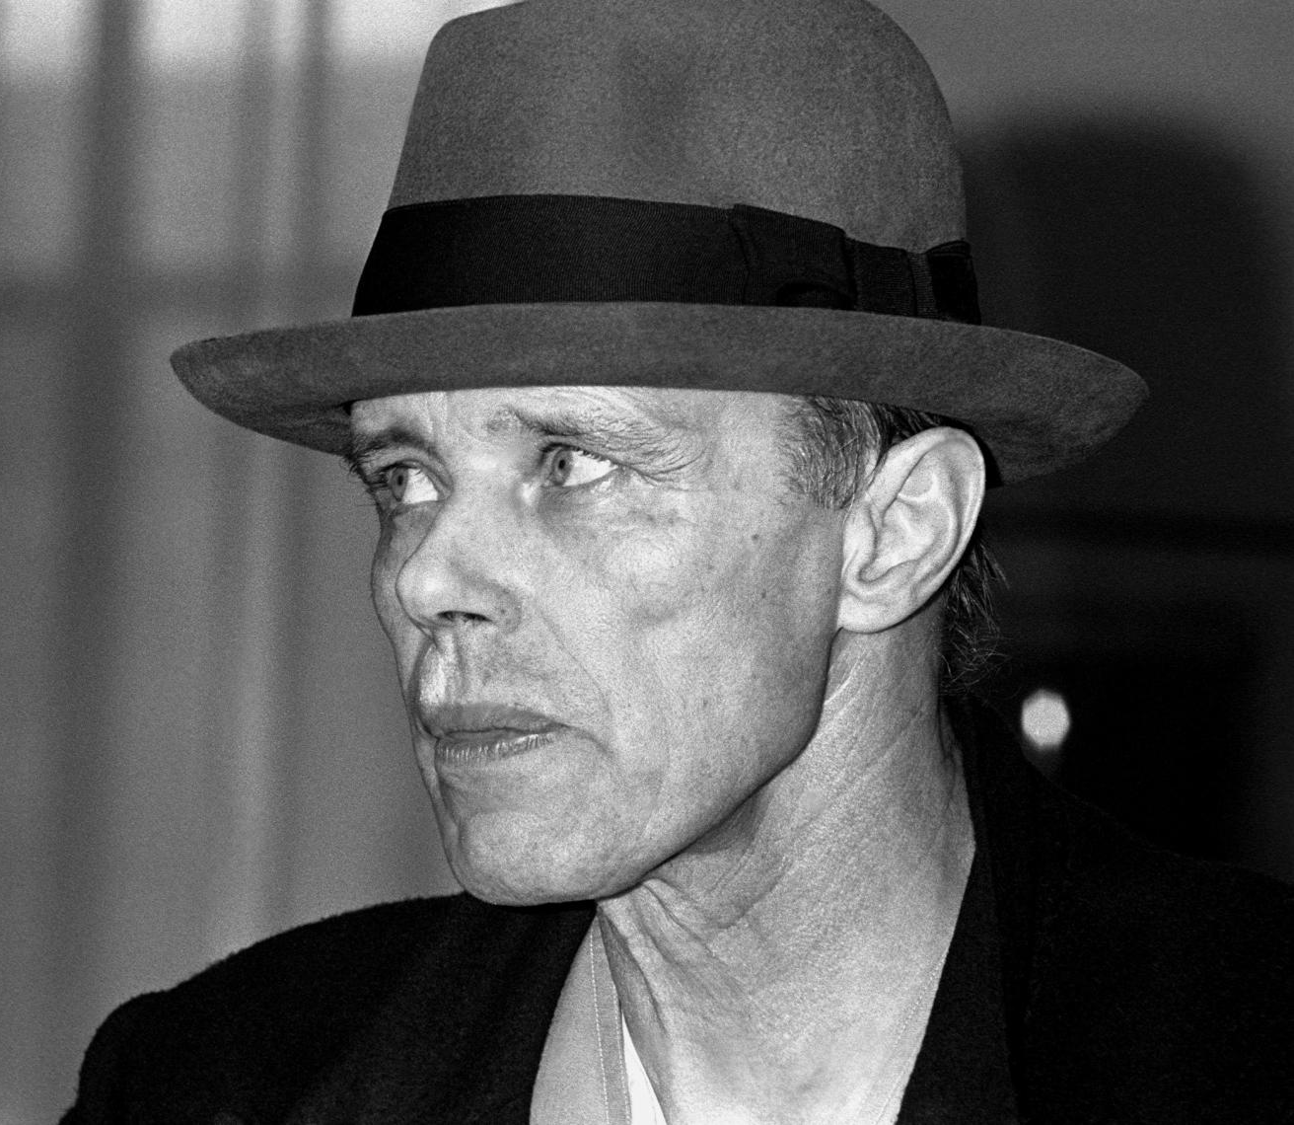
Discussion: What makes an artist?
7 Min discuss the quote and questions in your group.
“EVERYONE IS AN ARTIST”.
(JOSEPH BEUYS)
What do you think Beuys wanted to
express with this quote?
Do you agree with Beuys? Why (not)?
ČTK/Mary Evans/AF Archive

Slide 7
Discussion: What makes an artist?
3 Min
What did your group discuss? Present.
Our group thought, Beuys wanted to express that …
Foto: ČTK/Mary Evans/AF Archive
“EVERYONE IS AN ARTIST”.
(JOSEPH BEUYS)

Slide 8
Diskussion: was macht eine*n Künstler*in aus?
7 Min
Diskutiert das Zitat und die Fragen in der Gruppe.
“JEDER MENSCH IST
EIN KÜNSTLER”.
(JOSEPH BEUYS)
Was wollte Beuys mit diesem Zitat
ausdrücken?
Stimmst du Beuys zu? Warum (nicht)?
ČTK/Mary Evans/AF Archive

Slide 9
Diskussion: Was macht eine*n Künstler*in aus?
3 Min
Was hast deine Gruppe diskutiert? Präsentiert!
Unsere Gruppe denkt, Beuys meint …
Foto: ČTK/Mary Evans/AF Archive
“JEDER MENSCH IST EIN KÜNSTLER”.
(JOSEPH BEUYS)

Slide 10





Overview: Program objective
5 Min listen to the Program‘s objectives.
“EVERYONE
IS AN
ARTIST”.
FOLLOW IN BEUYS’ STEPS
Find a Cause You’re
Passionate About!
Chose Materials
and Places that
Matter to You!
PROGRAM OBJECTIVE: CREATE A SOCIALLY RELEVANT ART PROJECT
Create Your
Art Persona!
Guiding
Course
Principle
How to
get there?
Brand Your
Project!

Slide 11






OVERVIEW: Where are we?
1 MIN
FIND OUT WHERE WE ARE IN OUR PROGRAM.
Find a Cause you’re Passionate About!
Choose Materials and Places that Matter to you!
Create your Brand and Art Persona!
Finalize and Present your Project Plan!
Share your Project in a Social Media Post!

Slide 12









Causes that matter
Challenge: 3 Min
WHICH SOCIAL/POLITICAL/ECONOMIC… CAUSES MATTER TO YOU?
IN YOUR GROUP, WRITE DOWN ALL YOUR IDEAS.
The team with the
most answers wins!

Slide 13
Causes that matter
5 Min
NAME THE 5 MOST INTERESTING TOPICS OF YOUR GROUP AND WRITE THEM ON OUR SMARTBOARD.

Slide 14
Themen, Die wichtig sind!
Challenge: 3 Min
WELCHE SOZIALEN/POLITISCHEN/WIRTSCHAFTLICHEN…
THEMEN SIND EUCH WICHTIG? NOTIERT ALL EURE IDEEN IM TEAM!
Das Team mit den meisten
Antworten gewinnt!

Slide 15
THEMEN, DIE WICHTIG SIND!
5 Min
NENNT DIE 5 INTERESSANTESTEN THEMEN AUS EUREM
BRAINSTORMING UND NOTIERT SIE AUF DEM SMARTBOARD.

Slide 16











Causes that matter
6 MIN
DISCUSS IN YOUR GROUP.
Last week, you learnt about Beuys and his artwork.
Which topics was he passionate about?
What do you think were the causes that
informed his work?

Slide 17

Causes that matter
4 MIN
LET‘S BRING OUR IDEAS TOGETHER. WHICH CAUSES
INFORMED BEUYS‘ ART?

Slide 18






Causes that matter
8 MIN
TOGETHER WITH A PARTNER, DISCUSS THE QUESTIONS ON THE WORK
SHEET & IDENTIFY THE CAUSES YOU‘RE PASSIONATE ABOUT.
CAUSES WE’RE PASSIONATE ABOUT

Slide 19
Themen, die wichtig sind!
8 MIN
DISKUTIERT ZU ZWEIT DIE FRAGEN AUF DEM ARBEITSBLATT UND FINDET
THEMEN, FÜR DIE IHR BRENNT!
THEMEN, FÜR DIE WIR BRENNEN!

Slide 20






OUR PERSONAL ART PROJECTS
6 MIN
FORM GROUPS FOR YOUR ART PROJECTS.
Think back to our brainstorming.
Which 3 topics are you most passionate about?
Write your favorite topics on three separate post-it-notes.
Walk around in the classroom and find 2-3 additional people that are
interested in the same topic.
Sit down in your new groups and stick the post-it-note with your group
topic in the middle of the table.

Slide 21

OUR PERSONAL ART PROJECTS
10 MIN
INSIDE YOUR TOPIC, WHAT ARE YOU MOST INTERESTED IN?
NARROW DOWN YOUR PROJECT FOCUS.
A
B
2 Minutes:
Choose one lettered square and brainstorm individually.
2 Minutes:
Read the ideas of your fellow group members. Search for commonalities.
4 Minutes:
Discuss the results with your group. Together, decide on the focus of your project and write it inside the center square.
C
D

Slide 22
OUR PERSONAL ART PROJECTS
8 MIN
YOU AGREED ON A PROJECT FOCUS. BUT HOW CAN YOU TRANSLATE
THIS FOCUS INTO AN ART PROJECT? DECIDE ON A GUIDING QUESTION.
HOW MIGHT WE CREATE AN ART PROJECT THAT …
FINAL 2 MINUTES:
Vote for your three favorite questions. The question with
the most votes will be the guiding question for your project.

Slide 23


Reflection
3 MIN
SUMMARIZE YOUR GROUP PROGRESS IN A 30 SECOND
ELEVATOR PITCH.
The social cause we want to pursue is ____________ . We decided to focus our project on __________ .
Our guiding question will be
_________________ .

Slide 24


Goals for today you know the objective of our after-school program.
You know which social /Political
Causes informed Beuys’ work
You decided on a cause that shapes your group project

Slide 25
Preview: Session 3
You will continue to work
on your project and…
… make an argument for why
others should care about your
cause and art project.
… write a slogan, which
communicates the core
Message of your project.
(JOSEPH BEUYS)

Slide 26
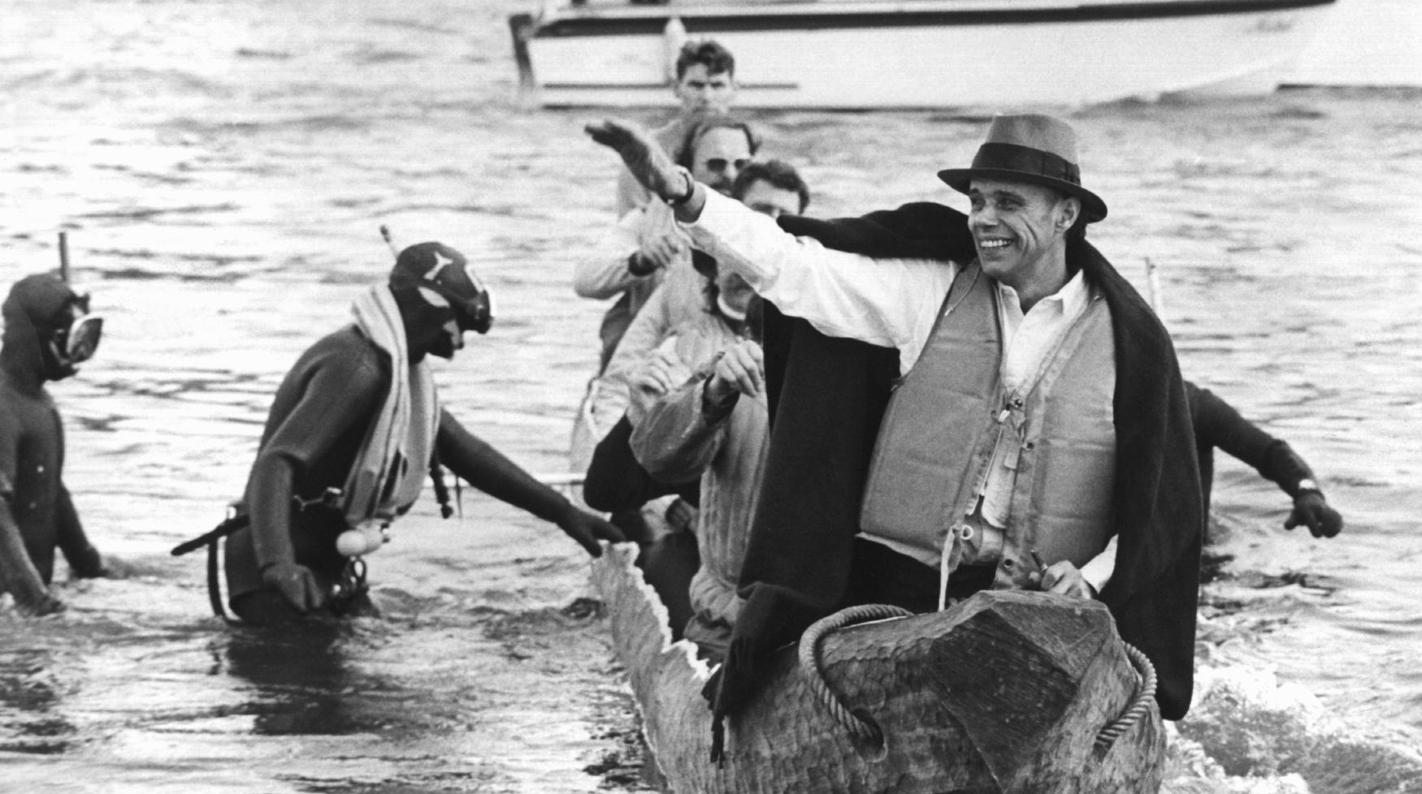
See you next week!
ČTK/DPA/Roland Scheidemann

Slide 27
Evans, M. (1985, May 01). Joseph Beuys Artist 01[Photograph]. AF Archive.
Scheidemann, R. (1973, October 20). Joseph Beuys in a log-boat.[Photograph]. ČTK/DPA, Düsseldorf.
Citations

