Slide 1
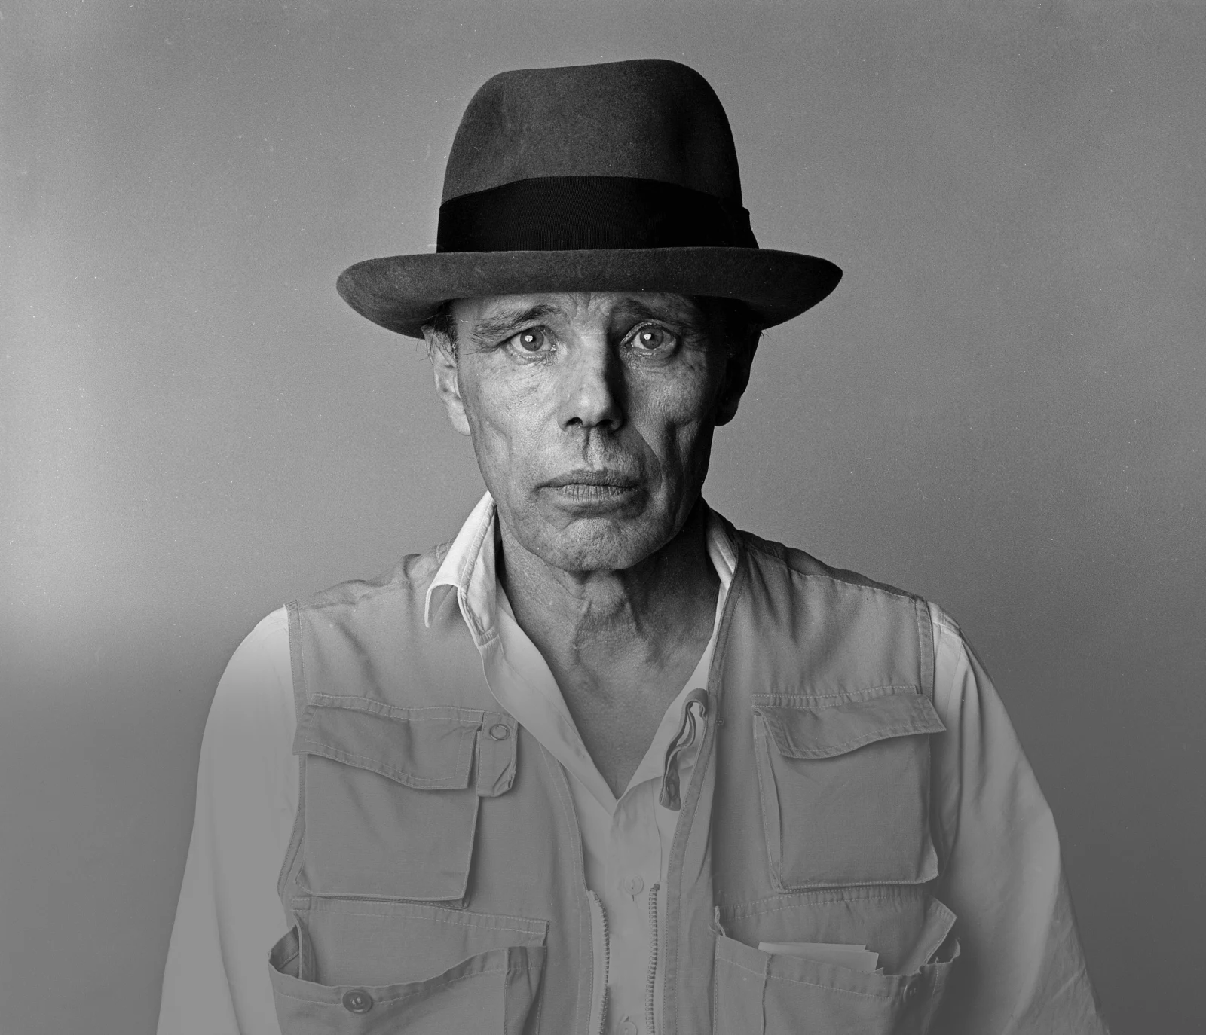
Afterschool
Program:
Be Beuys
Session 3 - Datum

Slide 2
Welcome to Session 3
Please activate
Microphone
Webcam

Slide 3
Welcome to Session 3
Microphone test
How was your day?
We can hear you.
We canNOT hear you.

Slide 4

Willkommen zu sitzung 3
Mikrofon test
Wie war dein Tag?
Wir hören dich.
Wir hören dich nicht.

Slide 5
Goals for today
→ you learn about the objective of our after-school program
→ You get to know which social /
Political Causes informed Beuys’ work
→ You decide on a cause that shapes your group project

Slide 6
Agenda
Steps | Time | Goal
Step 1 | 5 Minutes | Arrival
Step 2 | 10 Minutes | Discussion: What makes an Artist?
Step 3 | 5 Minutes | Overview: Program Objective
Step 4 | 26 Minutes | Causes That Matter
Step 5 | 24 Minutes | Our Personal Art Projects
Step 7 | 5 Minutes | Reflection, Preview & Goodbye

Slide 7


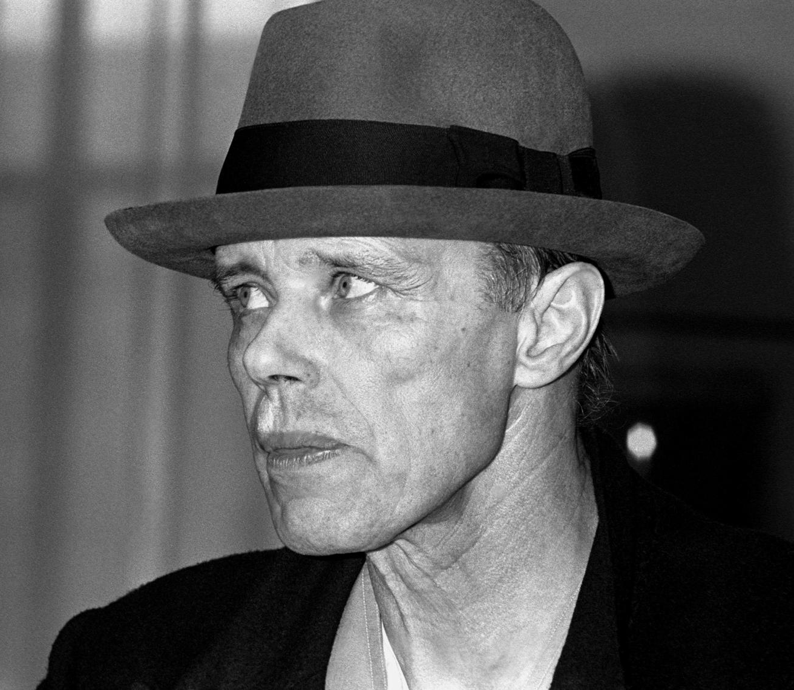
Discussion: What makes an artist?
7 Min discuss the quote and questions in your group.
Screenshot
“EVERYONE IS AN ARTIST”.
(JOSEPH BEUYS)
What do you think Beuys wanted to
express with this quote?
Do you agree with Beuys? Why (not)?
ČTK/Mary Evans/Mary Evans/AF Archive

Slide 8

Discussion: What makes an artist?
3 Min
What did your group discuss? Present.
Our group thought, Beuys wanted to express that …
Foto: ČTK/Mary Evans/Mary Evans/AF Archive
“EVERYONE IS AN ARTIST”.
(JOSEPH BEUYS)

Slide 9
Diskussion: was macht eine*n Künstler*in aus?
7 Min
Diskutiert das Zitat und die Fragen in der Gruppe.
Screenshot
“JEDER MENSCH IST
EIN KÜNSTLER”.
(JOSEPH BEUYS)
Was wollte Beuys mit diesem Zitat
ausdrücken?
Stimmst du Beuys zu? Warum (nicht)?
ČTK/Mary Evans/AF Archive

Slide 10
Diskussion: Was macht eine*n Künstler*in aus?
3 Min
Was hast deine Gruppe diskutiert? Präsentiert!
Unsere Gruppe denkt, Beuys meint …
Foto: ČTK/Mary Evans/AF Archive
“JEDER MENSCH IST EIN KÜNSTLER”.
(JOSEPH BEUYS)

Slide 11





Overview: Program objective
5 Min listen to the Program‘s objectives.
“EVERYONE
IS AN
ARTIST”.
FOLLOW IN BEUYS’ STEPS
Find a Cause You’re
Passionate About!
Chose Materials
and Places that
Matter to You!
PROGRAM OBJECTIVE: CREATE A SOCIALLY RELEVANT ART PROJECT
Create Your
Art Persona!
Guiding
Course
Principle
How to
get there?
Brand Your
Project!

Slide 12






OVERVIEW: Where are we?
1 MIN
FIND OUT WHERE WE ARE IN OUR PROGRAM.
Find a Cause you’re Passionate About!
Choose Materials and Places that Matter to you!
Create your Brand and Art Persona!
Finalize and Present your Project Plan!
Share your Project in a Social Media Post!

Slide 13









Causes that matter
8 Min
WHICH SOCIAL/POLITICAL/ECONOMIC… CAUSES MATTER TO YOU?
WRITE DOWN ALL YOUR IDEAS.

Slide 14
THEMEN, DIE WICHTIG SIND!
8 Min
WELCHE SOZIALEN/POLITISCHEN/WIRTSCHAFTLICHEN…
THEMEN SIND DIR WICHTIG? NOTIERE ALLE DEINE IDEEN.

Slide 15










Causes that matter
How to Explain Pictures to a Dead Hare.
6 MIN
DISCUSS IN YOUR GROUP.
Screenshot
The Fat Corner.
Last week, you learnt about Beuys and his artwork.
Which topics was he passionate about?
What do you think were the causes that
informed his work?
I Like America and America Likes me.
7000 Oaks.

Slide 16



Causes that matter
4 MIN
LET‘S BRING OUR IDEAS TOGETHER. WHICH CAUSES
INFORMED BEUYS‘ ART?

Slide 17






Causes that matter
8 MIN
Screenshot
TOGETHER WITH A PARTNER, DISCUSS THE QUESTIONS & IDENTIFY THE
CAUSES YOU‘RE PASSIONATE ABOUT.
WHICH PROBLEM WOULD YOU
LIKE TO FIGHT IN THE WORLD?
WHICH CAUSE IS RELEVANT TO
YOUR PERSONAL LIFE? WHY?
WHICH OF THESE CAUSES
DO YOU FOLLOW/LIKE/
POST ABOUT ON SOCIAL
MEDIA?
WHICH CAUSE COULD YOU
IMAGINE WRITING A BOOK
ABOUT?
WHICH CAUSE MOTIVATES
YOU TO GET OUT OF BED
EVERY DAY?
WHICH ACTIVIST INSPIRES YOU?
WHAT’S THEIR WORK ABOUT?

Slide 18
Themen, die wichtig sind!
8 MIN
Screenshot
DISKUTIERT ZU ZWEIT DIE FRAGEN UND FINDET THEMEN, FÜR DIE IHR BRENNT!
WELCHES PROBLEM WÜRDEST
DU GERN BEKÄMPFEN?
WELCHES THEMA SPIELT IN
DEINEM LEBEN EINE ROLLE?
ÜBER WELCHES THEMA
KÖNNTEST DU EIN GANZES
BUCH SCHREIBEN?
WELCHE DIESER THEMEN
LIKEST DU AUF SOCIAL
MEDIA? ÜBER WELCHE
POSTEST DU SELBST?
WELCHES THEMA MOTIVIERT
DICH, MORGENS AUFZUSTEHEN?
WELCHE*R AKTIVIST*IN
INSPIRIERT DICH? WARUM?

Slide 19

OUR PERSONAL ART PROJECTS
4 MIN
WRITE YOUR NAME NEXT TO 2-3 TOPICS YOU‘RE MOST PASSIONATE ABOUT.
OUR BRAINSTORMING

Slide 20

OUR PERSONAL ART PROJECTS
10 MIN
Screenshot
INSIDE YOUR TOPIC, WHAT ARE YOU MOST INTERESTED IN?
NARROW DOWN YOUR PROJECT FOCUS.
A
B
2 Minutes:
Choose one lettered
square and brainstorm
individually.
2 Minutes:
Read the ideas of your
fellow group members.
Search for commonalities.
4 Minutes:
Discuss the results with
your group. Together,
decide on the focus of
your project and write it
inside the center square.
C
D

Slide 21
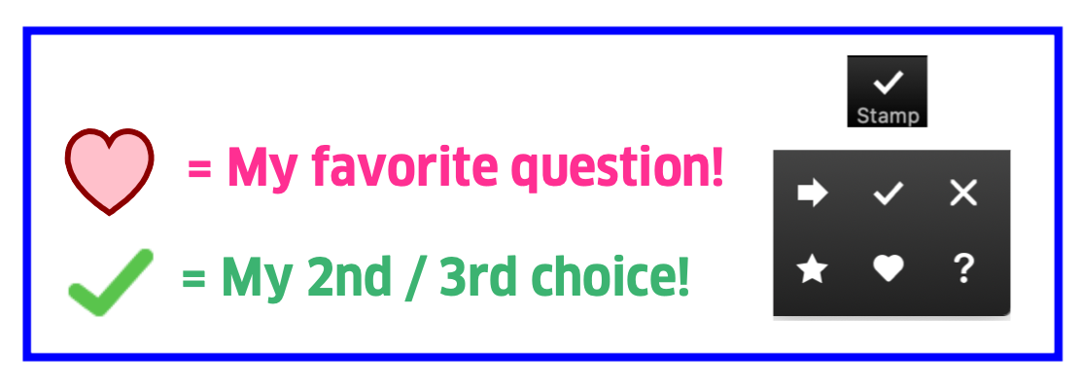
OUR PERSONAL ART PROJECTS
10 MIN
Screenshot
YOU AGREED ON A PROJECT FOCUS. BUT HOW CAN YOU TRANSLATE
THIS FOCUS INTO AN ART PROJECT? DECIDE ON A GUIDING QUESTION.
HOW MIGHT WE CREATE AN ART PROJECT THAT …
FINAL 3 MINUTES:
Vote for your three favorite questions. The question with the
most votes will be the guiding question for your project.

Slide 22


Reflection
3 MIN
SUMMARIZE YOUR GROUP PROGRESS IN A 30 SECOND
ELEVATOR PITCH.
The social cause we want to pursue is ____________ . We decided to focus our project on __________ .
Our guiding question will be
_________________ .

Slide 23

Goals for today you know the objective of our after-school program.
You know which social /Political
Causes informed Beuys’ work
You decided on a cause that shapes your group project

Slide 24
Preview: Session 3
You will continue to work
on your project and…
… make an argument for why
others should care about your
cause and art project.
… write a slogan, which
communicates the core
Message of your project.
(JOSEPH BEUYS)

Slide 25
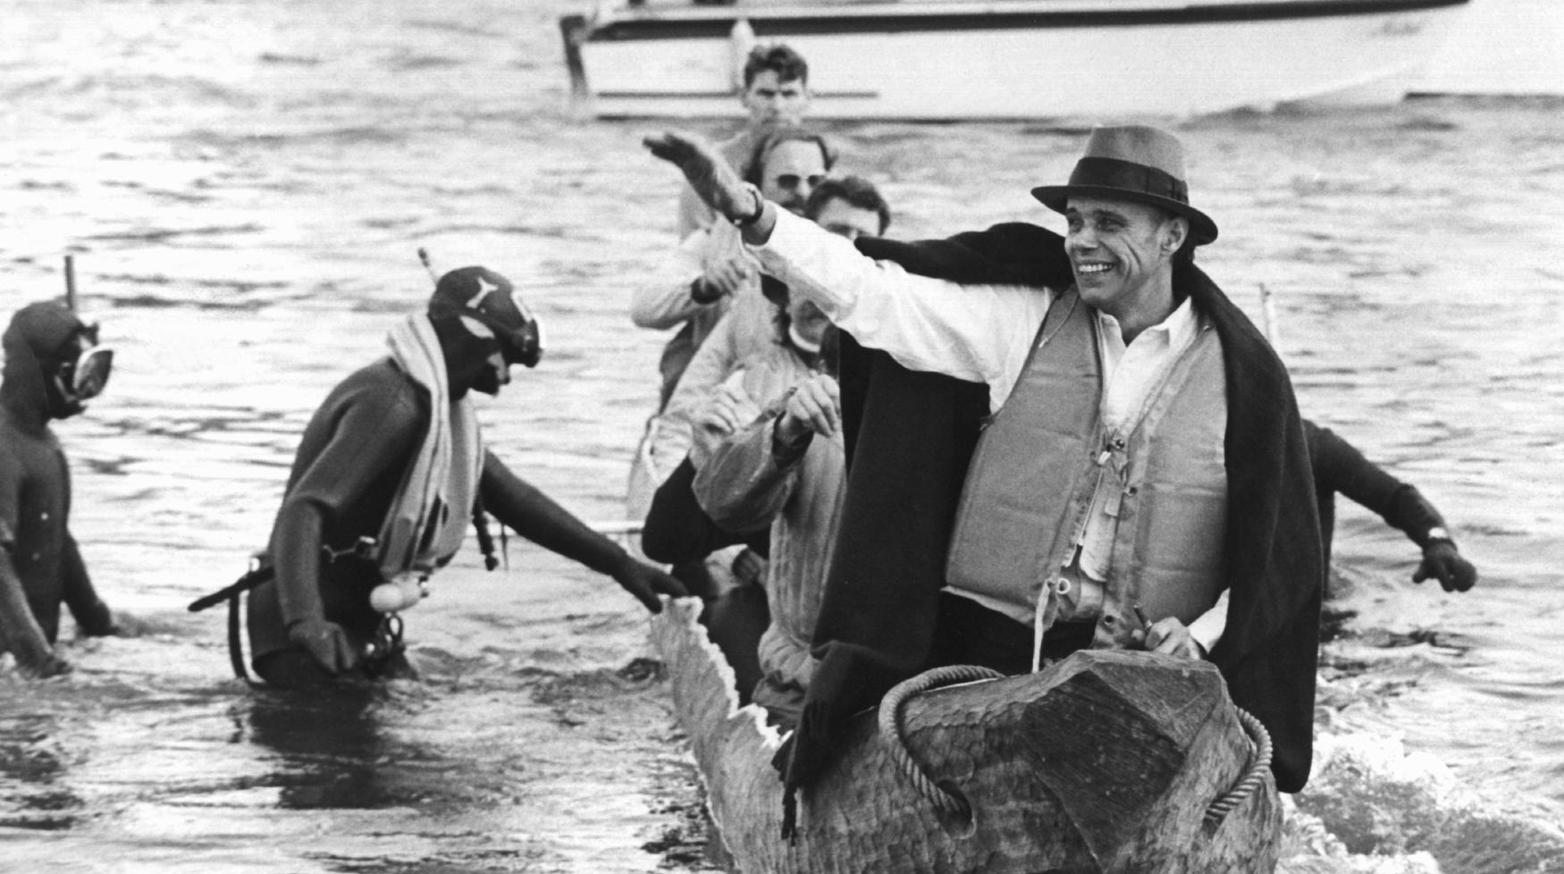
See you next week!
ČTK/DPA/Roland Scheidemann

Slide 26
Evans, M. (1985, May 01). Joseph Beuys Artist 01[Photograph]. AF Archive.
Scheidemann, R. (1973, October 20). Joseph Beuys in a log-boat.[Photograph]. ČTK/DPA, Düsseldorf.
Citations

