Slide 1
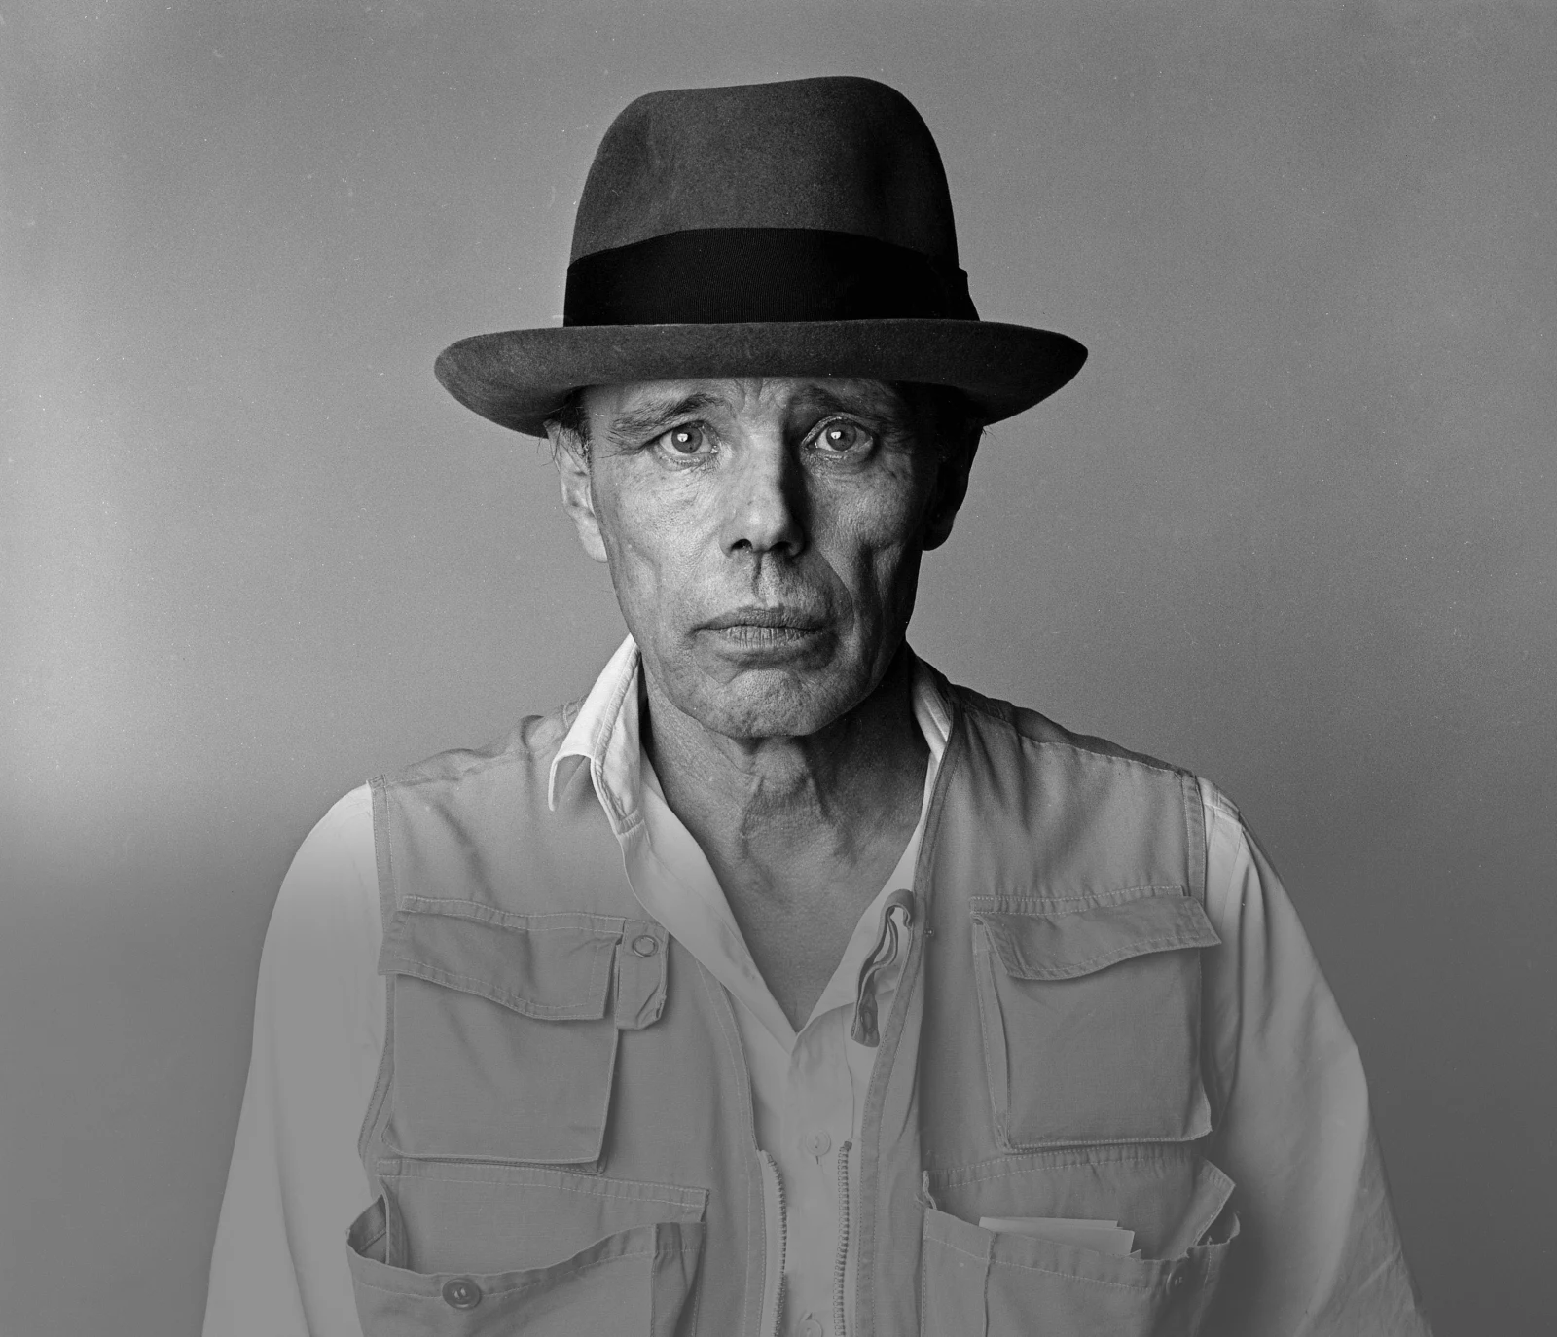
Afterschool
Program:
Be Beuys
Session 5 - Datum

Slide 2
Welcome to Session 5
Please activate
Microphone
Webcam

Slide 3
Welcome to Session 5
Microphone test
How are you today?
We can hear you.
We canNOT hear you.

Slide 4

Willkommen zu sitzung 5
Mikrofon test
Wie geht‘s dir heute?
Wir hören dich.
Wir hören dich nicht.

Slide 5
Goals for today
→ you learn about important places that shaped Beuys’
Life & Art.
→ You reflect on places that
Inspire you.
→ you decide on the location where your Project takes place.

Slide 6






PROGRAM OVERVIEW
1 MIN
FIND OUT WHERE WE ARE IN OUR PROGRAM.
Find a Cause you’re Passionate About!
Choose Materials and Places that Matter to you!
Create your Brand and Art Persona!
Finalize and Present your Project Plan!
Share your Project in a Social Media Post!

Slide 7
Agenda
Steps | Time | Goal
Step 1 | 5 Minutes | Arrival
Step 2 | 10 Minutes | Warm-Up: Places That Shaped Your Life
Step 3 | 23 Minutes | Input: Places That Shaped Beuys‘ Life & Art
Step 4 | 5 Minutes | Brainstorming: Places that inspire you
Step 5 | 17 Minutes | Miro Task: Deciding on a Location
Step 7 | 8 Minutes | Reflection, Preview & Goodbye

Slide 8



Warm-Up: Places that shaped your life
2 Min
CHOOSE ONE OF THE QUESTIONS. ON YOUR PHONE/PC, FIND
A PICTURE OF THE PLACE YOU WANT TO TALK ABOUT.
Where did you grow up?
Which place shaped your life?
What is currently your favorite place?

Slide 9




Warm-Up: Places that shaped your life
6 Min
questions in
the chat
PRESENT YOUR PICTURE IN THE GROUP AND EXPLAIN
WHY YOU CHOSE IT.
Where did you grow up?
Which place shaped your life?
What is currently your favorite place?
BONUS:
If your group is very
fast, you can discuss
the remaining
questions .

Slide 10


Warm-Up: Places that shaped your life
2 Min
WHICH MOOD OR ATMOSPHERE DO YOU ASSOCIATE WITH THE
PHOTOS OF YOUR CLASSMATES? WRITE DOWN 1-2 WORDS.
colorful
peaceful

Slide 11
Warm-Up: Orte, die dein Leben beeinflusst haben
2 Min
WÄHLE EINE DER FRAGEN. SUCHE EIN FOTO VON DEM ORT,
DEN DU PRÄSENTIEREN MÖCHTEST, AUF DEINEM HANDY/PC.
Wo bist du aufgewachsen?
Was ist momentan dein Lieblingsort?
Welcher Ort hat dein Leben beeinflusst?

Slide 12
Warm-Up: orte, die dein Leben beeinflusst haben
6 Min
Fragen im Chat
PRÄSENTIER DEIN FOTO IN DER GRUPPE UND ERKLÄRE,
WARUM DU ES GEWÄHLT HAST.
Wo bist du aufgewachsen?
Was ist momentan dein Lieblingsort?
Welcher Ort hat dein Leben beeinflusst?
BONUS:
Ist eure Gruppe schnell?
Dann könnt ihr auch
die restlichen
Fragen
diskutieren.

Slide 13
Warm-Up: Orte, die dein Leben beeinflusst haben
2 Min
WELCHE STIMMUNG ODER ATMOSPHÄRE ASSOZIIERST DU MIT DEN FOTOS DEINER KURSKOLLEG*INNEN? NOTIERE 1-2 WÖRTER
bunt
ruhig und friedlich

Slide 14
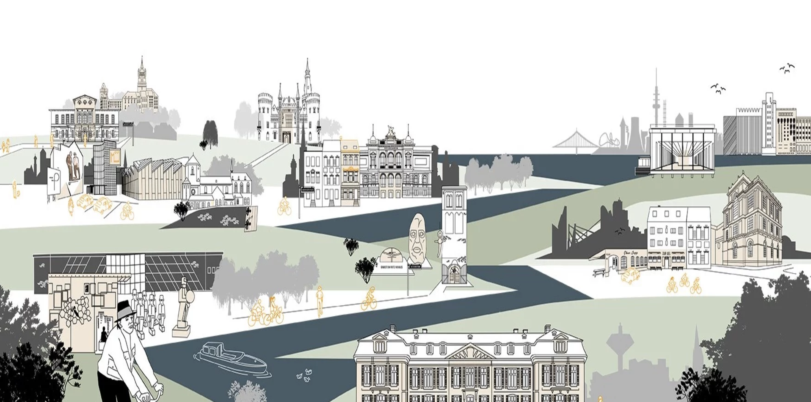


Places that shaped Beuys’ Life & Art
15 Min
EXPERT GROUPS: RESEARCH ONE PLACE THAT SHAPED BEUYS LIFE.
READ THE TEXT AND FIND INFORMATION FOR EACH QUESTION.
Group 1: Kleve
Group 2: Düsseldorf
Group 3: Mönchengladbach
Group 4: Krefeld / Duisburg
Photo: 100 Years of Beuys (2021)

Slide 15

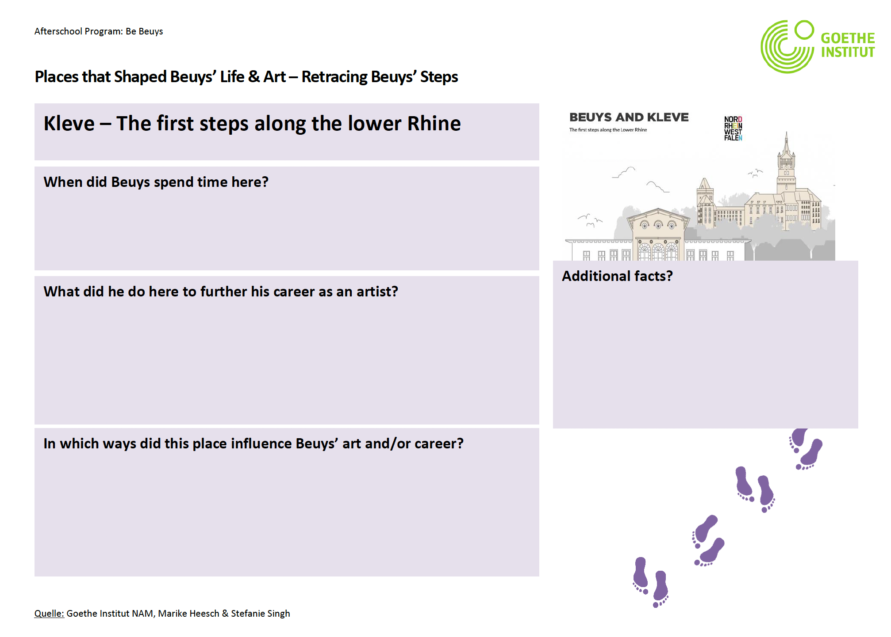
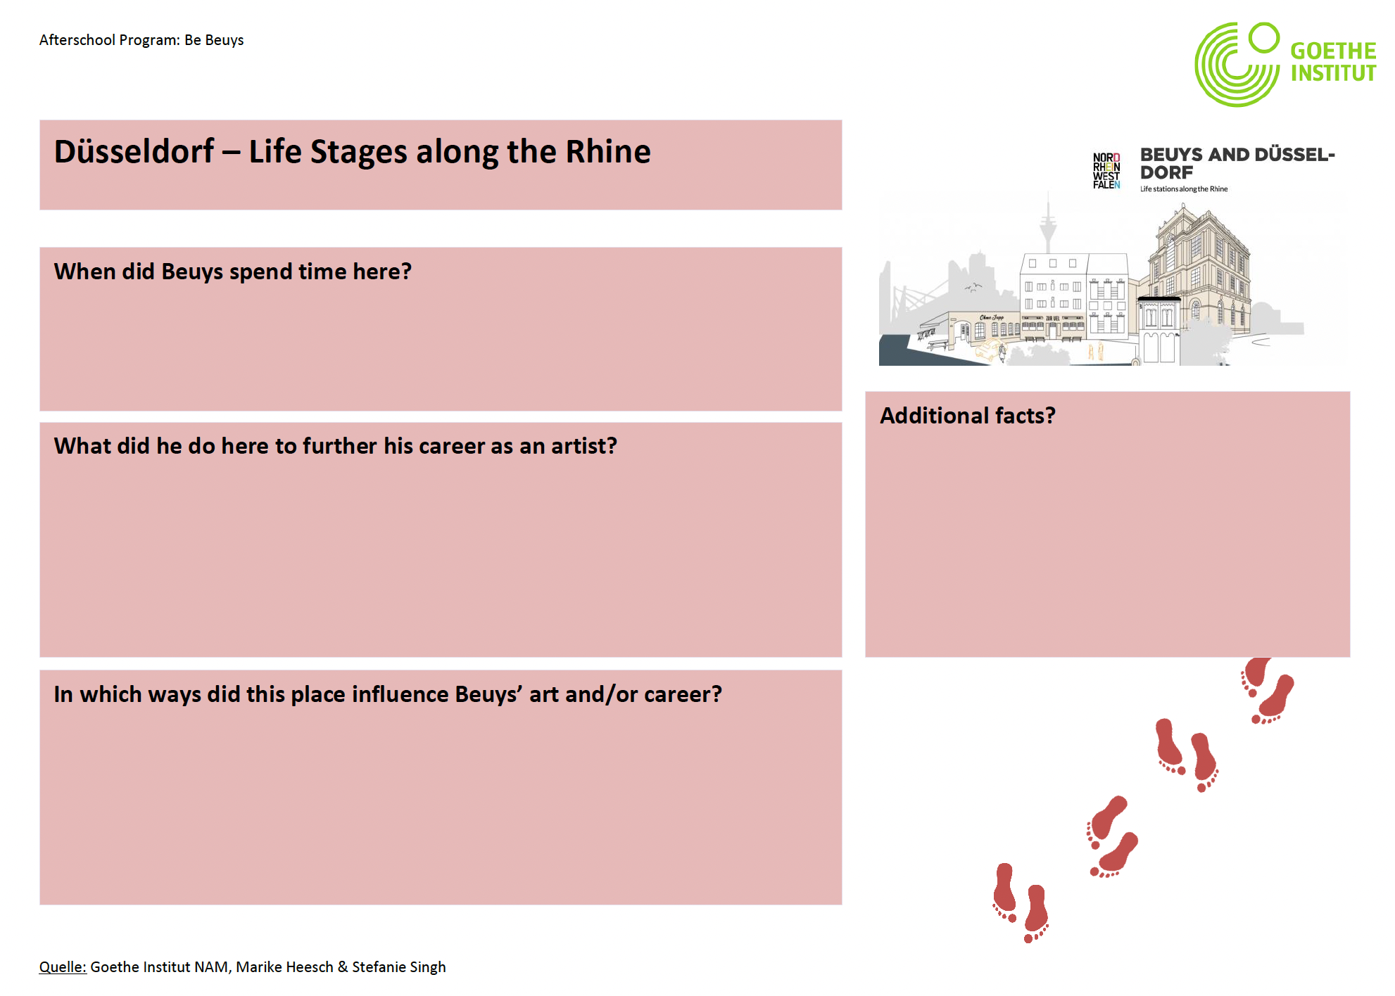
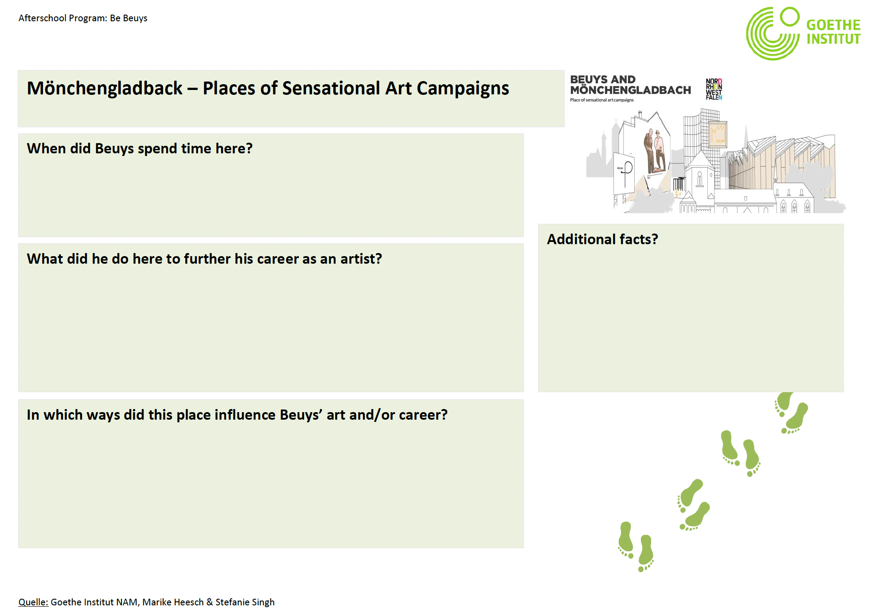
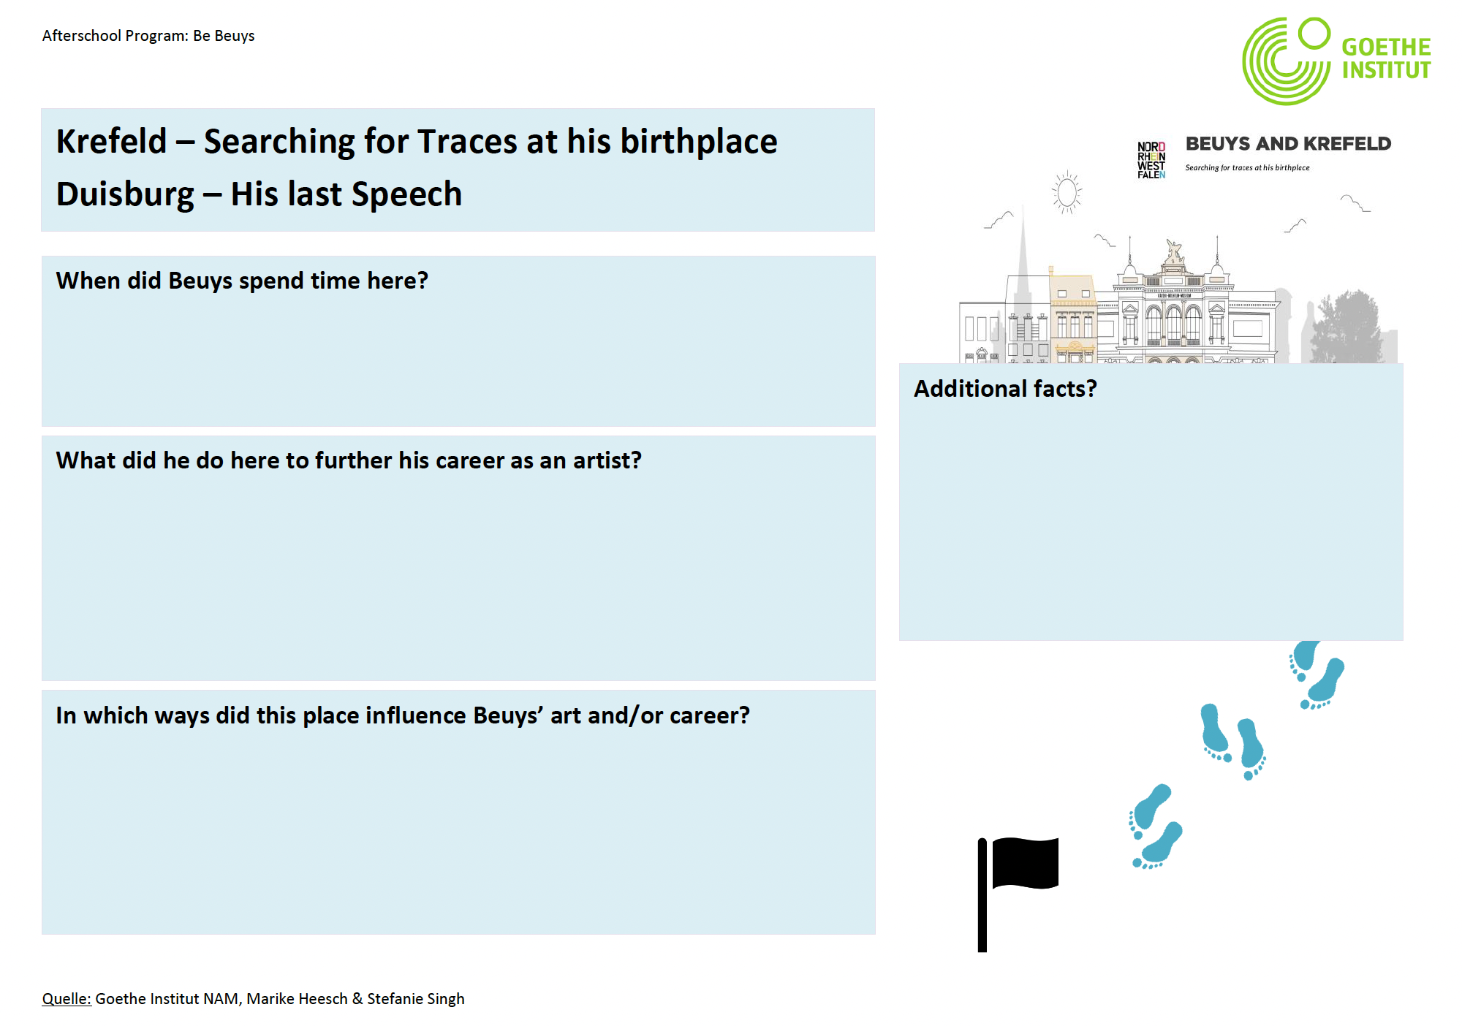

Places that shaped Beuys’ Life & Art
15 Min
PRESENT THE PLACE YOU RESEARCHED TO YOUR NEW GROUP
MEMBERS. TOGETHER, FILL IN THE WORKSHEET.
TIP: While one person is presenting, assign another person
in your group to take notes and fill in the worksheet.

Slide 16
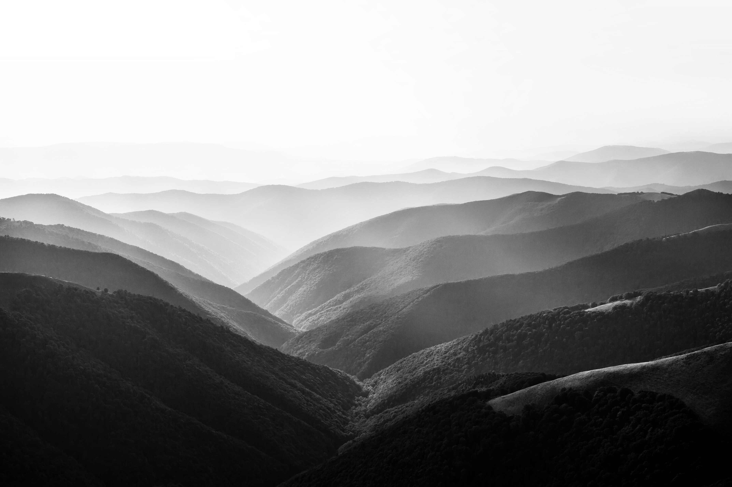
Brainstorming: Places that inspire us
5 Min
BEUYS‘ ART WAS INSPIRED BY VARIOUS PHYSICAL PLACES. WHICH
PLACES INSPIRE YOU? WRITE DOWN YOUR IDEAS.
PLACES THAT INSPIRE US

Slide 17
Brainstorming: orte, die uns inspirieren
5 Min
BEUYS KUNST WURDE DURCH VIELE ORTE INSPIRIERT. WELCHE
ORTE INSPIRIEREN DICH? NOTIERE DEINE IDEEN.
ORTE, DIE UNS
INSPIRIEREN

Slide 18


Miro TASK: DECIDE ON A LOCATION
17 MIN
DISCUSS THE QUESTION AND WRITE A SLOGAN.
Screenshot
1. Reflect on the following question:
→ Thinking about your art project, what would be the perfect place?
2. Find (a) picture(s) representing the place
your group chose.
→ You can search online (Pixabay).
→ You can choose a personal photograph.
→ You can take a picture of your immediate surroundings.
3. Post your photo(s) on the Miro Board and write 2-3 sentences that explain the thoughts behind your choice.

Slide 19

Goals for today you know important places that shaped Beuys’ Life & Art.
You can reflect on places that
Inspire you. you decided on the location where your Project takes place.

Slide 20

I pack my suitcase and take with me…
5 Min
What did you learn today? Write everything in our suitcase.

Slide 21
Ich packe meinen Koffer und nehme mit…
5 Min
Was hast du heute gelernt? Notiere Alles im Koffer.

Slide 22
Preview: Session 6
You will …
… learn about the
materials, which played
a central role in Beuys’ art.
… decide on materials
you want to use in your
project.
(JOSEPH BEUYS)

Slide 23
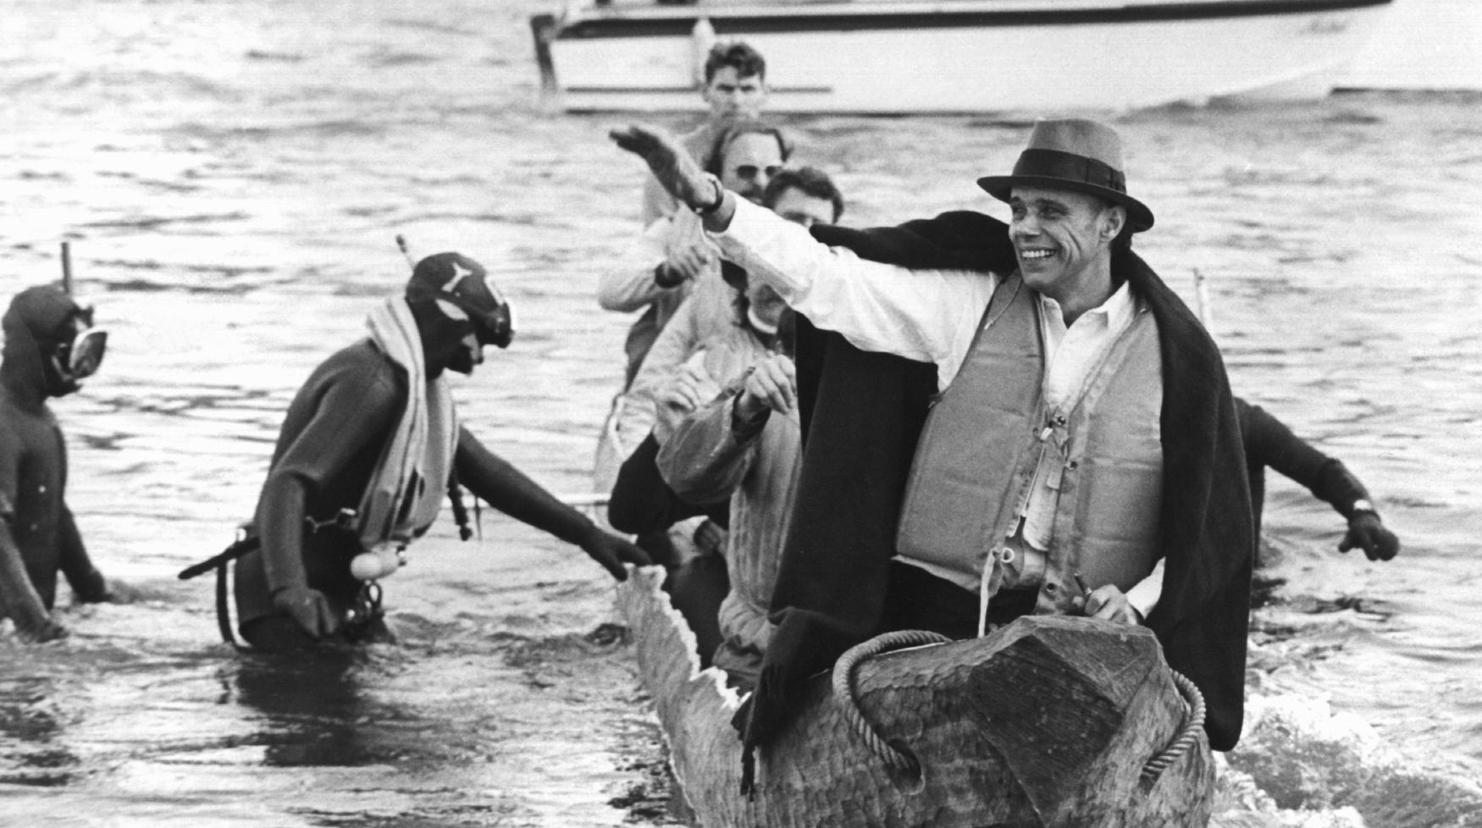
See you next week!
ČTK/DPA/Roland Scheidemann

Slide 24
Scheidemann, R. (1973, October 20). Joseph Beuys in a log-boat.[Photograph]. ČTK/DPA, Düsseldorf.
100 Years of Beuys – The Anniversary Cycling Tour. (2021, April 27). Retrieved from https://www.nrw-tourism.com/beuys#beuysbiketotheanniversarybybike
Citations

