Slide 1
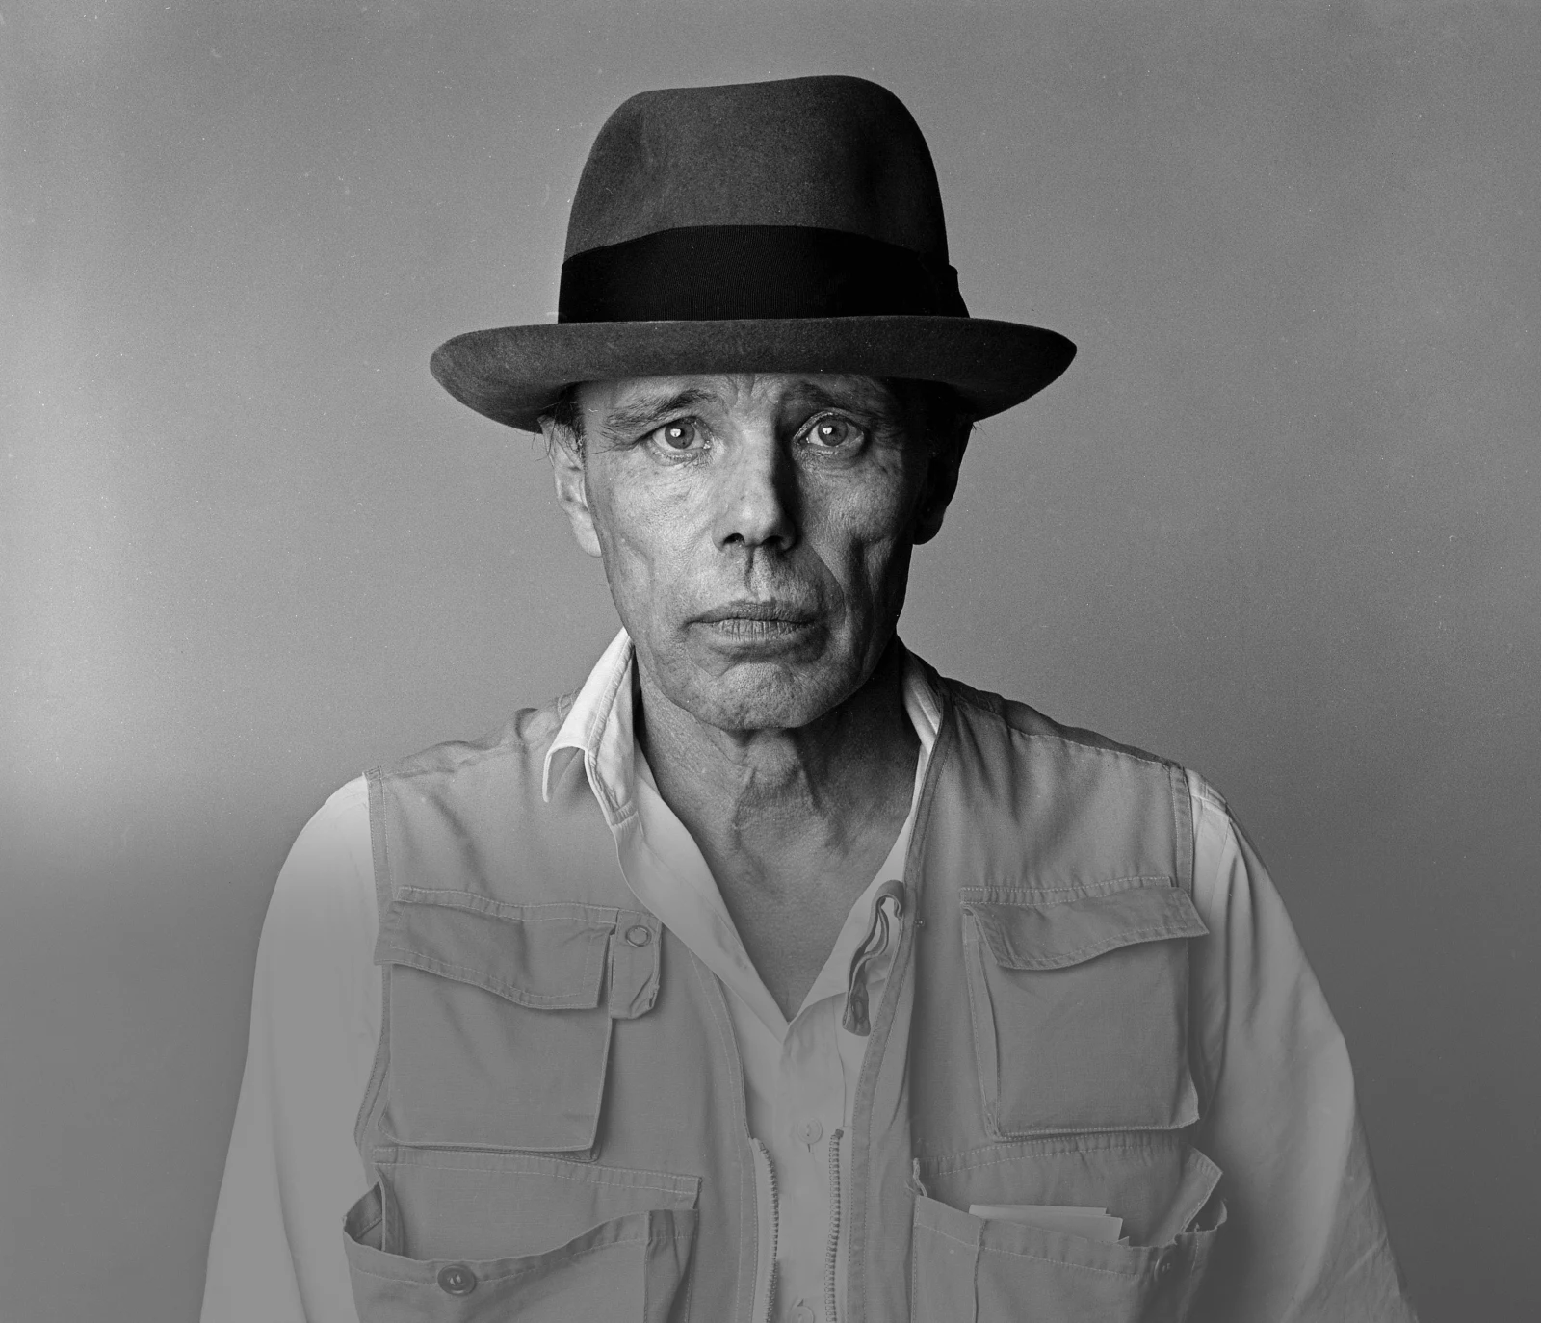
AFTERSCHOOL PROGRAM: BE BEUYS
Session 6 - Datum

Slide 2
Welcome to Session 6
How are you?

Slide 3

Willkommen zu Sitzung 6
Wie geht es dir?

Slide 4

GOALS FOR TODAY You reflect on the choice of objects and materials in Beuys’ art. You decide on objects and materials for your project.

Slide 5






PROGRAM OVERVIEW 1 MIN FIND OUT WHERE WE ARE IN OUR PROGRAM.
Find a Cause you’re Passionate About!
Choose Materials and Places that Matter to you!
Create your Brand and Art Persona!
Finalize and Present your Project Plan!
Share your Project in a Social Media Post!

Slide 6
AGENDA
STEPS | TIME | CONTENT
Step 1 | 5 Minutes | Arrival
Step 2 | 10 Minutes | Warm-Up: My Favorite Object
Step 3 | 22 Minutes | Discussion and Input: Materials
Step 4 | 8 Minutes | Brainstorming: Materials and Objects
Step 5 | 20 Minutes | Materials for your Art Project
Step 6 | 7 Minutes | Voting
Step 7 | 3 Minutes | Reflection, Preview & Goodbye

Slide 7








WARM-UP: MY FAVORITE OBJECT
7 MIN DESCRIBE YOUR FAVORITE OBJECT TO YOUR GROUP.
THE OTHERS GUESS YOUR FAVORITE OBJECT.
How does your favorite object look like?
What can you do with your favorite object?
Why is it so important to you?
Is your favorite object…?

Slide 8

WARM-UP: MY FAVORITE OBJECT
3 MIN PRESENT THE FAVORITE OBJECT OF ONE OF YOUR PARTNERS.
...favorite object is, because...

Slide 9
WARM-UP: MEIN LIEBLINGSOBJEKT
7 MIN BESCHREIBE DEIN LIEBLINGSOBJEKT DEINER GRUPPE.
DIE ANDEREN ERRATEN DEIN LIEBLINGSOBJEKT.
Wie sieht dein Lieblingsobjekt aus?
Was kannst du mit deinem Lieblingsobjekt machen?
Warum ist es so wichtig für dich?
Ist dein Lieblingsobjekt…?

Slide 10
WARM-UP: MEIN LIEBLINGSOBJEKT
3 MIN PRÄSENTIERE DAS LIEBLINGSOBJEKT VON EINER PARTNERIN/ EINEM PARTNER.
Das Lieblingsobjekt von ...ist....

Slide 11

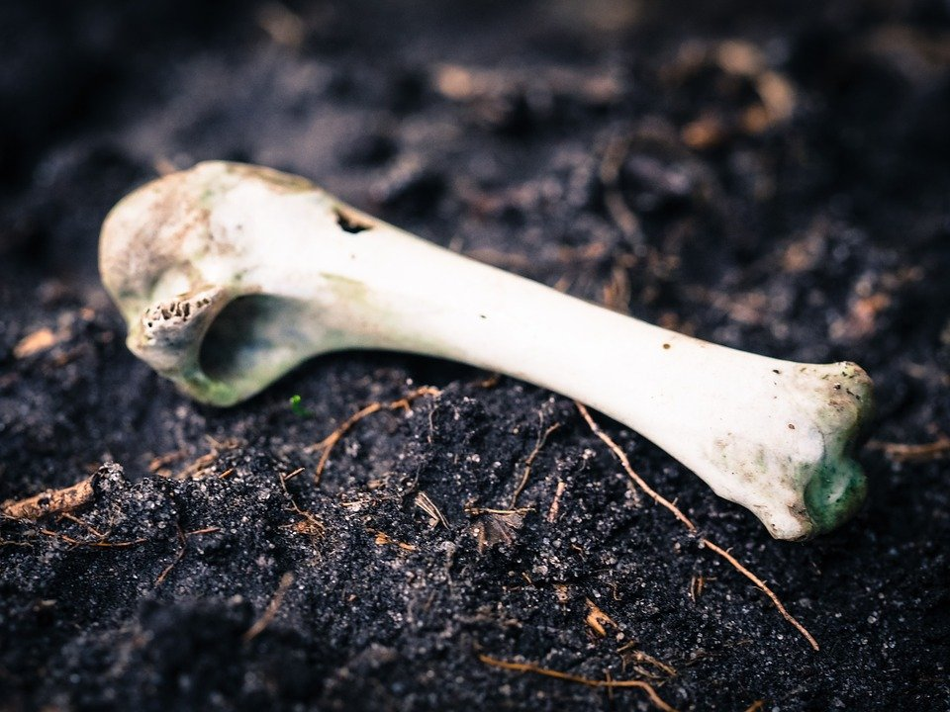
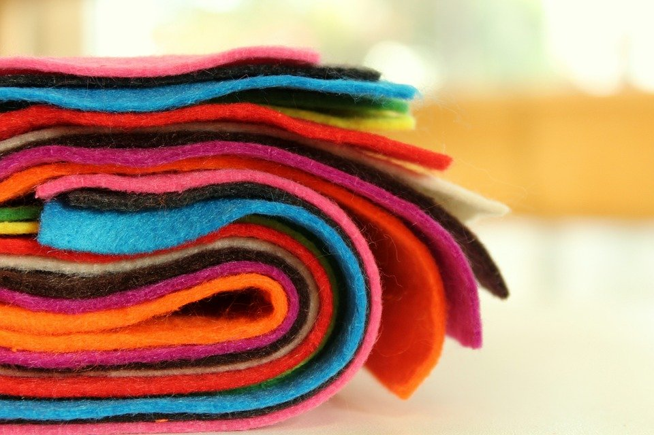
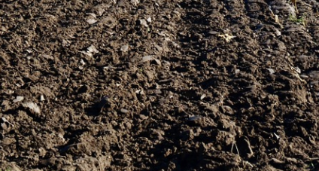
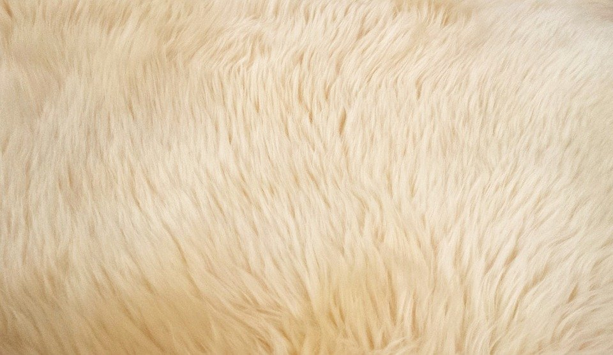
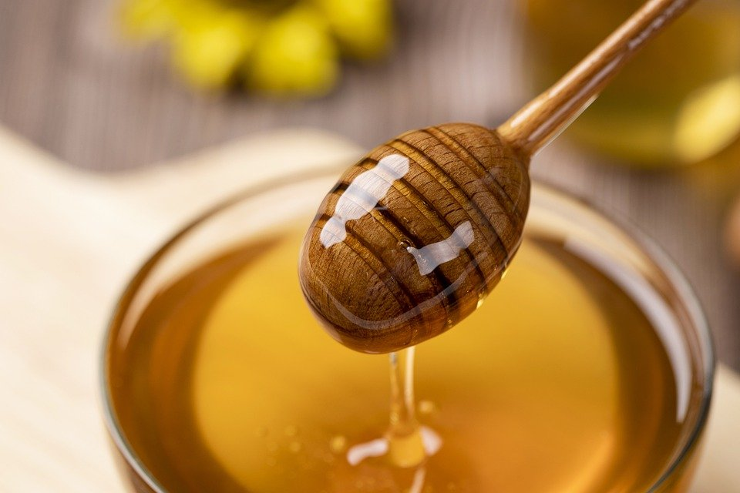
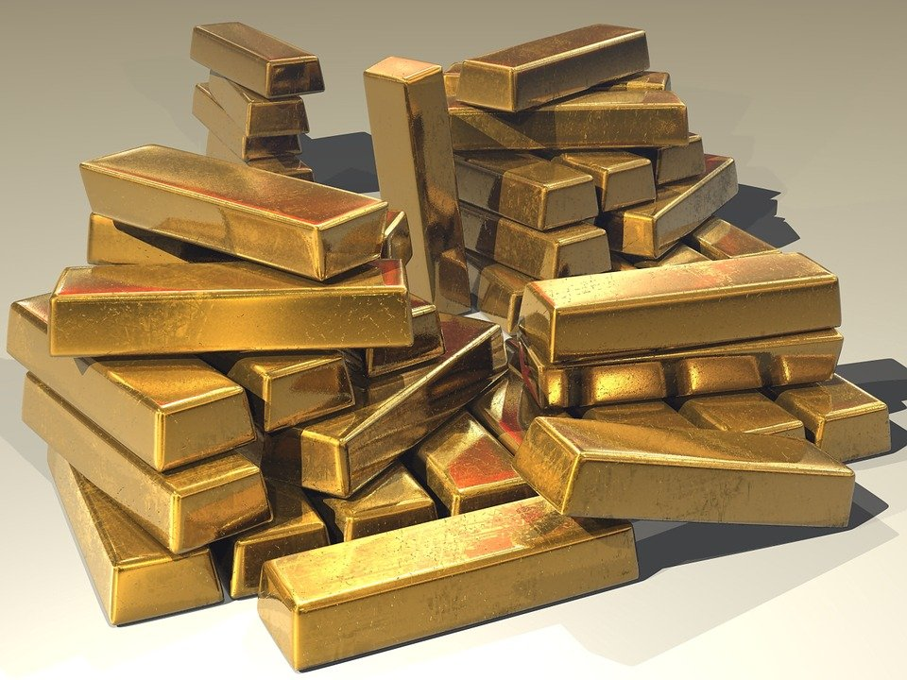
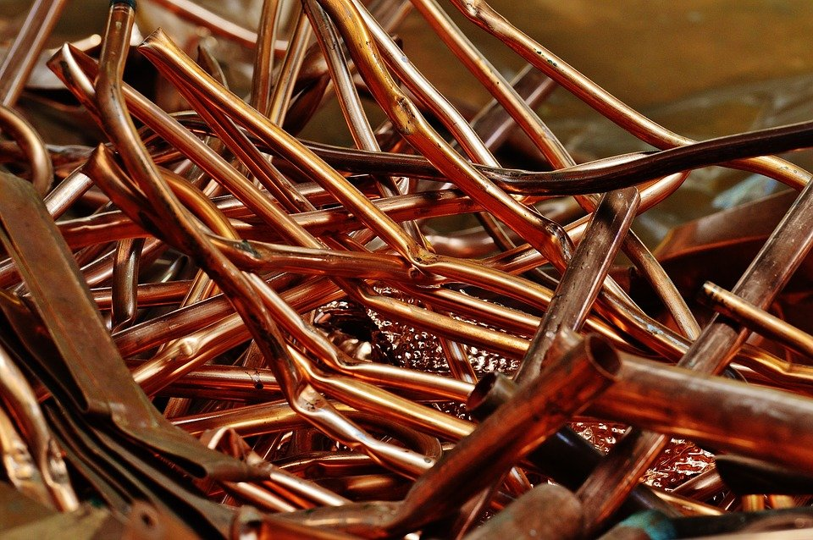
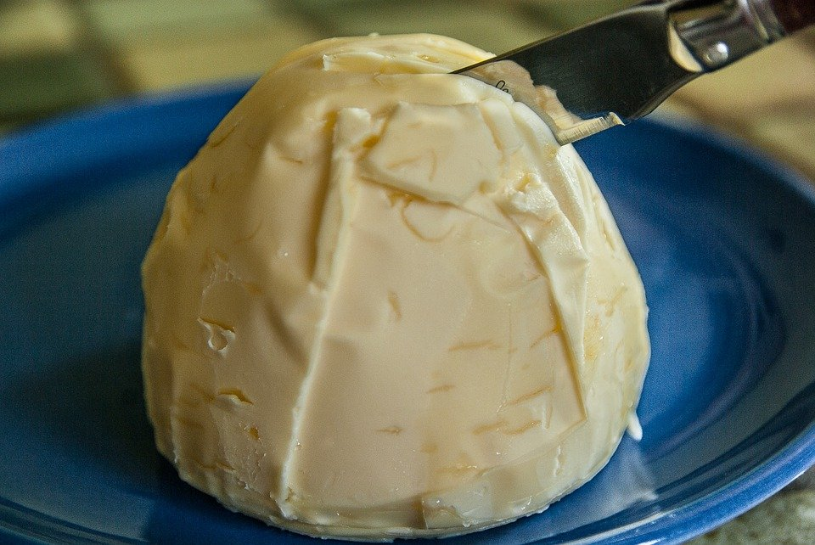
OBJECTS AND MATERIALS
4 MIN
IDENTIFY THE OBJECTS AND MATERIALS ON THE PICTURES.

Slide 12
OBJEKTE UND MATERIALIEN
4 MIN
IDENTIFIZIERT DIE OBJEKTE UND MATERIALIEN AUF DEN FOTOS.

Slide 13
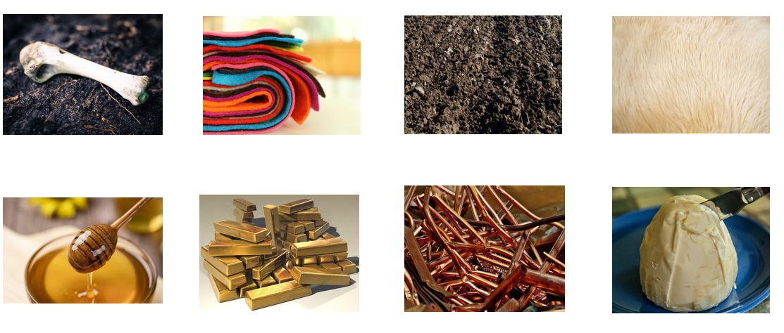
DISCUSSION: OBJECTS AND MATERIALS
6 MIN LOOK AGAIN AT THE PICTURES AND DISCUSS THE QUESTIONS.
What is your opinion on the choice of these objects/ materials for art?
Why did Beuys choose these objects/ materials?

Slide 14
INPUT: THE CHOICE OF MATERIALS
10 MIN READ THE TEXT AND DISCUSS THE QUESTION.
In which ways do you think materials and objects can influence the viewer?
How did these objects/ materials convey Beuys’ social and political messages?
Can you think of any other artists that used non-traditional materials for their art?
Materials and objects play a crucial role in art. They influence how artists make their work and how the viewers interpret the artwork. Beuys carefully selected the materials for his artwork to inform the meaning of his artwork and convey social and political messages he cared about. Beuys’ choice of materials was eclectic. He used a lot of non-traditional materials such as fat, felt, honey, bones, soil or fur.

Slide 15







BRAINSTORMING: OBJECTS AND MATERIALS 8 MIN
WHICH OTHER OBJECTS/ MATERIALS CAN YOU USE FOR ART PROJECTS? WRITE DOWN ALL YOUR IDEAS.

Slide 16





MATERIALS FOR YOUR ART PROJECT 20 MIN
LK muss den individuellen Miro Link/ QR Code hier einfügen!
DISCUSS MATERIALS FOR YOUR ART PROJECTS IN YOUR GROUPS.
What materials symbolically fit your project?/ What materials would you need to realize your project?
Can you think of any objects that you would want to include in your project?
Check out your surroundings. Take photos of interesting materials and objects. Or find images online. Copy-paste them on the Miro Board and add them to your collage. Write about your choices.

Slide 17




Voting CHECK OUT WHAT THE OTHER TEAMS CAME UP WITH. AWARD THREE GROUPS. TALK TO YOUR GROUP ABOUT YOUR CHOICES.
5 MIN
You can award one badge of each category to a team of your choice.
Do not award your own project.
Place the badge in the area marked with the dotted line.

Slide 18


GOALS FOR TODAY You reflected on the choice of objects and materials in Beuys’ art. You decided on objects and materials for your project.

Slide 19
PREVIEW: SESSION 7
You will continue to work on your project and…
… come up with a character that could represent your group.

Slide 20
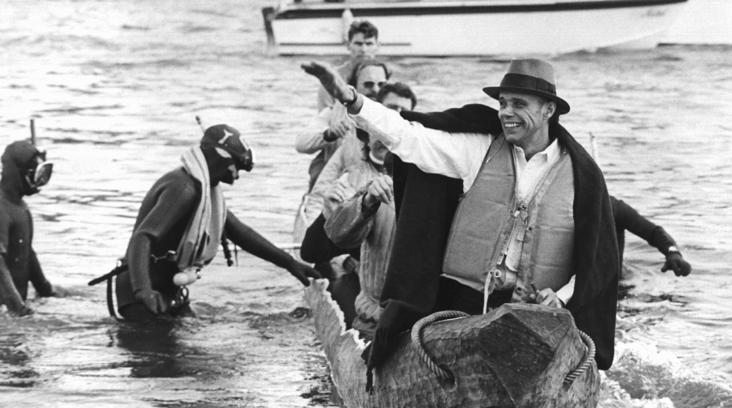
SEE YOU NEXT WEEK!

Slide 21
SCHEIDEMANN, R. (1973, OCTOBER 20). JOSEPH BEUYS IN A LOG-BOAT.[PHOTOGRAPH]. ČTK/DPA, DÜSSELDORF.
CITATIONS

