Slide 1
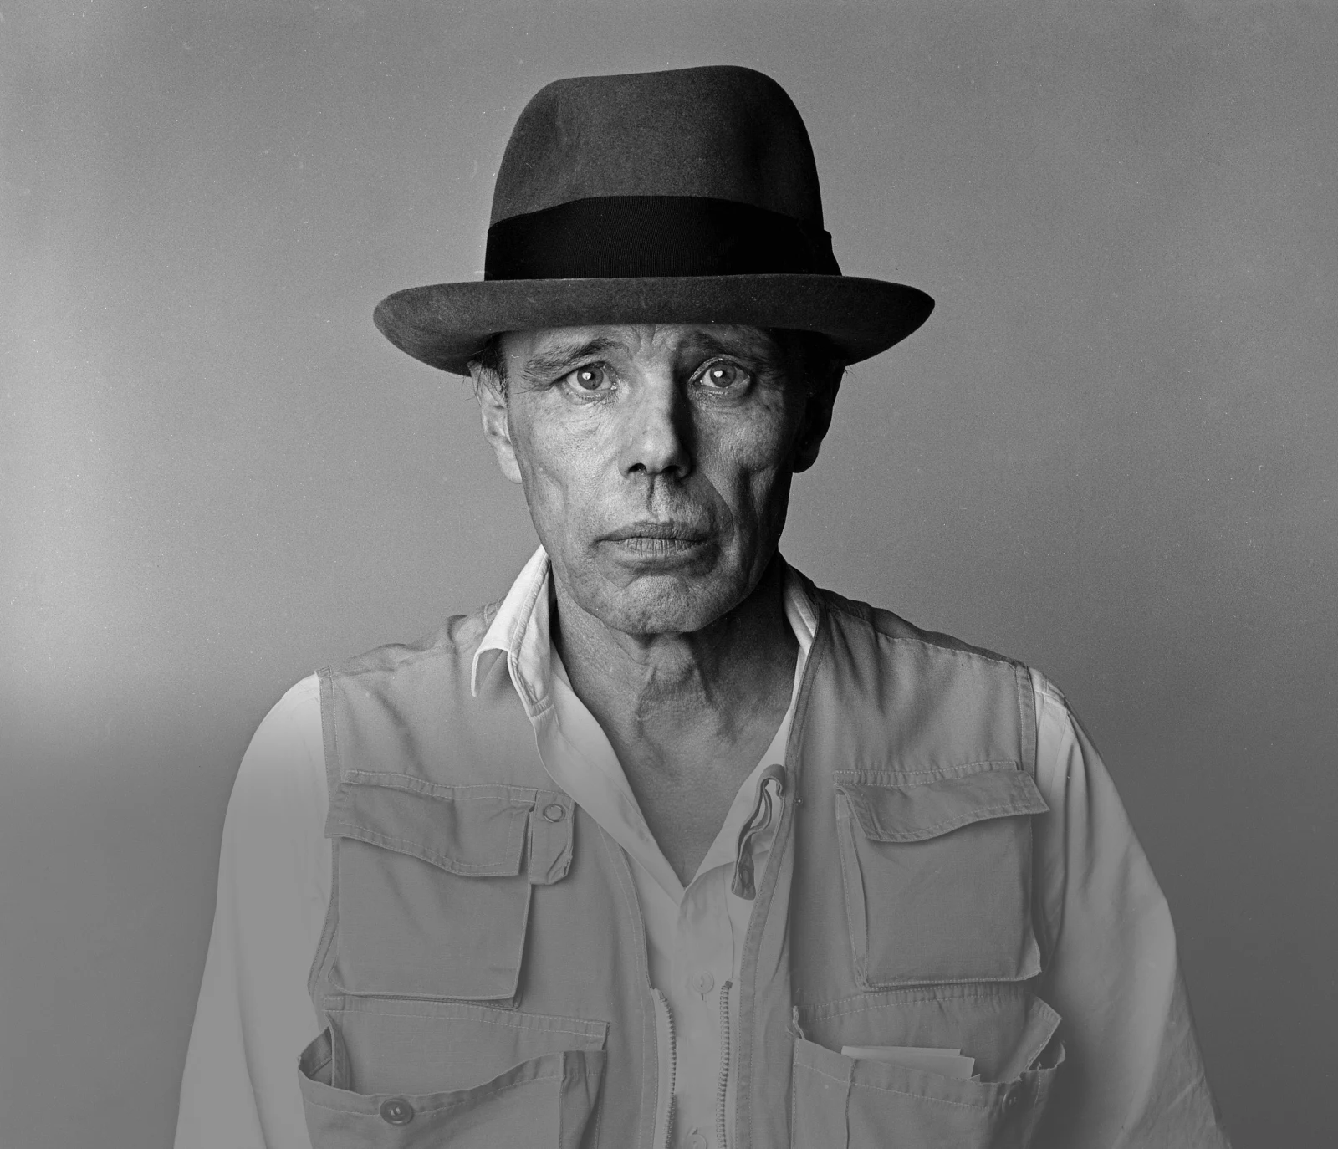
AFTERSCHOOL PROGRAM: BE BEUYS
Session 6 - Datum

Slide 2
WELCOME TO SESSION 6 PLEASE ACTIVATE
MICROPHONE
WEBCAM

Slide 3
WELCOME TO SESSION 6 MICROPHONE TEST
How are you today?
WE CAN HEAR YOU.
WE CANNOT HEAR YOU.

Slide 4

Willkommen zu Sitzung 6 Mikrofon TEST
Wie geht es dir?
WIR KÖNNEN DICH HÖREN.
WIR KÖNNEN DICH NICHT HÖREN.

Slide 5

GOALS FOR TODAY You reflect on the choice of objects and materials in Beuys’ art. You decide on objects and materials for your project.

Slide 6






PROGRAM OVERVIEW 1 MIN FIND OUT WHERE WE ARE IN OUR PROGRAM.
Find a Cause you’re Passionate About!
Choose Materials and Places that Matter to you!
Create your Brand and Art Persona!
Finalize and Present your Project Plan!
Share your Project in a Social Media Post!

Slide 7
AGENDA
STEPS | TIME | CONTENT
Step 1 | 5 Minutes | Arrival
Step 2 | 10 Minutes | Warm-Up: My Favorite Object
Step 3 | 22 Minutes | Discussion and Input: Materials
Step 4 | 8 Minutes | Brainstorming: Materials and Objects
Step 5 | 20 Minutes | Materials for your Art Project
Step 6 | 7 Minutes | Voting
Step 7 | 3 Minutes | Reflection, Preview & Closing

Slide 8









WARM-UP: MY FAVORITE OBJECT
7 MIN FIND YOUR FAVORITE OBJECT AND PRESENT IT TO YOUR GROUP.
Screenshot
What is currently your favorite object?
Why is it so important to you?
Where do you usually keep your object?

Slide 9



WARM-UP: MY FAVORITE OBJECT
3 MIN WRITE THE FAVORITE OBJECT OF ONE OF YOUR PARTNERS IN THE CHAT.
...favorite object is, because...

Slide 10
WARM-UP: MEIN LIEBLINGSOBJEKT
7 MIN FINDE DEIN LIEBLINGSOBJEKT UND STELLE ES DEINER GRUPPE VOR.
Screenshot
Was ist momentan dein Lieblingsobjekt?
Warum ist es so wichtig für dich?
Wo bewahrst du dein Lieblingsobjekt auf?

Slide 11
WARM-UP: MEIN LIEBLINGSOBJEKT
3 MIN SCHREIBE DAS LIEBLINGSOBJEKT VON EINER PARTNERIN/ EINEM PARTNER IN DEN CHAT.
Das Lieblingsobjekt von ...ist....

Slide 12


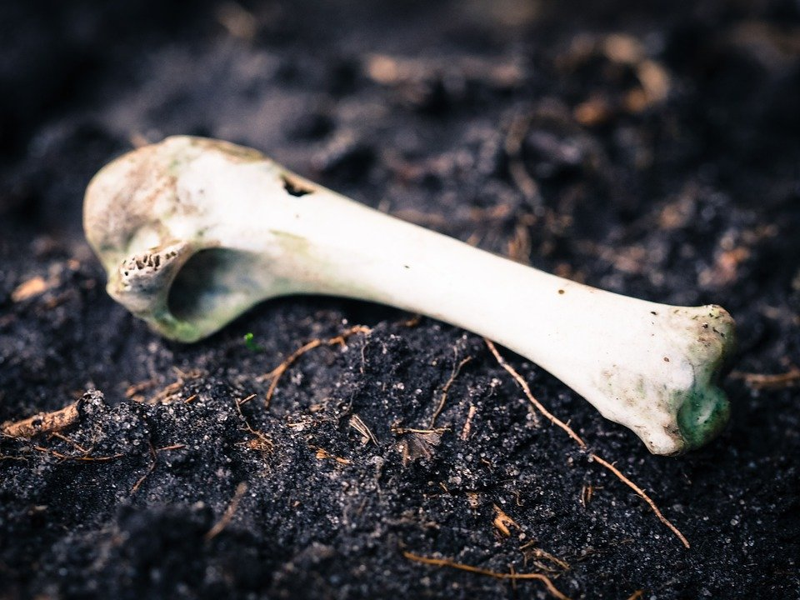
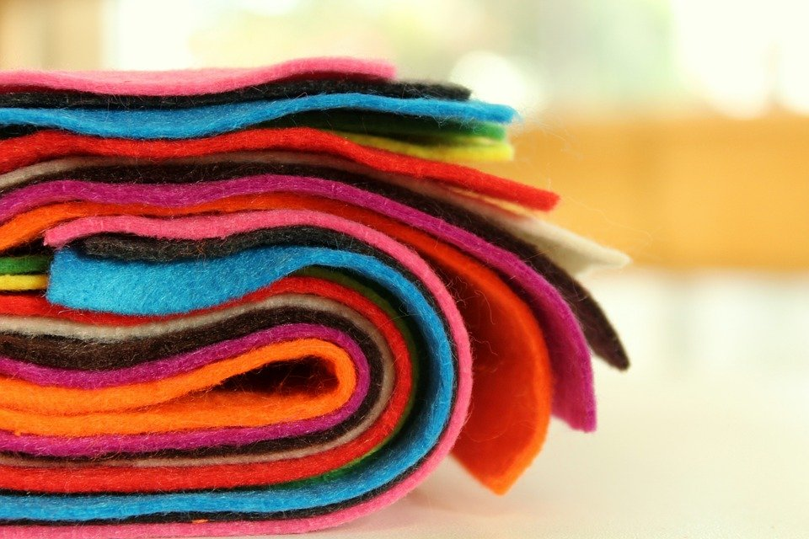
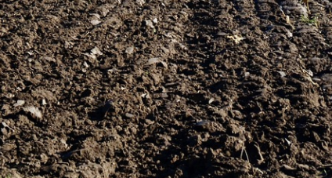

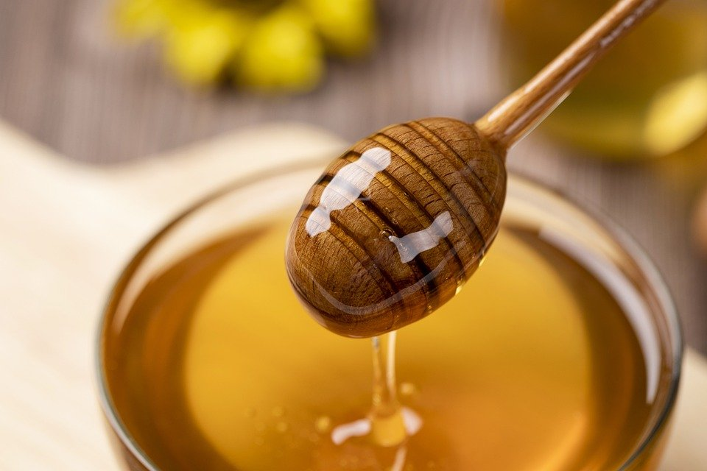
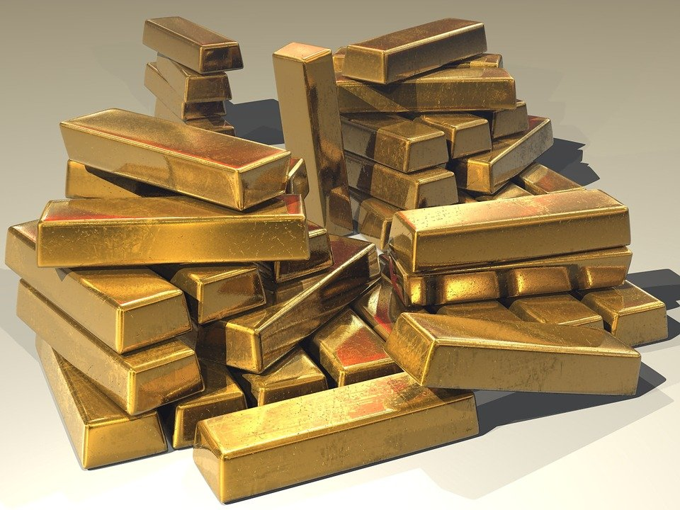
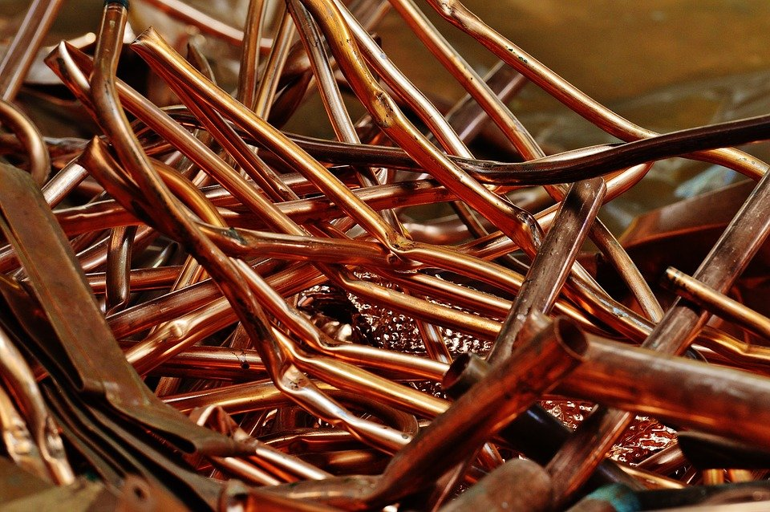
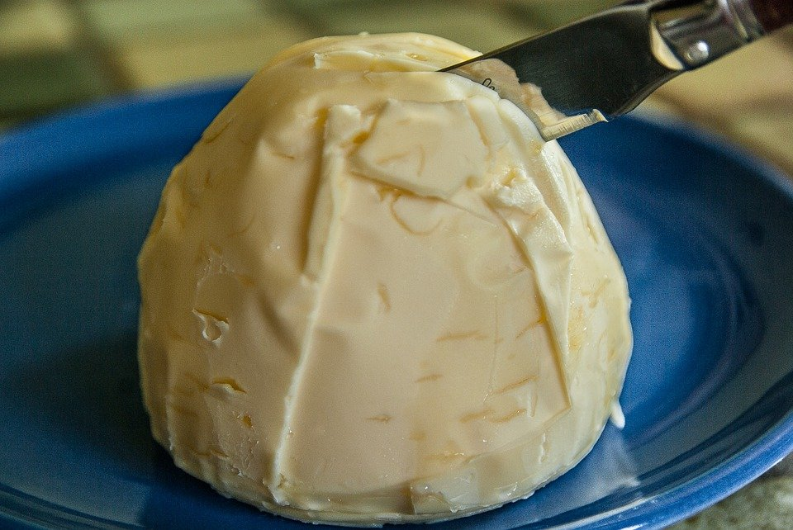
OBJECTS AND MATERIALS
4 MIN
IDENTIFY THE OBJECTS AND MATERIALS ON THE PICTURES.

Slide 13
OBJEKTE UND MATERIALIEN
4 MIN
IDENTIFIZIERT DIE OBJEKTE UND MATERIALIEN AUF DEN FOTOS.

Slide 14
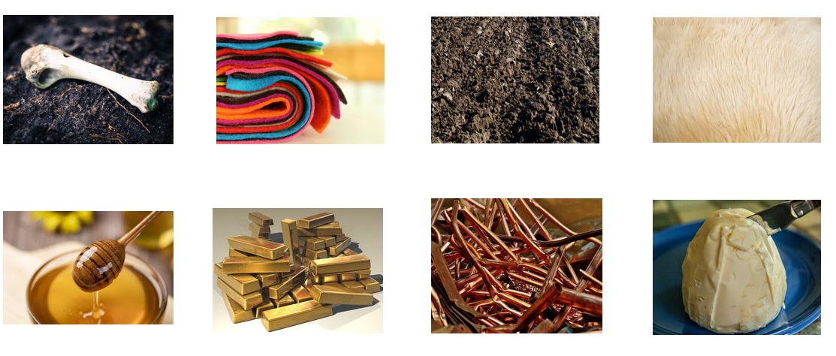
DISCUSSION: OBJECTS AND MATERIALS
6 MIN LOOK AGAIN AT THE PICTURES AND DISCUSS THE QUESTIONS.
What is your opinion on the choice of these objects/ materials for art?
Why did Beuys choose these objects/ materials?

Slide 15

INPUT: THE CHOICE OF MATERIALS
10 MIN READ THE TEXT AND DISCUSS THE QUESTION.
In which ways do you think materials and objects can influence the viewer?
How did these objects/ materials convey Beuys’ social and political messages?
Can you think of any other artists that used non-traditional materials for their art?
Materials and objects play a crucial role in art. They influence how artists make their work and how the viewers interpret the artwork. Beuys carefully selected the materials for his artwork to inform the meaning of his artwork and convey social and political messages he cared about. Beuys’ choice of materials was eclectic. He used a lot of non-traditional materials such as fat, felt, honey, bones, soil or fur.

Slide 16








BRAINSTORMING: OBJECTS AND MATERIALS 8 MIN
WHICH OTHER OBJECTS/ MATERIALS CAN YOU USE FOR ART PROJECTS? WRITE DOWN ALL YOUR IDEAS.

Slide 17





MATERIALS FOR YOUR ART PROJECT 20 MIN
DISCUSS MATERIALS FOR YOUR ART PROJECTS IN YOUR GROUPS.
What materials symbolically fit your project?/ What materials would you need to realize your project?
Can you think of any objects that you would want to include in your project?
Check out your surroundings. Take photos of interesting materials and objects. Or find images online.
Copy-paste them on the Miro Board and add them to your collage. Write about your choices.

Slide 18




Voting CHECK OUT WHAT THE OTHER TEAMS CAME UP WITH. AWARD THREE GROUPS. TALK TO YOUR GROUP ABOUT YOUR CHOICES.
5 MIN
You can award one badge of each category to a team of your choice.
Do not award your own project.
Place the badge in the area marked with the dotted line.

Slide 19
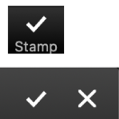
GOALS FOR TODAY You reflected on the choice of objects and materials in Beuys’ art. You decided on objects and materials for your project.

Slide 20
PREVIEW: Session 7
You will continue to work on your project and…
… come up with a character that could represent your group.

Slide 21
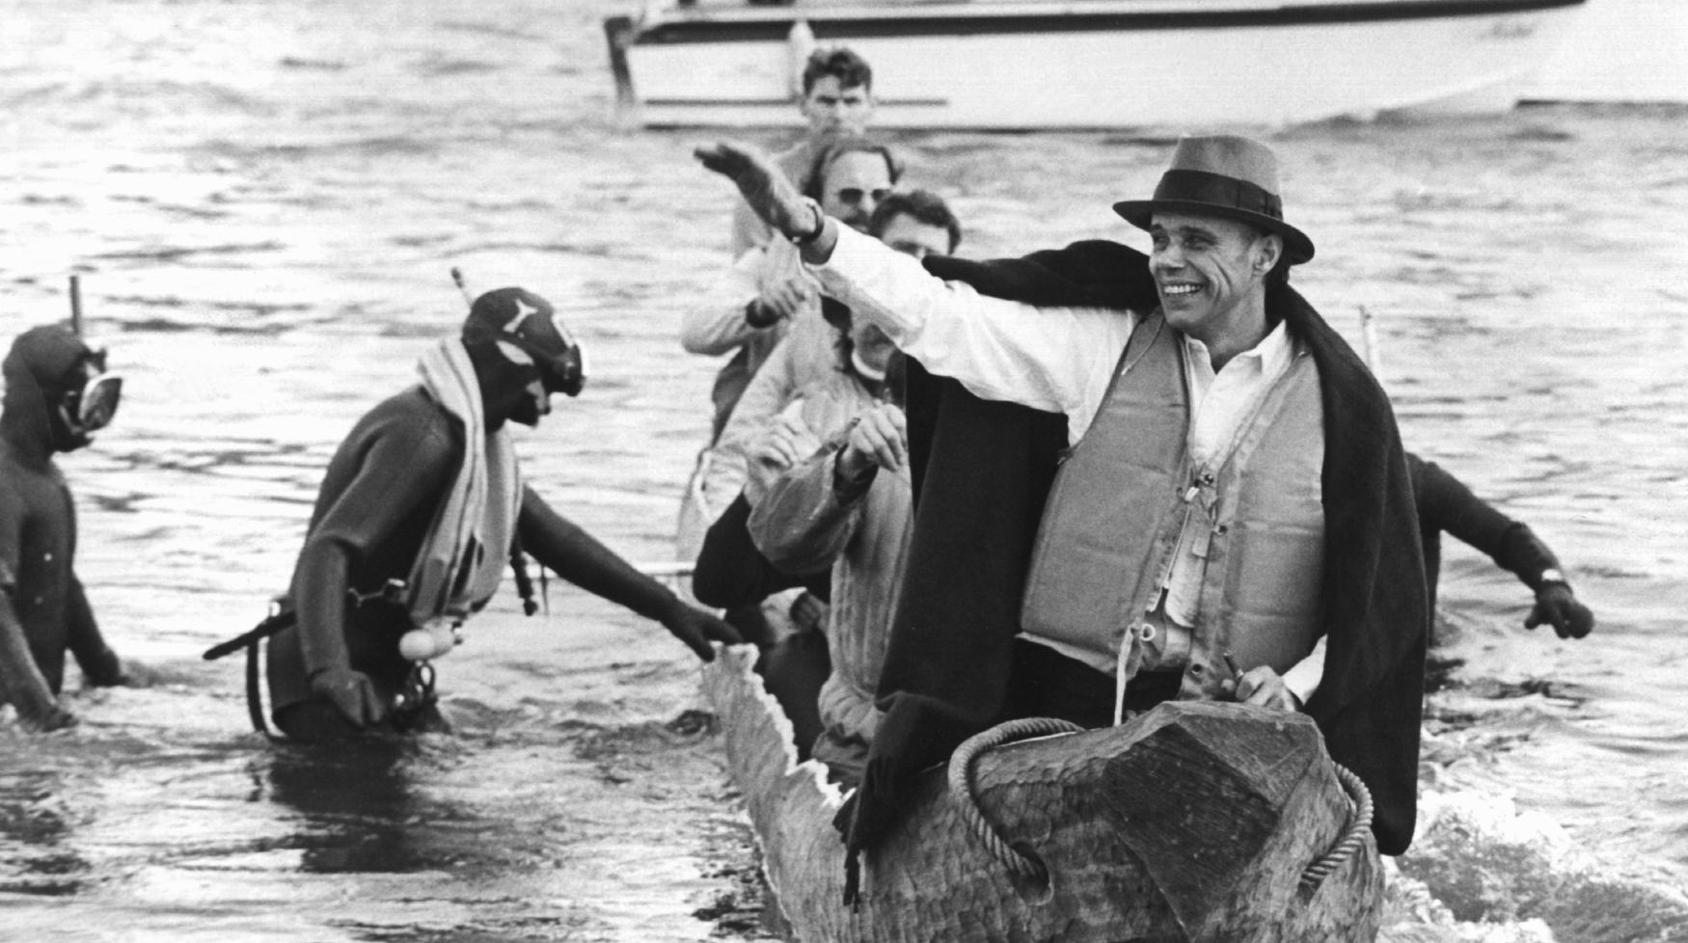
SEE YOU NEXT WEEK!

Slide 22
SCHEIDEMANN, R. (1973, OCTOBER 20). JOSEPH BEUYS IN A LOG-BOAT.[PHOTOGRAPH]. ČTK/DPA, DÜSSELDORF.
CITATIONS

