Slide 1
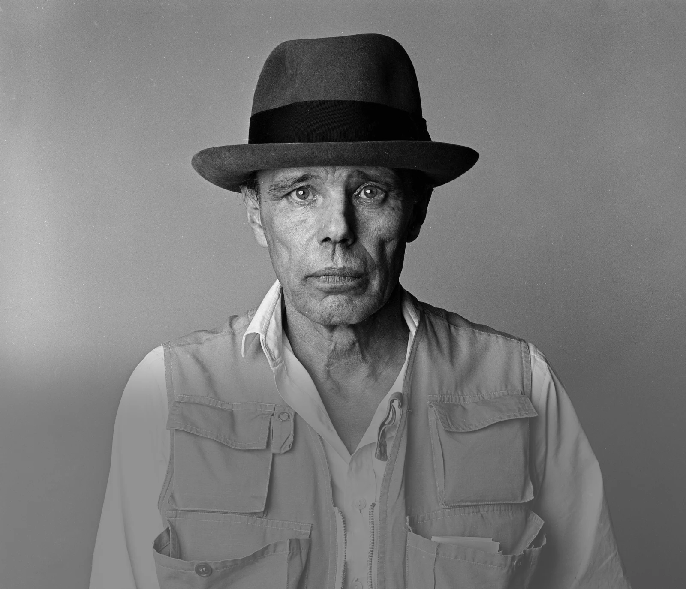
AFTERSCHOOL
PROGRAM:
BE BEUYS
Session 7 - Datum

Slide 2
WELCOME TO SESSION 7
PLEASE ACTIVATE
MICROPHONE
WEBCAM

Slide 3
WELCOME TO SESSION 7
MICROPHONE TEST
What is your favorite movie?
WE CAN HEAR YOU.
WE CANNOT HEAR YOU.

Slide 4

Willkommen zu Sitzung 7
Mikrofon TEST
Was ist dein Lieblingsfilm?
WIR KÖNNEN DICH HÖREN.
WIR KÖNNEN DICH NICHT HÖREN.

Slide 5

GOALS FOR TODAY
You understand the role of branding in Beuys’ art.
You reflect on the meaning of branding in the context of art.
You create a brand & character for your project.

Slide 6






PROGRAM OVERVIEW
1 MIN
FIND OUT WHERE WE ARE IN OUR PROGRAM.
Find a Cause you’re Passionate About!
Choose Materials and Places that Matter to you!
Create your Brand and Art Persona!
Finalize and Present your Project Plan!
Share your Project in a Social Media Post!

Slide 7
AGENDA
STEPS | TIME | CONTENT
Step 1 | 5 Minutes | Arrival
Step 2 | 10 Minutes | Warm-Up: My Favorite Character
Step 3 | 23 Minutes | Input: The Brand Beuys
Step 4 | 25 Minutes | Project Work: Our Character
Step 5 | 7 Minutes | Voting
Step 6 | 5 Minutes | Reflection, Preview & Goodbye

Slide 8
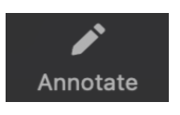
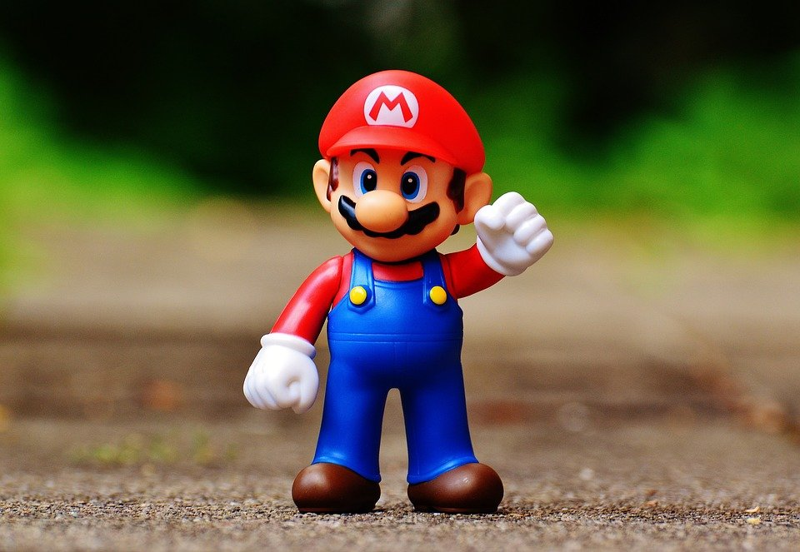
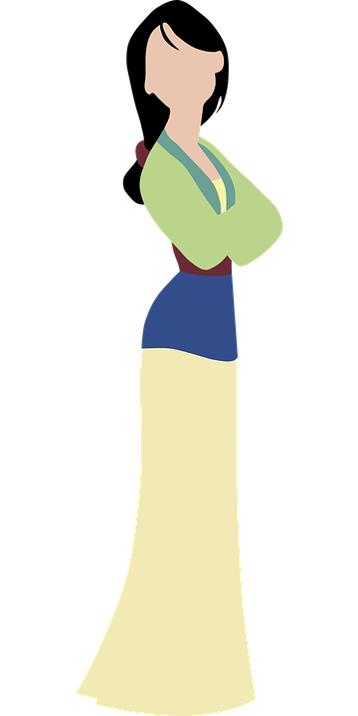
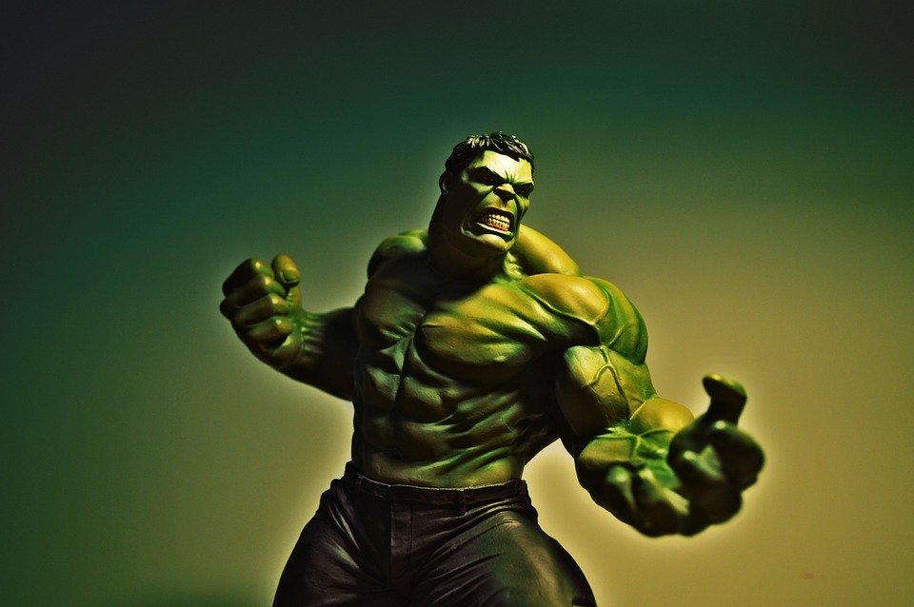
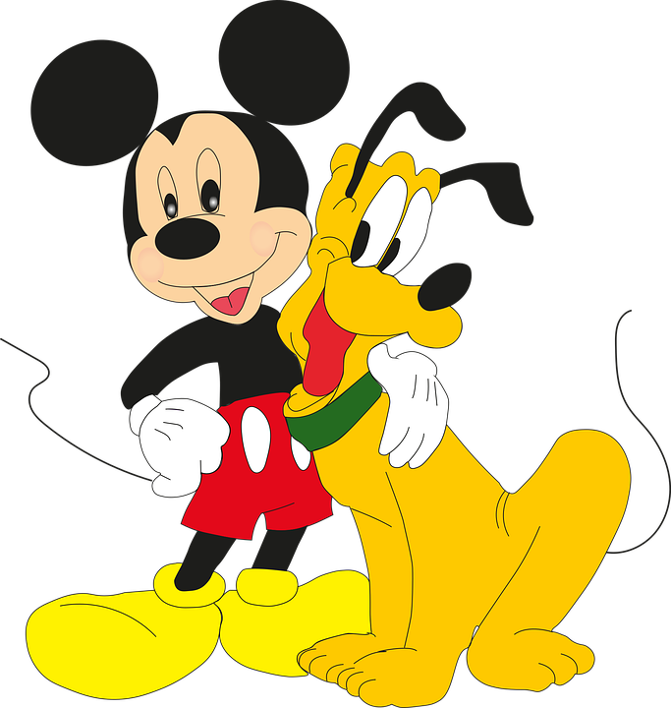
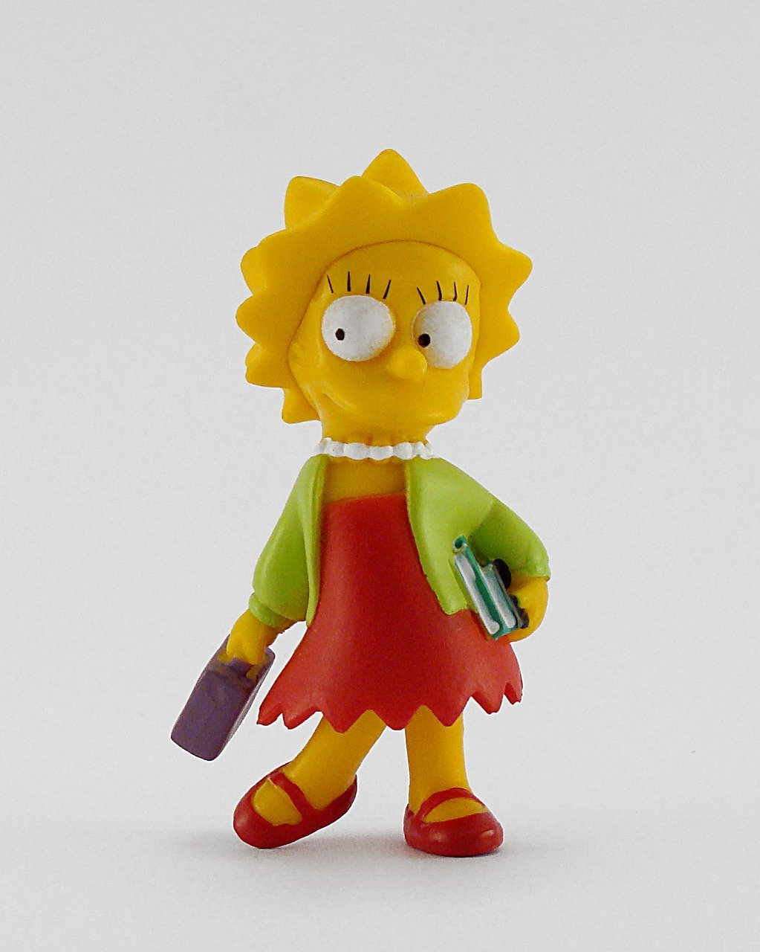
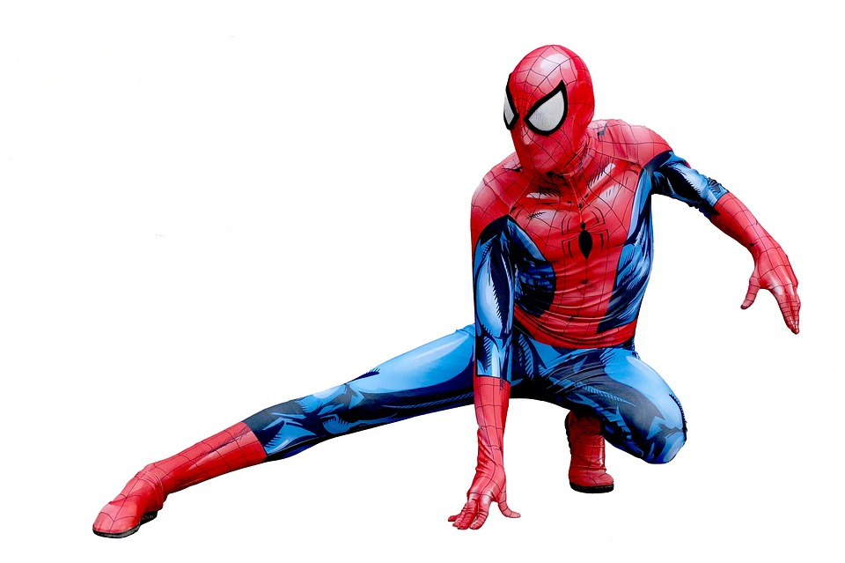
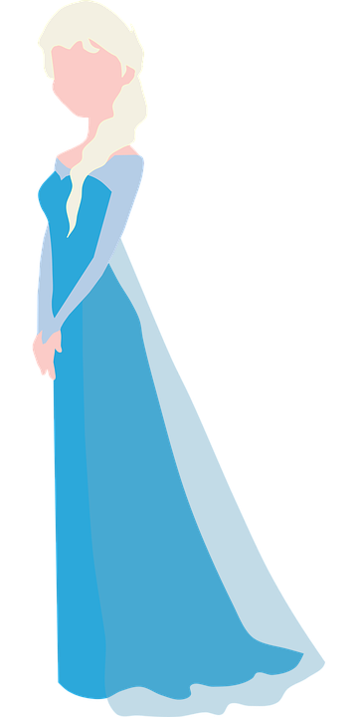
WARM-UP: MY FAVORITE CHARACTER
2 MIN
IDENTIFY THE CHARACTERS ON THE PICTURES.
Who are the characters on the pictures?

Slide 9

WARM-UP: MY FAVORITE CHARACTER
6 MIN
PRESENT YOUR FAVORITE CHARACTER TO YOUR GROUP.
Screenshot
Who is your favorite character? Why?
What character traits do you like about this character?

Slide 10


WARM-UP: MY FAVORITE CHARACTER
2 MIN
VOTE FOR YOUR FAVORITE CHARACTER.
Who is your favorite character?

Slide 11
WARM-UP: MEIN LIEBLINGSCHARAKTER
2 MIN
IDENTIFIZIERT DIE CHARAKTER AUF DEN BILDERN.
Welche Charaktere seht ihr auf dem Foto?

Slide 12
WARM-UP: MEIN LIEBLINGSCHARAKTER
6 MIN
WER IST DEIN LIEBLINGSCHARAKTER? STELLE IHN DEINER GRUPPE VOR.
Screenshot
Welcher dieser Charaktere ist dein Lieblingscharakter?
Warum?
Welche Eigenschaften magst du an ihm?

Slide 13
WARM-UP: MEIN LIEBLINGSCHARAKTER
2 MIN
STIMME FÜR DEINEN LIEBLINGSCHARAKTER AB.
Wer ist dein Lieblingscharakter?

Slide 14

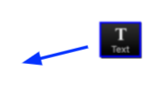
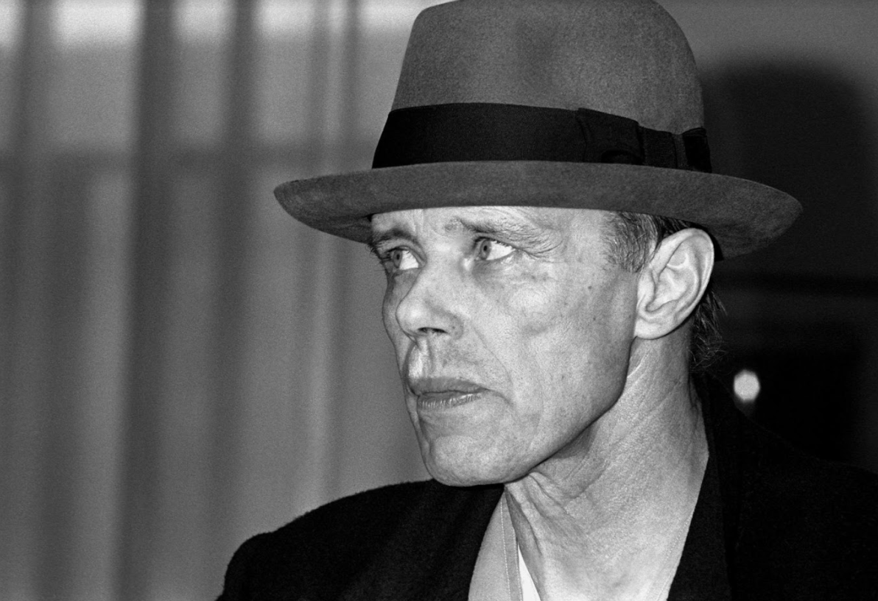
BRAINSTORMING: THE BRAND BEUYS
5 MIN
WHAT ARE YOUR ASSOCIATIONS WITH THE TERM THE BRAND BEUYS. WRITE YOUR IDEAS DOWN.
Foto: ČTK/Mary Evans/Mary Evans/AF Archive

Slide 15



BEUYS SELF-BRANDING STRATEGIES
4 min
6 min/ 2 min per group
10 MIN
READ MORE ABOUT BEUYS’ SELF-BRANDING STRATEGIES.
Read your text and discuss it with your group. Take notes.
Foto: ČTK/Mary Evans/Mary Evans/AF Archive
Summarize your text for your new group.

Slide 16
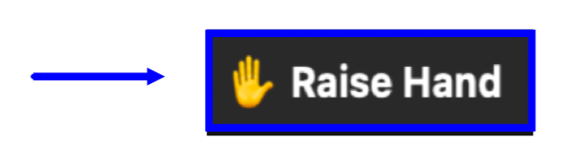
BEUYS SELF-BRANDING STRATEGIES
8 MIN
DISCUSS THE QUOTE AND QUESTIONS.
“[Beuys world was] a world of myth, ideas, obsession and hope. A world where facts and fiction are indistinguishable…, where questions don’t have answers, but just offer up more questions.”
(Will Gompertz)
How does it make you feel, that in Beuys world, fact and fiction are indistinguishable?
Do you think an artist's brand should be identical to his “real” persona? Or can they diverge?
Has Beuys art and his branded persona inspired you? In which ways?
ČTK/Mary Evans/AF Archive

Slide 17
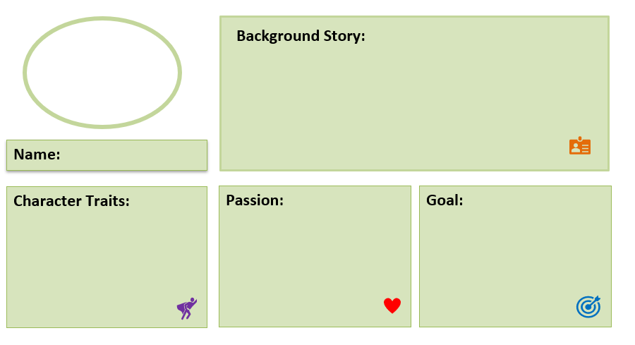
YOUR ART PROJECT BRAND
15 MIN
COME UP WITH A CHARACTER THAT COULD BE HEADING YOUR ART PROJECT AND FITS YOU AS A GROUP. FILL OUT THE WORKSHEET.
Which real or fictive person/ animal/ figure represents your group and your idea?
Why does this character fit?

Slide 18







A CHARACTER FOR YOUR ART PROJECT
10 MIN
DRAW AND WRITE ABOUT YOUR CHARACTER ON THE MIRO BOARD.
Draw your character on the Miro board using the pen tool.
Write a short text to describe
why this character fits your
project.

Slide 19




Voting
CHECK OUT WHAT THE OTHER TEAMS CAME UP WITH. AWARD THREE GROUPS.
TALK TO YOUR GROUP ABOUT YOUR CHOICES.
5 MIN
You can award one badge of each category to a team of your choice.
Do not award your own project.
Place the badge in the area marked with the dotted line.

Slide 20
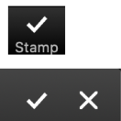
GOALS FOR TODAY
You understand the role of branding in Beuys’ art.
You reflected on the meaning of branding in the context of art.
You created a brand & character for your project.

Slide 21




REFLECTION
5 MIN
REFLECT ON TODAY’S LESSON. CHOOSE ONE SENTENCE STARTER AND COMPLETE THE SENTENCE.
I enjoyed…
I am proud of…
I want to know…
I learned…
I found challenging…

Slide 22
REFLEXION
5 MIN
REFLEKTIERE ÜBER DIE HEUTIGE STUNDE. ERGÄNZE EINEN DER SATZANFÄNGE.
Mir hat Spaß gemacht, dass…
Ich bin stolz auf…
Ich will wissen…
Ich habe gelernt, dass…
Schwierig war…

Slide 23
PREVIEW: SESSION 8
You will ...
...continue to work
on your project,
…and finalize your project plan.

Slide 24
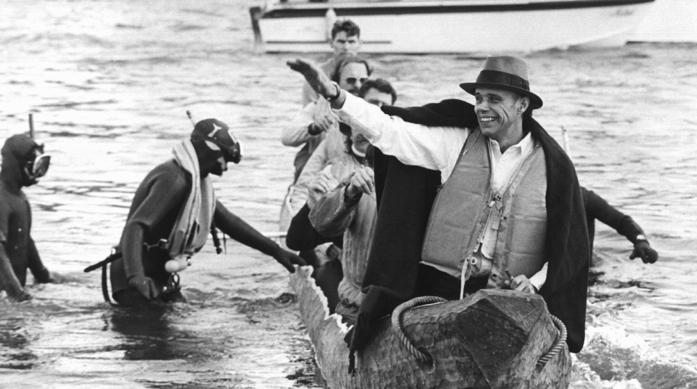
SEE YOU NEXT WEEK!

Slide 25
EVANS, M. (1985, MAY 01). JOSEPH BEUYS ARTIST 01[PHOTOGRAPH]. AF ARCHIVE.
SCHEIDEMANN, R. (1973, OCTOBER 20). JOSEPH BEUYS IN A LOG-BOAT.[PHOTOGRAPH]. ČTK/DPA, DÜSSELDORF.
Citations

