Slide 1
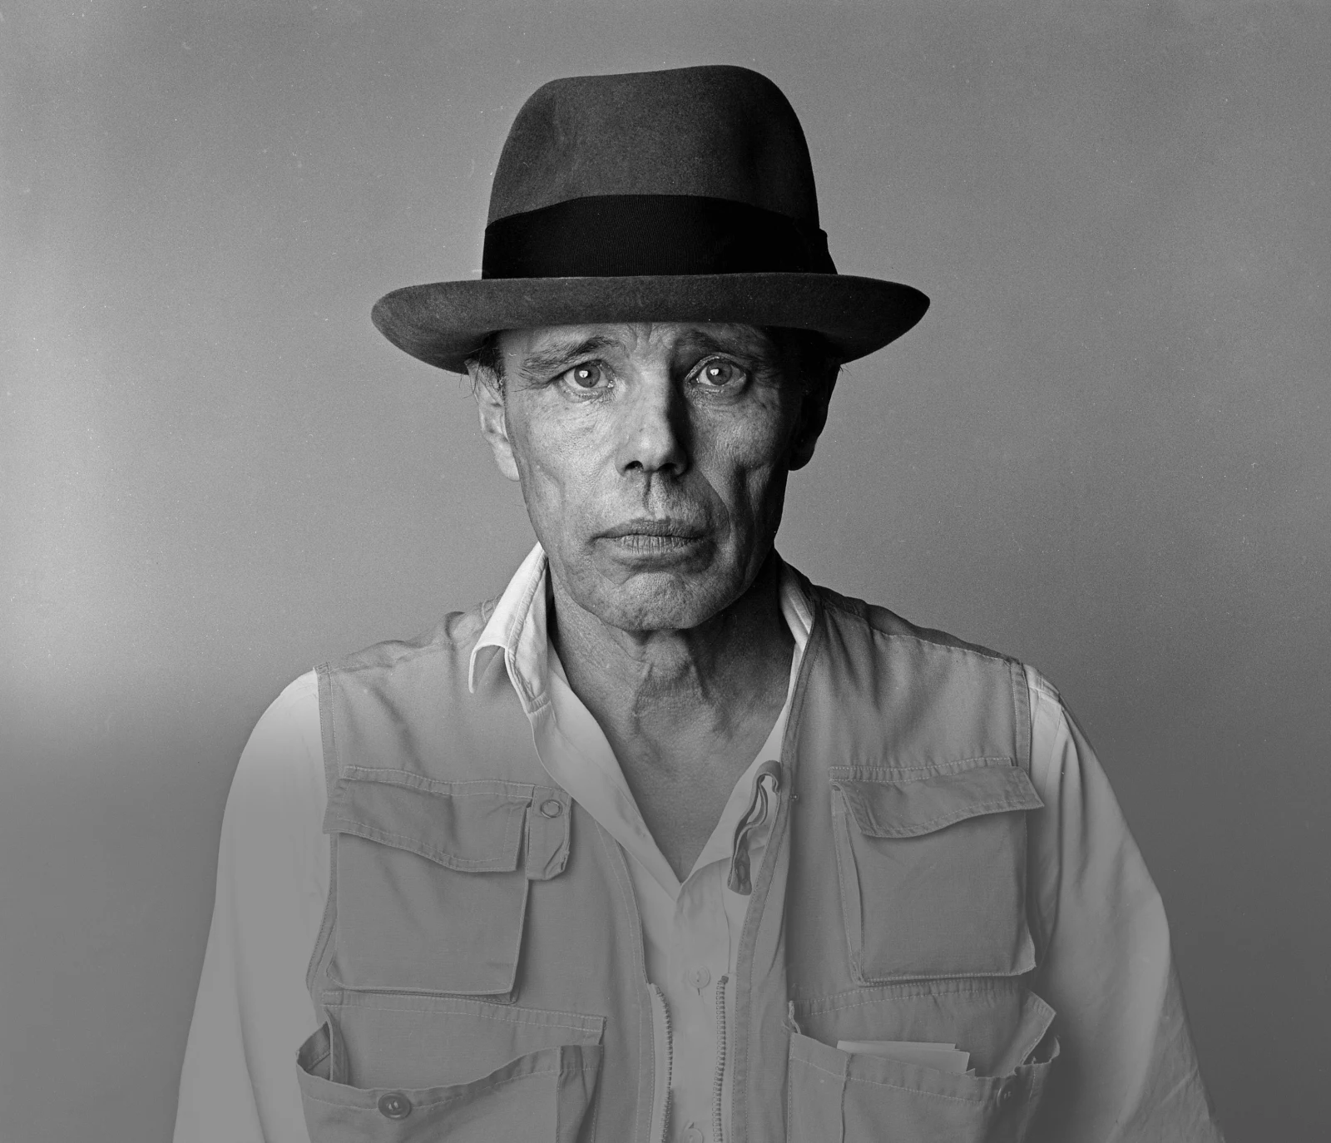
Afterschool Program: Be Beuys
Session 8 - Datum

Slide 2
Welcome to Session 8 Please activate
Microphone
Webcam

Slide 3
Welcome to Session 8 Microphone test
What‘s one thing you did last weekend?
We can hear you.
We canNOT hear you.

Slide 4
Willkommen zu sitzung 8 Mikrofon test
Welche Aktivität hast du am Wochenende gemacht?
Wir hören dich.
Wir hören dich nicht.

Slide 5
Goals for today → you Choose a name for your art project group. → You finalize your project plan. → you decide on a way to visualize Your Project plan.

Slide 6
PROGRAM OVERVIEW 1 MIN FIND OUT WHERE WE ARE IN OUR PROGRAM.
Find a Cause you’re Passionate About!
Choose Materials and Places that Matter to you!
Create your Brand and Art Persona!
Finalize and Present your Project Plan!
Share your Project in a Social Media Post!

Slide 7
Agenda
Steps | Time | Goal
Step 1 | 5 Minutes | Arrival
Step 2 | 12 Minutes | Warm-Up: Two Truths and a Lie
Step 3 | 12 Minutes | Choosing a Group Name
Step 4 | 5 Minutes | Recap: Course Achievements
Step 5 | 33 Minutes | Finalizing your Project Plan
Step 6 | 8 Minutes | Reflection, Preview & Goodbye

Slide 8
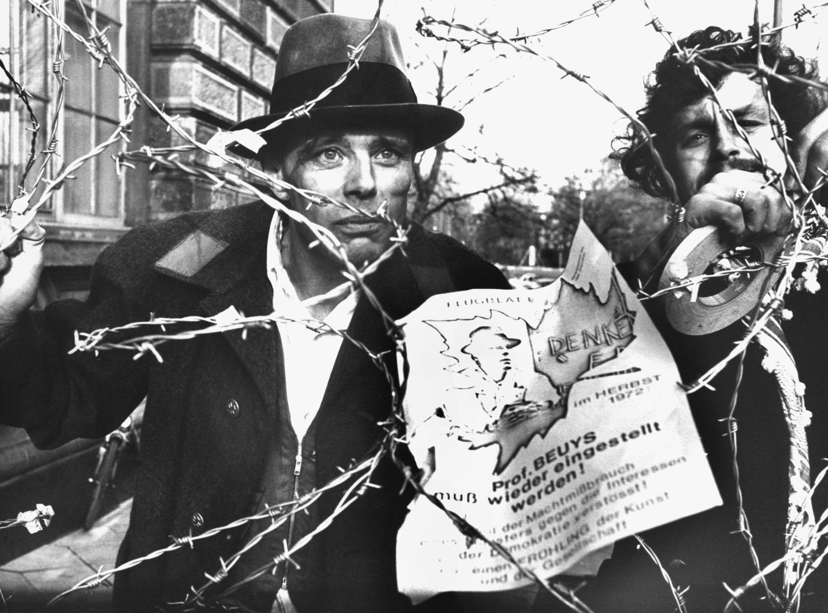
Warm-Up: Two truths and a lie 3 Min
WHICH STATEMENT ABOUT JOSEPH BEUYS IS A LIE?
Beuys survived a plane crash.
He was fired from his job as professor at the art academy in Düsseldorf.
DPA/ Bernd Müller (1972)
He was one of the first members of the Christian political party CDU.

Slide 9
Warm-Up: Two truths and a lie 2 Min
WRITE DOWN TWO TRUTHS AND A LIE ABOUT YOURSELF.

Slide 10
Warm-Up: Two truths and a lie 5 Min
PRESENT YOUR STATEMENTS AND FIND OUT THE LIES OF YOUR CLASS COLLEAGUES.
I believe your second statement is a lie, because …

Slide 11
Warm-Up: Two truths and a lie 2 Min
WHICH LIES DID YOU DISCOVER? PRESENT.
I discovered a lie
about _________ .
S/he said that …

Slide 12
Warm-Up: Zwei Wahrheiten und eine Lüge 3 Min
WELCHES STATEMENT ÜBER BEUYS IST EINE LÜGE?
Beuys hat einen Flugzeugabsturz überlebt.
Er wurde von von der Kunstakademie in Düsseldorf gefeuert. Dort war er Professor.
DPA/ Bernd Müller (1972)
Er war einer der ersten Mitglieder der christlichen Partei CDU.

Slide 13
Warm-Up: Zwei wahrheiten und eine Lüge 2 Min
NOTIERT JEWEILS ZWEI WAHRHEITEN UND EINE LÜGE ÜBER EUCH SELBST.

Slide 14
Warm-Up: ZWEI WAHRHEITEN UND EINE LÜGE 5 Min
PRÄSENTIERT EURE STATEMENTS UND FINDET DIE LÜGEN VON DEN ANDEREN PERSONEN IM KURS HERAUS.
Ich glaube, dein zweites Statement ist eine Lüge, weil…

Slide 15
Warm-Up: Zwei wahrheiten und eine lüge 2 Min
WELCHE LÜGEN HABT IHR HERAUSGEFUNDEN? PRÄSENTIERT.
Ich habe eine Lüge über ______ herausgefunden .
Er/Sie sagt, dass…

Slide 16
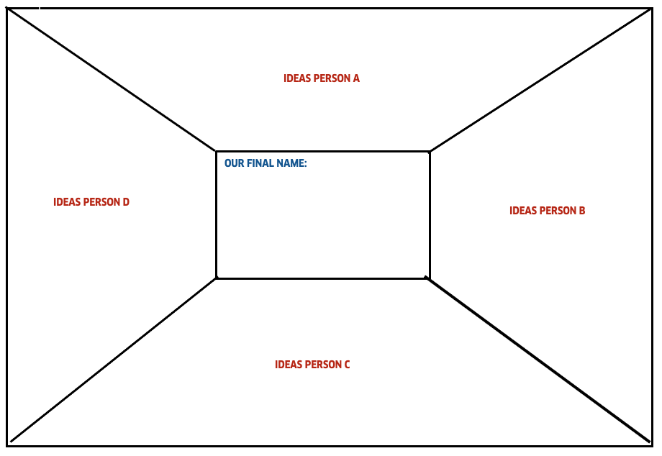
Choosing a group name 10 Min
Screenshot
DECIDE ON A GROUP NAME THAT BEST REFLECTS YOUR ART PROJECT.
Think of 2-3 names for your team and write them in your section of the worksheet.
Present your ideas to your fellow team members.
Discuss all ideas and decide on one name for your team.
3 Min
5 Min

Slide 17
Choosing a group name 2 Min
BRIEFLY PRESENT YOUR GROUP NAME.
We chose the group name __________ because …

Slide 18
RECAP: COURSE ACHIEVEMENTS 5 Min
THINK BACK TO OUR PREVIOUS SEVEN SESSIONS. WHAT DID WE ACHIEVE FOR OUR ART PROJECTS SO FAR? WRITE DOWN YOUR IDEAS.
Choose a group name

Slide 19
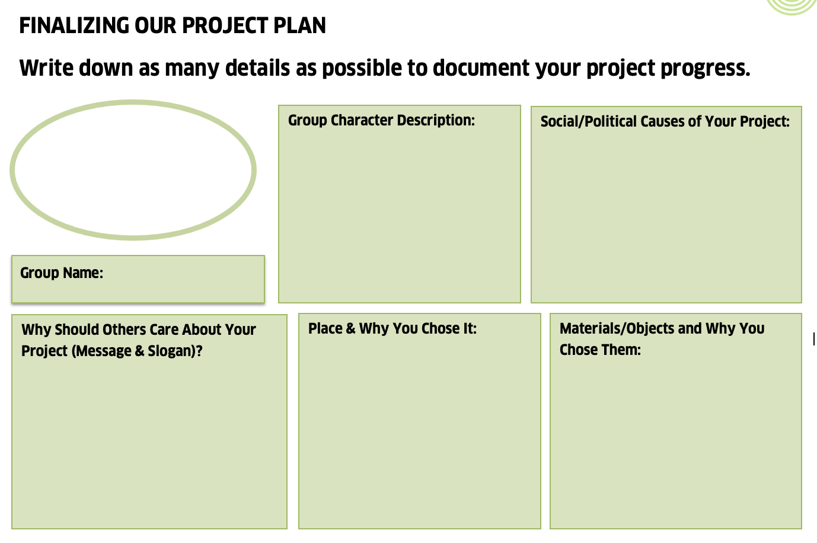
Finalizing your project plan 10 Min
IN YOUR GROUP, DOCUMENT THE DIFFERENT ELEMENTS OF YOUR ART PROJECT PROGRESS.
Fill out each section as comprehensively as possible.
You can use your notes on the Miro Board as a reference.

Slide 20
Finalizing your project plan 20 Min
DISCUSS THE FOLLOWING QUESTIONS:
Screenshot
What is the goal of your project?
What is the message you want to convey?
3. In which format would you like to present your project plan?
Video / Audio
Collage
Photography
Power Point/ Presentation
Poem
*If you’ve answered all the questions, you can already get started on your presentation. Start visualizing your project plan with the format you’ve chosen (Power Point, Video, Poem …) .

Slide 21
Finalizing your project plan 3 Min
PRESENT THE PROJECT PLAN FORMAT YOU DECIDED ON.
We decided to present our project as a ______ because …

Slide 22
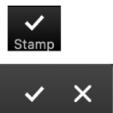
Goals for today you chose a name for your art project group. You finalized your project plan. you decided on a way to visualize your project plan.

Slide 23
Reflection: FEATHER & STONE 5 Min
WHAT WAS EASY/DIFFICULT FOR YOU TODAY? WRITE AT LEAST ONE ASPECT IN EACH BOX.

Slide 24
Preview: Session 9
You will …
… visualize your project plans.
… present your project.
… and you will reflect on your team performance.
(JOSEPH BEUYS)

Slide 25
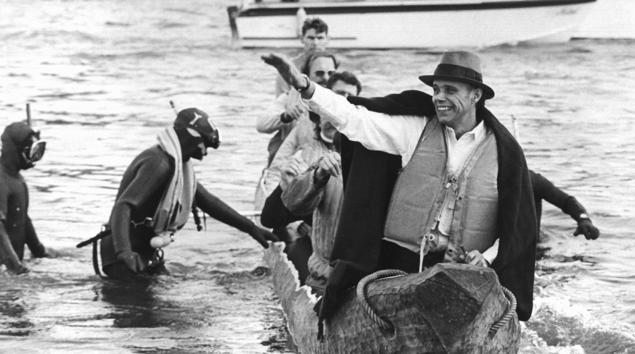
See you next week!
ČTK/DPA/Roland Scheidemann

Slide 26
Scheidemann, R. (1973, October 20). Joseph Beuys in a log-boat.[Photograph]. ČTK/DPA, Düsseldorf. Müller, B. (1972, November 23). Joseph Beuys Maschendrahtzaun[Photograph]. DPA, Düsseldorf.
Citations

