Slide 1
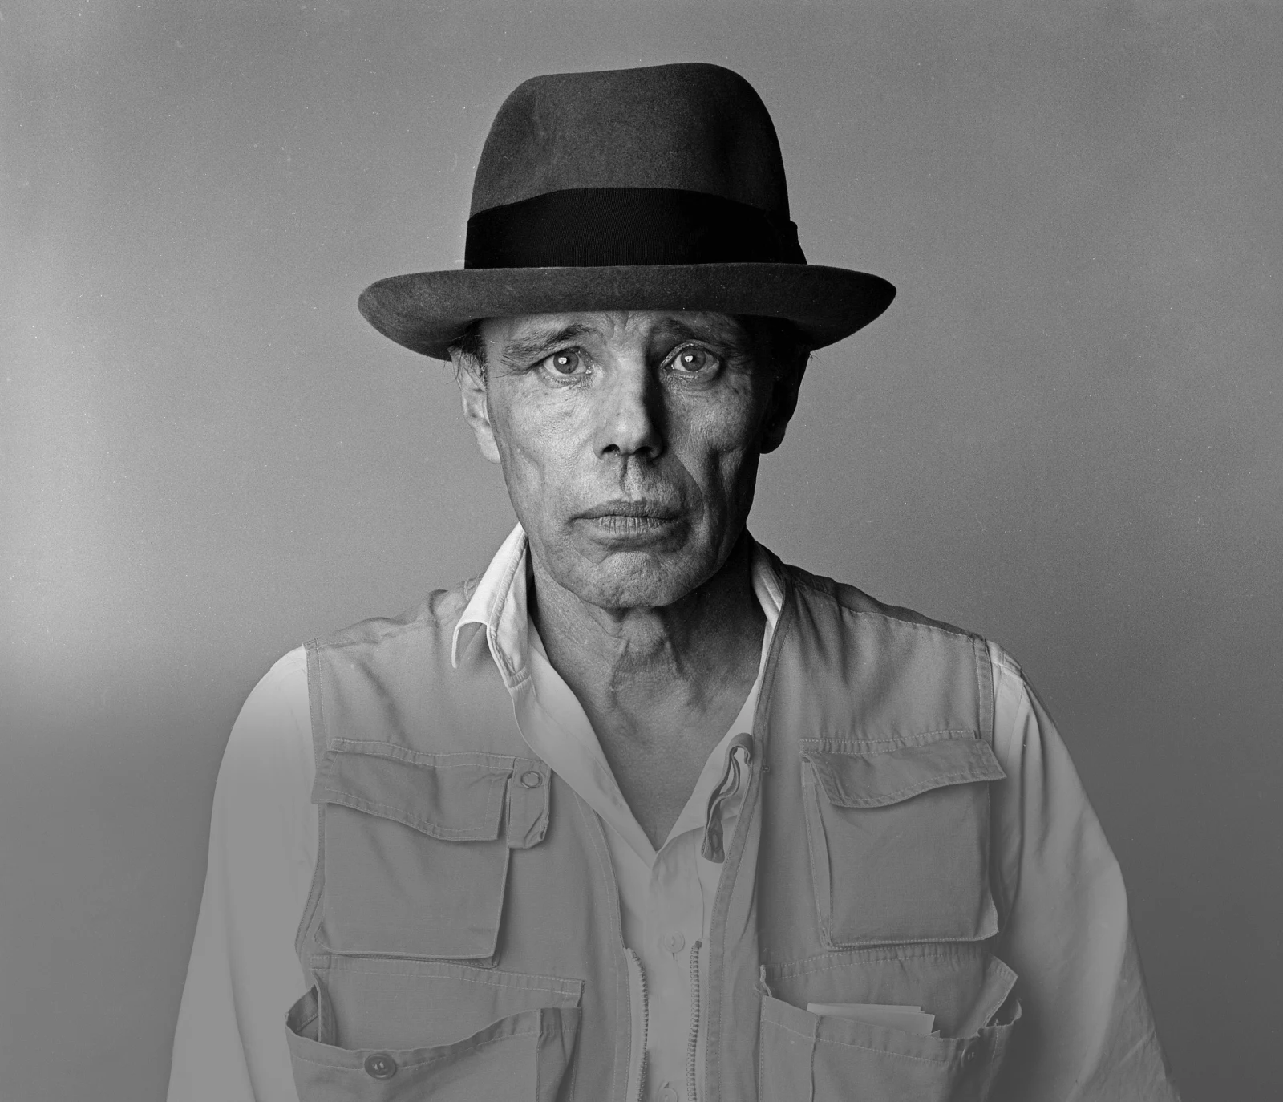
Afterschool
Program:
Be Beuys
Session 9 - Datum

Slide 2
Welcome to Session 9
Please activate
Microphone
Webcam

Slide 3
Welcome to Session 9
Microphone test
How are you today?
We can hear you.
We canNOT hear you.

Slide 4

Willkommen zu sitzung 9
Mikrofon test
Wie geht‘s dir heute?
Wir hören dich.
Wir hören dich nicht.

Slide 5
Goals for today
→ you visualize your project plan.
→ You present your project plan.
→ you reflect on your group performance.

Slide 6






PROGRAM OVERVIEW
1 MIN
FIND OUT WHERE WE ARE IN OUR PROGRAM.
Find a Cause you’re Passionate About!
Choose Materials and Places that Matter to you!
Create your Brand and Art Persona!
Finalize and Present your Project Plan!
Share your Project in a Social Media Post!

Slide 7
Agenda
Steps | Time | Goal
Step 1 | 3 Minutes | Arrival
Step 2 | 5 Minutes | Warm-Up: Dream Places
Step 3 | 25 Minutes | Project Plan Visualization
Step 4 | 30 Minutes | Presenting your Art Project Plans
Step 5 | 10 Minutes | Team Performance Reflection
Step 6 | 2 Minutes | Reflection, Preview & Goodbye

Slide 8
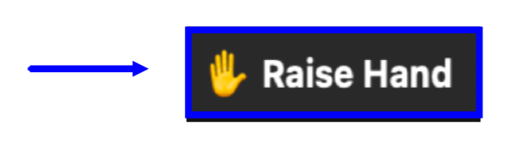

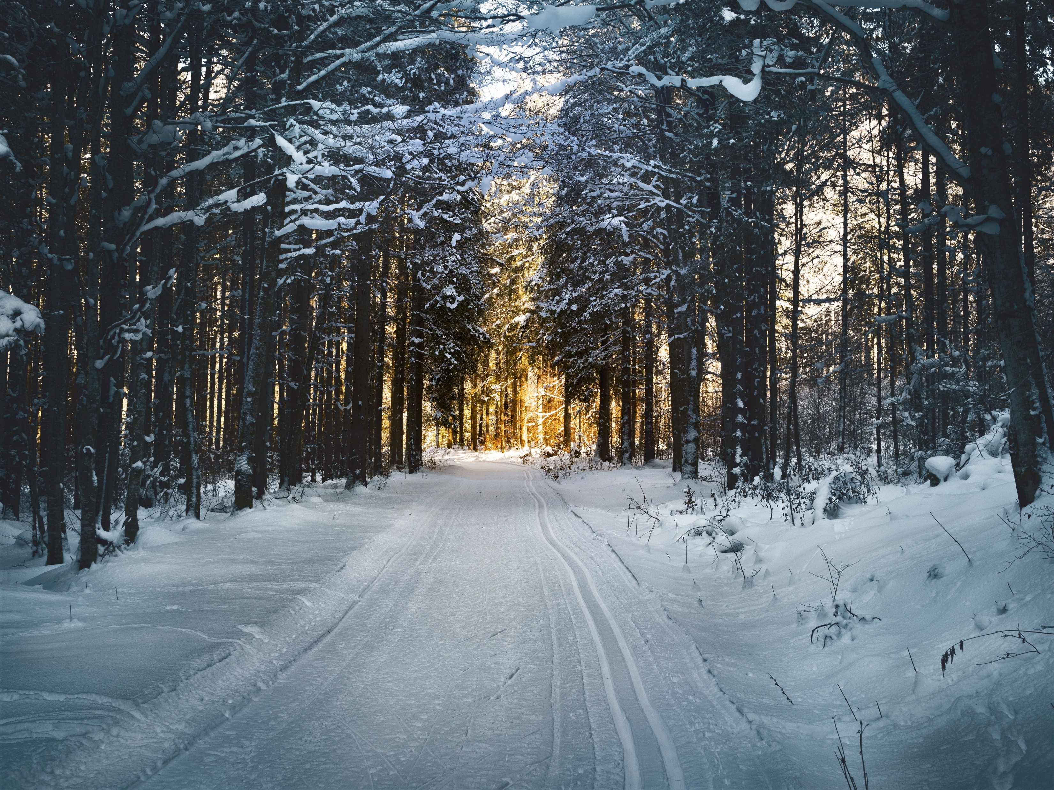
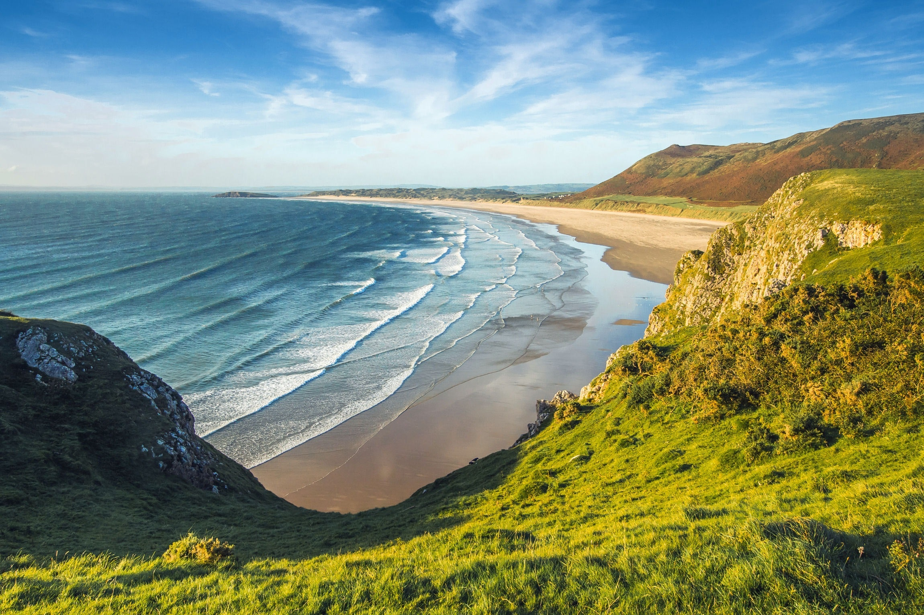

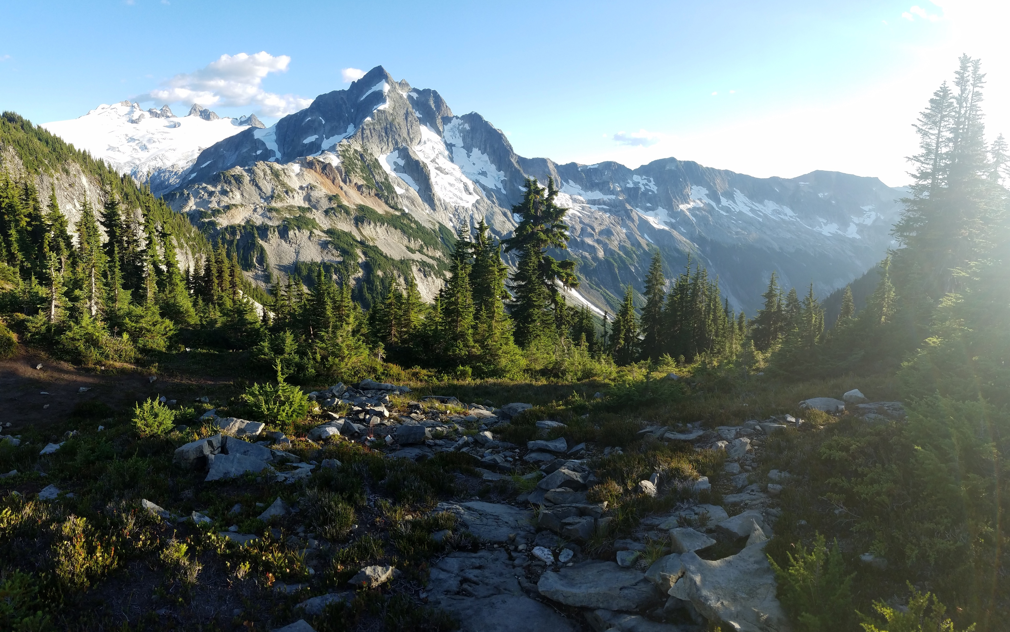

Warm-Up – Dream Places
5 Min
WHERE WOULD YOU LIKE TO BE RIGHT NOW? AND WHY?

Slide 9
Warm-Up – Traumorte
5 Min
WOHIN MÖCHTET IHR GERN REISEN? WARUM?
Ich möchte gern ans Meer reisen, weil …
ans Meer
in den Regenwald
in die Berge
in die Wüste
in den Schnee

Slide 10



project plan visualization
25 Min
Screenshot
VISUALIZE YOUR PROJECT PLAN AND PREPARE YOUR PRESENTATION.
Last live session, you finalized your project plans. In your
group, briefly recap the details you decided on.
→ goal of project / message to convey / presentation format
2. Visualize your project plan in the chosen format.
→ i.e. prepare a PPT, take a photo, write a poem…
Tip: Try to include as many details as possible from your plan.
IMPORTANT: The goal is to present your project plan in ~4 mins.
The visualization is the framework for your presentation.

Slide 11



Presenting your art project plans
25 Min
Screenshot
PRESENT YOUR PROJECT PLAN VISUALIZATIONS. PROVIDE AS
MUCH DETAIL ABOUT YOUR PROJECT PLAN AS POSSIBLE.
Assign a timekeeper. S/he manages the time
→ Max. 4 minutes allotted per presentation.
2. Before each presentation, designate one person to provide
feedback. This person will compliment the presenter once finished.
i.e. What inspired you? What was particularly interesting? What did the group do well? …

Slide 12



Presenting your art project plans
5 Min
WHAT IMPRESSED YOU MOST ABOUT THE PRESENTATIONS OF
YOUR CLASS COLLEAGUES? WRITE ON THE SLIDE.
things that
impressed us

Slide 13




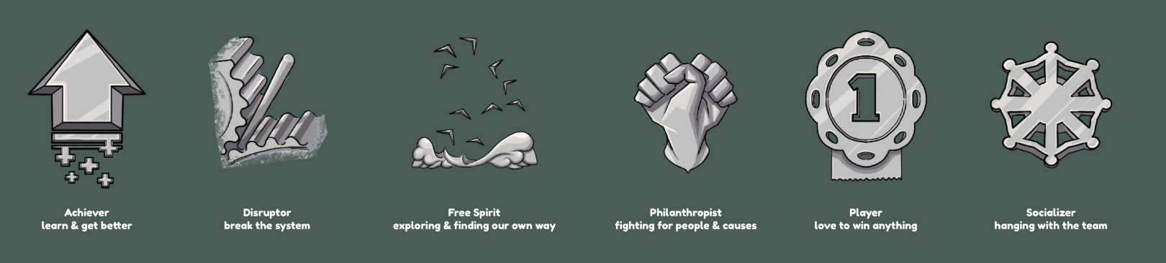
Team Performance Reflection
7 Min
Screenshot
DISCUSS THE QUESTIONS. ASSIGN YOURSELF A BADGE.
1. How did you do as a group?
2. What went particularly well?
3. What could you optimize next time?
Done? Open the Miro Board. Based on your reflections,
assign one of the badges to your own group.

Slide 14

Team Performance reflection
3 Min
PRESENT THE BADGE YOU AWARDED YOURSELF AND EXPLAIN WHY.
We awarded ourselves
the badge _________,
because …

Slide 15
Team-Performance reflexion
3 Min
PRÄSENTIERT EUER GEWÄHLTES ABZEICHEN UND BEGRÜNDET
EURE WAHL.
Wir haben das Abzeichen
___________ gewählt,
Weil …

Slide 16
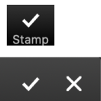
Goals for today you visualized your project plan.
You presented your project plan. you reflected on your group performance.

Slide 17
Preview: Session 10
You will …
… learn about Joseph Beuys
and his PR work.
… write a social media post
about your group project.
… reflect the after school
program.
(JOSEPH BEUYS)

Slide 18
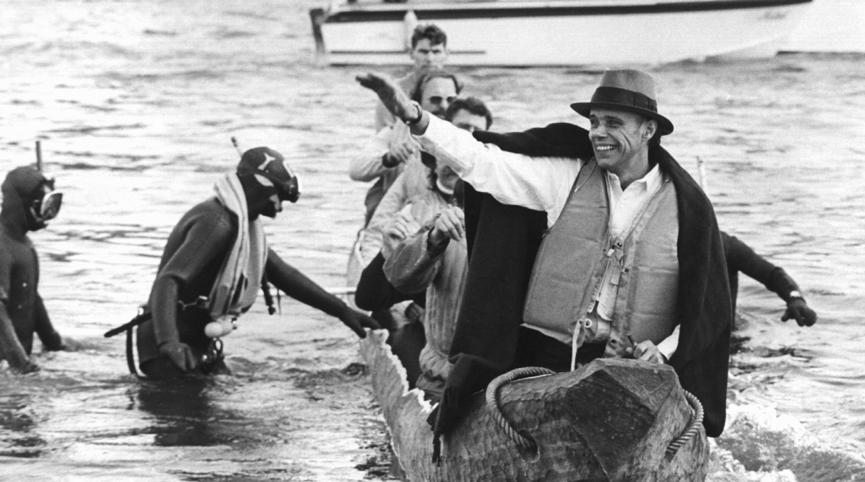
See you next week!
ČTK/DPA/Roland Scheidemann

Slide 19
Scheidemann, R. (1973, October 20). Joseph Beuys in a log-boat.[Photograph]. ČTK/DPA, Düsseldorf.
Citations

