Slide 1
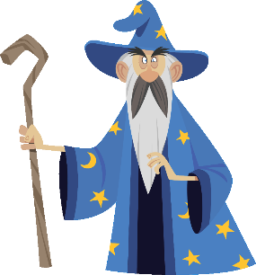

THE LANGUAGE MAGICIAN - A magical tweak
THE LANGUAGE MAGICIAN
Notes:
This presentation was created by Steven Fawkes from ALL for workshops in the UK. You are welcome to adjust the presentation for your own needs and context. Please see the notes below screens.

Slide 2
Why should I tweak?
If your class is asking you ‘When can we play THE LANGUAGE MAGICIAN again?’
and you would like to maintain their motivation …. how about tweaking some activities you do anyway to make them look more like TLM?
THE LANGUAGE MAGICIAN
Notes:
TLM = THE LANGUAGE MAGICIAN

Slide 3
How do I tweak?
You don’t need magic!
You just need to think about
The style
The imagery
The characters
The storyline
THE LANGUAGE MAGICIAN

Slide 4
Have you seen the tweaking?
THE LANGUAGE MAGICIAN has begun to share Teacher-generated resources via links on
https://www.thelanguagemagician.net/
An article outlining the idea is here:
A Magical Tweak – Integrating THE LANGUAGE MAGICIAN into Lessons
THE LANGUAGE MAGICIAN

Slide 5
Example 1
In THE LANGUAGE MAGICIAN Classroom Resources you will find an activity called ‘I made a potion …’
This is a traditional classroom game called ‘I went to market and I bought ..’
tweaked to be a TLM type activity.
THE LANGUAGE MAGICIAN
Notes:
Pupils take it in turn to say a line , remembering the list and adding something on:
I went to market and I bought …. Potatoes
I went to market and I bought …. Potatoes and oranges
I went to market and I bought …. Potatoes and oranges and carrots
I went to market and I bought …. Potatoes and oranges and carrots and a cabbage
Etc.

Slide 6
Module 3:
I made a potion and I put in ..
Pupil 1: I made a potion and I put in a frog!
Pupil 2: I made a potion and I put in a frog and a chair!
Pupil 3: I made a potion and I put in a frog, a chair and some chocolate!
Pupil 4: I made a potion and I put in a frog, a chair, some chocolate and a horse’s tooth!
THE LANGUAGE MAGICIAN
Notes:
This is ‘I went to market and I bought ..’ tweaked to be a TLM type activity – from the Classroom Resources on the TLM website https://www.thelanguagemagician.net/

Slide 7
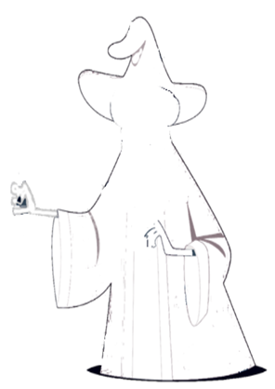
Example 2: Create your magician
Pupils create their own magician
(S/he doesn’t need to look like this! You can use a different sketch)
They practise describing - size, colours, clothes, body parts
They draw a picture and get ready to answer questions about it aloud
THE LANGUAGE MAGICIAN
Notes:
This image comes from the Classroom Resources https://www.thelanguagemagician.net/

Slide 8
Create your magician
Children listen to a description of someone else’s magician and draw or write down what he/she looks like
Children read a description of a magician and draw or write down what he/she looks like
Children answer questions about the magician they have created:
Is it a man?
Is he tall?
Has he got a beard?
What colour is his hair?
Does he wear a big hat?
Notes:
Alternative activities

Slide 9
Example 3: Power of Language:
Make something happen
Maths shapes and prepositions
Cercle
Carré
Trait
Triangle
… make a Spell
dans
sur
sous
La Rioja- Enchanted by The Language Magician
Notes:
Details on next screen
You can change the language to what is appropriate!

Slide 10
… make a Spell
Teach the names of the Maths shapes in the language by drawing them on the screen and then drawing them in the air with your finger
Teach the prepositions by doing gestures
Give your instructions to the class:
Draw a circle / a big circle
On top of the circle draw a triangle / a small triangle
etc.
Pupils respond by drawing in the air
Then challenge a pupil to invent a spell in the same way for others to respond to.
La Rioja- Enchanted by The Language Magician

Slide 11
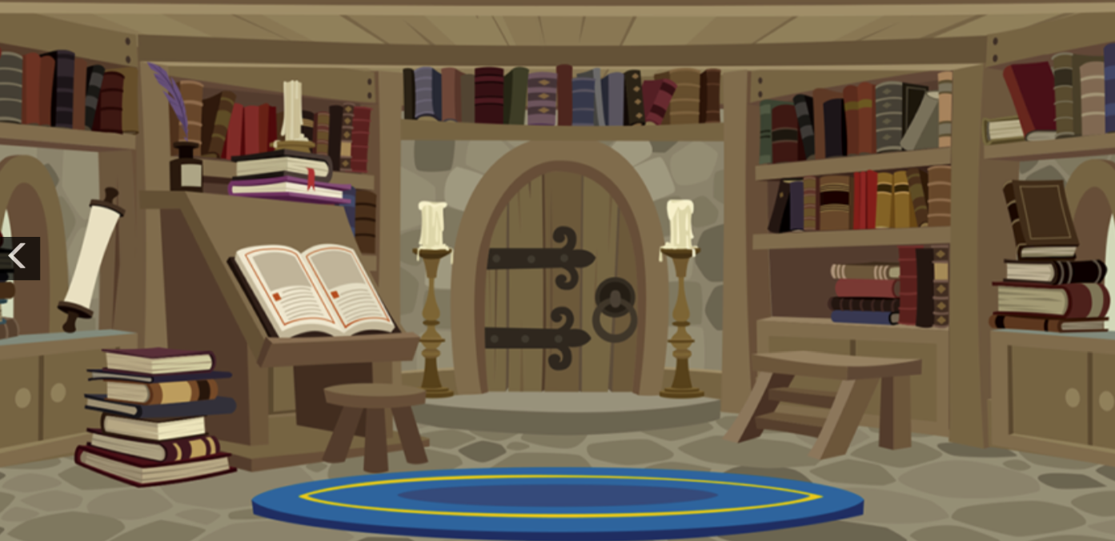
Example 4: In the Magician‘s Library
THE LANGUAGE MAGICIAN
Notes:
This is a Worksheet from Classroom Resources Module 2
Details on next screen

Slide 12
In the Magician‘s Library
This could be for a pair -/ group-work activity or for the whole class, on screen or on paper
Teacher (or partner) shows the image and asks for ideas of where to hide things (they could be magical animals)
Pupils say : under the carpet, on the shelf , behind the books
Teacher points and asks them to be precise:
These books? The shelf at the top? Etc. and pastes an image accordingly
THE LANGUAGE MAGICIAN
Notes:
This is a Worksheet from Classroom Resources Module 2
You wil find some images later in the presentation
If played by pupils they need to make paper counters with the pictures on

Slide 13
Have you seen the tweaking?
THE LANGUAGE MAGICIAN has begun to share Teacher-generated resources via links on
https://www.thelanguagemagician.net/
An article outlining the idea is here:
A Magical Tweak – Integrating THE LANGUAGE MAGICIAN into Lessons
THE LANGUAGE MAGICIAN
Notes:
If you have resources to share please follow the links on the website

Slide 14
Example 5: Specially written playlets
‘Where is Crocodile?’ was specially written for this project; it is available on the TLM website in English and German, and via the links provided in French and Spanish.
A sample follows…
Also available via THE LANGUAGE MAGICIAN website an original German playlet called ‘Bad weather’ has been tweaked to be ‘Bad weather for magical creatures’ featuring the TLM characters.
THE LANGUAGE MAGICIAN
Notes:
Using a playlet opens up a lot of learning opportunities for pupils – not just reading the words, but learning how to say them well, how to use intonation in a sentence, how to project their voice to an audience how to stand and use their body language and gesture, how to memorise longer pieces of language .
Beyond this they learn about sound effects, the use of music and props, stage directions and how to improve on a performance.

Slide 15
¿Dónde está Cocodrilo?
Músicos tocando una canción
Narrador 1 !Bienvenidos a la granja mágica!
Narrador 2 Y bienvenidos a nuestra obra de teatro : “¿Dónde está Cocodrilo?”
Narrador 1 !Conozcamos a los animales mágicos!
(Entra y sale un gato a gran velocidad)
Gato: !Meeeeeeow!
(Entra el perro)
Perro: ¡Guau! ¡Guau! ¡Hola! ¡Adiós! ¡Me voy rápido a atrapar al gato! (Sale el perro)
(Entra el Aprendiz de mago)
Aprendiz de mago: !Este perro nunca está quieto! ¿Dónde está todo el mundo?
(Entra Ratón)
Ratón: Hola aprendiz de mago. Estoy buscando algo de comida para mi familia, es que acabo de tener 12 ratoncitos. ¡Y ya tenia 44!
Aprendiz de mago: ¡Enhorabuena!
THE LANGUAGE MAGICIAN
Notes:
This playlet ‘Where us Crocodile?’ exists in Spanish, French, German and the original in English

Slide 16
Doing a play
Auditioning
Feedback
Casting
Rehearsing
Directions
  Adverbs
  Verbs
Choosing characters
  Pour (le chat)
  On choisit ..
  Qui voudrait ..?
  Est-ce que ...
Finding props
  Il faut ..
  Qui a ..?
THE LANGUAGE MAGICIAN
Notes:
Here are some of the areas teachers can develop / discuss with their pupils

Slide 17
Let‘s do the show right here !
Use the English script first?
- to establish the tone , characters, actions etc.
Ask if there any of the words , phrases, verbs etc, the class knows in French (memory, interpreting)
Have the English on screen to support when the use the French script?
Do it in parts
Think about voice, actions, use of props
THE LANGUAGE MAGICIAN
Notes:
This screen is intended for classes .in English speaking countries learning French.
For other countries please change the languages accordingly.

Slide 18
Let‘s do the show right here !
Who will watch ?
Other learners?
Younger learners?
Families? Other adults?
Will you make a film?
THE LANGUAGE MAGICIAN
Notes:
It is motivating for the learners to have an audience , and encourages them to rehearse really well !
They refine their language – pronunciation, intonation , their memorising skills, and their presentation skills .
If you make a film other learners can take roles in that also.

Slide 19

Example 6: THE LANGUAGE MAGICIAN song
THE LANGUAGE MAGICIAN

Slide 20
Using THE LANGUAGE MAGICIAN song
As a sort of spoken Round
Select the lines for them to join in with
Give out lines / parts of lines to individuals / pairs / groups to learn
Cue them with first words as needed
THE LANGUAGE MAGICIAN

Slide 21
THE LANGUAGE MAGICIAN Round
La magie du chapeau
Emprisonne les animaux
La girafe, la souris,
Tu dois sauver tes amis.
Où est le cheval?
Le crocodile?
Où est le lapin?
Mais où sont-ils?
Ils sont dans la tour du Magicien
Tu peux les sauver;
sauve le chien!
La magie du chapeau
Emprisonne les animaux
L’éléphant et la souris,
Tu dois sauver tes amis.
Ton pouvoir est dans la magie des mots
Sauve les animaux,
prends le chapeau
Ils sont dans la tour du Magicien
Tu peux les sauver;
sauve le chien!
THE LANGUAGE MAGICIAN
Notes:
The song exists on the website and on YouTube in all of the languages of the project.
This activity is clearly for pupils who are already reading words in their foreign language
This is the whole text in French. On the next screen are the lines (in red) of verse 1 I would want the class to join in with first.

Slide 22
THE LANGUAGE MAGICIAN recital
La magie du chapeau
Emprisonne les animaux
La girafe, la souris,
Tu dois sauver tes amis.
Où est le cheval?
Le crocodile?
Où est le lapin?
Mais où sont-ils?
Ils sont dans la tour du Magicien
Tu peux les sauver;
sauve le chien!
La ma ..
Empri ..
La gi ..
Tu dois sauver tes amis.
Où est ..
Le cro ..
Où est ..
Mais où s..
Ils sont dans la tour du Magicien
Tu peux les sauver;
sauve l ..
THE LANGUAGE MAGICIAN
Notes:
Verse 1: To start with I would ask pupils to join in just with the lines in red
The right hand section is to cue them into trying to recall the words

Slide 23
THE LANGUAGE MAGICIAN recital
La magie du chapeau
Emprisonne les animaux
L’éléphant et la souris,
Tu dois sauver tes amis.
Ton pouvoir est dans la magie des mots
Sauve les animaux,
prends le chapeau
Ils sont dans la tour du Magicien
Tu peux les sauver;
sauve le chien!
La ma ..
Empri ..
L’élé ..
Tu dois sauver tes amis.
Ton pouvoir est dans la magie des mots
Sauve les animaux
prends l ..
Ils sont dans la tour du Magicien
Tu peux les sauver;
sauve l ..!
THE LANGUAGE MAGICIAN
Notes:
Verse 2: To start with I would ask pupils to join in just with the lines in red
The right hand section is to cue them into trying to recall the words

Slide 24
Example 7: Using THE LANGUAGE MAGICIAN song
A different learning sequence is outlined in an article available in the Shared Resources area
THE LANGUAGE MAGICIAN

Slide 25
Example 8: THE LANGUAGE MAGICIAN stories
Available in the Shared Resources area
Pupils could …
… listen to the story and show their understanding by speaking, or by making a tableau, or by re-enacting a scene from the story
… retell a part of the story in their own words
… follow the text as it is read
… use the structure to create their own story
THE LANGUAGE MAGICIAN

Slide 26
Example 9: Using TLM picture card and matching word cards
- any language
In Shared Resources area of website
Contributed by Steven Fawkes
Notes:
Teachers are welcome to vary the activities, add their own ideas etc. to make it as useful as possible, but it is not for commercial use. Copyright of this text remains with the author.

Slide 27
Print cards with pictures of the characters / other vocabulary (Some pictures are available below)
Print cards with written words to match the pictures of the characters / other vocabulary
Example follows

Slide 28
Speaking games with miniflashcards – in pairs: Turn over picture cards and say the word Turn over word cards and say them Turn over word cards and spell Turn over picture cards – say and spell Turn over the picture cards one at a time and say the words against the clock Say a sentence using the picture card .
Children in groups have two sets per group of all the picture cards. In turn, turn over 2 cards to find a pair and say the words In turn each child says in a sentence if they like the thing on the picture / which is their favourite Children in groups have two sets per group of all the word cards. In turn, turn over 2 cards to find a pair and say and translate the words
Children in groups have a set per group of all the picture cards and all the word cards. In turn, turn over 2 cards to find a pair and say and spell the words.
Notes:
Teachers make paired cards – picture cards and word cards to support these activities and memory training

Slide 29
Example 9: Picture / Word mats and cards
Teacher creates a picture mat (Example follows)
For use in games to retrieve vocabulary and use it in sentences – in speaking (and/or writing)
These ideas can be use in different Years / across a year for different purposes
THE LANGUAGE MAGICIAN

Slide 30
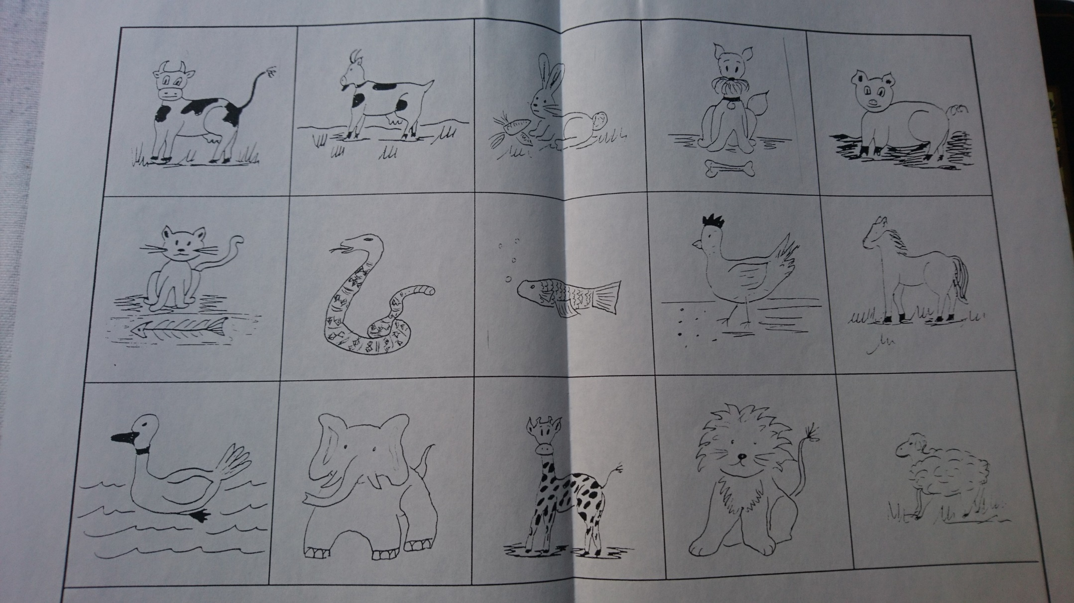
THE LANGUAGE MAGICIAN
Notes:
This is sample artwork only .
If you are working on reading and writing you will need also a mat of the words that correspond the pictures
In some of the activities below you use the mats
In others you cut out the individual pictures / words
Or you have a mat AND pictures
Or you have a mat AND words
Or you have pictures AND words.

Slide 31
Practice
Listening
  put the cards in the order you hear (vocabulary level)
  put the cards in the order you hear (sentence level)
  put the cards in the order you hear (story level)
Speaking
  in pairs? Turn over picture cards and say the word, pelmanism
  alphabet - spelling challenge?
  say a sentence?
THE LANGUAGE MAGICIAN
Notes:
The teacher invents the order and says the words, or invents sentences, or tells a short invented story

Slide 32
Practice
Reading
  put the word cards on to the picture mat in the correct places (vocabulary level)
  put the picture cards on the word mat in the correct places (vocabulary level)
  read a short story and put the picture cards in the order they appear (story level)
Writing
  label the picture cards on the reverse – by checking / from memory
  in pairs choose a picture and challenge each other to write the correct label
  Look at a sequence of pictures and try to write sentences abut them to create a class story. Agree on the best ideas.
THE LANGUAGE MAGICIAN
Notes:
These activities are for different levels of ability. They can be differentiated as is appropriate.

Slide 33
Also if/ when Writing
Writing a sentence for a Picture (Here is a dog)
  Write two sentences, using a pronoun (Here is a dog, He is black.)
  Write three sentences, using pronouns and verbs. (Here is a dog. He is black and his name is X.)
Writing a questionnaire: Do you like (animals)?
  Model the plural forms first.)
THE LANGUAGE MAGICIAN

Slide 34
Picture mat and picture cards – think progressive
How many new words? How many old words?
Can you introduce / re-introduce vocabulary
  with the article? (The cat / a cat?)
Whole class – can you adapt the ideas for Whiteboard games
THE LANGUAGE MAGICIAN

Slide 35
What grammar is appropriate?
Spoken grammar v written grammar
Sort the cards into gender groups.
  Does it sound right in your head / mouth?
  Make the link. Here is a/the x ; he / she is ….
Match a Word card with a Pronoun chart
  Match a Picture card with a Pronoun chart
Match a Word / Picture card with a suitable verb
  Use a dictionary to look for a verb?
THE LANGUAGE MAGICIAN

Slide 36
Where is everything?
https://www.thelanguagemagician.net/
e.g. Classroom Resources
  Module 1: to introduce the story , characters and challenge types
  Module 2: Activities to focus on problem areas
  Module 3 : extra activities (for end of year)
THE LANGUAGE MAGICIAN

Slide 37
Objectives of the classroom resources
  To arouse pupils’ curiosity and build confidence about the magical game that they will play later
  To introduce the characters in the game.
  To remind pupils of language they know and skills they have
  To provide examples of communicative activities
  To inspire other ideas
THE LANGUAGE MAGICIAN
Notes:
We also hope that if children enjoy the concept of the Game there may be other activities teachers can frame within the style of THE LANGUAGE MAGICIAN

Slide 38







THE LANGUAGE MAGICIAN

