Slide 1
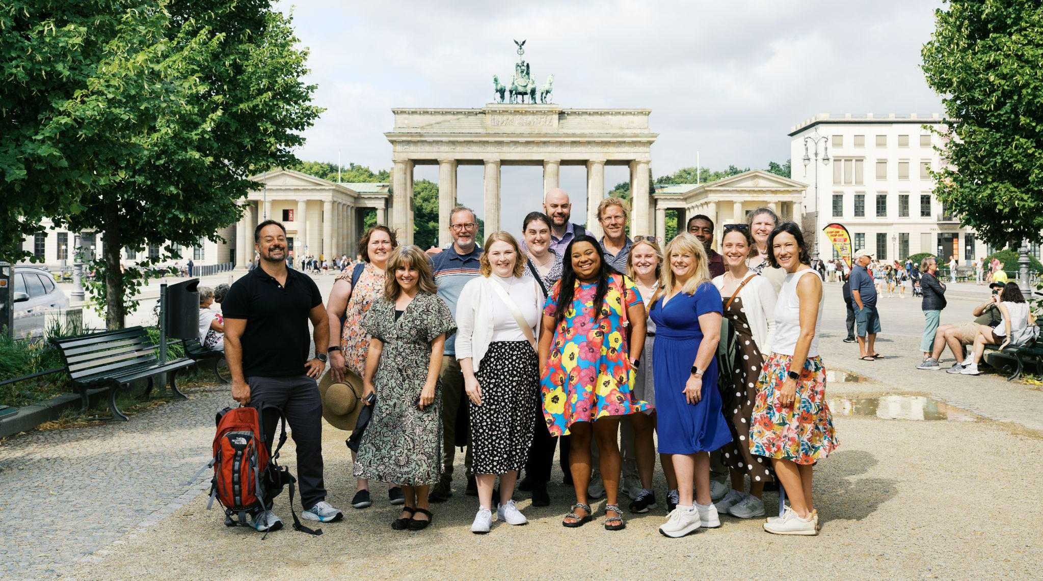

TRANSATLANTIC OUTREACH PROGRAM (TOP) WORKSHOP

Slide 2
AGENDA
INTRODUCTIONS
ICE BREAKER ACTIVITY
ABOUT TOP
TOP MATERIALS + SAMPLE LESSON
STUDY TOURS + APPLICATION
Q&A

Slide 3


TOP IS A PUBLIC / PRIVATE PARTNERSHIP

Slide 4
ABOUT TOP
Founded: 2002
Fosters dialogue and exchange between the United States, Canada, and Germany in the fields of social studies, STEM, and CTE.
2,000 Program Alumni from U.S. and Canada

Slide 5
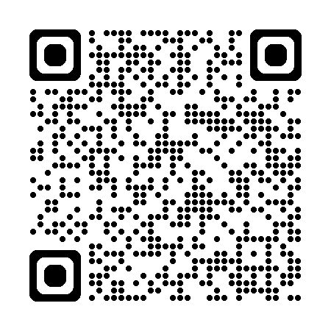
CONTACT
Web: www.goethe.de/top
Social media: @topteachgermany
E-mail: top@goethe.de

Slide 6
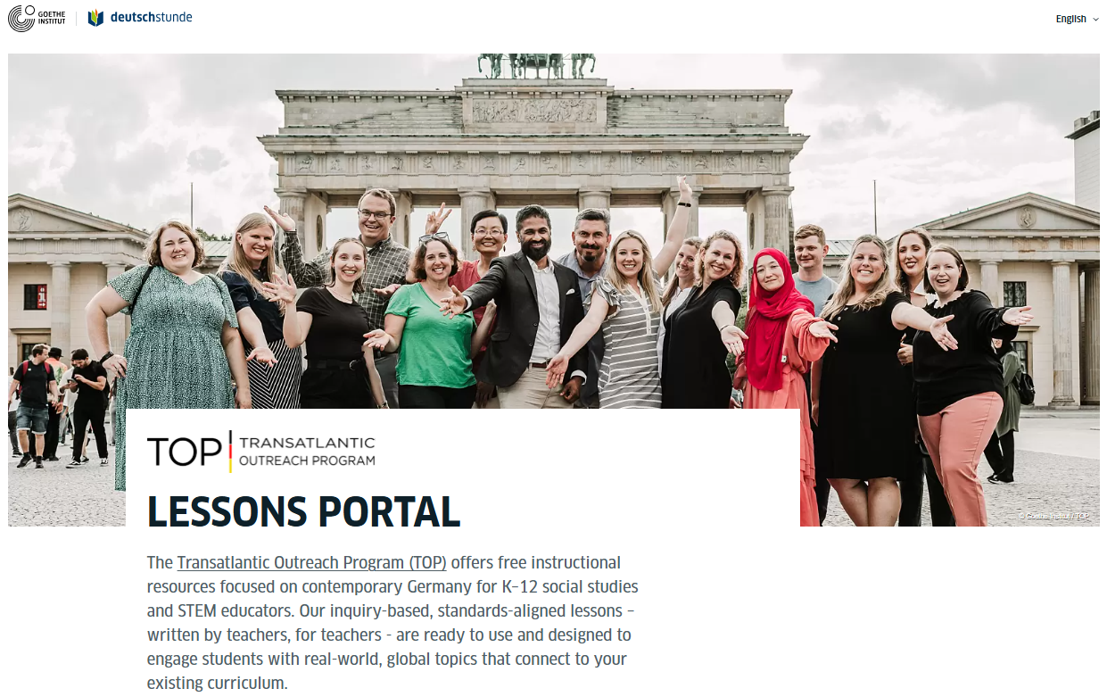
TOP TEACHING MATERIALS

Slide 7
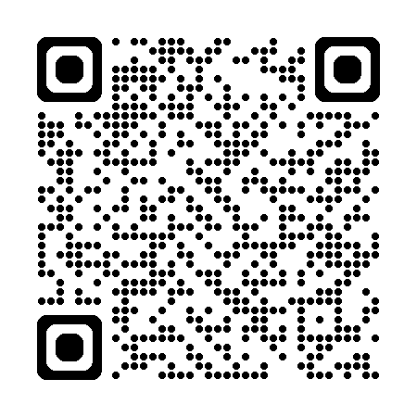
INSTRUCTIONAL RESOURCES
TOP produces (FREE) inquiry-based teaching materials for social studies and STEM
TOP Lessons Portal - filter and search by grade level, topic, keyword, etc.
www.goethe.de/TOPlessons

Slide 8
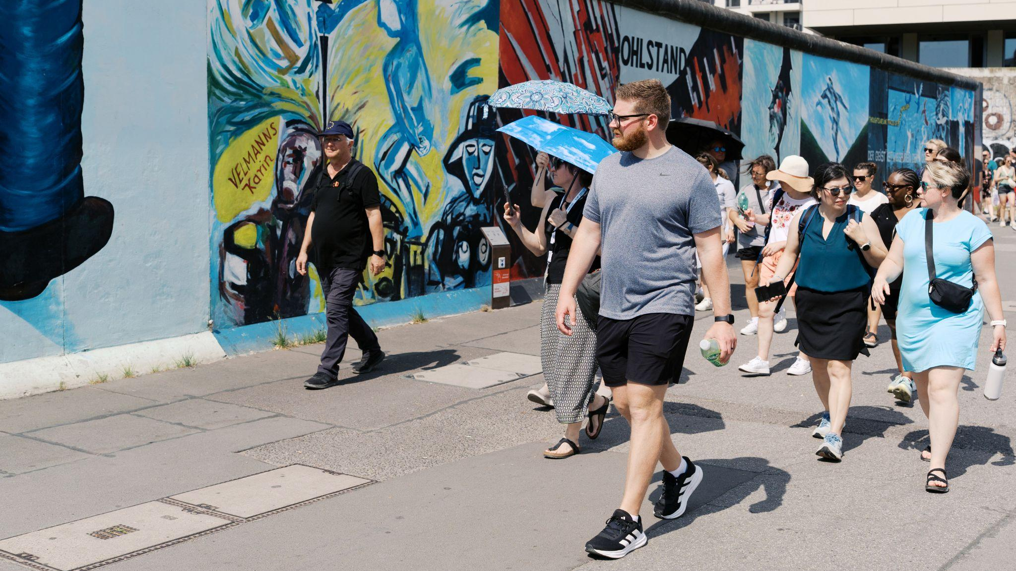
STUDY TOURS

Slide 9
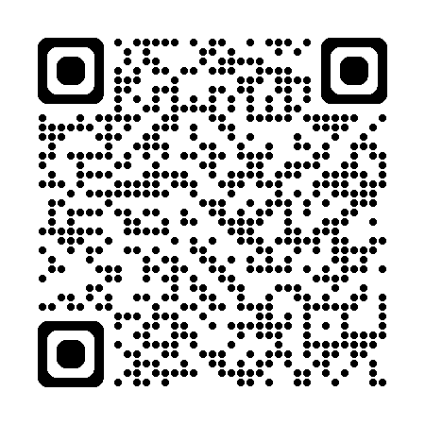
STUDY TOURS
For Social Studies Educators
10 Days
All expenses paid ($350 refundable deposit)
Travel dates in June and July
Itineraries tailored to group interests
Group size 14-15
www.goethe.de/TOPstudytours

Slide 10
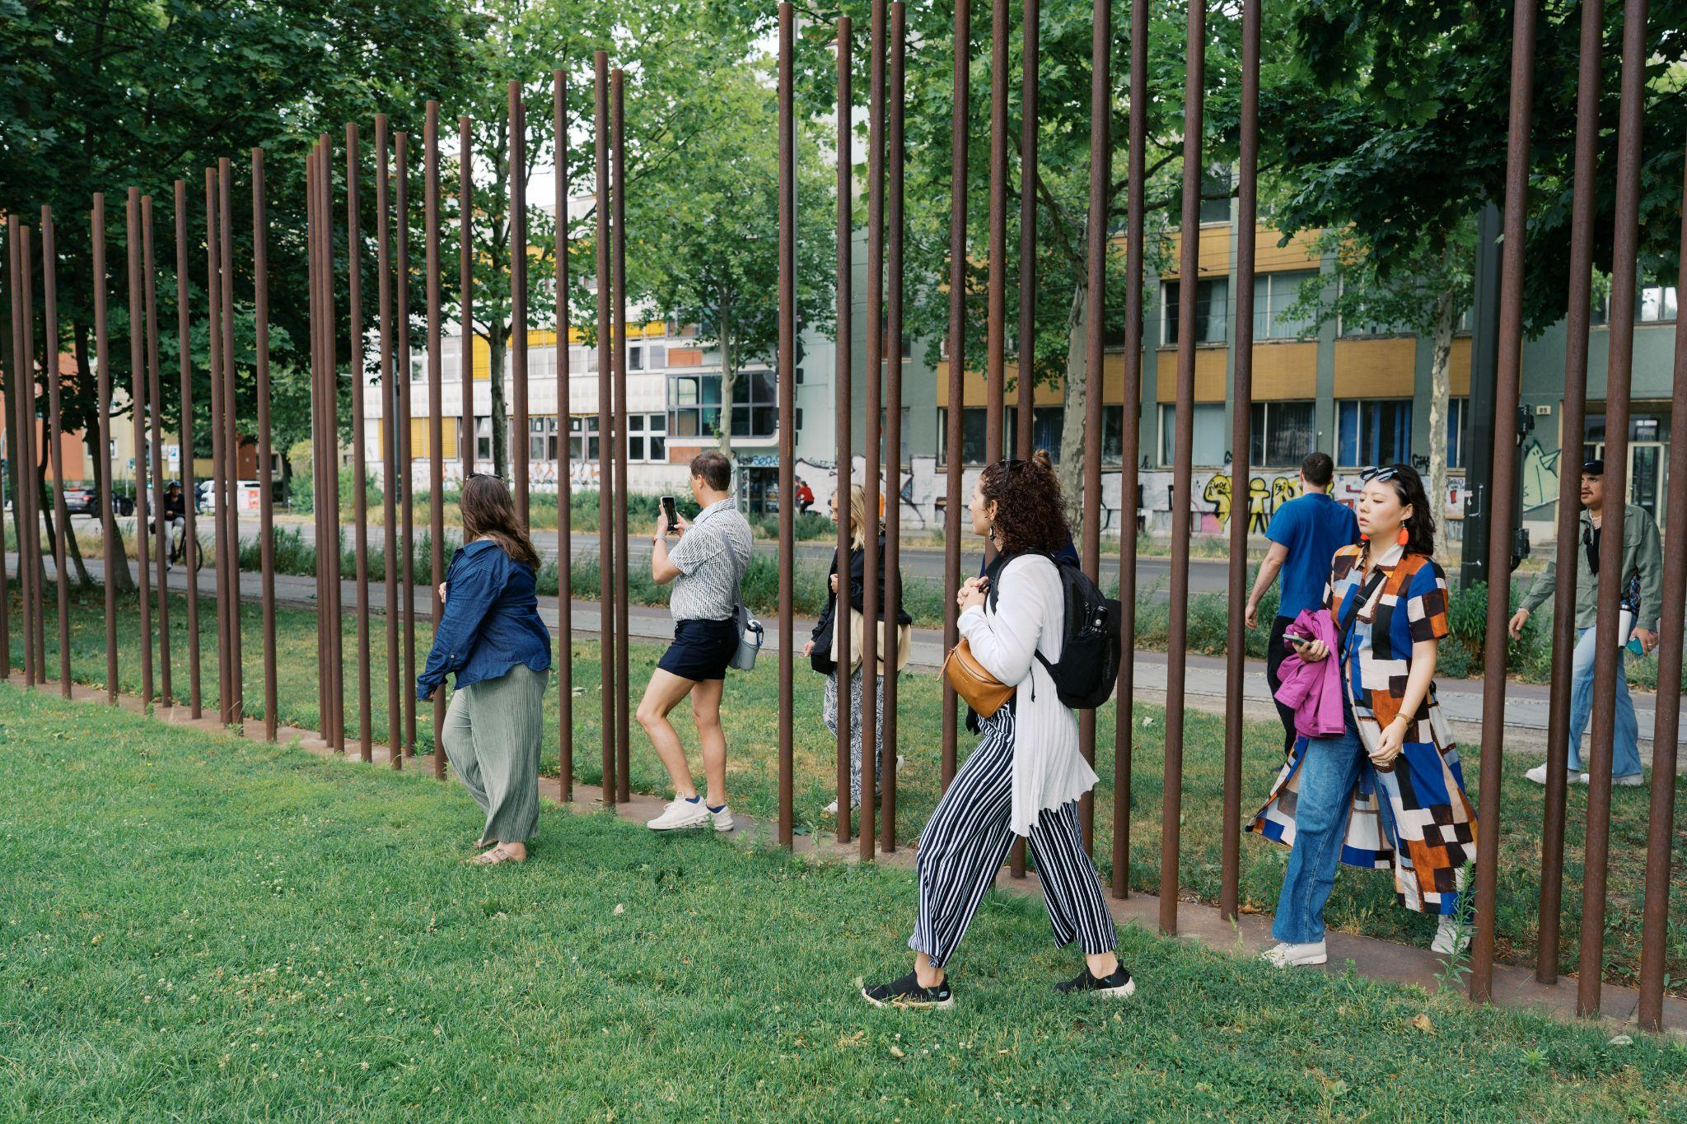
APPLICATION PROCESS

Slide 11
APPLICATION
Published late fall, due in January
Average time requirement: 10 hours +/-
Requirements
  Professional statement of Purpose
  Personal Statement
  Lesson Plan
  Employment Verification from Supervisor
Post-tour Requirements:
Inquiry lesson + workshop + multiplier activity

Slide 12
APPLICATION STRATEGY
Read the FAQ
Attend the Info Session
Don’t wait to the last minute
Keep it student & peer focused
Make your lesson stand out
Ask someone to proofread
HIT SUBMIT

Slide 13
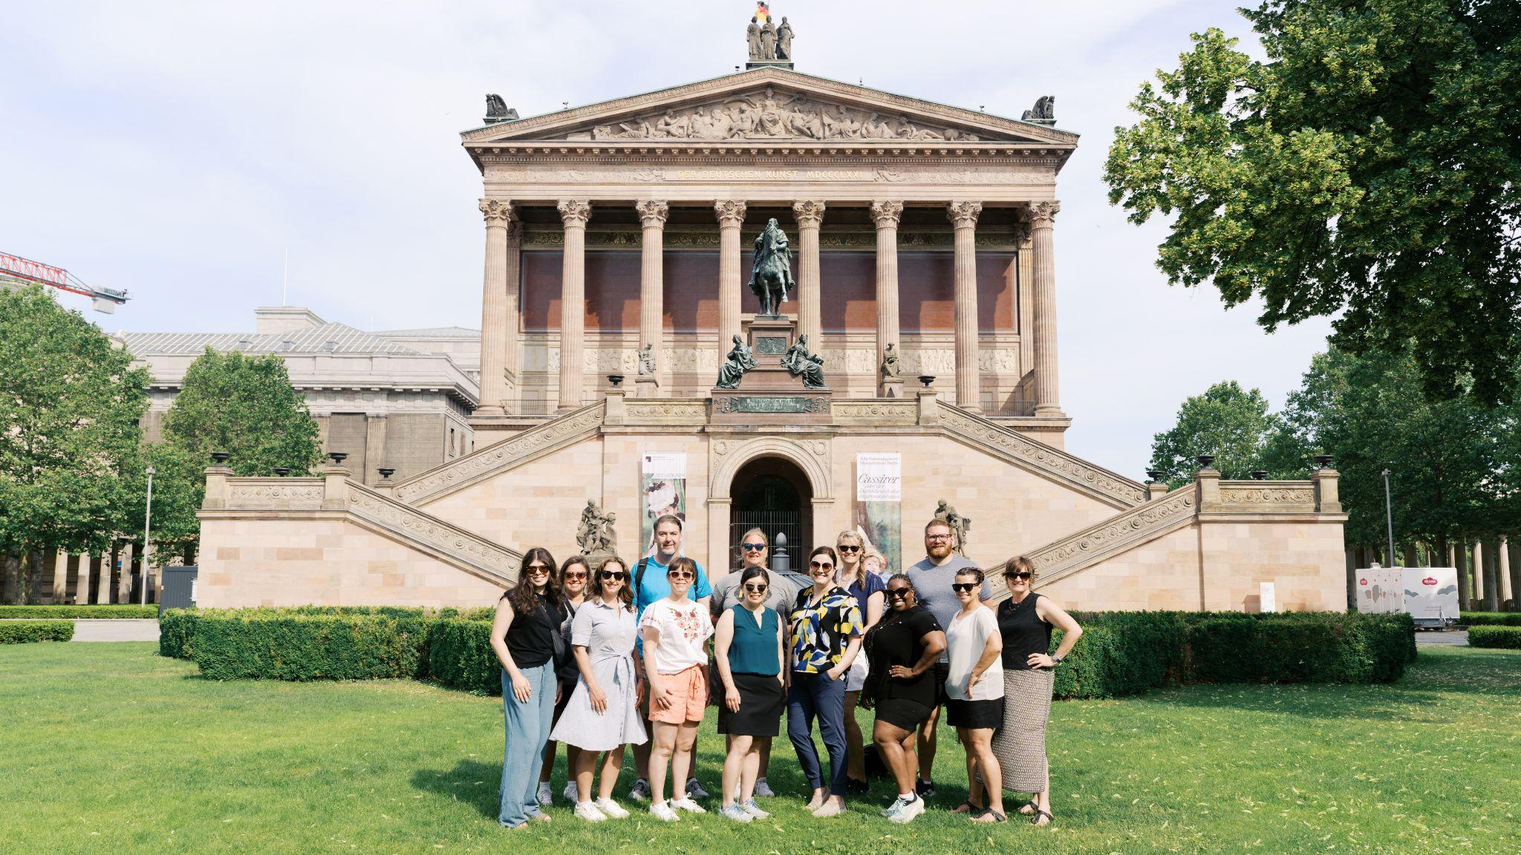
Q&A

