Slide 1
Volume 1, Chapter 2

Slide 2
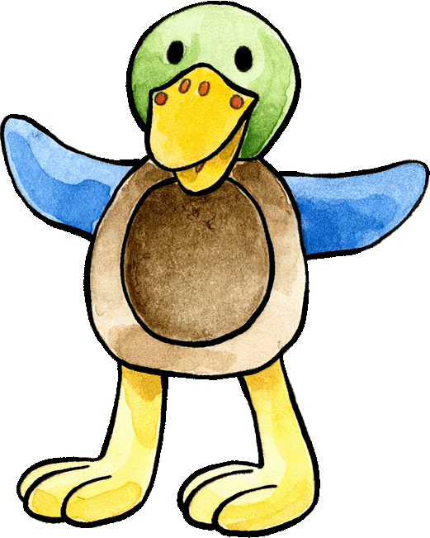
Can you help Franzi pair up the words with the pictures? Can you answer her question about how you are feeling today?
Wie geht's ?
nicht gut
schlecht
krank
es geht
gut
wunderbar

Slide 3



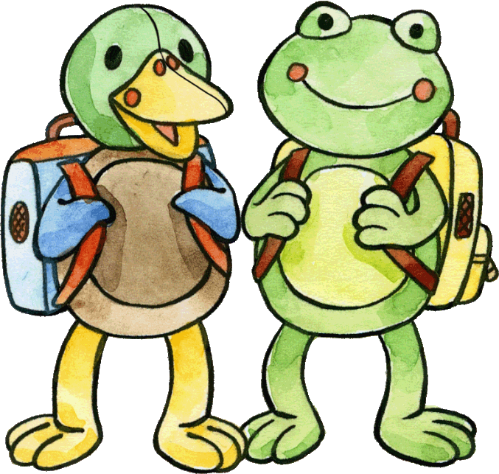
How quickly can you guess all the expressions for how people are feeling? There are seven to find. Start from top left.
Herr
wunderbar
schlecht
Frau
Danke, gut
gut
Guten Tag
es geht
nicht gut
krank

Slide 4
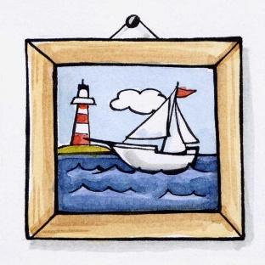
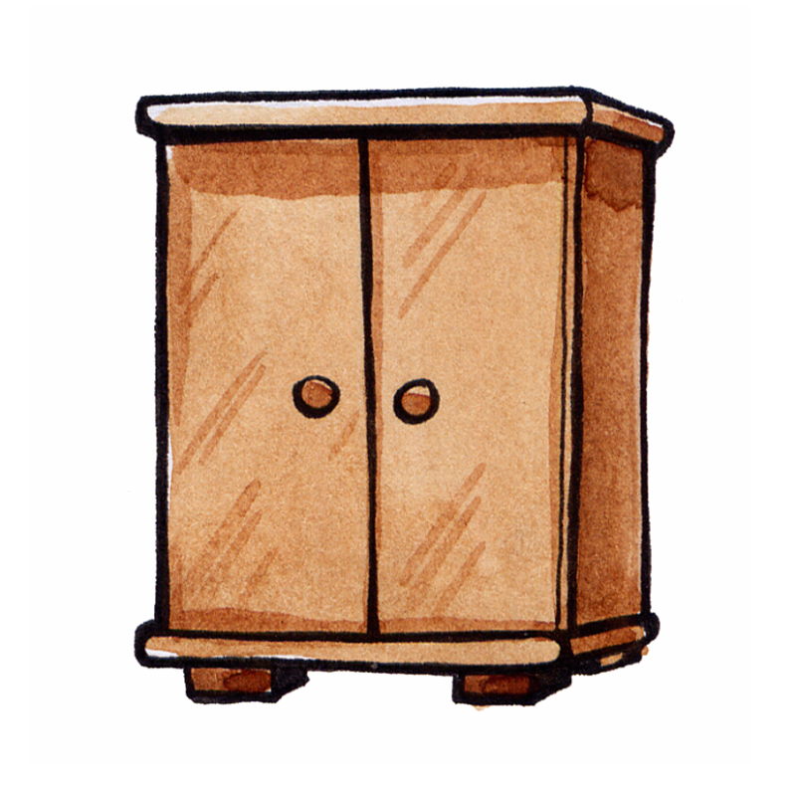
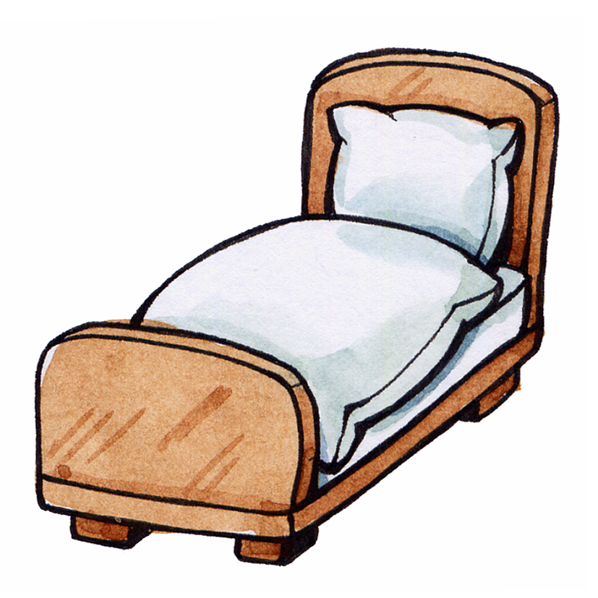
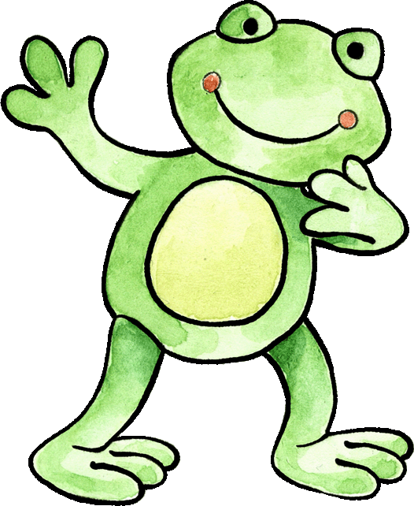
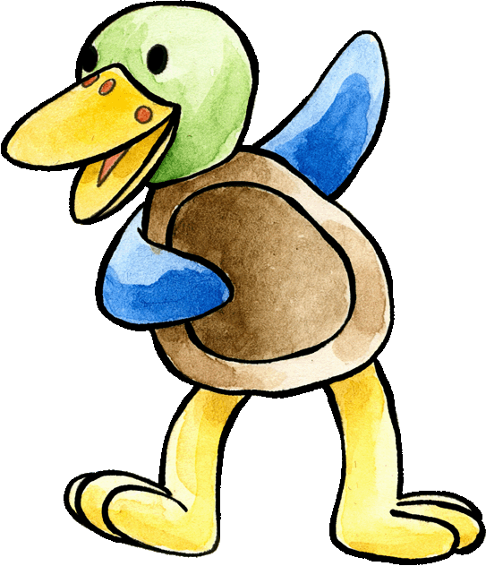
Hallo, Felix. Wie geht's?
Guten Morgen Franzi.
Mir geht's schlecht.
Ich habe eine Idee.
... ist gut.
Hallo Felix, wie geht's?
Ich bin krank.
Eine Postkarte
Ein Telefon
Ein Lied
Eine Medizin
Felix isn't feeling well. Please choose a treatment for him and drag it into
Franzi's speech bubble. Read the dialogue and act out the scene.
Notes:
Sing than the song „Wie geht‘s Felix“ for Felix.

Slide 5

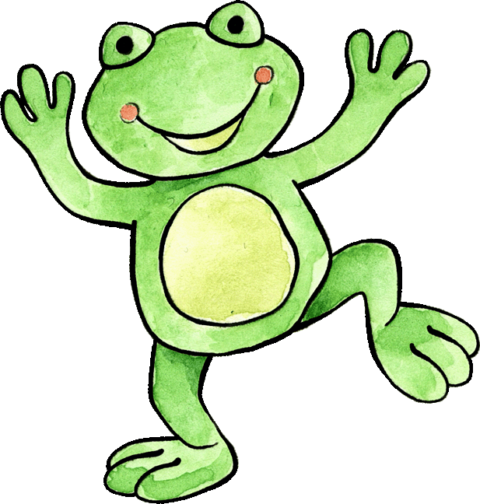
Franzi has done her best to cheer Felix up. She has persuaded him to come and play in the garden. How do you think their conversation goes now? What is Franzi asking? What is Felix answering?
Wunderbar!
Hallo Felix,
wie geht‘s?

Slide 6
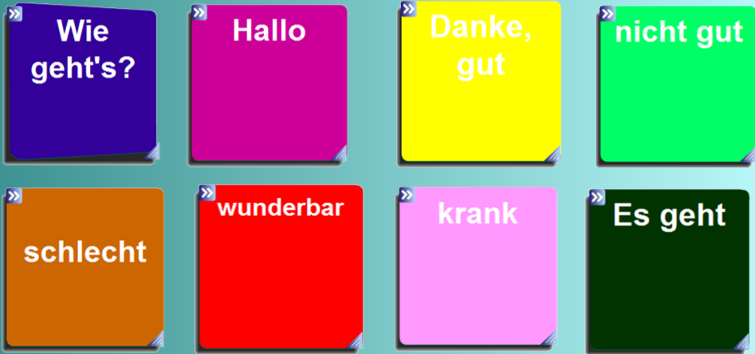
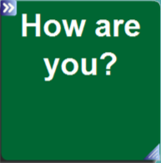
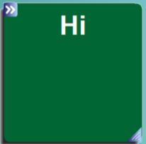

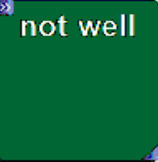
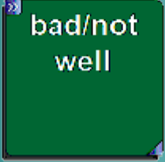

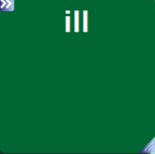
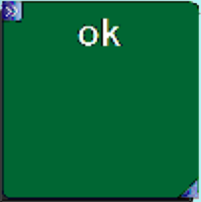
Form two teams and help Felix and Franzi to work out what these words mean in German. Extra points can be awarded for full sentences!

Slide 7
