Slide 1
Volume 1, Chapter 11

Slide 2


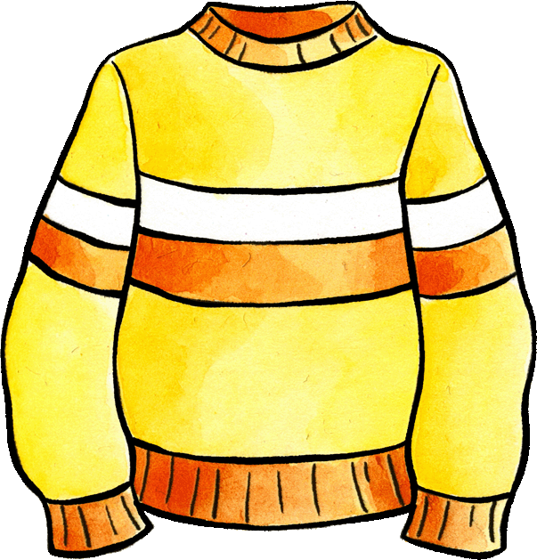
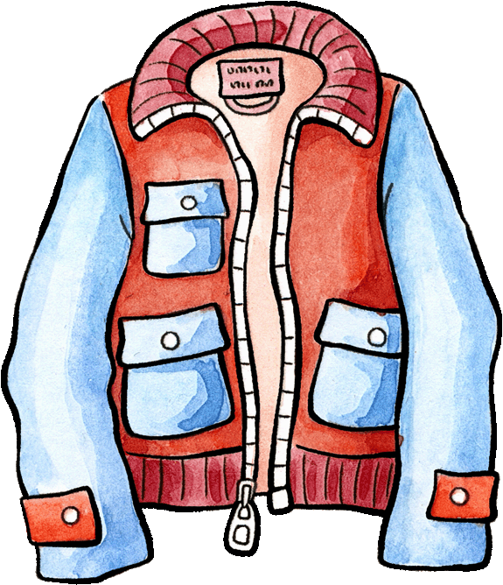
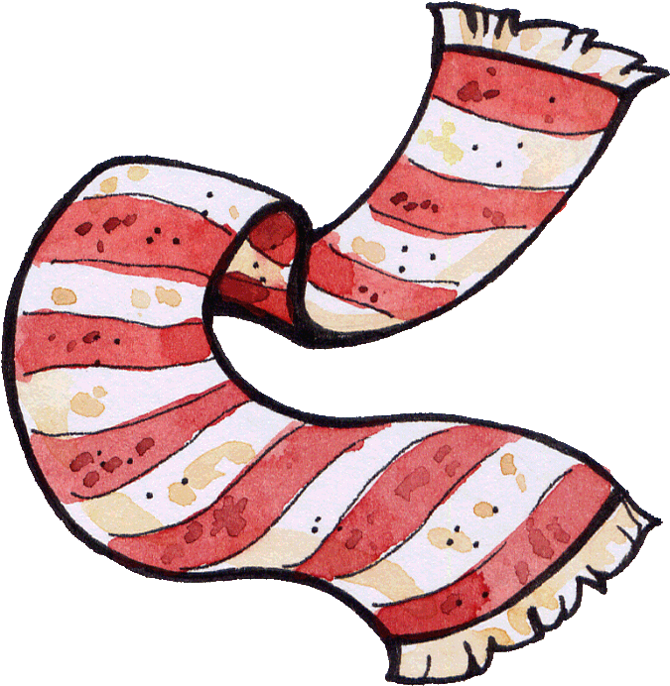
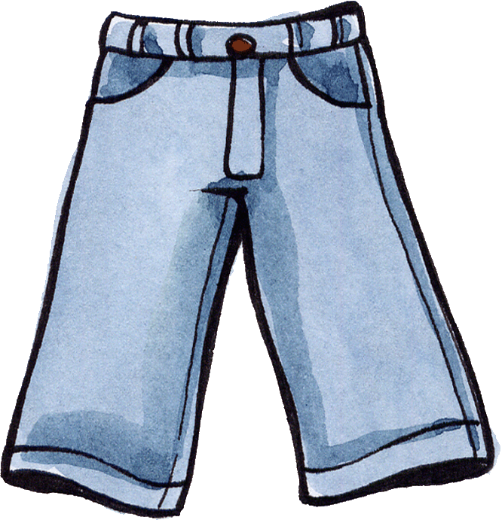
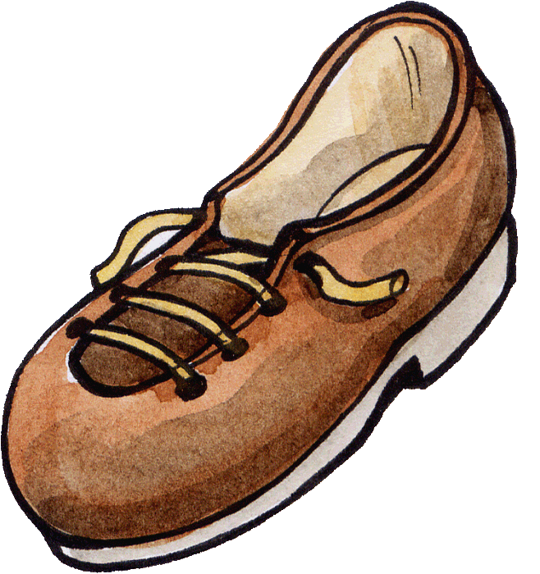

Felix wants you to help him dress for the day's weather. Choose a window, reveal the weather and then dress him in the appropriate items. Say the German word as you are dressing him.
Ist das richtig?

Slide 3
Felix wants you to help him dress for the day's weather. Choose a window, reveal the weather and then dress him in the appropriate items. Say the German word as you are dressing him.
Ist das richtig?

Slide 4
Felix wants you to help him dress for the day's weather. Choose a window, reveal the weather and then dress him in the appropriate items. Say the German word as you are dressing him.
Ist das richtig?

Slide 5
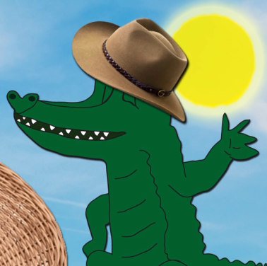
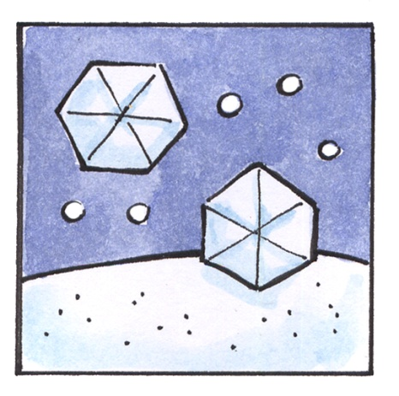
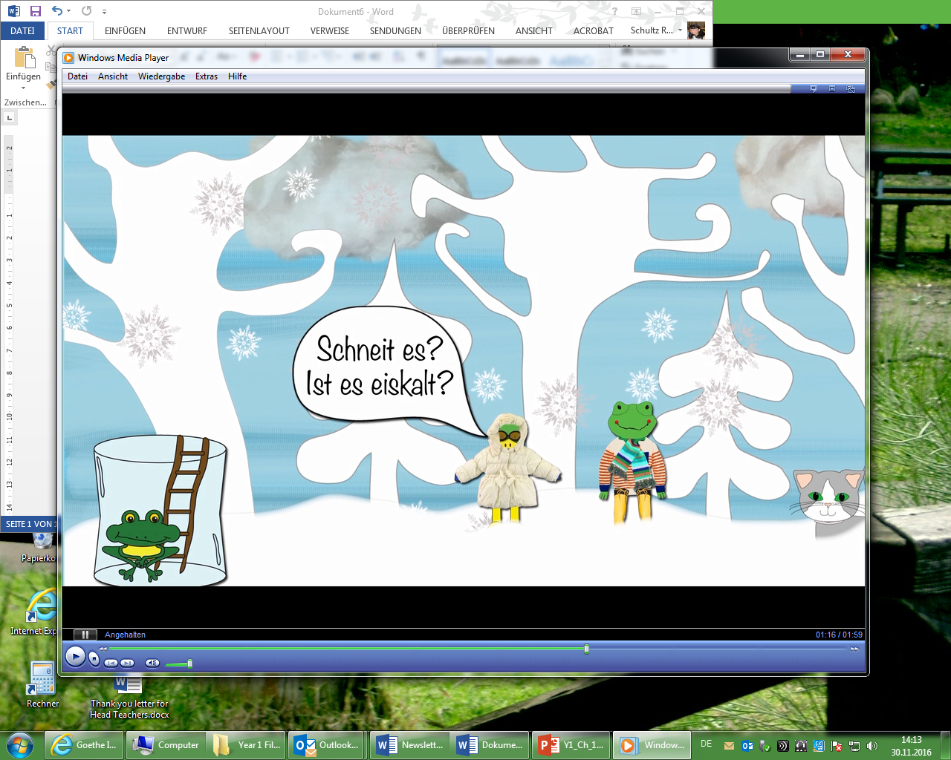
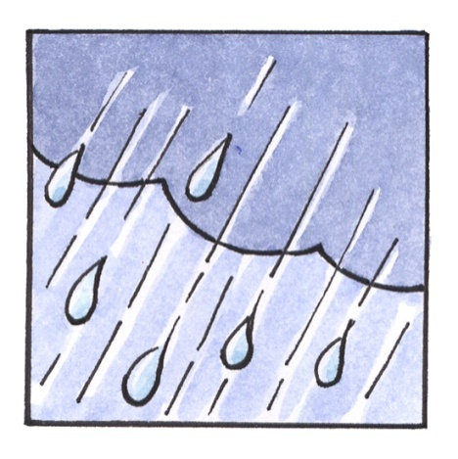
Read out loud, than say what weather symbol you see.
Es ist heiß.
Es ist kalt.
Es regnet.
Es schneit.

Slide 6




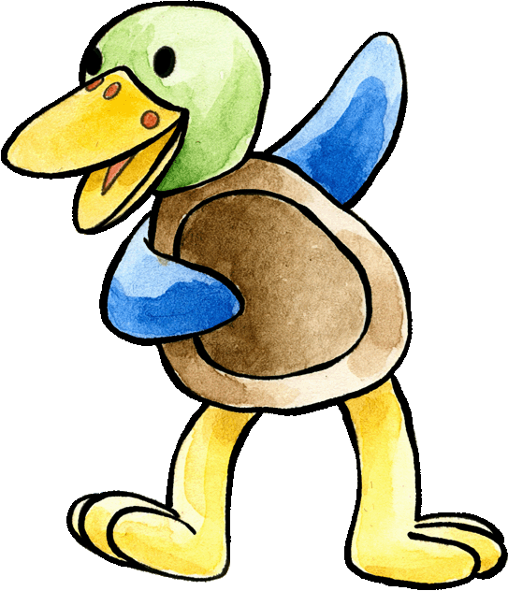
Pair the weather expressions up with the pictures. Start from top left. Can you do an action for each one?
Die Sonne scheint.
Es regnet.
Es schneit.
Wie ist das Wetter heute?
Es ist heiß.
Es ist kalt.
Die Sonne scheint.
Es regnet.
Es ist heiß.
Es ist kalt.
Es schneit.

Slide 7

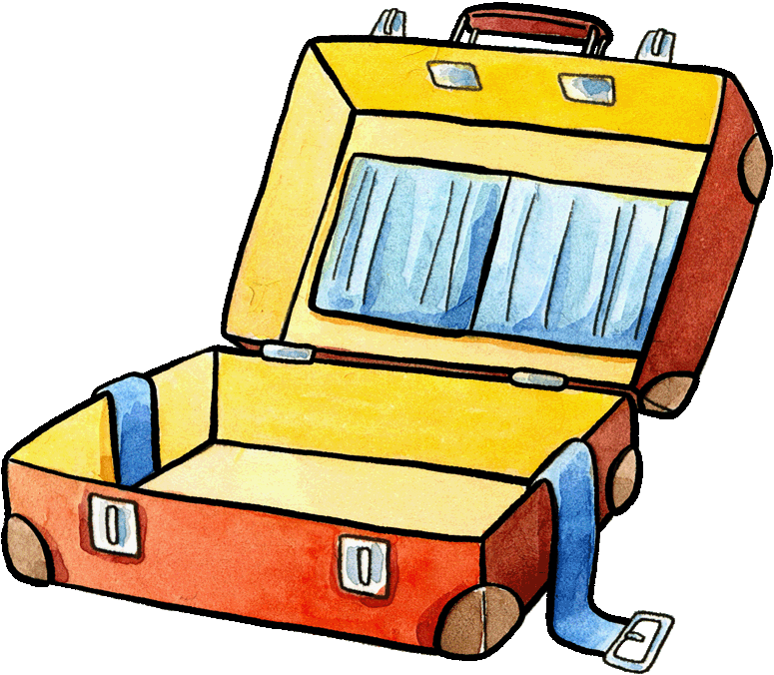
Which weather symbol or item of clothing do you see? Say it in German. Time yourselves to see how quickly you can do it.
Which team can finish the fastest?
der Pullover
Es schneit.
die Jacke
Es regnet.
der Schal
Die Sonne scheint.

Slide 8
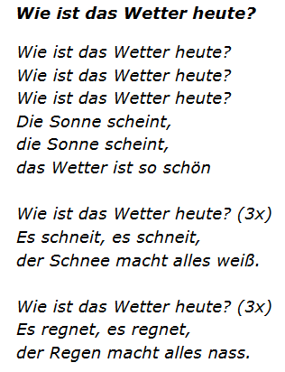


Sing the song. Then read the text.
How well do you remember it?
Try to write it down correctly.
You can work in pairs and discuss the spelling.
Notes:
Print out and play in class.

Slide 9

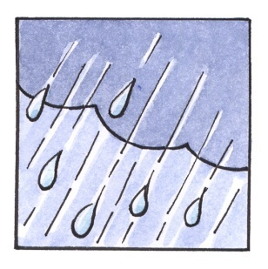
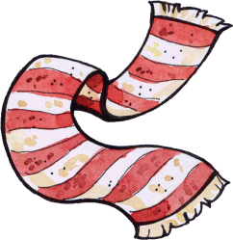

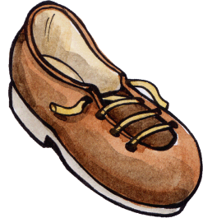
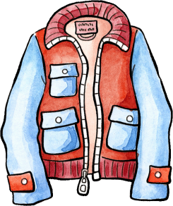

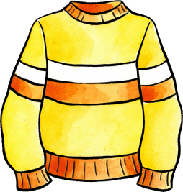
Form two teams, one to help Franzi, and one to help Felix win the weather noughts and crosses game.
Notes:
Print out and play in class.

Slide 10


