Slide 1
Volume 1, Chapter 3

Slide 2
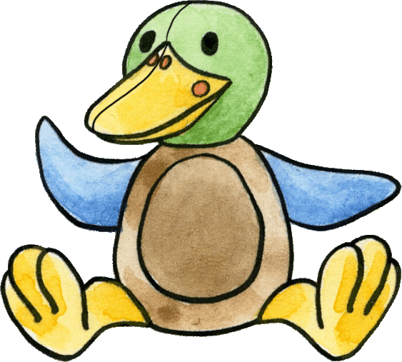
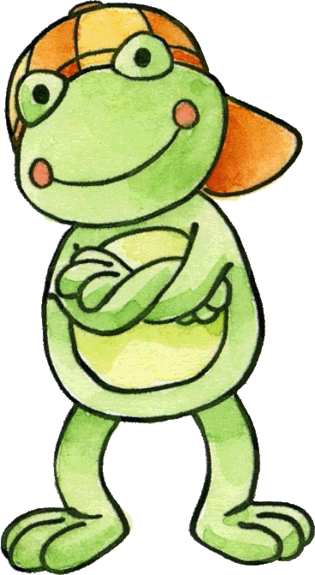
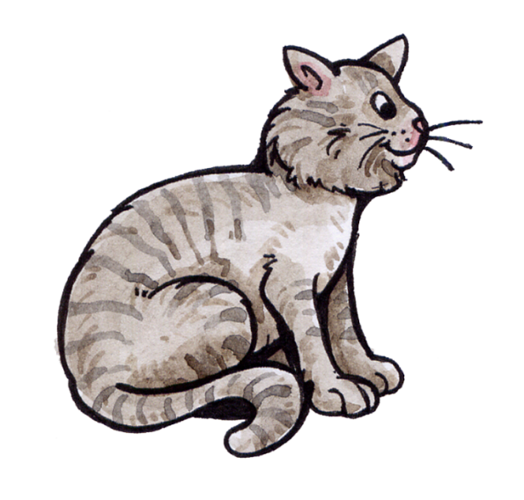
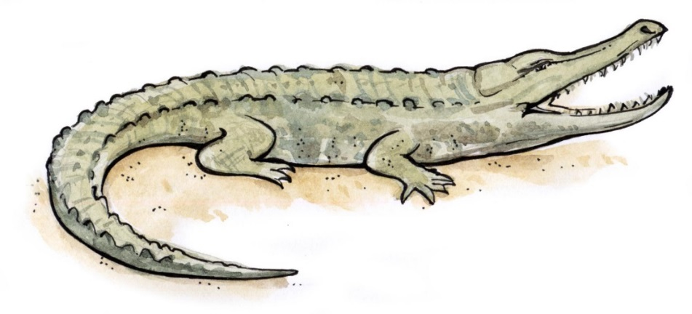
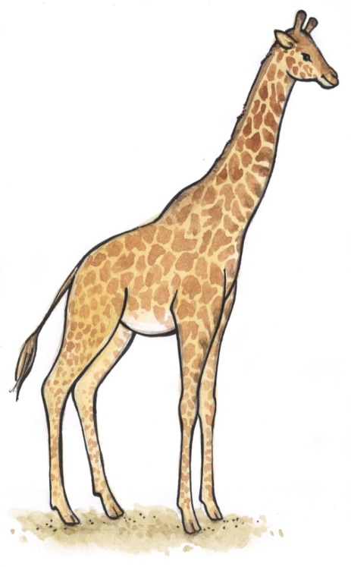
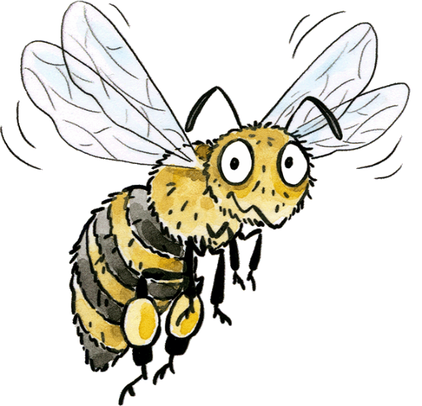
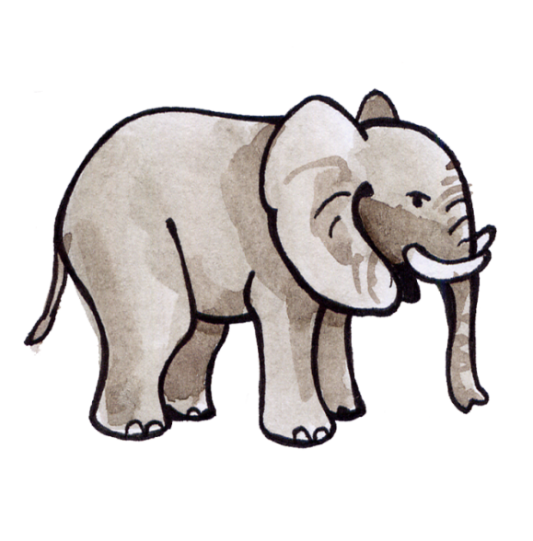
Wer ist das? Drag the sentences to the correct pictures.
Das ist die Giraffe.
Das ist das Krokodil.
Das ist der Elefant.
Das ist die Biene.
Das ist die Katze.

Slide 3
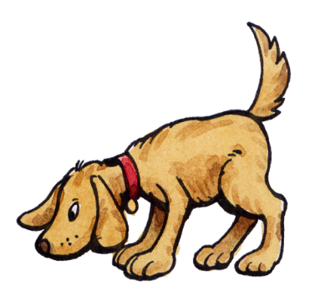
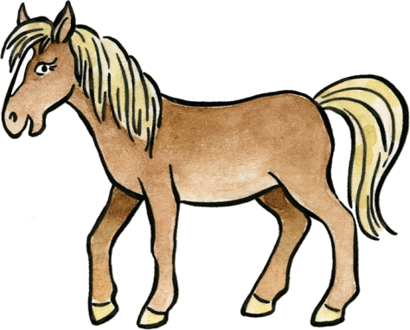


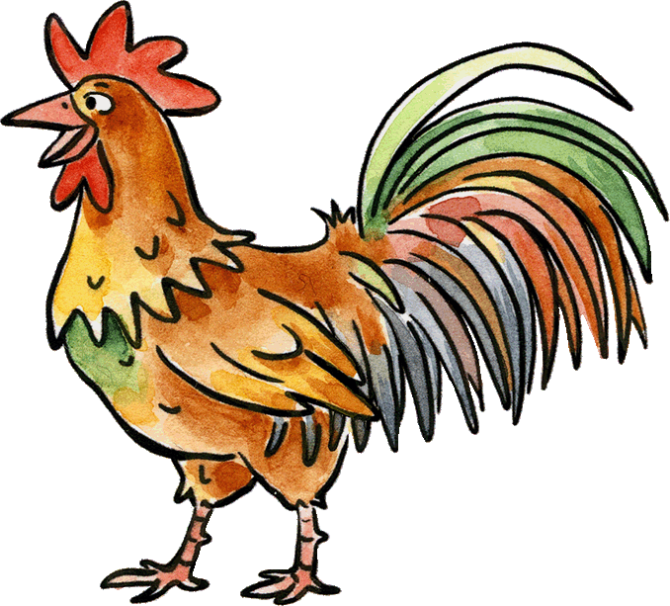
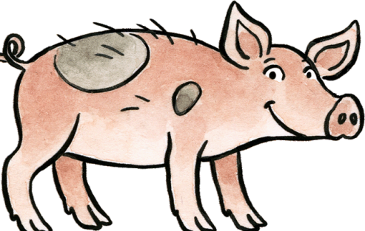
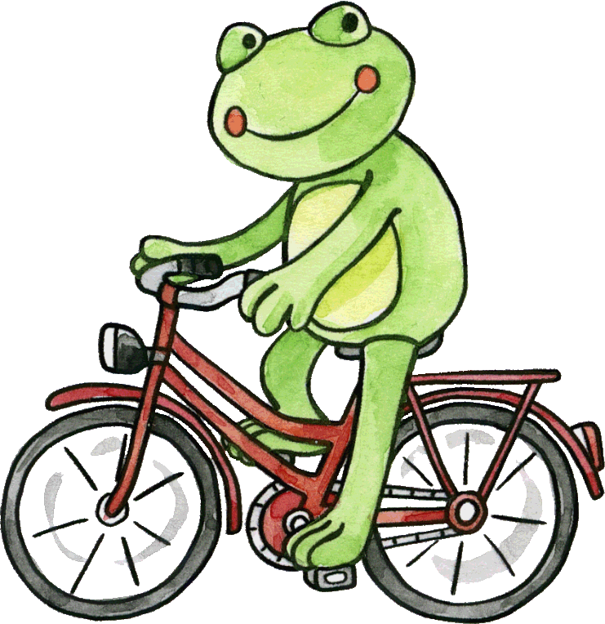
Play Pairs with the animal words and pictures!
das Schwein
das Pferd
der Elefant
der Hahn
das Krokodil
der Hund

Slide 4
Which animal is hidding here?
Say its name in German!

Slide 5
Which animal is hidding here?
Say its name in German!

Slide 6
Which animal is hidding here?
Say its name in German!

Slide 8
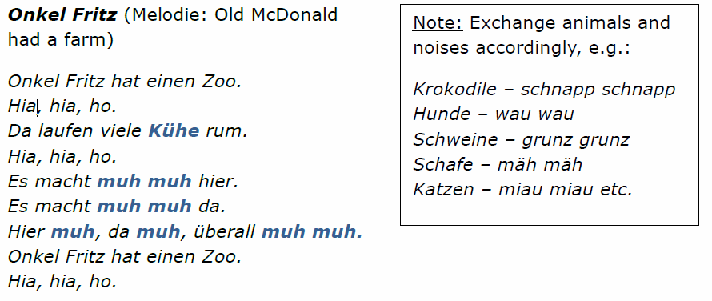

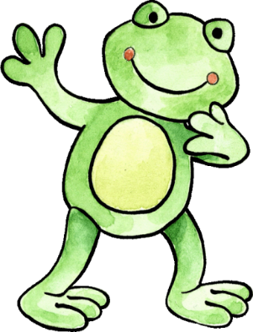
Sing das Lied! (Sing the song.)
Then read the text . How well do you remember it?
Try to write it down correctly.
You can work in pairs and discuss the spelling.

Slide 9
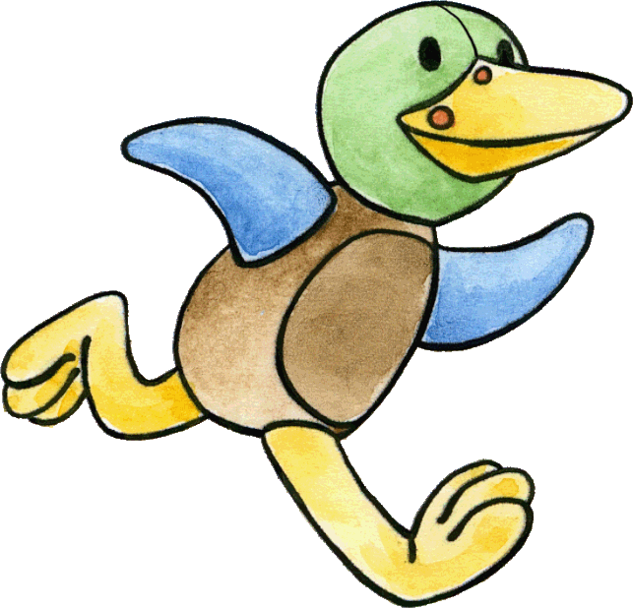
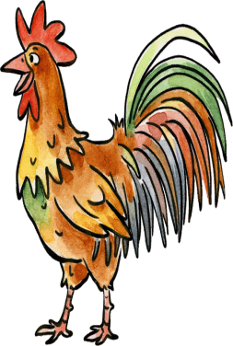
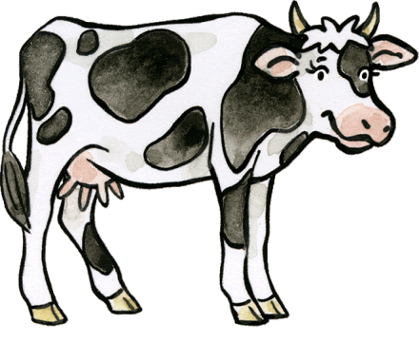
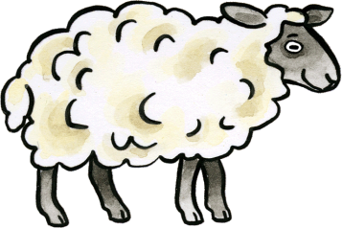
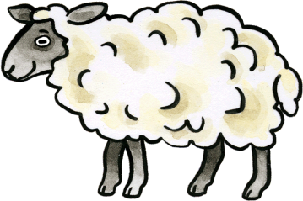

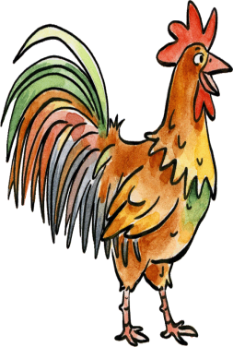
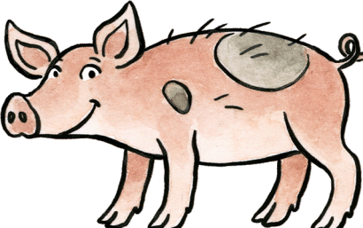
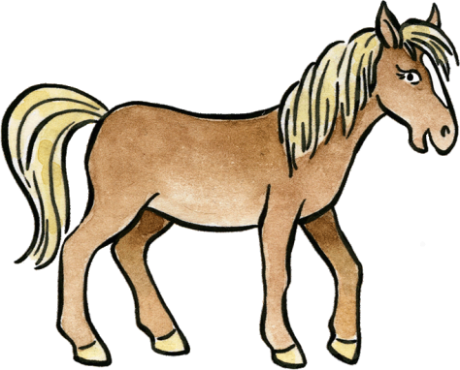
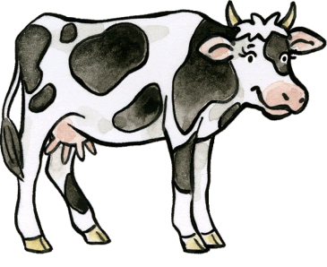
How quickly can you return the animals to their homes? When they return tell their name and tell how many there are of each animal ?
2
4
die Schafe
die Kühe
3
2
2
die Pferde
die Schweine
die Hähne

Slide 10




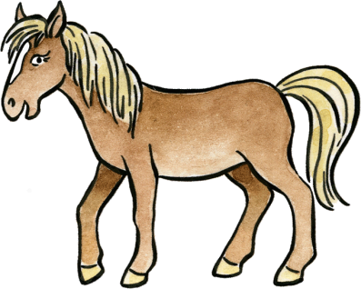


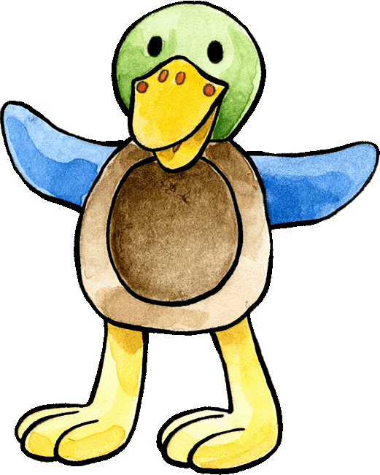




Wer ist das? Play against your partner, one to help Franzi and one to help Felix. Win the animal Noughts and Crosses Game! Name the correct animal in German to win the nought/cross.
Notes:
Print out and play in class.

Slide 11


