Slide 1
Volume 1, Chapter 7

Slide 2
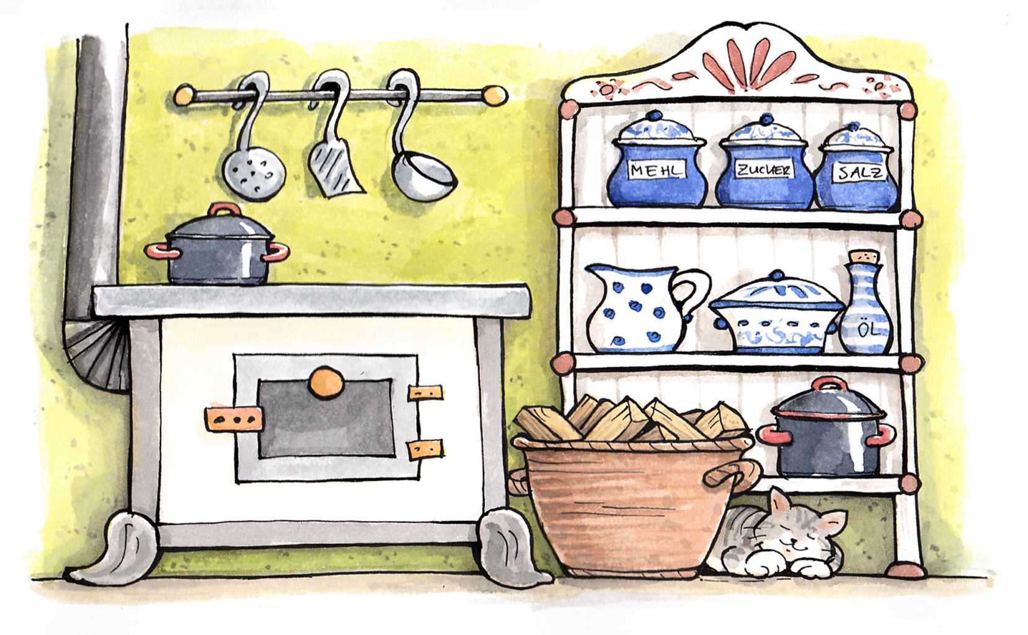
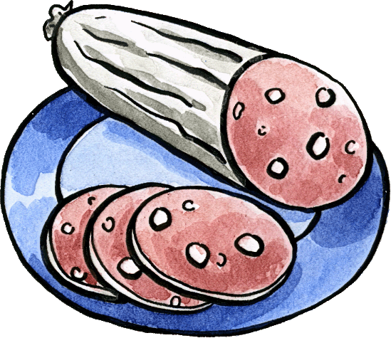
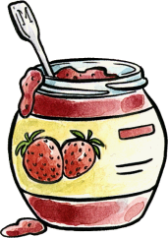
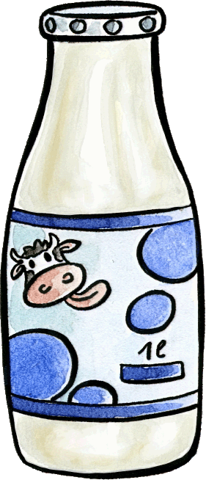
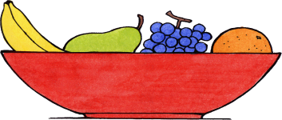

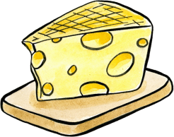
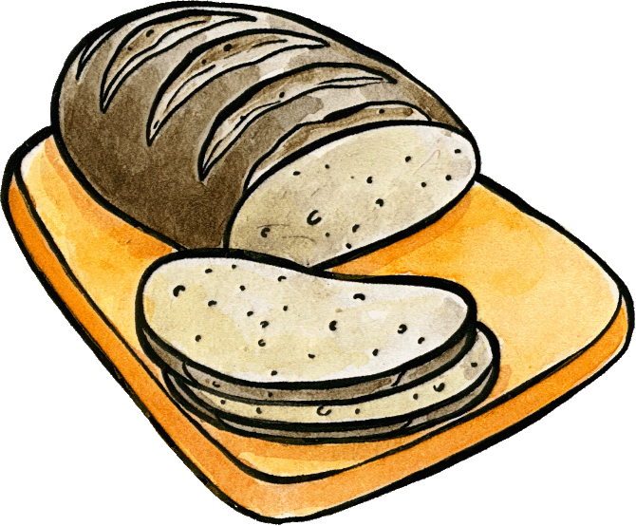
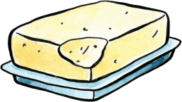
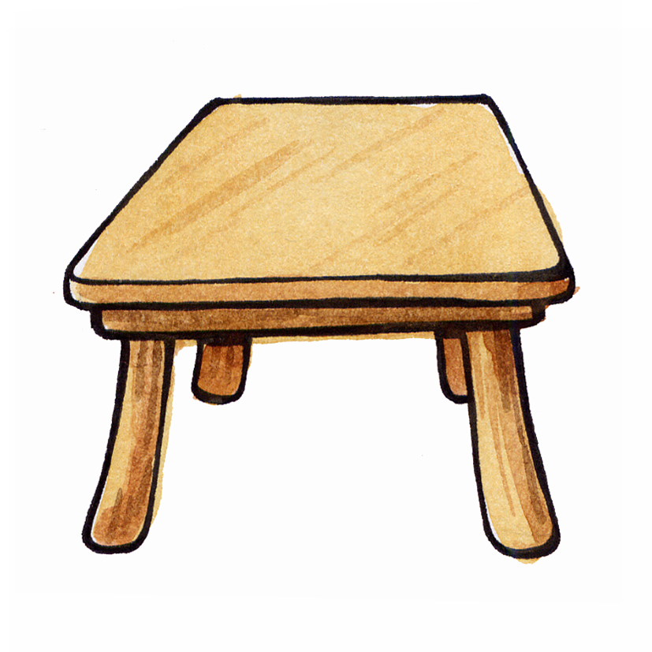
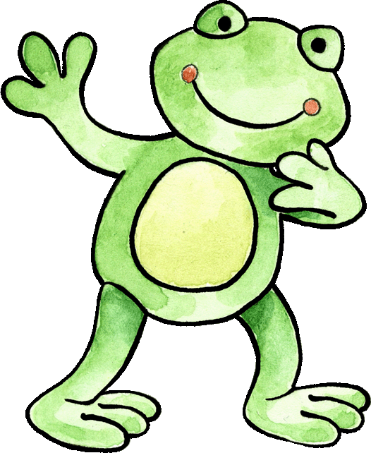
Can you help Felix get breakfast ready? Say the breakfast items in German.
Ich habe Hunger!

Slide 3
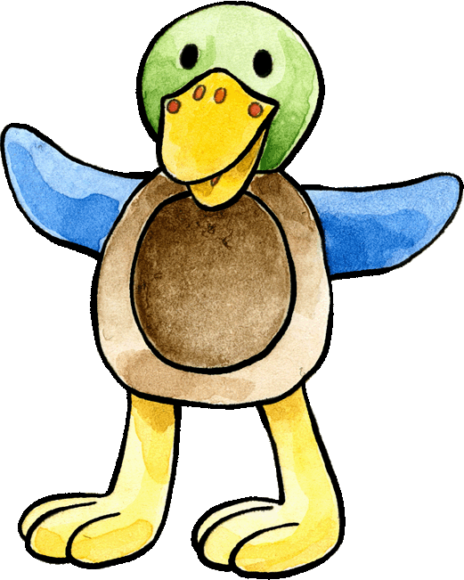
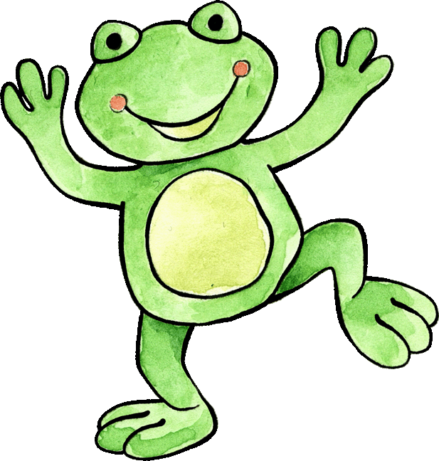
Look closely and see what Felix and Franzi like/do not like.
Ich esse gern...!
Ich esse nicht gern...!
Ei
Wurst
Brot
Marmelade
Butter
Orangen

Slide 4

Das Picknick - Can you help Franzi lay the table? Say the words in German while you do this. Start from top right.

Slide 5

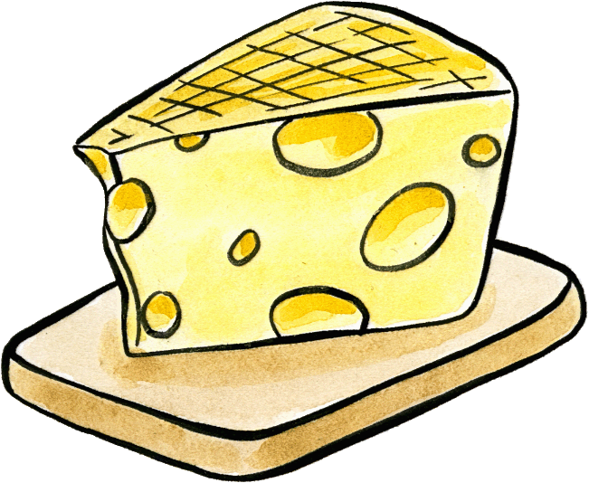
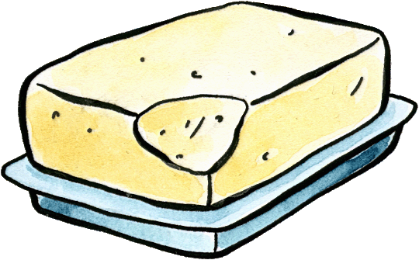
How well do you know the words?
Which item is disappearing? Say it in German.
Was ist das?

Slide 6


What is hidden behind the stars? Start from top left.
die Orange
die Milch
das Brot
Was ist hinter den Sternen?
die Wurst
der Saft
die Butter
der Käse

Slide 7
