Slide 1
Volume 1, Chapter 8

Slide 2
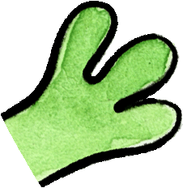
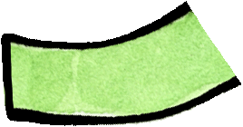

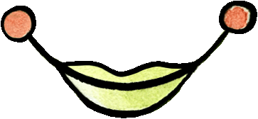
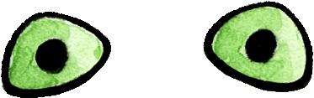
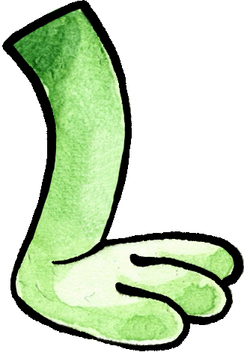
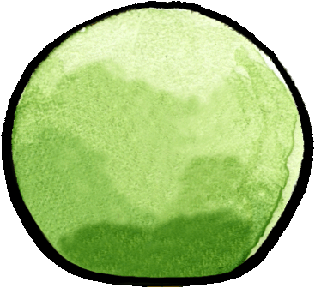
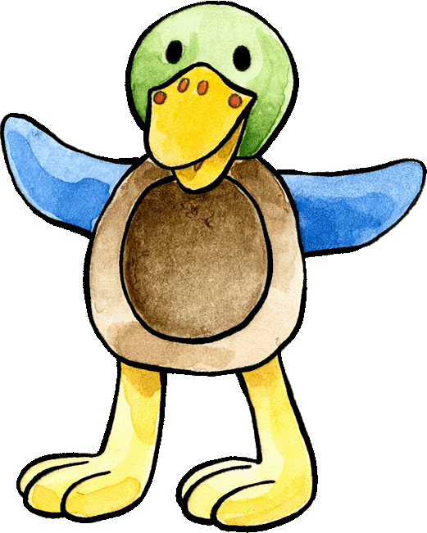
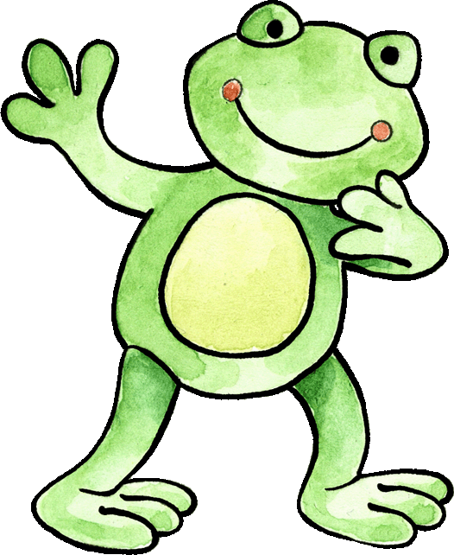
Get into two teams! Each team takes it in turns. Start from top left, and then guess which body part is hiding behind it. When it is right, your team gets a point. The team with the most points is the winner.
Nein, das ist falsch! Das ist der Kopf.
Das ist der Arm.

Slide 3
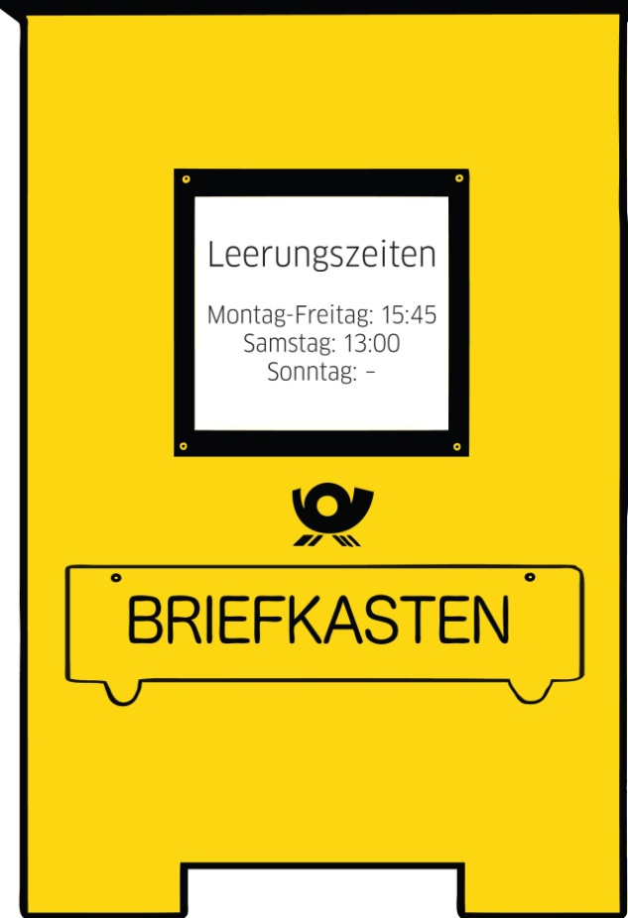
Complete the picture of Franzi and Felix by drawing in the missing body parts. Can you label them, too?
die Arme
der Mund
die Augen
die Finger
die Hände
die Füße
die Beine
Notes:
Print out. Pupils will draw the missing body parts and label them. Check it together!

Slide 4
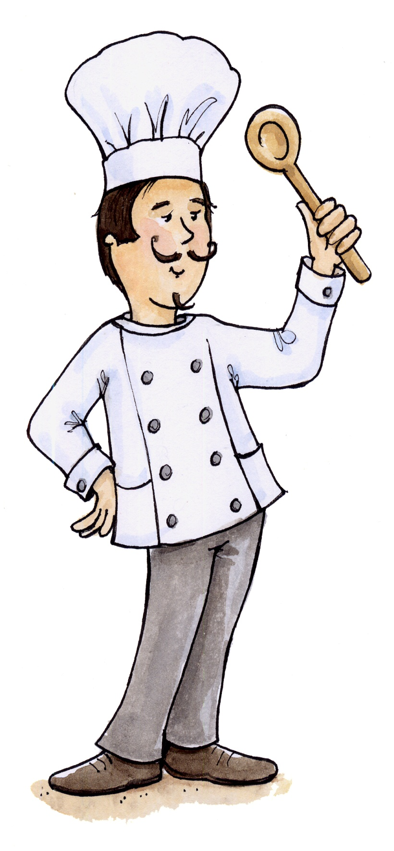
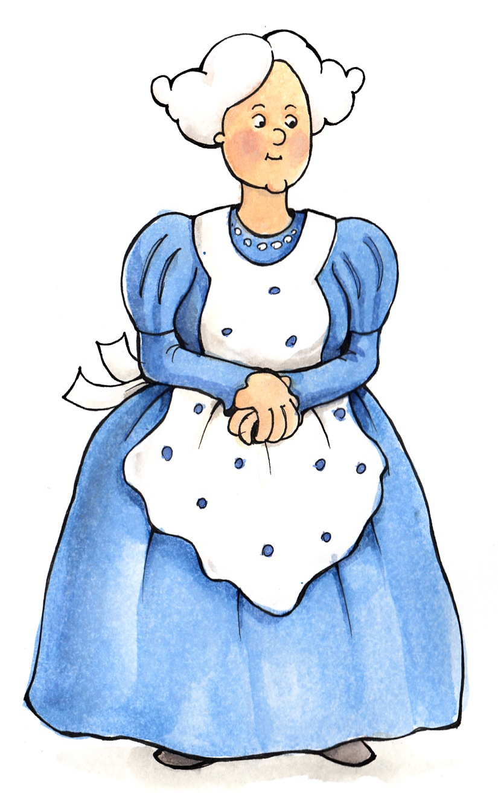
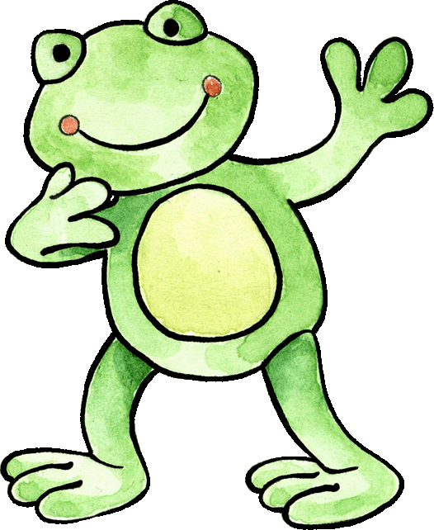
Felix has tried to label the body parts on these pictures, but he has put the labels in the wrong place! Can you help him to get the labels right? Start with the cook. Work from down to up. Time yourselves.
die Hände
die Füße
Ist das richtig?
die Augen
die Ohren
der Mund
die Nase
die Nase
die Beine
die Hände

Slide 5
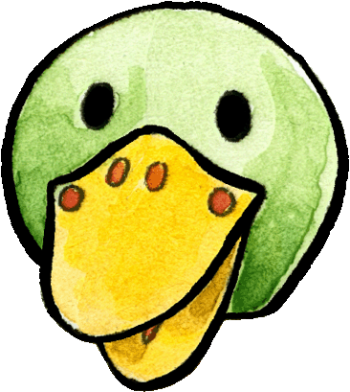
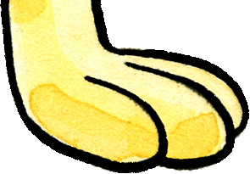
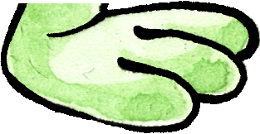
We are creating a monster of four body parts of Felix and Franzi. Name the body parts appearing in the middle.
What name do you give the creation using the correct German words? Is it a Hand-Kopf-Finger-Mund Monster?

Slide 6

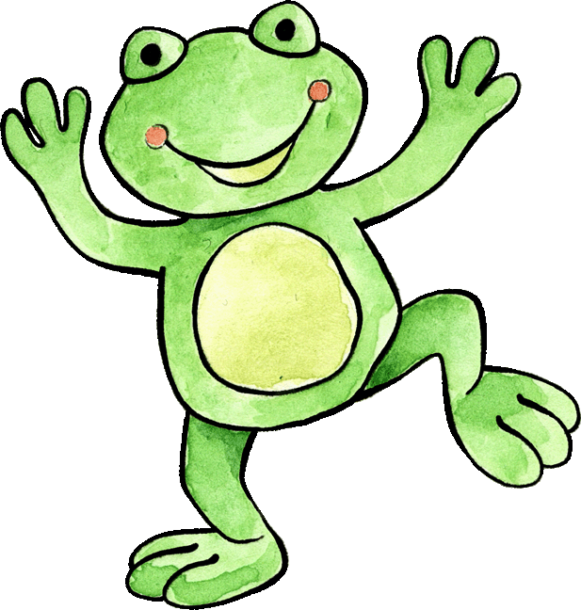
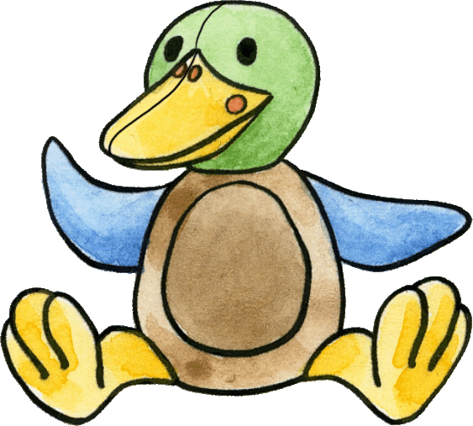
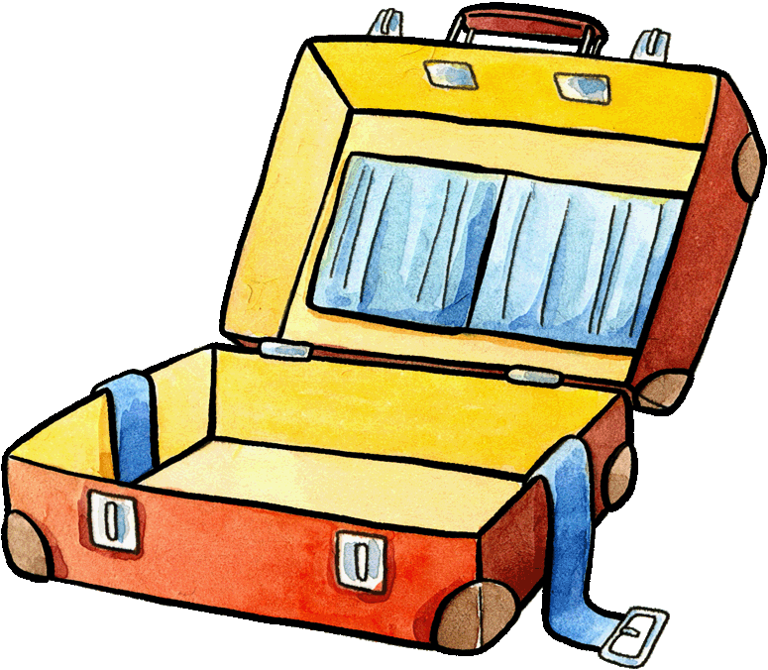
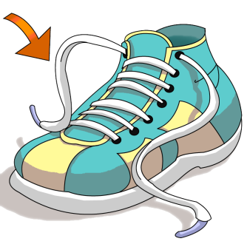
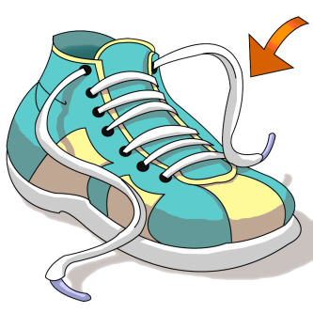
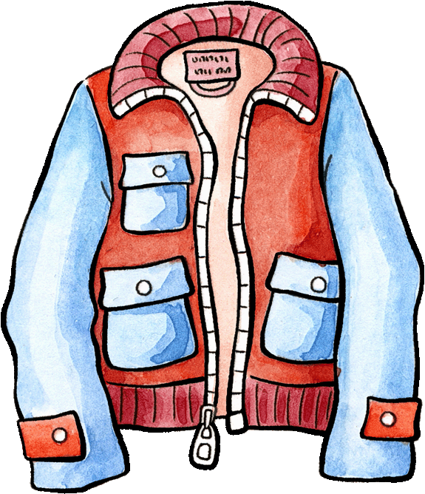
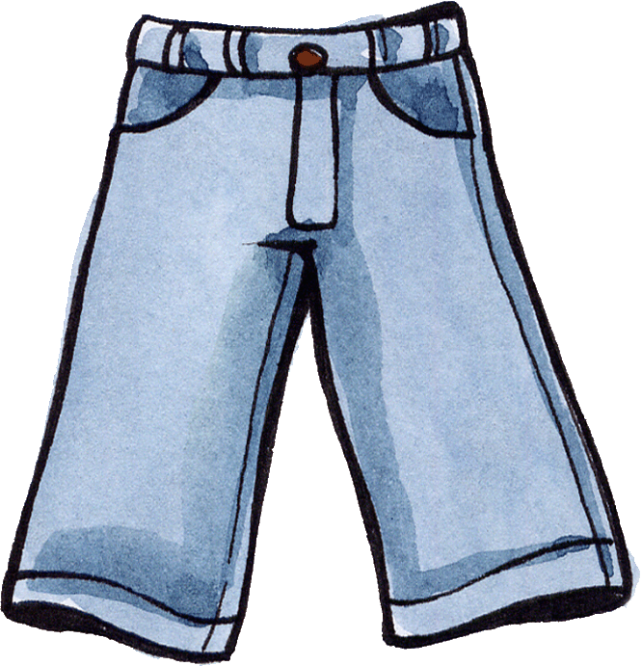
It is winter time and Felix is feeling very cold. Play the part of Franzi by saying what he needs and then dress him with the correct warm piece of clothing each time.
Felix braucht
eine Mütze.
Felix braucht
Schuhe.
Mein Bauch
ist kalt!
Felix braucht
eine Hose.
Meine Füße
sind kalt!
Felix braucht
eine Jacke.
Meine Beine
sind kalt!
Felix braucht
Handschuhe.
Meine Hände
sind kalt!
Mein Kopf
ist kalt!

Slide 7
